Slide 1
ANDROID CAMREA STACK
Jiban krishna dutta
Rashmi D

Slide 2

Contents:-
Basics of CAMERA
Android Anatomy
Android HAL

Slide 3
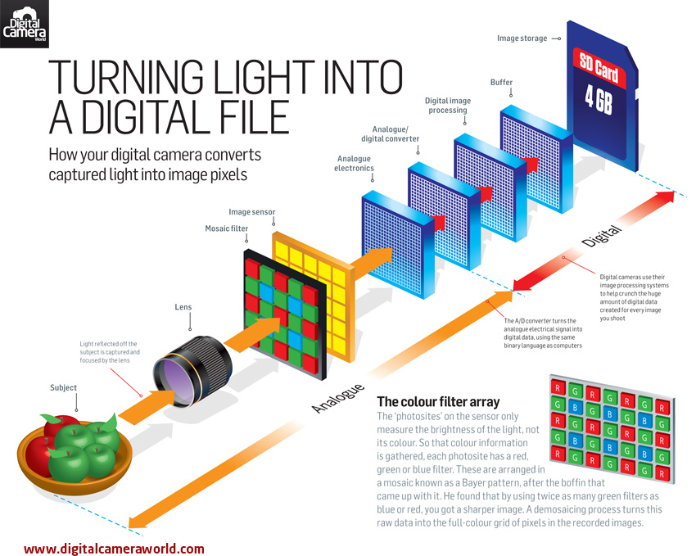
Basics of Camera

Slide 4
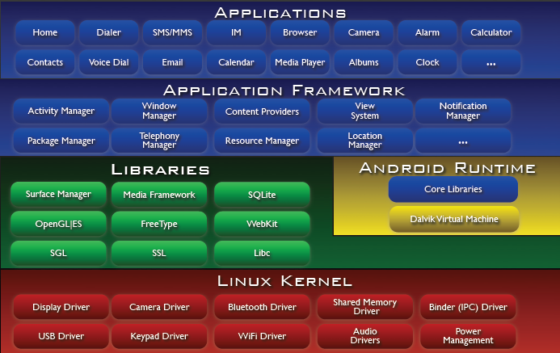
ANDROID ANATOMY

Slide 5
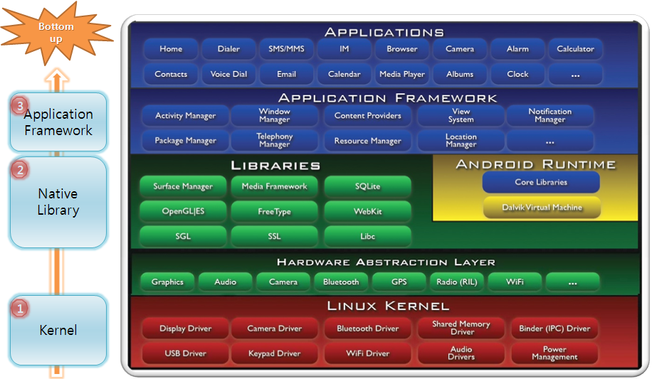
CAMERA HAL
Camera

Slide 6
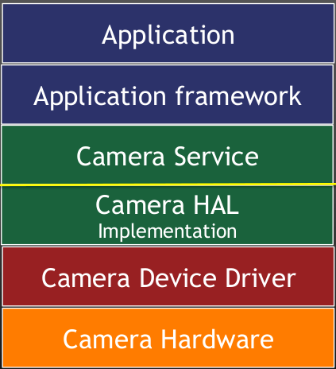
CAMERA SUBSYSTEM
HARDWARE INDEPENDENT
HARDWARE DEPENDENT

Slide 7
Camera Hardware Abstraction Layer
Review of a Typical Implementation

