Slide 1
Gstreamer
                By
                Archana Polampalli

Slide 2
Multimedia
multimedia is the integration of multiple forms of media. This includes text, graphics, audio, video, etc.
The android multimedia system includes multimedia applications, multimedia framework, OpenCore engine and hardware abstract for audio/video input/output devices.
And the goal of the android multimedia framework is to provide consistent interface for Java services.
The multimedia framework consists of several core dynamic libraries such as libmediajni, libmedia, libmediaplayservice and so on

Slide 3
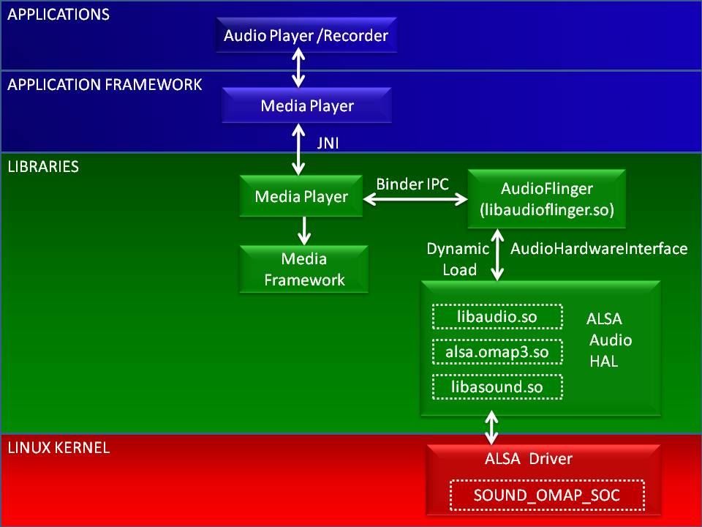
Gstreamer on android
Multimedia Architecture
Multimedia Architecture

Slide 4
Gstreamer on android
Multimedia Architecture
Multimedia Architecture
Java classes call the Native C library Libmedia through Java JNI (Java Native Interface).
Libmedia library communicates with Media Server guard process through Android’s Binder IPC (inter process communica-tion) mechanism.
Media Server process creates the corresponding multimedia service according to the Java multimedia applications.
The whole communication between Libmedia and Media Server forms a Client/Server model.

Slide 5
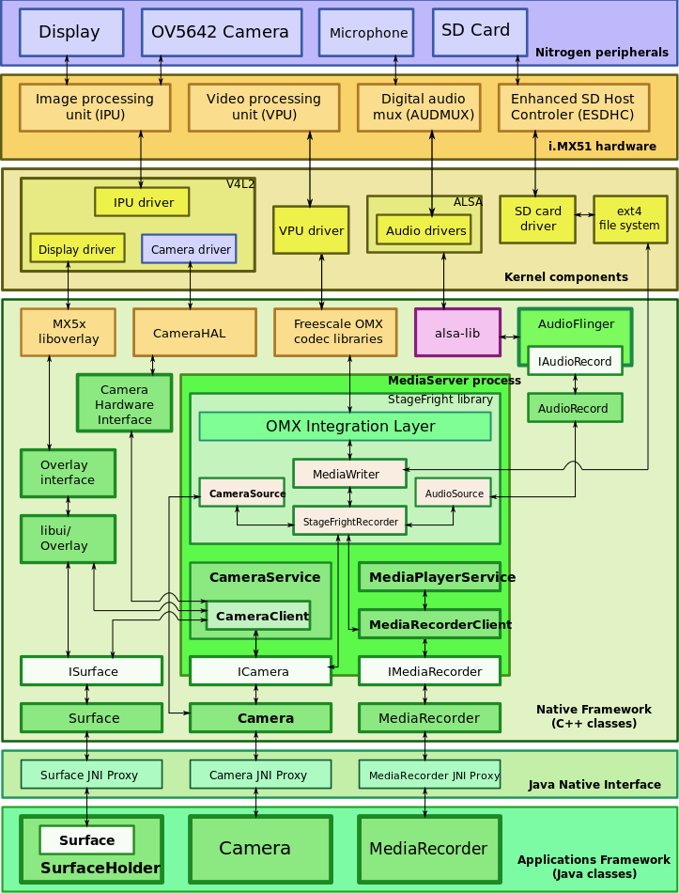
Gstreamer on android
Multimedia Architecture
Multimedia Architecture

Slide 6
What is a Gstreamer
Gstreamer is a framework for creating streaming media applications.
Gstreamer is a pipeline-based multimedia framework that links together a wide variety of media processing systems to complete complex workflows
The fundamental design comes from the video pipeline at Oregon Graduate Institute
One of the most obvious uses of GStreamer is using it to build a media player

Slide 7
What Gstreamer provides
Pipeline based multimedia framework
plugin based architecture
Cross platform,open source
Binding for many languuages
Stable API/ABI
Flexible and extensible design
Easy to integrate with other software

Slide 8
Gstreamer provides
Active developer and user community
Media-handling components.
Over 250 plug-ins providing more than 1000 elements
A set of tools

Slide 9
Gstreamer technical overview
GStreamer processes media by connecting a number of processing elements into a pipeline
Each element is provided by a plug-in . Elements can be grouped into bins which can be further aggregated, thus forming a hierarchical graph.
Elements communicate by means of pads . A source pad on one element can be connected to a sink pad on another.
When the pipeline is in the playing state, data buffers flow from the source pad to the sink pad . Pads negotiate the kind of data that will be sent using capabilities .

Slide 10
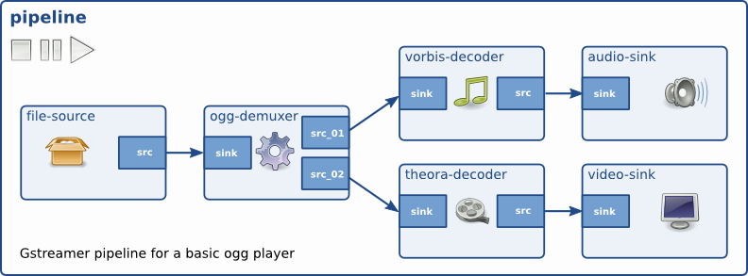
Gstreamer technical overview
Gstreamer pipeline

Slide 11
Gstreamer technical overview
For example if we want play an MP3 file using gstreamer.
The file source reads an MP3 file from a computer's hard-drive and sends it to the MP3 decoder.
The decoder decodes the file data and converts it into PCM sampleswhich then pass to the ALSA sound-driver.
The ALSA sound-driver sends the PCM sound samples to the computer's speakers.

Slide 12
Gstreamer technical overview
Some important objects in gstreamer are
Elements
Pads
Bins
Bus
Buffers
Messages

Slide 13
Gstreamer technical overview
Elements
Source Elements
Filters,Decoders,coders,Muxers...
Sink Elements
Creating a GstElement
gst_init
gst_element_factory_make
gst_object_unref

Slide 14
Gstreamer technical overview
GstElementFactory
Element factories are the basic types retrieved from the GStreamer registry, they describe all plugins and elements that GStreamer can create
Getting information about an element using a factory
Finding out what pads an element can contain

Slide 15
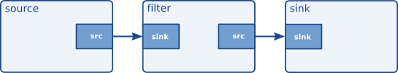
Gstreamer technical overview
Bins
A bin is a container for a collection of elements.

Slide 16
Gstreamer technical overview
Bins Cont
Creating a bin
gst_bin_new ()
gst_pipeline_new()
gst_bin_add ()
gst_bin_remove ()
Bins manage states of their children

Slide 17
Gstreamer technical overview
Pads and capabilities
The pads are the element's interface to the outside world.
Streams flow from an element's source pad to another element's sink pad . Pads can be built before execution or during runtime . Pads can have different capabilities , so before connecting two elements together we must make sure that two elements can so to speak talk together.
The specific type of media that the element can handle will be exposed by the pad's capabilities.
Pad Type: Direction ,Availability
Pad availability : Always,Sometimes and On request.

Slide 18
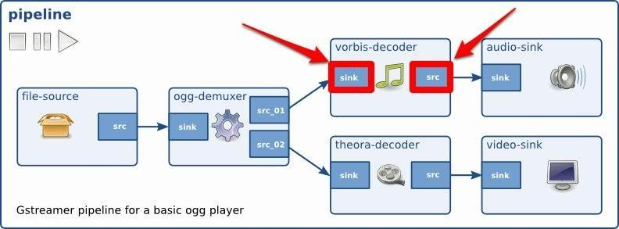
Gstreamer technical overview
Pads and capabilities

Slide 19
Gstreamer technical overview
Request pads
These pads are not created automatically but are only created on demand
This is very useful for multiplexers, aggregators and tee elements.
Capabilities
A pad's capabilities are described in a GstCaps object.
Capabilities describe the type of data that is streamed between two pads, or that one pad supports.

Slide 20
Gstreamer technical overview
Bus
Every pipeline contains a bus by default .
A bus is a simple system that takes care of forwarding messages from the streaming threads to an application in its own thread context.
Each element can communicate with other elements via a bus. Bins usually transfer the bus messages of their children to applications .
Buffers
Events
Message
Query

Slide 21
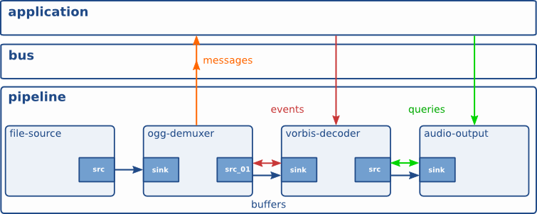
Gstreamer technical overview
Bus

Slide 22
Gstreamer – plugins
GStreamer uses a plug-in architecture which makes the most of
GStreamer's functionality implemented as shared libraries.
GStreamer's base functionality contains functions for registering and loading plug-ins and for providing the fundamentals of all classes in the form of base classes.
Plug-in libraries get dynamically loaded to support a wide spectrum of codecs, container formats, input/output drivers and effects.
Since version 0.10, the plug-ins come grouped into three sets
The Good
The Bad
The Ugly)

Slide 23
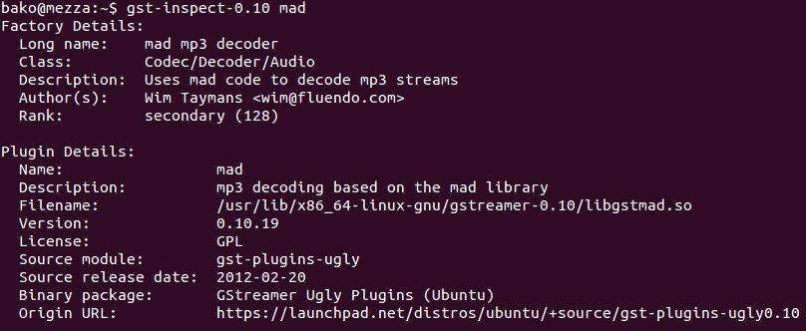
Gstreamer –Command line tools
Gst-inspect-1.0
gst-inspect-1.0 audiotestsrc

Slide 24
Gstreamer –Command line tools
Gst-launch-1.0
Ges-launch-1.0
ges-launch-1.0 +clip /path/to/media
ges-launch-1.0 +clip /path/to/media inpoint=4.0

Slide 25
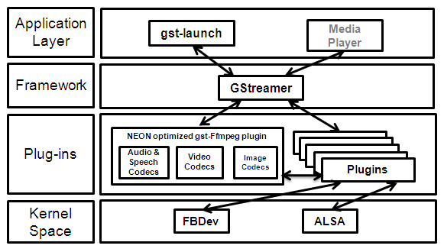
Gstreamer Framework
GStreamer - Open source framework for creating media applications on Linux

Slide 26
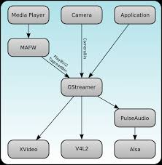
Gstreamer Framework

Slide 27
Gstreamer on android
Why we need gstreamer in android
Androd multimedia stack has Good multimedia API for playback and architectures
Supprot for more common audio and vedio formats like iac,mp3
and Supprts few straming protocols like HTTP and HLS.
But we need more than plyback and streaming.
Less codecs and formats
Device specific
Few streaming protocols

Slide 28
Gstreamer on android
Problem with the gstreamer using in android
Pluging based archicture so ,so many shared libraries
Android dynamic linker limits the no of shared libraries per process
The ndk is limited: C librari like boinic and other somthing like openSL
How to solve it
We employ the Prelink technology to enhance the execution efficiency.
Provide the librarie called gstremerandroid.lib
We also apply the OpenMax IL Standard

Slide 29
Gstreamer on android
Implementation of the Multimedia Framework
Porting some Gstreamer required open-source libraries to Android, such
as Glib, Liboil, etc.
According to Gstreamer framework, write two plug-ins. One is used to
send the decoded original video data from Gstreamer to Android display system(Surfaceflinger). And another is used to send the decoded original PCM audio data to Android audio system (Audioflinger).
Based on Gstreamer, we should construct a mediaplayer which can be used in Media Server guard process to supply media player service.
Modify assembly codes to apply Gstreamer to diversified CPU architectures, and apply some commonly used optimized technologies in embedded environment to Gstreamer.

Slide 30
Gstreamer on android
Implementation of the Multimedia Framework
We use the Gstreamer existed high-level element “Playbin2” to start the pipeline.
Then we add a bus to Playbin2 to let the video data and video processing event flow in the bus. Finally, we start the pipeline and bus.
When running our framework,the Gstreamer sends the original video data (RGB 555) to Surfaceflinger, and sends original audio data to Audioflinger.

Slide 31
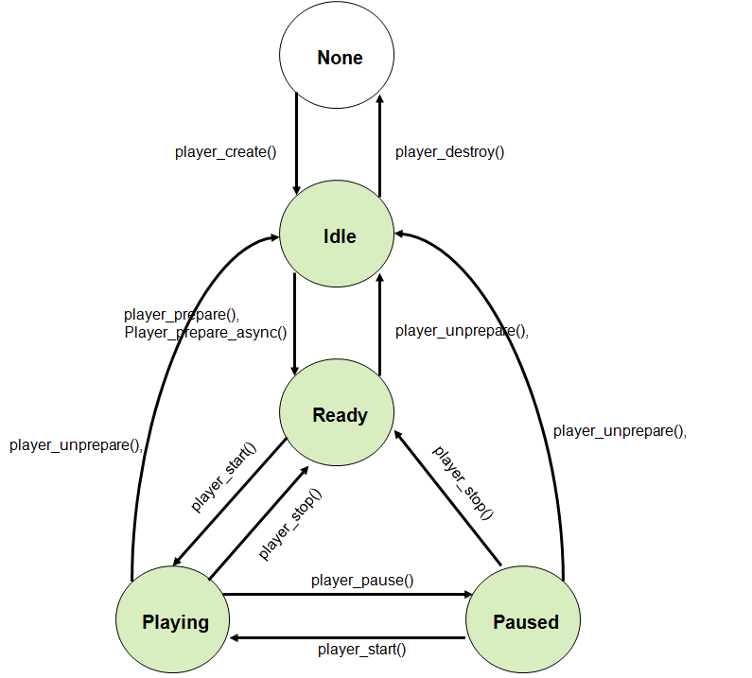
Gstreamer on android
Implementation of the Multimedia Framework

Slide 32
Gstreamer on android
Build system for sdk
We use the build system called cerbero it is the single build system used to build SDK in all platforms
Every system has native packages for supproting SDK
Easy to maintain
Easy to add new packages or third party libraries

