Slide 1
Human Interface Computing Project – Group 7
Presented by: Garrett Bearss, Justin Labrie, Matthew Moore, Joshua Sakal, Casey Shimko

Slide 2
Introduction
- The website we created is based off online food catering or providing service such as McDonalds, Arby’s, etc.
- We hoped to replicate that by creating a website from which you could order different food items such as fries, soda, or hotdogs.

Slide 3
Technologies Used
We used HTML to design the website.
To make stylizing the website easier, we adopted the use of a CSS framework called Bootstrap 3.

Slide 4
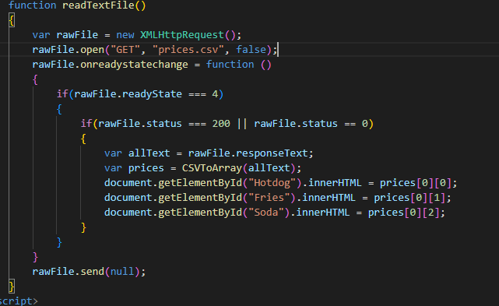
Backend
For the backend we used a csv to load the prices of our product.
The text could then be changed to update the prices on the menu.

Slide 5
The Eight Golden Rules
Site Entrance/ Homepage:
Consistency, Shortcuts, Reduce Short-Term Memory Load
Category Display:
Consistency, Shortcuts, Reversal of Actions
Item Display:
Consistency, Shortcuts, Reversal of Actions, Support Inner Locus of Control

Slide 6
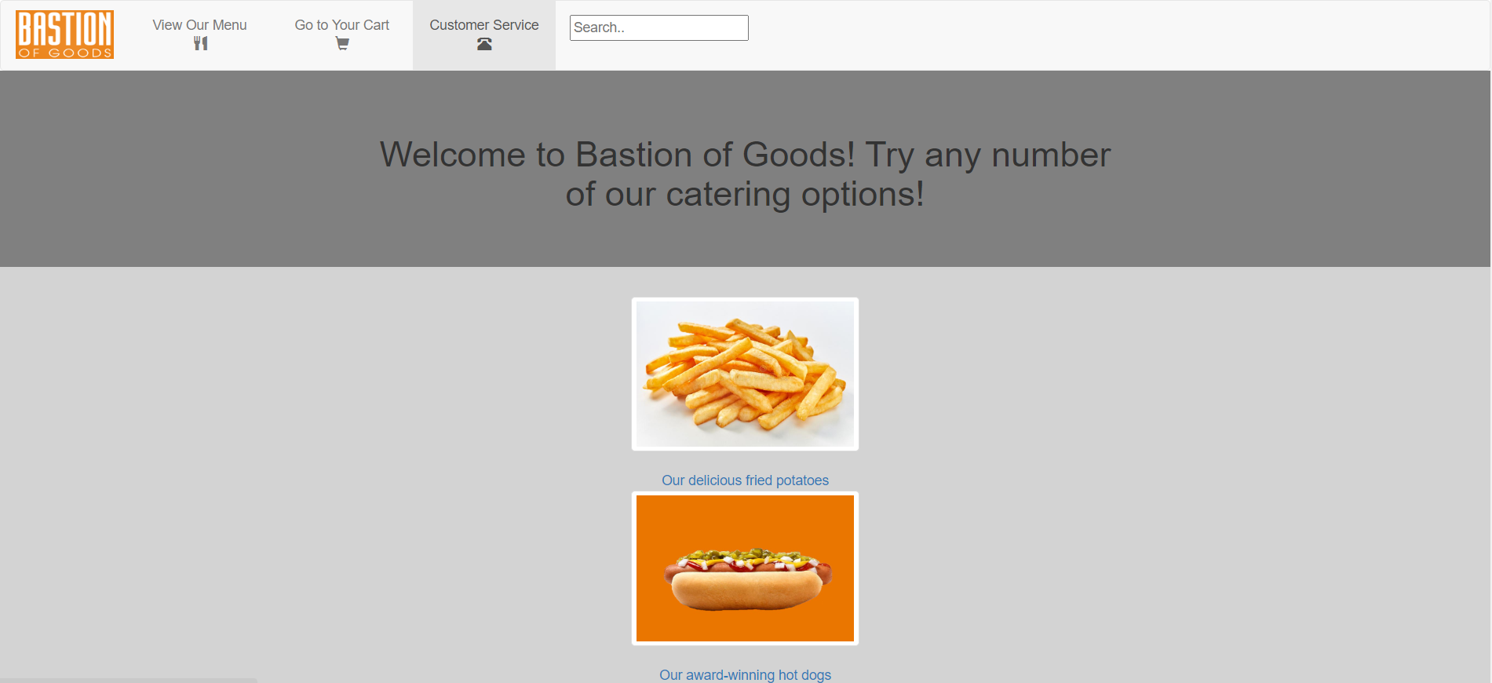
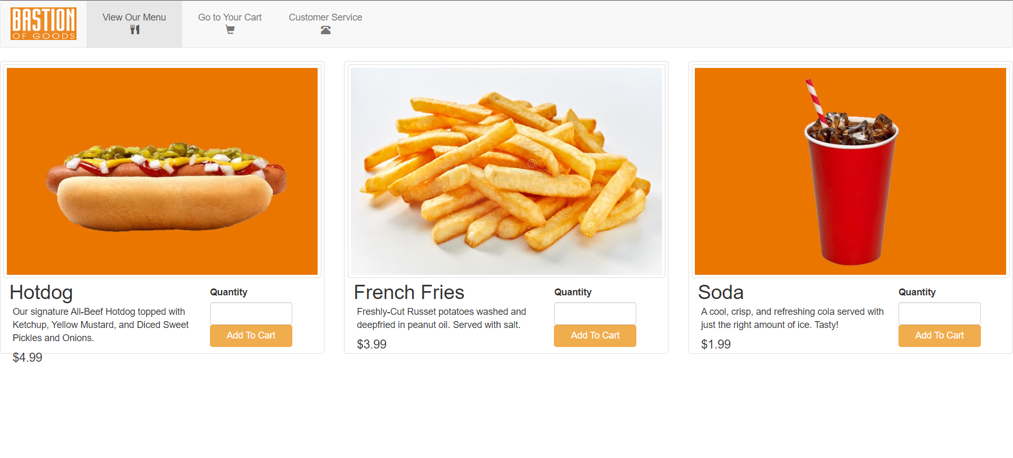
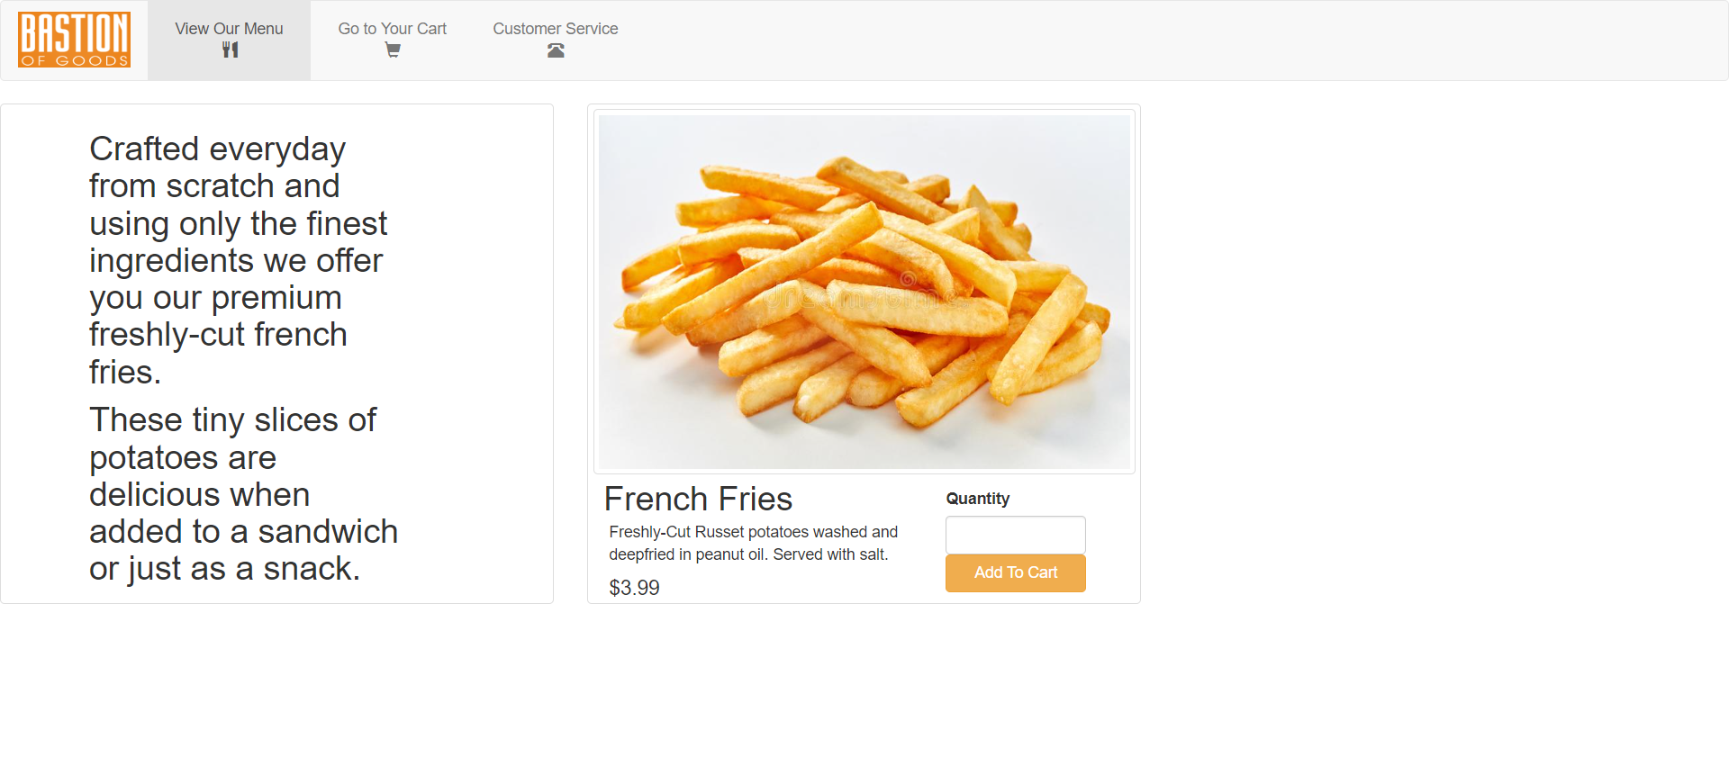
The Eight Golden Rules: Website Screenshots

Slide 7
The Eight Golden Rules (cont.)
Cart Display:
Consistency, Shortcuts, Reversal of Actions
Review Payment:
Reduce Short-Term, Reversal of Actions, Offer Informative Feedback
Order Placed/ Confirmation Page:
Dialogue Yielding Closure, Consistency, Offer Simple Error Handling
Customer Service:
Consistency, Offer Informative Feedback, Reduce Short-Term Memory Load

Slide 8
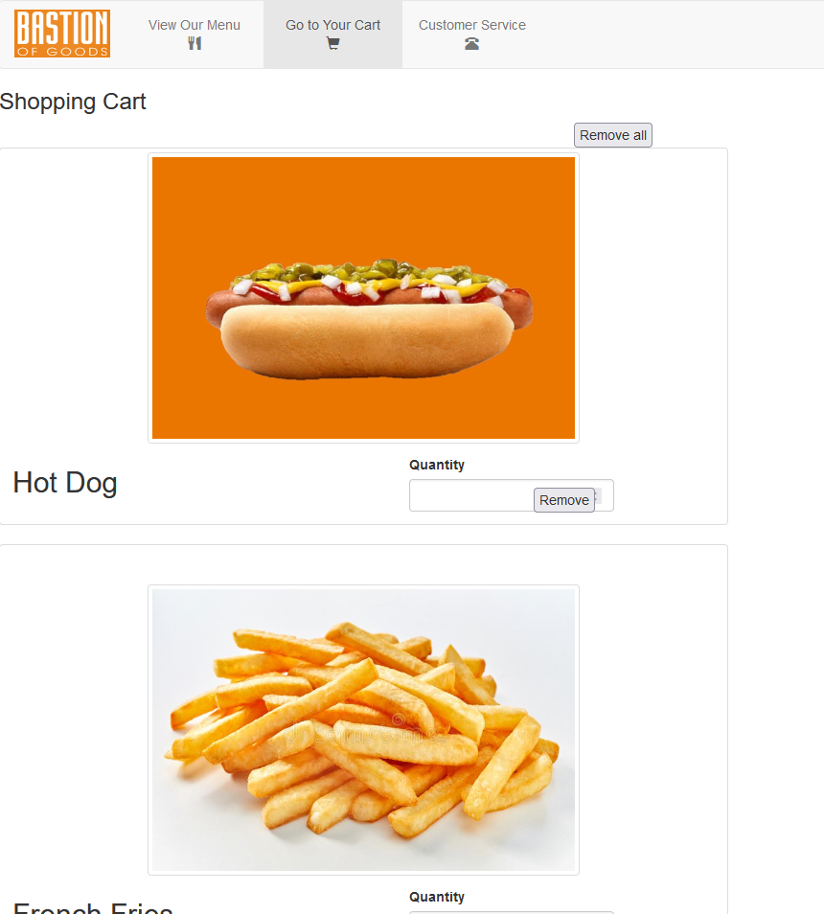
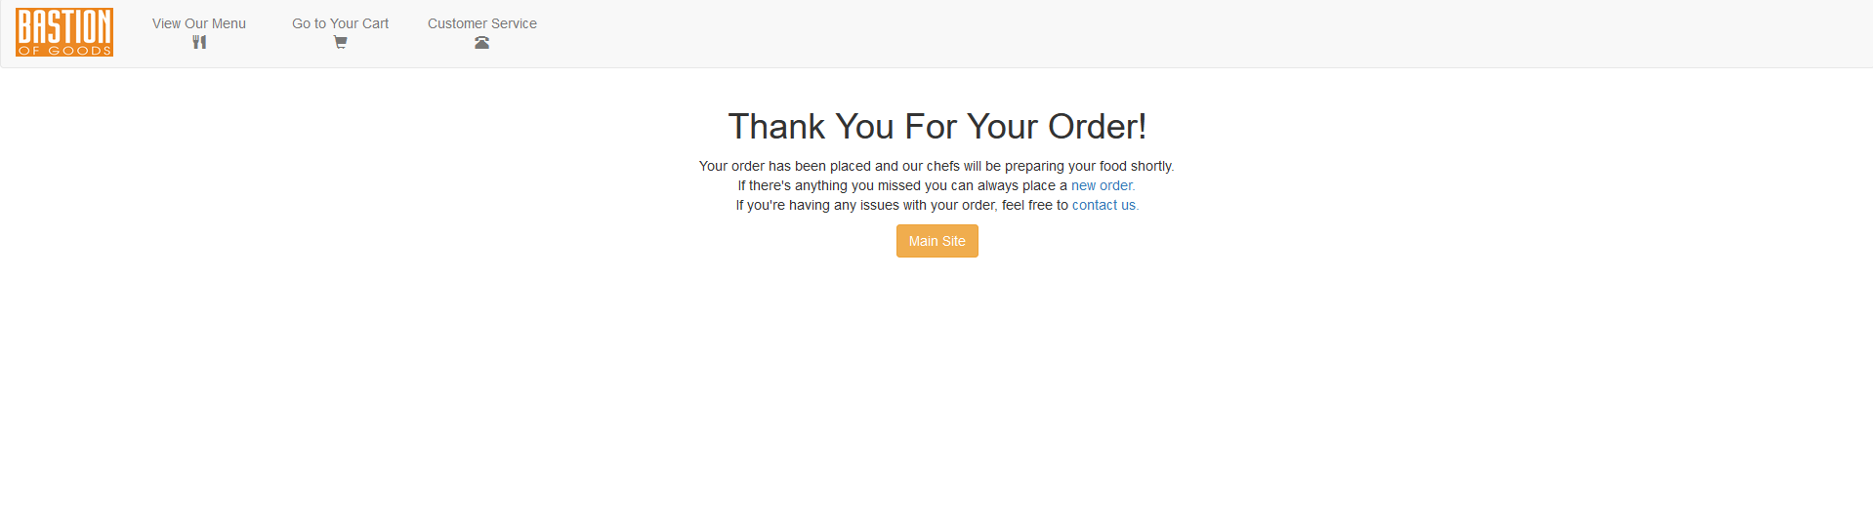
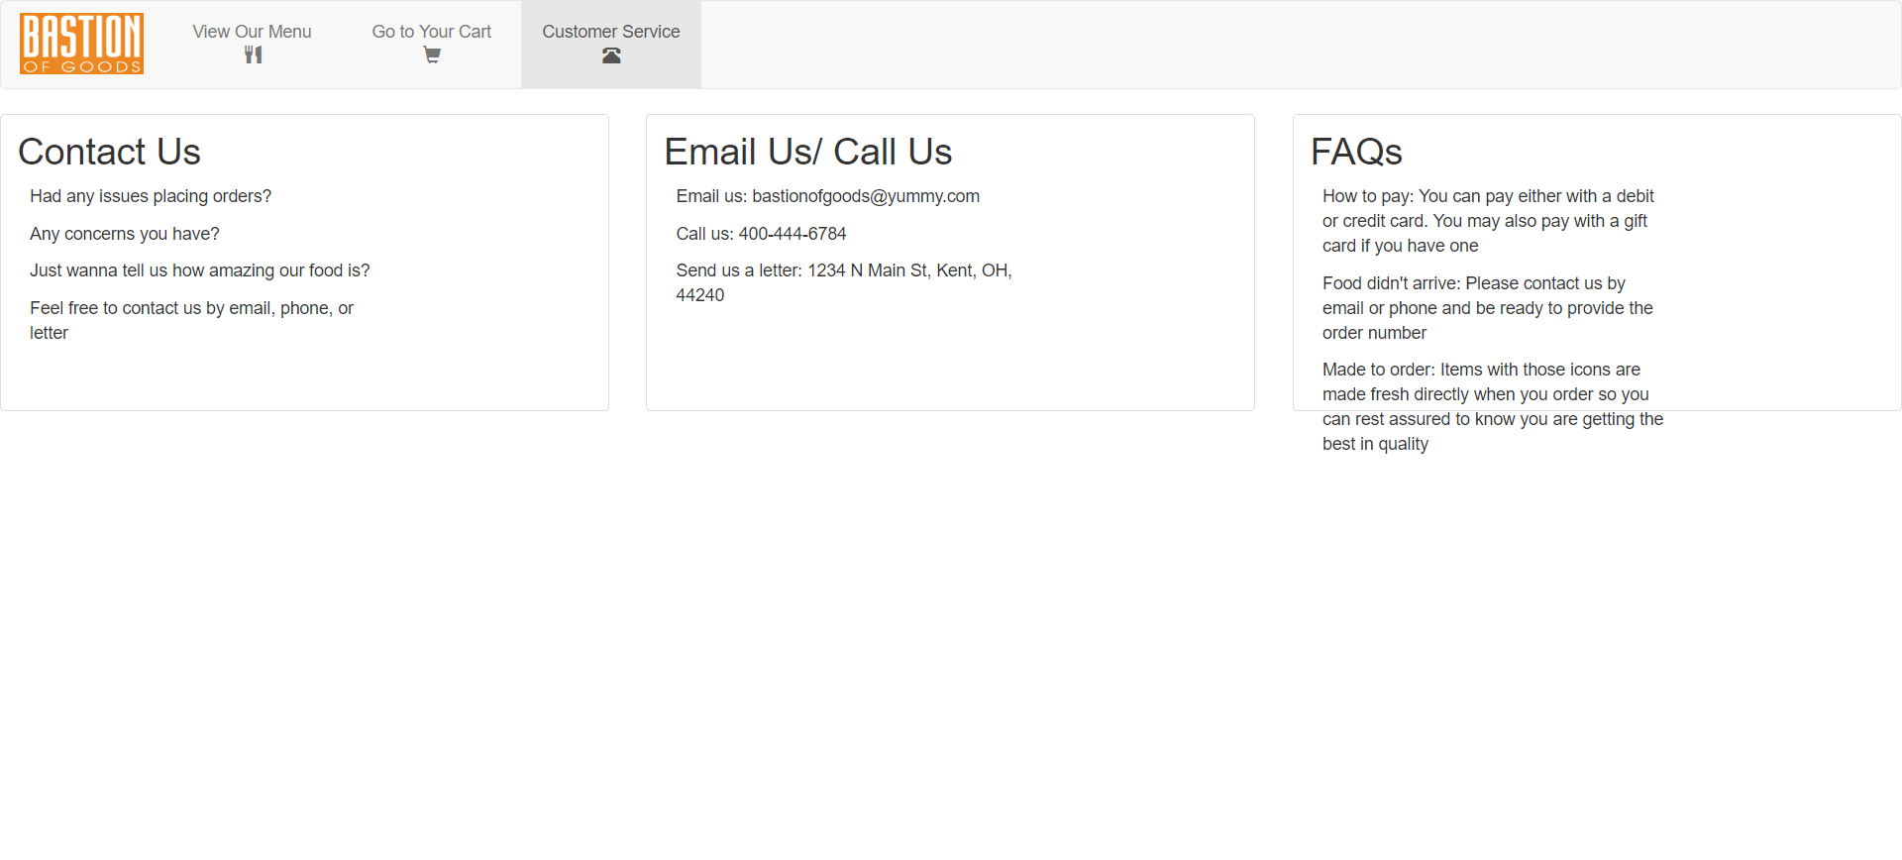
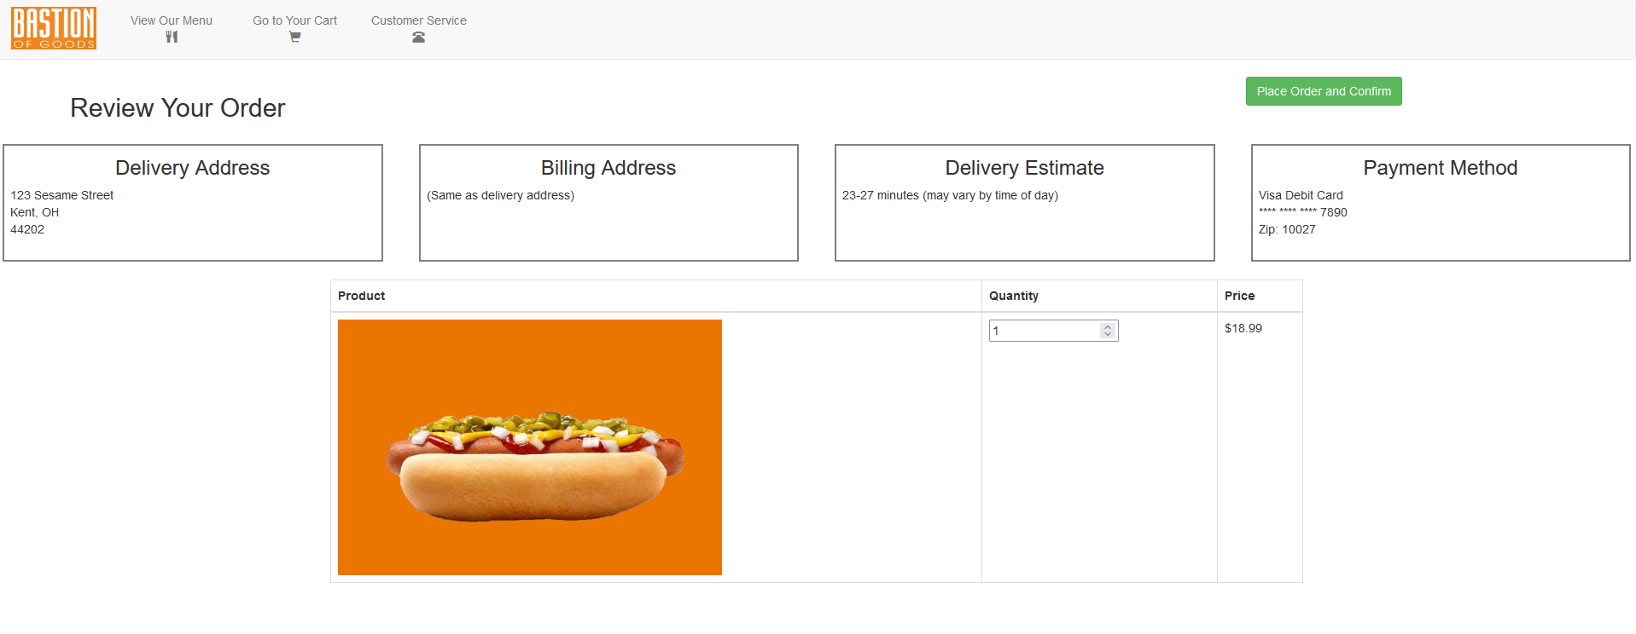
The Eight Golden Rules: Website Screenshots

Slide 9
Demo
- Now let’s proceed with the demo of the website.

Slide 10
Closing Remarks
Overall, we are satisfied with the way that the website came out.
Thank you for your attention!

