Slide 1

Welcome to "Switch to Desktop from Slide show" for Windows App
How to use it.

Slide 2
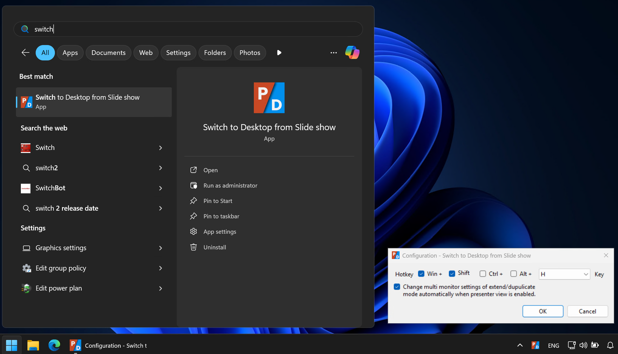
Preparation: Start "Switch to Desktop from Slide show".
It stays in task tray.

Slide 3
When you want to switch from PowerPoint slide show to desktop …
Enter
Win
+
Shift
+
H
The "Switch to Desktop from Slide show" app toggles hiding or showing the PowerPoint slideshow window each time you type that key combination.

Slide 4
Have a good presentation :)
END
Notes:
In Slide Show mode, select the arrows to visit links.

