Slide 1
NLP – Toxic Comment Classifier
Hannah and Jacob
Notes:
Jacob

Slide 2
Introduction
Natural Language Processing (NLP) is used in classifying toxic text
Our goal: to classify toxic comments
Jigsaw Toxicity Classification challenge
Biggest challenge: Bias!
Notes:
Jacob

Slide 3
Challenges
Unintended bias
Associating names or identities with toxicity
Due to data sources referring to certain identities/names in offensive ways.
Data
Missing fields
Spelling/grammar errors
Imbalance of classes
Notes:
Jacob

Slide 4
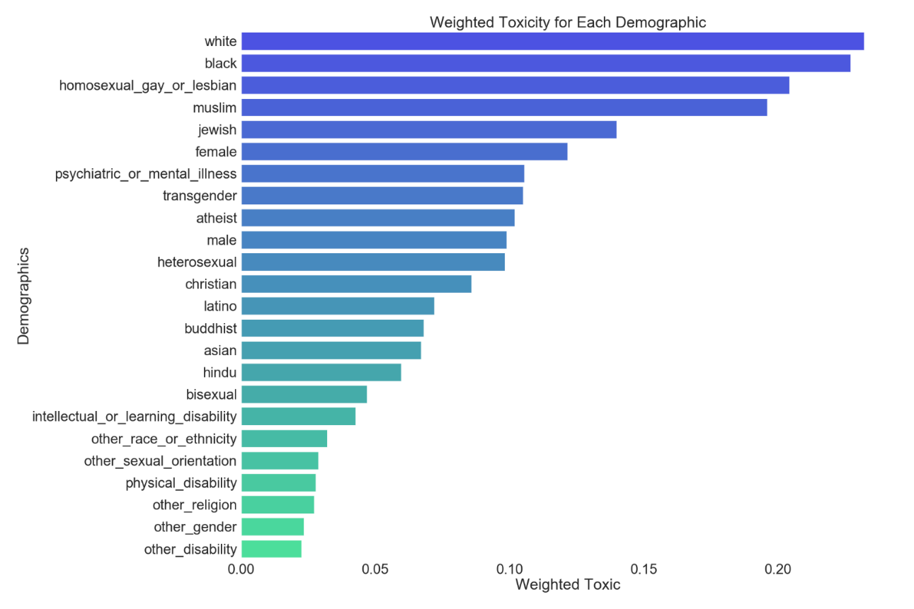
Unintended Bias – Demographics & Toxicity
Notes:
Jacob

Slide 5
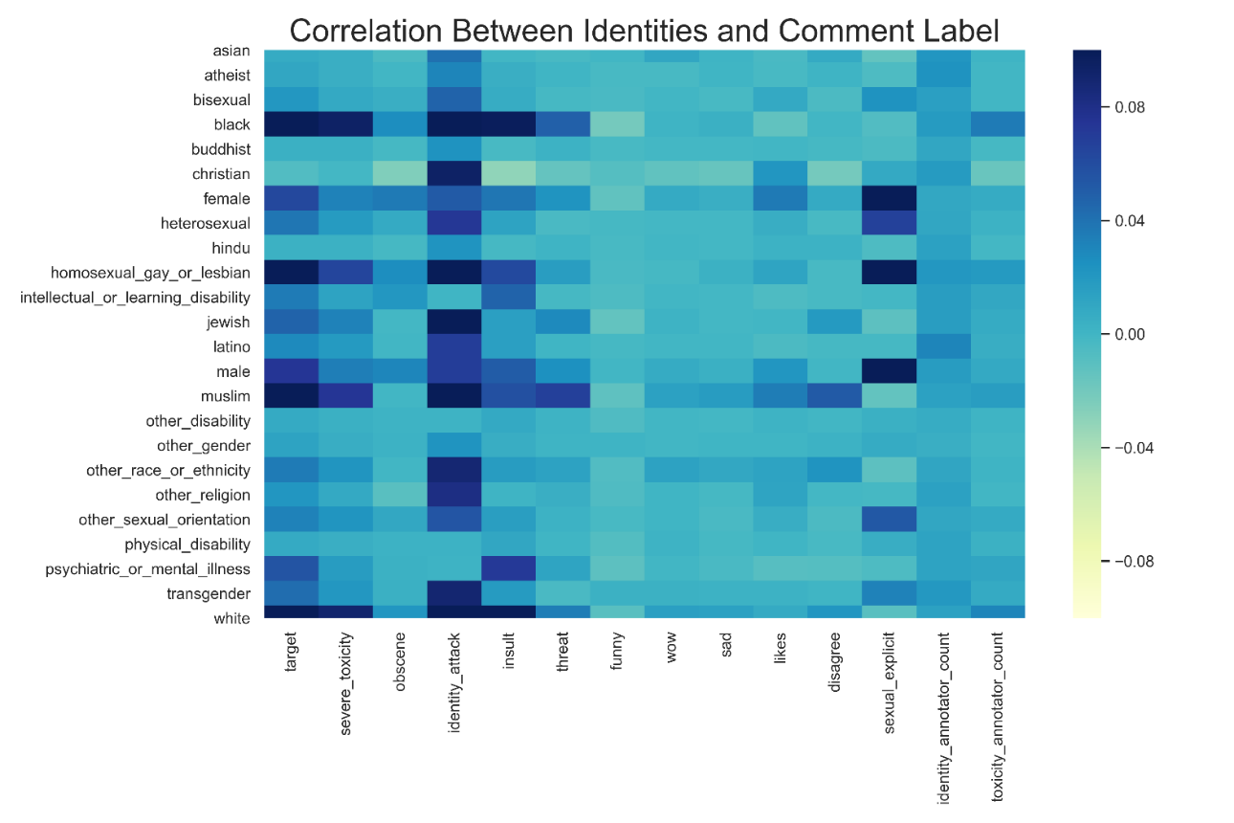
Unintended Bias – Demographics & Comment Label
Notes:
Jacob

Slide 6
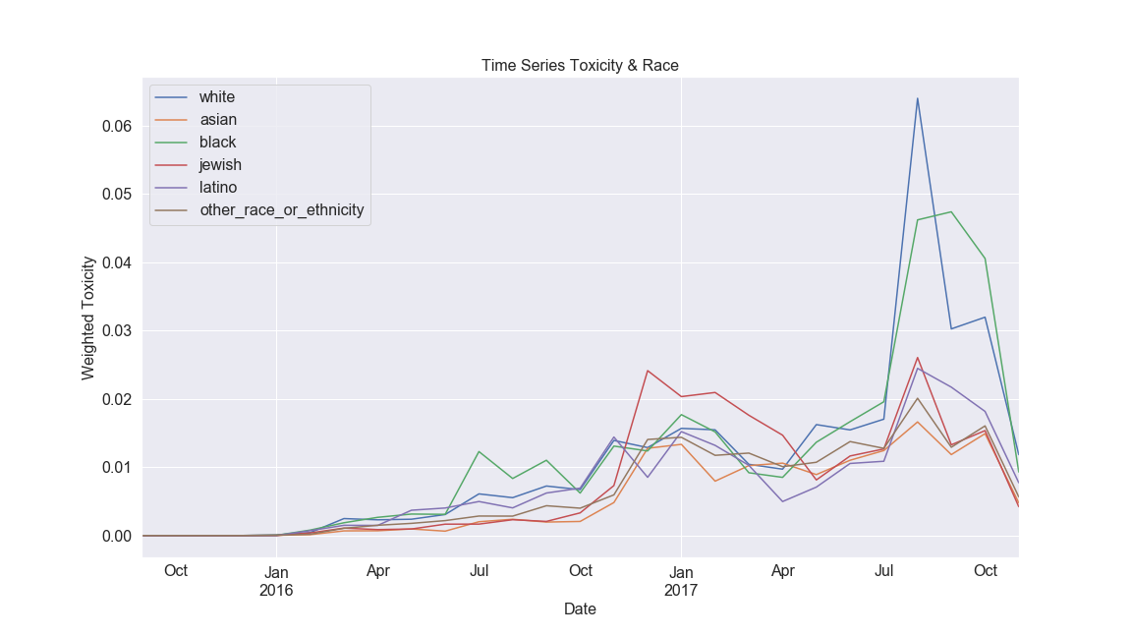
Unintended Bias – Time
Weighted toxicity per race over time
Notes:
Jacob

Slide 7
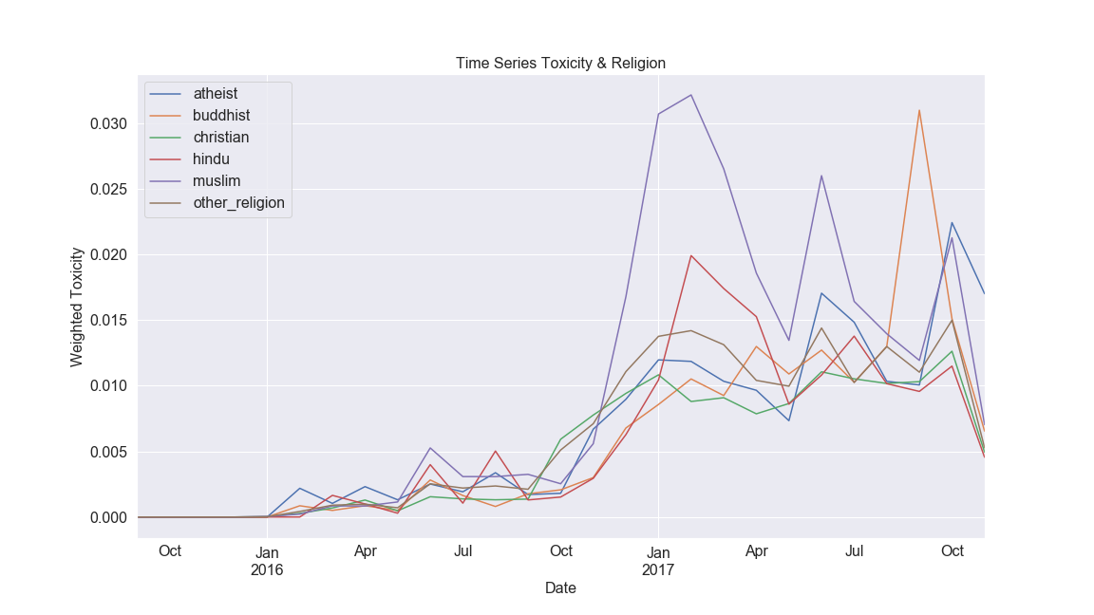
Unintended Bias – Time
Weighted toxicity per religion over time
Notes:
Jacob

Slide 8
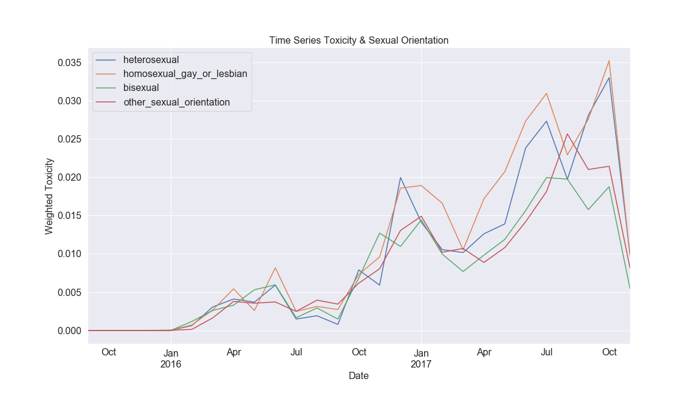
Unintended Bias – Time
Weighted toxicity per sexual-orientation over time
Notes:
Jacob

Slide 9
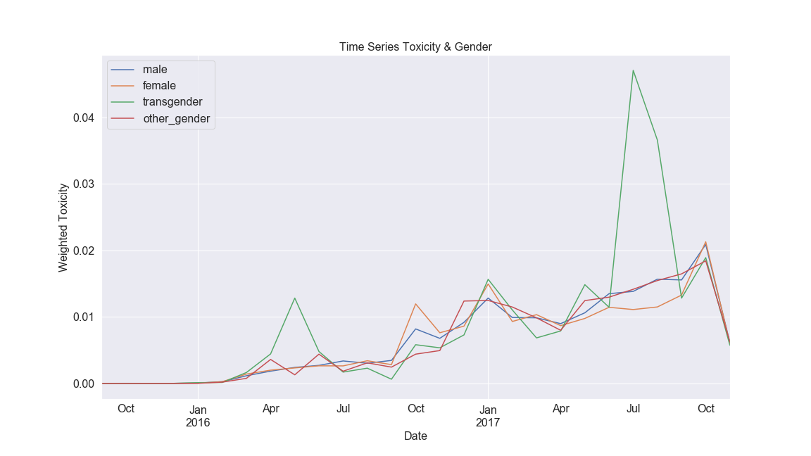
Unintended Bias – Time
Weighted toxicity per gender over time
Notes:
Jacob

Slide 10
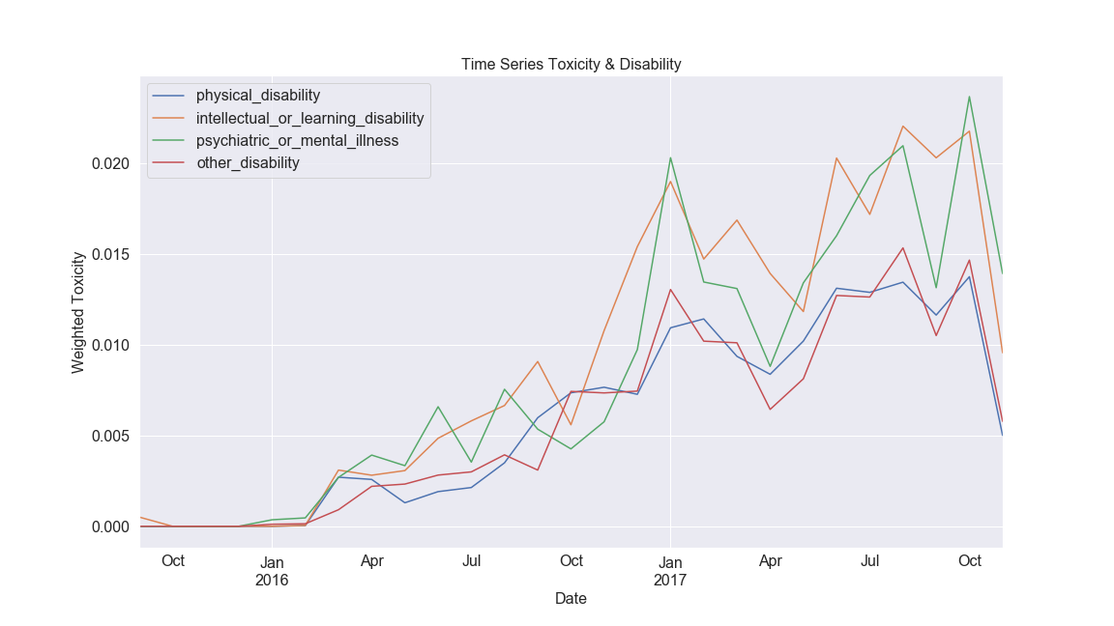
Unintended Bias – Time
Weighted toxicity per disability over time
Notes:
Jacob

Slide 11
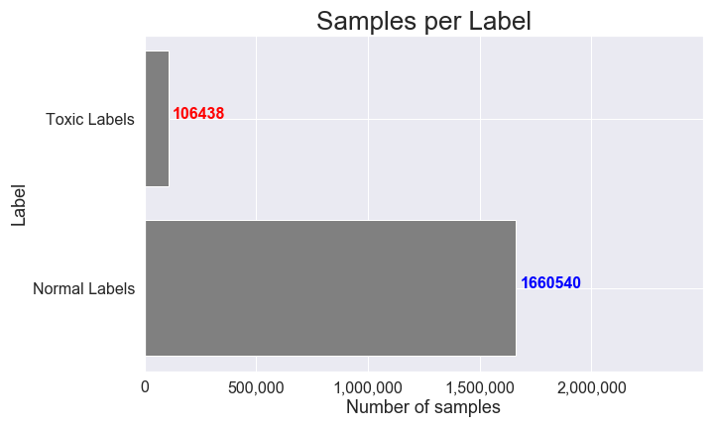
Class Imbalance
Notes:
Hannah
Looking at the data, it can be seen there is a clear class imbalance
Only 6% of comments are toxic compared to 94% considered non toxic
This data was then randomly split 80-20 train test, with 20% of the 80% being allocated for validation

Slide 12
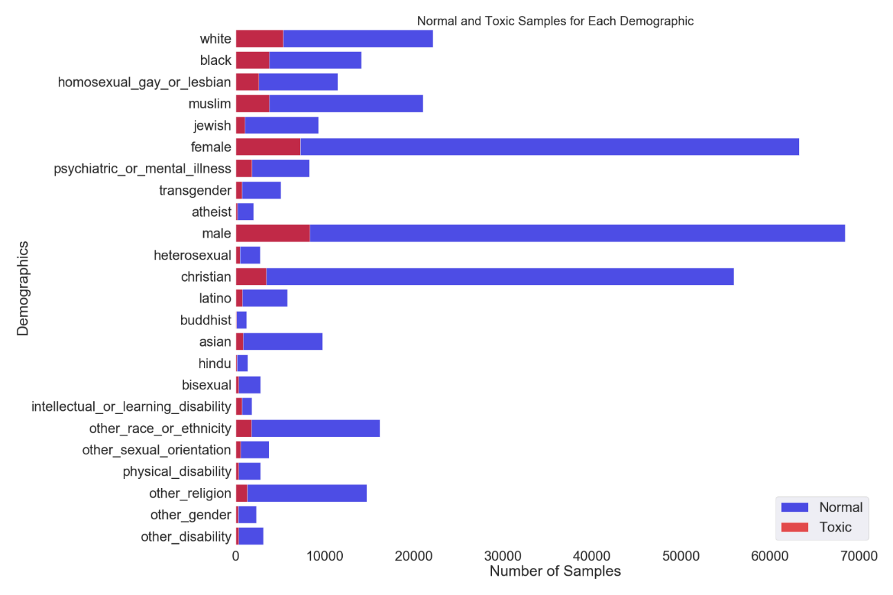
Class Imbalance - Demographic
Notes:
Hannah
Broke down the number of samples per demographic as well as how each demographic is labelled
Note that every demographic does contain toxic comments, so it itsn’t biased towards certain groups
Ratio of normal vs toxic is similar for all groups. The one group which seems to have the least number of toxic comments compared to normal comments is Christian
If you look at different groups of demographics, disability is a lot smaller than the other categories (gender, race, sexual orientation, religion)
Due to less representation of disability groups compared to other demographic groups, so this can be considered bias. (Model may not learn well for these type of toxic comments)

Slide 13
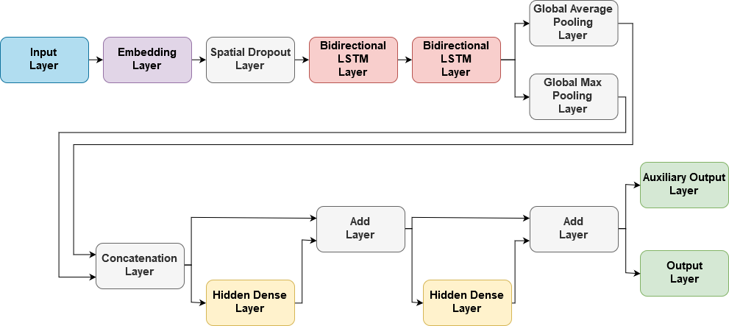
Model
Notes:
Hannah
Input layer
The model takes in the text for the comment to classifiy. Considers comments to have a max length of 220 words
Embedding Layer
uses a pretrained word embedding as the first layer so we don’t have to learn this.
Pretrained word embedding used is glove, which was trained on text from a common web crawl (840 billion tokens used where 2.2 million unique words are considered and each word vector is expressed using 300 dimensional vector
Bidirectional LSTM Layer
LSTM = long short term memory
LSTM is a type of recurrent neural network which is able to learn and handle long term demendencies (which corresponds to words far apart in a comment which are related).
LSTM is able to see/perserves past information since information is run through it for a forward pass
Bidirectional LSTM runs the data forward and backward so LSTM units can preserve past and future information to learn context better
Hidden Dense Layers
These layers are just densely connect layers, similar to layers in neural networks/multi layer perception networks
Add layers act like skip connections for info before dense layer and ouput of dense layer
Output Layers
- Output layer has 1 output for predicting if the comment is toxic or not
Auxiliary output layer has 6 outputs: target, severe_toxicity, obscene, identity_Attack, insult, and threat.
Aux outputs are not used directly or used to measure performance, but having neural networks/ML/DL models learn multiple outputs that are related can help with prediction accuracy/performance
Dropout – helps with regularization/ prevents overfitting by randomly selecting inputs to drop. Spatial Dropout 1D drops entire feature maps instead.
Pooling – Finds the max and average features over all time steps (ie the LSTM layers output a 2D matrix where one dimension is time steps and the other is features, and over the time steps axis the pooling layers find the max and average layer)
Auxiliary outputs
Looks at more than just comment toxicity

Slide 14
Preliminary Results
Class | Precision | Recall | F1-Score | Number of Test Samples | % of Test Samples
False | 0.98 | 0.95 | 0.97 | 331,897 | 92%
True (Toxic) | 0.58 | 0.76 | 0.66 | 29,078 | 8%
Overall Accuracy |  |  |  | 94%
Notes:
Hannah
Model is learning something (if a model only predicted false then it would achieve 92% accuracy. Actual accuracy is higher at 94%)
Precision = percent of samples in predicted class which were predicted correctly/belong to that class (TP / TP + FP)
Having a lot of False positives decreases the value
Can be seen that almost half of the samples which were predicted to be toxic are not actually toxic
Recall = percent of samples in a class were predicted to be in that class (TP / TP + FN) (percent of predictions for a class where the samples actually belong to that class)
Having a lot of false negatives decreases the value
Can be seen that about a quarter of the toxic comments are not labelled as toxic
F1 score – uses precision and recall for calculation (kinda like a mean between the two)
There is a lot of room for improvement

Slide 15
Model Deployment – Societal Impacts
Transparency (Opacity)
Transparency to the deploying company
Determining auxiliary outputs can help make the model more transparent
Bias
Ensuring output is not biased towards certain groups
Labor
Very minimal
Privacy
Some people might be concerned with their data being used
These are public comments
Liability
Missing a toxic comment
Flagging a non-toxic comment
Notes:
Hannah

Slide 16
Freedom of Speech and Censorship
Societal controversy regarding freedom of speech and censorship
How is this considered in AI models?
Is this model necessary?
Notes:
Jacob

Slide 17
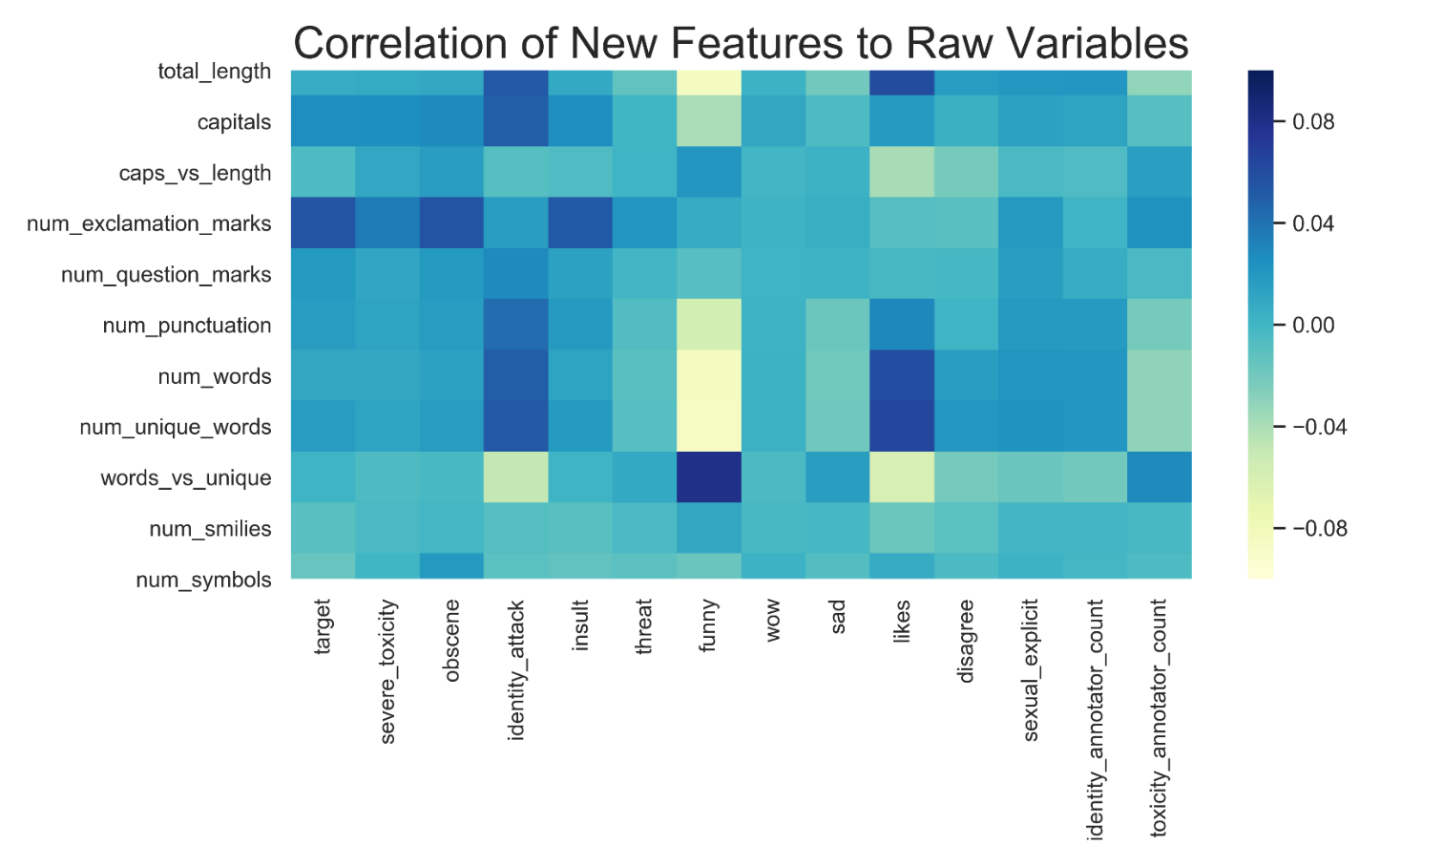
Future Work
Feature engineering
New features
Data cleaning
Contraction mapping
Addressing class imbalance
Performance based on demographic
Toxicity and auxiliary outputs

