Slide 1
NLP – Toxic Comment Classifier
Hannah and Jacob
Notes:
Jacob

Slide 2
Introduction
Natural Language Processing (NLP) is used in classifying toxic text
Our goal: to classify toxic comments
Jigsaw Toxicity Classification challenge
Biggest challenge: Bias!
Notes:
Jacob
Natural Language Processing is a subfield of artificial intelligence that is used in a variety of applications.
In this presentation, we will be discussing the use of NLP in classifying toxic text.
We will be attempting to classify toxic comments using the jigsaw toxicity classification challenge.
Data contains a large sum of comments (~2 million) along with their target (toxicity value) and subtype (threat, insult, identity attack, sexual explicit, etc.)
Biggest challenge we faced so far is bias in the data. We will dedicate a large portion of this presentation talking about bias.

Slide 3
Challenges
Unintended bias
Associating names or identities with toxicity
Due to data sources referring to certain identities/names in offensive ways.
Data
Missing fields
Spelling/grammar errors
Imbalance of classes
Notes:
Jacob
One of the main challenges in comment classification is the unintended bias in the data.
Generally, there are words that tend to be used frequently in toxic comments, so machine learning models often associate these words with toxicity.
Example the word “gay”
Another challenge within the data is its structure. There are missing fields in the data, there exists spelling and grammar errors in some of the comments, and there is a significant imbalance between the classes.
There are more normal comments that toxic ones.
Next, we will discuss the various sources of unintended bias!

Slide 4
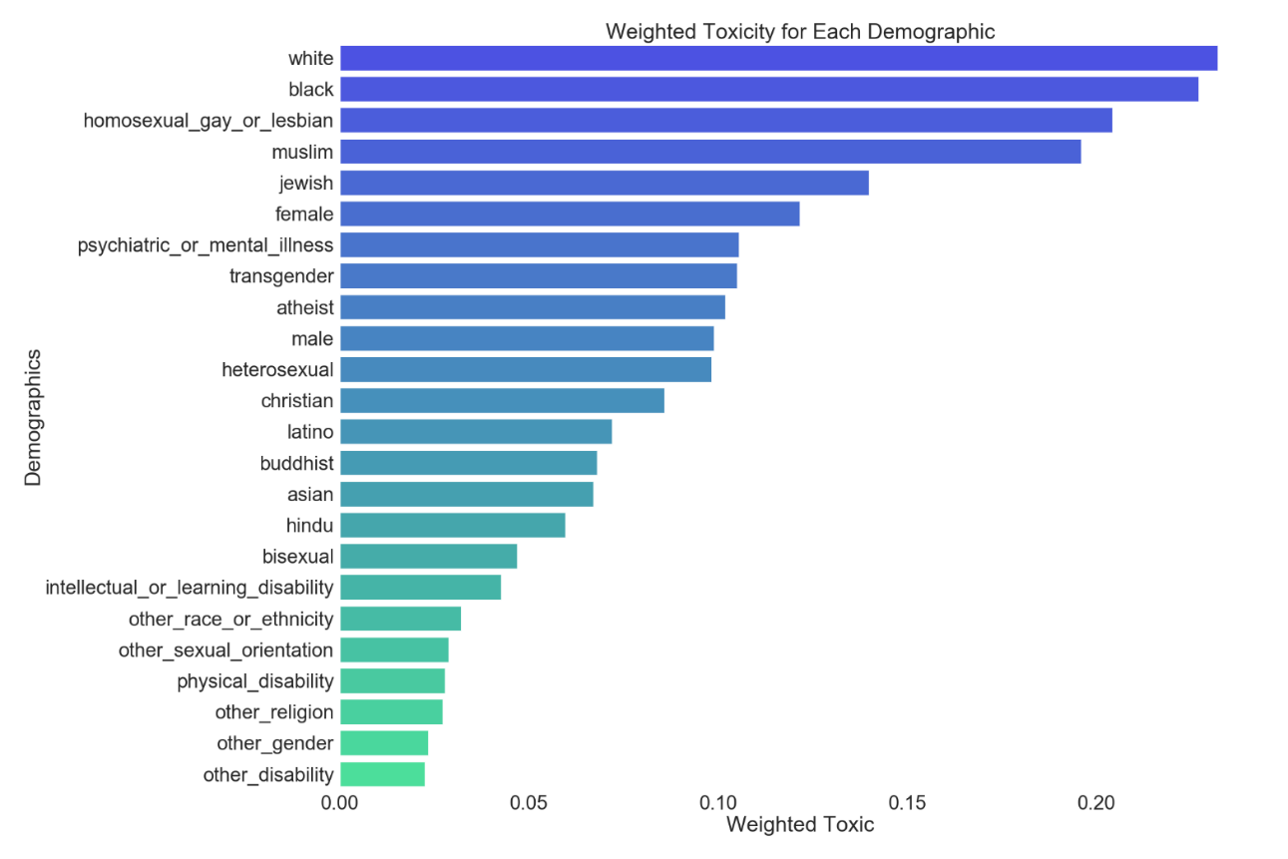
Unintended Bias – Demographics & Toxicity
Notes:
Jacob
The first form of unintended bias is bias towards demographics.
To investigate this bias, we calculated the average weighted toxicity associated with each demographic.
In this dataset, comments associated with “white” and “black” have the highest weighted toxic value.
This can result in the model being biased towards comments who mention white or black

Slide 5
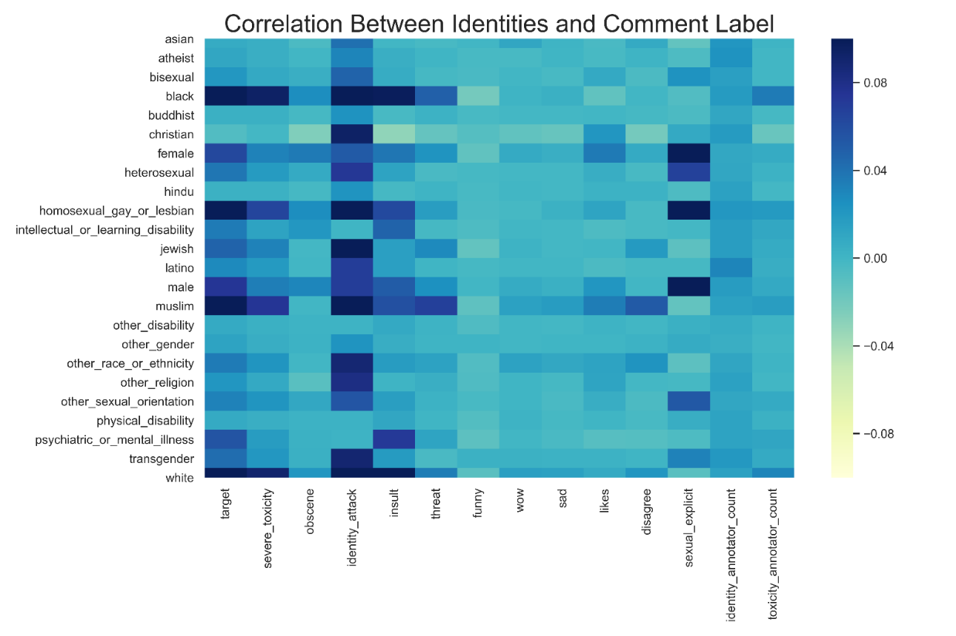
Unintended Bias – Demographics & Comment Label
Notes:
Jacob
- To dive a little deeper into bias in demographics, we investigated the correlation of each demographic with the labels within the data.
As we can see,
Insult is associated the most with white/black
Also associated more with physical and mental illness as well as homosexual
Sexual explicit is associated more with male, female, and homosexual.
It is worth noting that while there are differences in these correlations, they are of small magnitude.

Slide 6
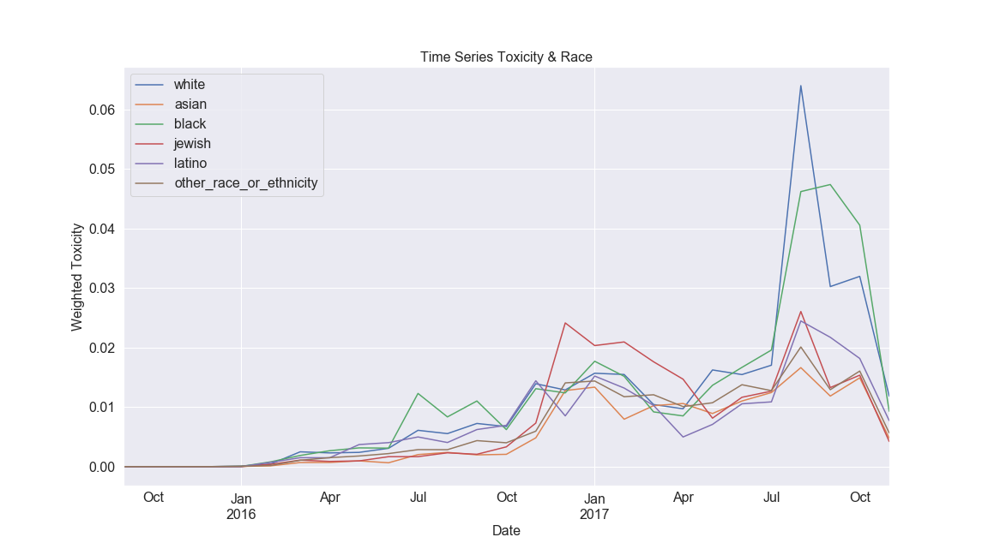
Unintended Bias – Time
Weighted toxicity per race over time
Notes:
Jacob
Another interesting form of unintended bias is bias with time.
We investigated this by computing the weighted toxicity for each demographic over time.
We noticed that there are “peaks” in the graph
Different demographics appear in toxic comments more frequently in specific times.
Example: The peak in July for white and black is most likely associated with the white supremacist rally in Charlottesville, Virginia.

Slide 7
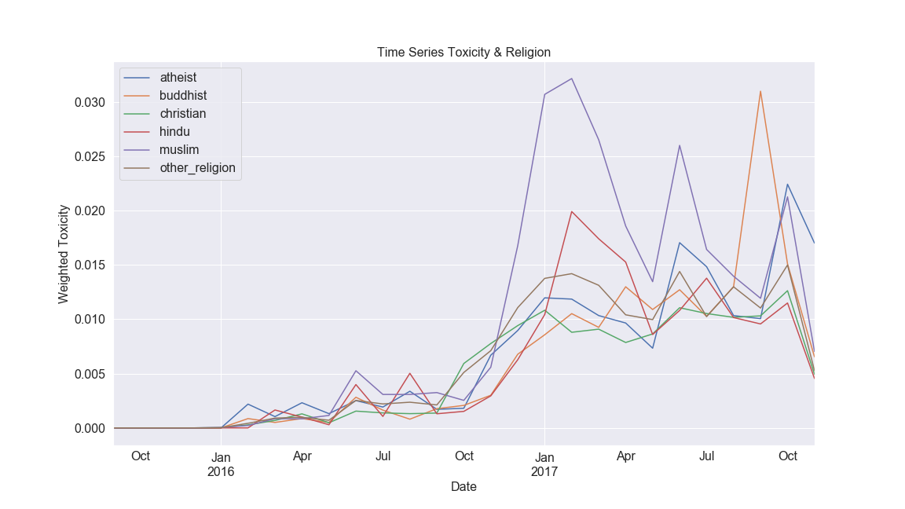
Unintended Bias – Time
Weighted toxicity per religion over time
Notes:
Jacob
Another example is the peak of toxicity associated with muslim in Jan 2017.
This was when trump initiated the Muslim ban
In a lot of cases, we are able to explain these peaks based on events in the news. But unless these news is considered by the model, this bias will cause problems in classifying toxicity.

Slide 8
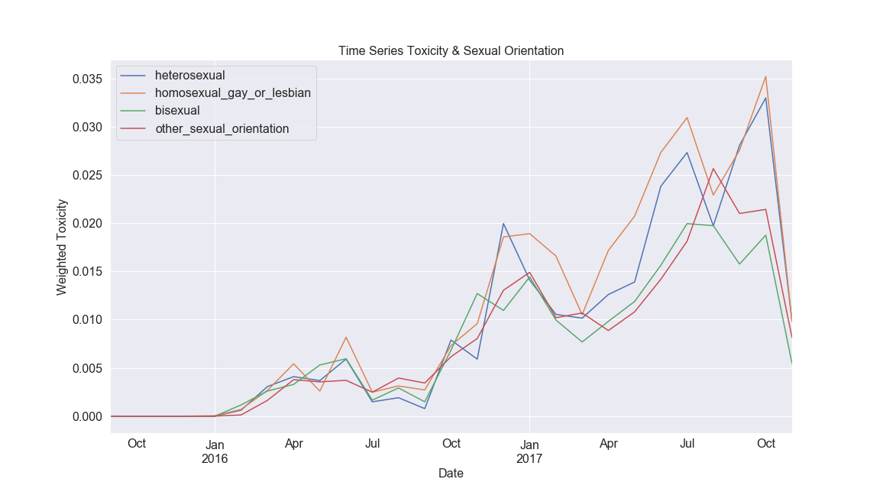
Unintended Bias – Time
Weighted toxicity per sexual-orientation over time
Notes:
Jacob
We still see an overall increase in toxicity over time

Slide 9
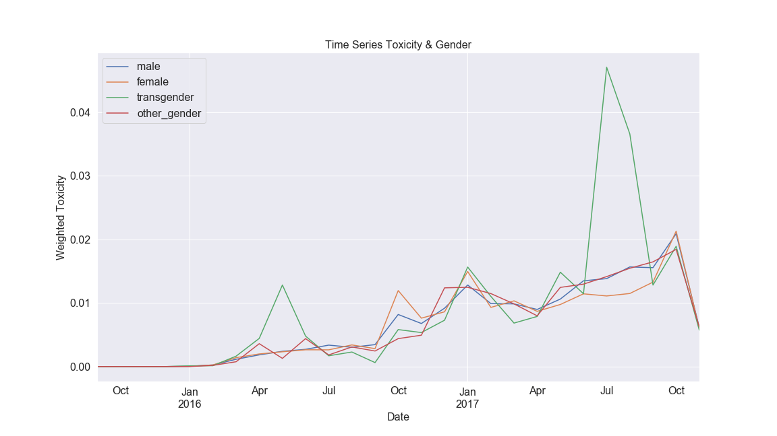
Unintended Bias – Time
Weighted toxicity per gender over time
Notes:
Jacob

Slide 10
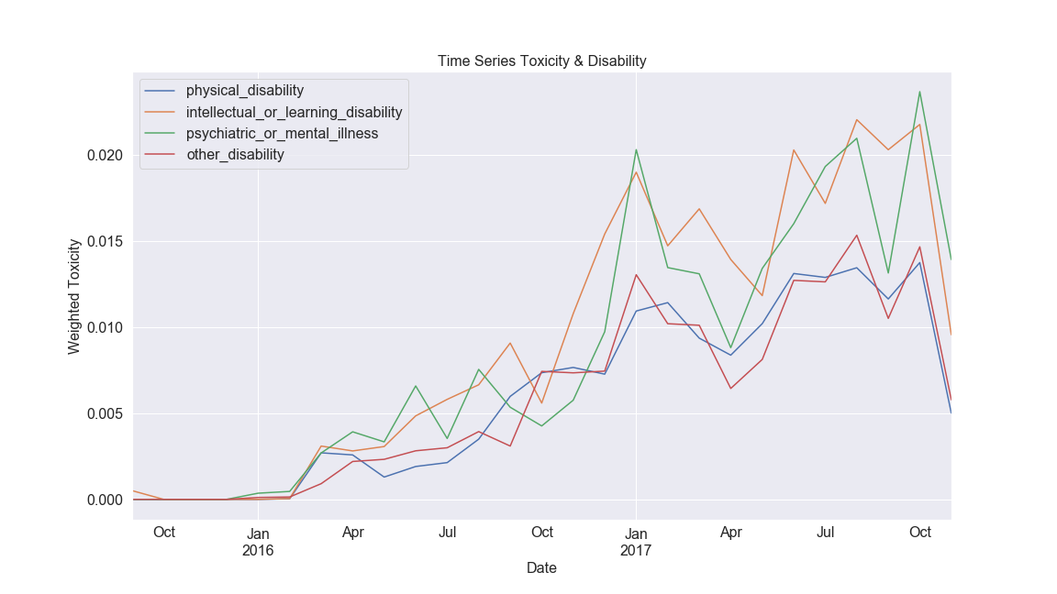
Unintended Bias – Time
Weighted toxicity per disability over time
Notes:
Jacob
A general trend of increased toxicity over time in all demographics. What does that mean?
Are people becoming more toxic? Probably not
It is most likely due to events in news or social media. But this can still cause problems for our model.
Unintended bias is something that should be considered when designing and deploying a toxicity classification model.

Slide 11
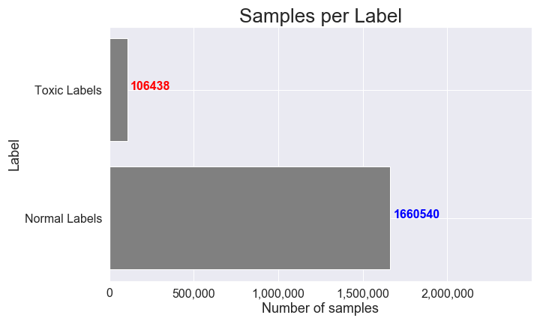
Class Imbalance
Notes:
Hannah
Looking at the data, it can be seen there is a clear class imbalance
Only 6% of comments are toxic compared to 94% considered non toxic
This data was then randomly split 80-20 train test, with 20% of the 80% being allocated for validation

Slide 12
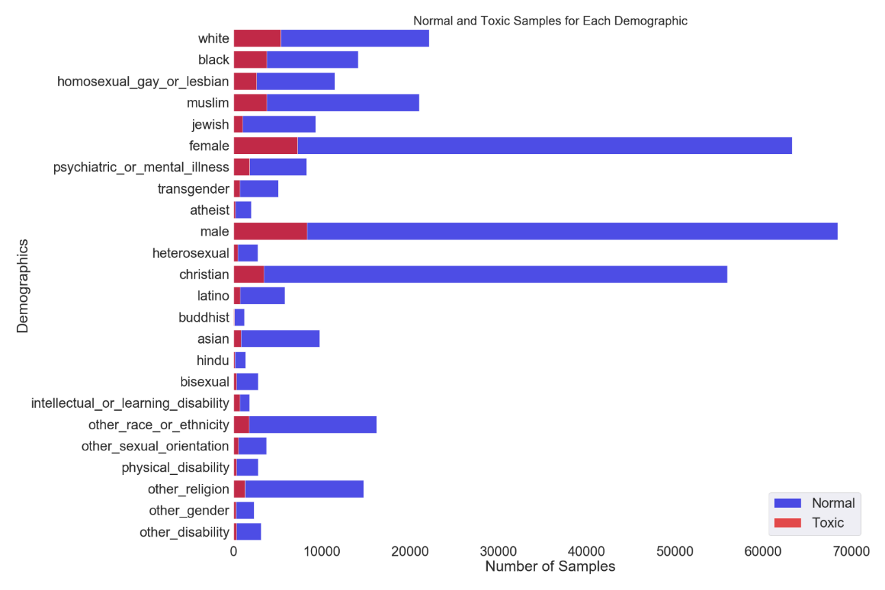
Class Imbalance - Demographic
Notes:
Hannah
Broke down the number of samples per demographic as well as how each demographic is labelled
Note that every demographic does contain toxic comments, so it itsn’t biased towards certain groups
Ratio of normal vs toxic is similar for all groups. The one group which seems to have the least number of toxic comments compared to normal comments is Christian
If you look at different groups of demographics, disability is a lot smaller than the other categories (gender, race, sexual orientation, religion)
Due to less representation of disability groups compared to other demographic groups, so this can be considered bias. (Model may not learn well for these type of toxic comments)

Slide 13
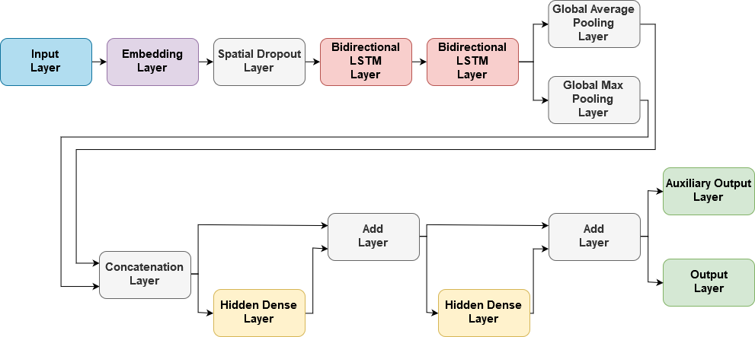
Model
Notes:
Hannah
Input layer
The model takes in the text for the comment to classifiy. Considers comments to have a max length of 220 words
Embedding Layer
uses a pretrained word embedding as the first layer so we don’t have to learn this.
Pretrained word embedding used is glove, which was trained on text from a common web crawl (840 billion tokens used where 2.2 million unique words are considered and each word vector is expressed using 300 dimensional vector
Bidirectional LSTM Layer
LSTM = long short term memory
LSTM is a type of recurrent neural network which is able to learn and handle long term demendencies (which corresponds to words far apart in a comment which are related).
LSTM is able to see/perserves past information since information is run through it for a forward pass
Bidirectional LSTM runs the data forward and backward so LSTM units can preserve past and future information to learn context better
Hidden Dense Layers
These layers are just densely connect layers, similar to layers in neural networks/multi layer perception networks
Add layers act like skip connections for info before dense layer and ouput of dense layer
Output Layers
- Output layer has 1 output for predicting if the comment is toxic or not
Auxiliary output layer has 6 outputs: target, severe_toxicity, obscene, identity_Attack, insult, and threat.
Aux outputs are not used directly or used to measure performance, but having neural networks/ML/DL models learn multiple outputs that are related can help with prediction accuracy/performance
Dropout – helps with regularization/ prevents overfitting by randomly selecting inputs to drop. Spatial Dropout 1D drops entire feature maps instead.
Pooling – Finds the max and average features over all time steps (ie the LSTM layers output a 2D matrix where one dimension is time steps and the other is features, and over the time steps axis the pooling layers find the max and average layer)
Auxiliary outputs
Looks at more than just comment toxicity

Slide 14
Preliminary Results
Class | Precision | Recall | F1-Score | Number of Test Samples | % of Test Samples
False | 0.98 | 0.95 | 0.97 | 331,897 | 92%
True (Toxic) | 0.58 | 0.76 | 0.66 | 29,078 | 8%
Overall Accuracy |  |  |  | 94%
Notes:
Hannah
Model is learning something (if a model only predicted false then it would achieve 92% accuracy. Actual accuracy is higher at 94%)
Precision = percent of samples in predicted class which were predicted correctly/belong to that class (TP / TP + FP)
Having a lot of False positives decreases the value
Can be seen that almost half of the samples which were predicted to be toxic are not actually toxic
Recall = percent of samples in a class were predicted to be in that class (TP / TP + FN) (percent of predictions for a class where the samples actually belong to that class)
Having a lot of false negatives decreases the value
Can be seen that about a quarter of the toxic comments are not labelled as toxic
F1 score – uses precision and recall for calculation (kinda like a mean between the two)
There is a lot of room for improvement

Slide 15
Model Deployment – Societal Impacts
Transparency (Opacity)
Transparency to the deploying company
Determining auxiliary outputs can help make the model more transparent
Bias
Ensuring output is not biased towards certain groups
Labor
Very minimal
Privacy
Some people might be concerned with their data being used
These are public comments
Liability
Missing a toxic comment
Flagging a non-toxic comment
Notes:
Hannah
Considering the case where a toxic comment classifier is used in social media to flag or remove toxic comments

Slide 16
Freedom of Speech and Censorship
Societal controversy regarding freedom of speech and censorship
How is this considered in AI models?
Is this model necessary?
Notes:
Jacob
If people can’t agree to what is considered toxic, how can we deploy such a model?

Slide 17
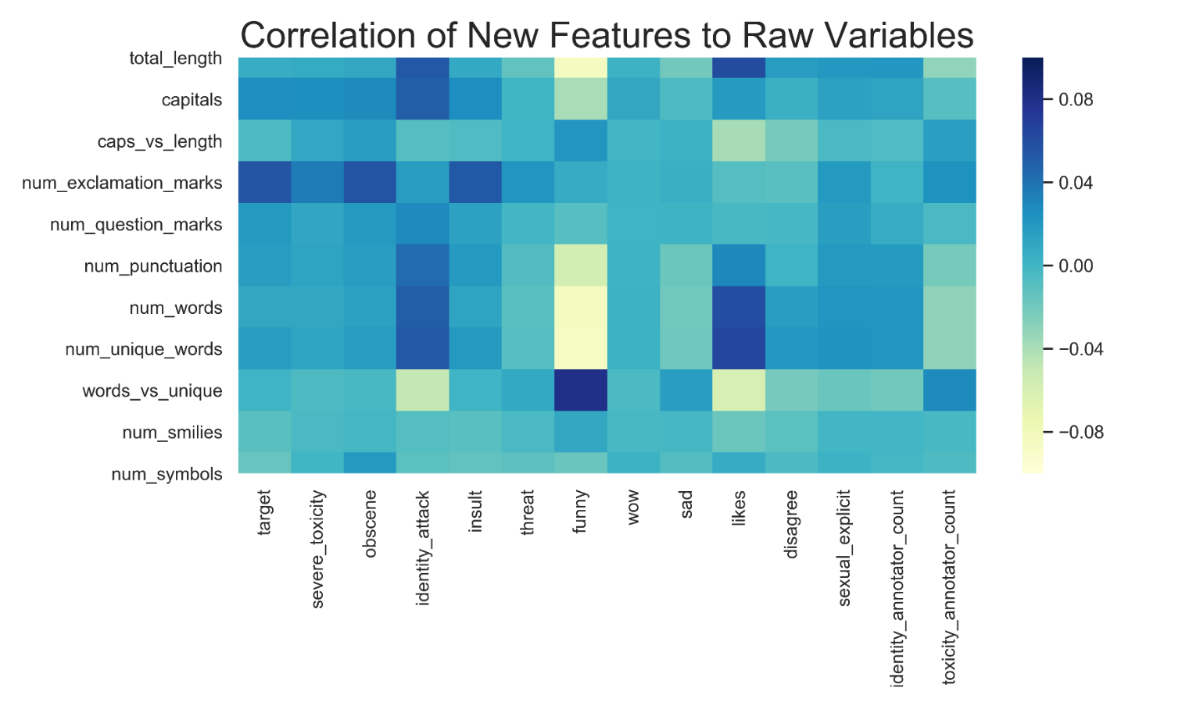
Future Work
Feature engineering
New features
Data cleaning
Contraction mapping
Addressing class imbalance
Performance based on demographic
Toxicity and auxiliary outputs
Notes:
Jacob
New features generated (length of comment, number of capitals, number of question marks, number of exclamation marks, etc)
We think those features can help
We calculated the correlation with original features
Data cleaning using a contraction map (dictionary of potential spelling mistakes)
We must consider class imbalance
Random sampling?
GAN?
We want to evaluate the performance of our model on different demographics.
We also want to train our model on auxiliary outputs such as “funny”, “sad”, “insult”, etc.
We want to see if the model will associate any of these outputs with specific demographic

