Slide 1
DATA VISUALIZATION PROJECT
Video Game Sales
Analysis
Exploring global platform, genre, and critic-score trends across four decades of video game releases.
Tools: Python · Pandas · Plotly · Jupyter Notebook
Dataset: Video Game Sales Dataset (10,092 titles)
VIDEO GAME SALES ANALYSIS
01

Slide 2
PROJECT OVERVIEW
What This Analysis Covers
A course project built around an interactive dashboard analyzing 10,092 video game titles — covering global sales, genres, platforms, publishers, and critic ratings.
10,092
6,230.3M
69.0
7.1
TOTAL GAMES
GLOBAL SALES
AVG CRITIC SCORE
AVG USER SCORE
01
02
03
Explore
Visualize
Interpret
Clean and profile 10K+ game records across platform, genre, and region.
Build interactive Plotly charts: bars, scatter, heatmap, and time series.
Surface trends in platform dominance, genre popularity, and critical reception.
VIDEO GAME SALES ANALYSIS
02

Slide 3
PLATFORM PERFORMANCE
Top 10 Gaming Platforms by Total Global Sales
PlayStation 2 leads by a wide margin, followed closely by the Xbox 360 and PlayStation 3 — the three flagship consoles of the 2000s.
VIDEO GAME SALES ANALYSIS
03

Slide 4
GENRE PERFORMANCE
Global Sales by Genre
Action, Sports, and Shooter titles dominate worldwide sales, together accounting for more than half of all global revenue.
VIDEO GAME SALES ANALYSIS
04

Slide 5
INDUSTRY TREND
Global Sales by Release Year
Physical game sales peaked around 2008–2009 before declining steadily — a shift widely attributed to the rise of digital distribution.
VIDEO GAME SALES ANALYSIS
05

Slide 6
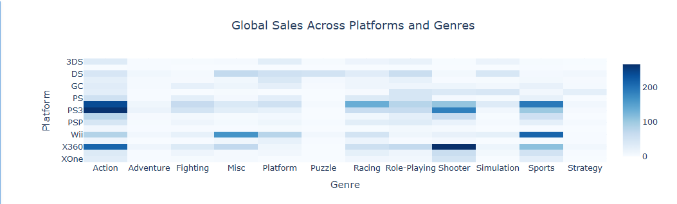
CROSS-CUTTING VIEW
Global Sales Across Platforms and Genres
A platform × genre heatmap reveals where sales concentrate: PS3 and X360 Action/Shooter titles, and Wii Sports, stand out as clear hotspots.
VIDEO GAME SALES ANALYSIS
06

Slide 7
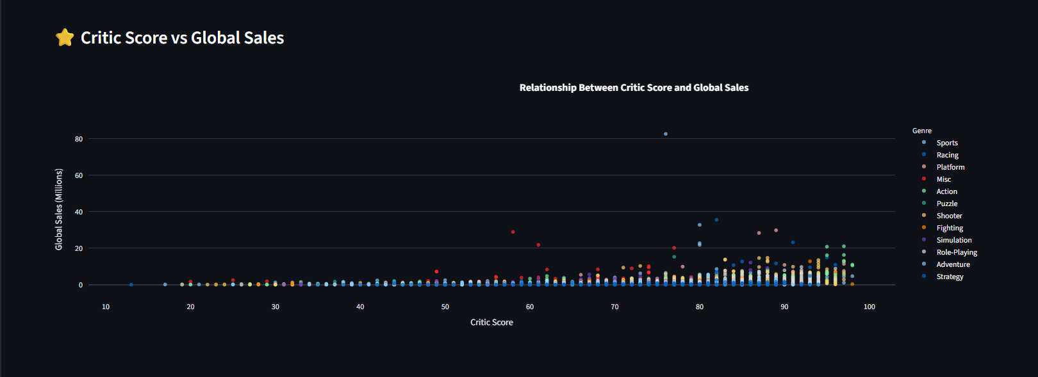
CRITICAL RECEPTION
Critic Score vs. Global Sales
High critic scores don't guarantee blockbuster sales — but nearly every top seller (25M+ copies) scored above 75, suggesting quality is a floor, not a ceiling.
VIDEO GAME SALES ANALYSIS
07

Slide 8
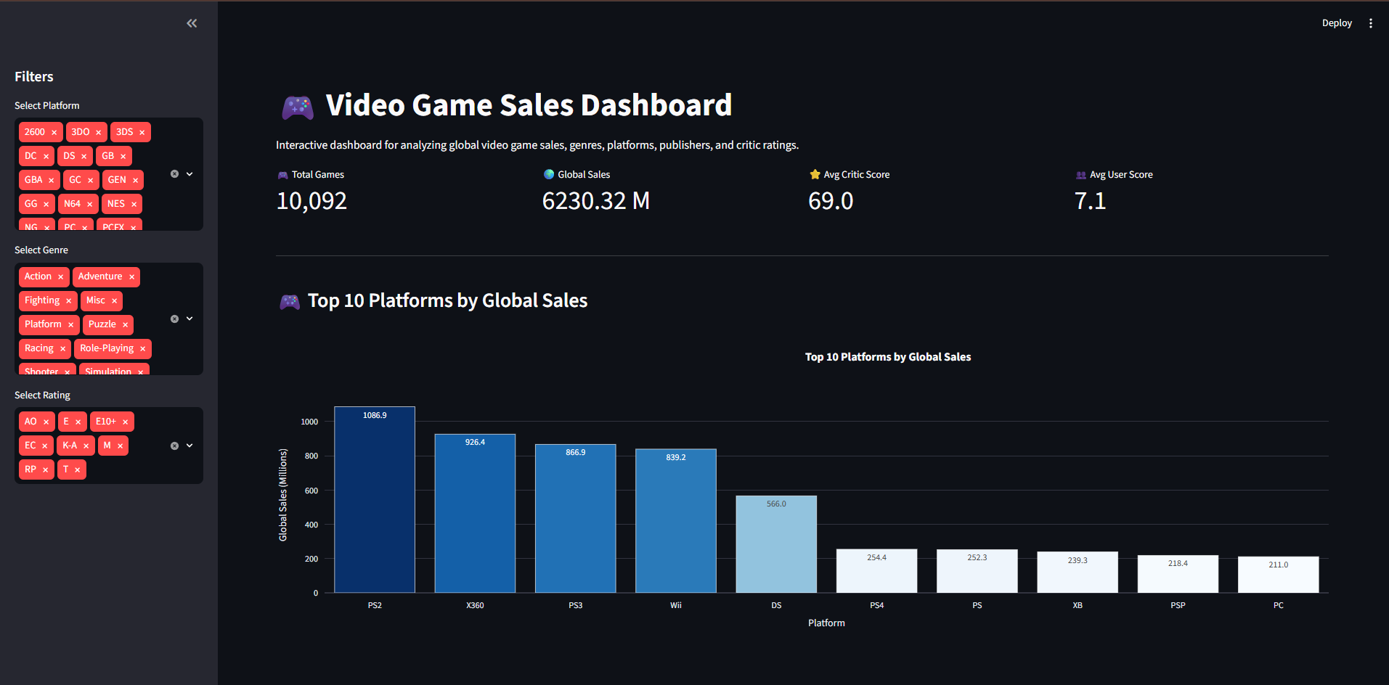
DELIVERABLE
The Interactive Dashboard
All findings are packaged into a filterable dashboard — sliceable by platform, genre, and rating — for self-serve exploration.
VIDEO GAME SALES ANALYSIS
08

Slide 9
KEY TAKEAWAYS
What the Data Tells Us
PlayStation 2, Xbox 360, and PlayStation 3 drove the industry's commercial peak.
Action, Sports, and Shooter genres consistently outsell every other category.
Global sales peaked near 2008–2009, then declined as digital distribution grew.
Strong critic scores cluster around top-selling titles, but don't guarantee them.
VIDEO GAME SALES ANALYSIS
09

