Slide 1
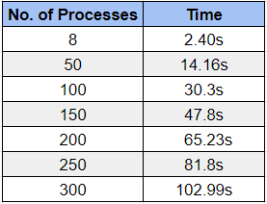
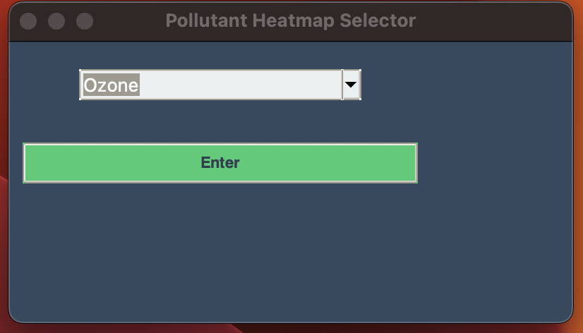
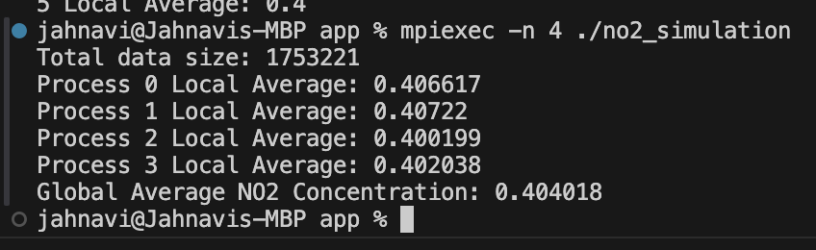
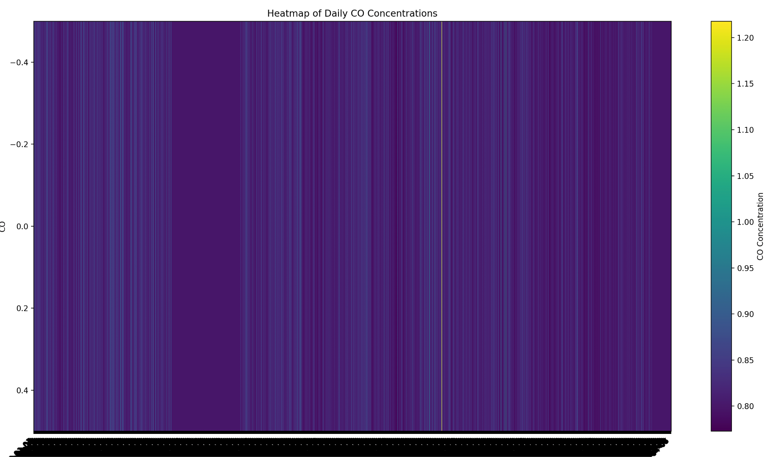
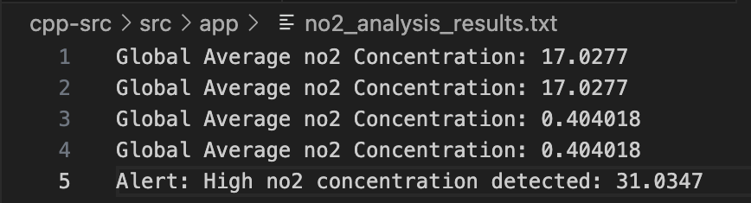
HPC Simulation of Air Now Data California 2015 to 2024
N02 Simulation
Data Extraction, data aggregation, data preprocessing and heat map visualization
Total data size : 1.7M
Global average for every pollutant - sourcing it to a text file

