Slide 1
Let’s Go!
Project Onboarding Meeting

Slide 2

Agenda
Introductions
What To Expect
System Setup
Action Items
Wrap Up Q&A
CONFIDENTIAL | ‹#›
Notes:
Ryan

Slide 3
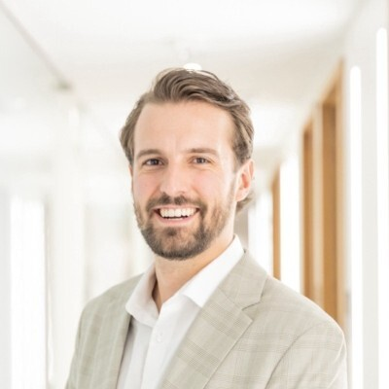

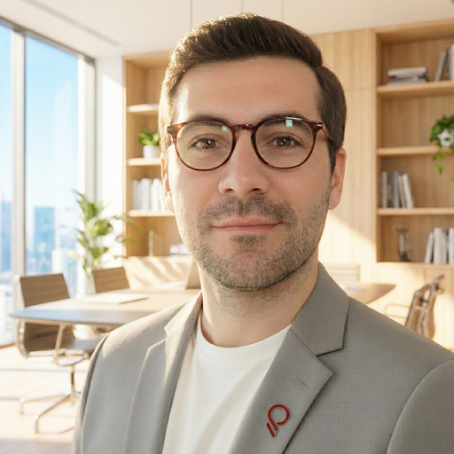
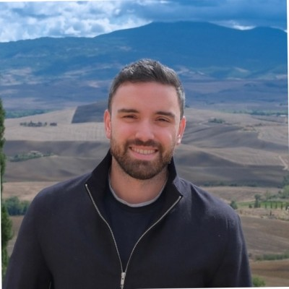
Project Sponsorship
Ryan Anderson
Mitch Young
Joel Salazar
Greg DelGenio
Client Partner
randerson@plative.com
Sales Director
myoung@plative.com
Delivery Director
jsalazar@plative.com
CRO
greg@plative.com
CONFIDENTIAL | ‹#›
Notes:
Ryan

Slide 4

Meet Your Project Manager
Lu De La Rocha
Sr. Project Manager
Notes:
Presenter: Plative Chair
Instructions:
For Basic Kickoffs, include only the Plative project lead
For Pro and Enterprise Kickoffs, include both a Plative chair and Client chair.
Plative chair will typically be the PM but could also be the AD/DM or lead consultant if needed/desired.
Client chair would typically be client project lead or business lead.
First Plative chair will introduce themselves, and then Client chair will do the same
Plative chair will be the overall MC for the remainder of the meeting.

Slide 5


Meet Your Team
Katie Chalmers
Principal Consultant, Salesforce
Ninon Aguilera
Consultant, Salesforce
Notes:
Presenter: Plative Chair
Instructions:
For Basic Kickoffs, include only the Plative project lead
For Pro and Enterprise Kickoffs, include both a Plative chair and Client chair.
Plative chair will typically be the PM but could also be the AD/DM or lead consultant if needed/desired.
Client chair would typically be client project lead or business lead.
First Plative chair will introduce themselves, and then Client chair will do the same
Plative chair will be the overall MC for the remainder of the meeting.

Slide 6
What To Expect
Expectations For A Successful Engagement
CONFIDENTIAL | ‹#›
Notes:
Ryan

Slide 7
Project Charter
Salesforce Implementation & Netsuite Integration
ENGAGEMENT SUMMARY
This initiative is focused on remediating and modernizing an existing Salesforce implementation: resolving known issues, upgrading the user interface to Salesforce Lightning, and reconfiguring the platform to better reflect how the business operates today. The work also includes building targeted automations to reduce manual, repetitive tasks and developing reports and dashboards that give leadership and teams clearer visibility into the metrics that matter most.
IN SCOPE
Lightning upgrade: all page layouts, buttons, and record pages
Case routing automation rebuild (killing the runaway workflow)
Nintex DocGen renewal template (print + email channel)
Ad-hoc configuration: Leads, Accounts, Contacts, Opportunities, Cases
Custom objects: Stores, Stations, Classes, Enrollments (as needed)
Automations / Flow builder (Process Builder migration)
Reports, dashboards, and basic KPI tracking
End-user and admin training
KEY DATES *
OUT OF SCOPE
Lead / opportunity data model restructuring (Phase 2)
Custom development
External data migration
Licensing system integration (Phase 2+)
Product catalog overhaul / pricing automation (Phase 2)
Quote PDF configuration
Billing system integration (Phase 2+)
Agentforce / AI deployment (Phase 3)
Marketing automation setup
Contract
Signed
Requirements Sign-off
QA & UAT Complete
Go-Live
6|26
7|24
9|4
9|11
7|7
8|21
9|10
Project Kickoff
Build Complete
Deploy
*Subject to change
Notes:
Presenter: Plative Chair and Client Chair
Client Chair first presents Mission Statement and Target Business Outcomes & KPIs
Plative Chair then presents In Scope, Out of Scope, Deliverables and Key Dates
ADs should support/encourage strategic conversations on this slide if needed. This should NOT be a quick drive by for any client.
Do not delete sections. Do not move stuff around. Do not write a long drawn out mission statement in 6 pt font.
For Pro and Enterprise Kickoffs, we want the Project Charter segment of the kickoff session to be highly interactive. Open up for discussion. Ask around the table if there are any comments or questions. Ask if they agree or if they have additional points they’d like to raise. Business stakeholder alignment on the Charter is critical to project success.
Instructions:
We are expecting Client Partners to build this slide into the Client Onboarding deck. PMs will then be able to just reuse that slide when building the Kickoff deck.
If not available in the Onboarding deck for any reason, PM should still be able to populate everything on the Project Charter slide from the Proposal deck content and/or Opportunity record, e.g. Target Business Outcomes & KPIs should be based on pre-sales ACER analysis.

Slide 8
Project Roadmap
Week 0
Ramp & Kickoff
Contract signed, deposit received, team onboarded, project rhythm established
Weeks 1–2
Discovery & Documentation
Lightning readiness assessment, org review sessions, Jira stories drafted
Weeks 3–4
Foundation Build
Permissions, page layouts, object configuration (Accounts, Contacts, Cases)
Weeks 5–6
Core Build
Custom objects, Automations, Nintex DocGen renewal template, Flow migrations, Case Routing
Weeks 6–7
QA & UAT
Internal QA throughout build; two-week UAT with client team using test scripts
Week 8
Training & Deployment
End-user training (2 sessions), metadata deployment to production, go-live
Notes:
Presenter: Plative Chair
Instructions:
The roadmap slide should be prepared as part of the pre-sales Proposal deck. Worst case, if it’s not already built into the Proposal deck, then PM can build one based on the resource plan gantt chart. Reuse what already exists – no need to reinvent a roadmap from scratch.
Always use this template/look and feel for the roadmap. Do NOT deviate from the colors, shapes, fonts, formatting on this slide
On the right hand side, include any commentary/callouts regarding the roadmap – e.g. any major dependencies or constraints that we want to highlight
The major milestones depicted above the months should be consistent with the Key Dates on the Project Charter
For Enterprise Kickoffs, we want this to be more interactive. So after going through the roadmap, open it up for discussion. Ask if there are any major dates/constraints/dependencies anyone wants to surface from a risk management perspective.

Slide 9
Project Team Roles
Director
PROJECT ROLE | ROLE DESCRIPTION
Delivery Director | Responsible for advising the project team throughout lifecycle, conducting periodic solution designs and actively identifying/ processing risks throughout the engagement. Point of escalation for both internal and client teams.
Project Manager | Responsible for ensuring the project team is accountable for budget, burn rate, key milestones, and staffing concurrent work-streams. Keeps client up to date and is a core point of contact throughout the engagement.
Sr. Salesforce Consultant | Responsible for bringing industry expertise and functional consulting background to engagement. Will be the primary point of contact for the Salesforce core deliverables.
Salesforce Consultant | Responsible for supporting with consulting background to engagement. Will be the secondary point of contact for the Salesforce core deliverables.
Project Manager
SF Lead Consultant
Salesforce Consultant

Slide 10








Project Methodology
DISCOVER
DESIGN
BUILD
TEST
ENABLE
DEPLOY
SUPPORT
  Transform is a project based, set scope engagement model intended to explicitly agree on a scope, deliverables schedule, and definition of “done”.
Clarify
Build
Deep-Dive Discovery
User Story Compilation
Artifact Creation
Process Reviews
Integration Planning
Data Dictionary
Sprint Definitions
Quality Assurance
User Acceptance
Integration Testing
User Training
Documentation
Workshops
1-1 Training
Final Data Load
Deployment
Go-Live
Post-Go Live
Workshops
1-1 Sessions
Iterations
Milestone
Adjust
Demo
CONFIDENTIAL | ‹#›
Notes:
Eli

Slide 11
Communication Structure
MEETING NAME | PURPOSE | FREQUENCY | CLIENT AUDIENCE | PLATIVE AUDIENCE
Project Status Meeting | Review status of Project - Accomplishments, Plans, Risks, Issues, Action Items, Decisions, Burn, Upcoming time away | Weekly 60 Minutes | Lenny Prion Chantal Wheeler | Lu De La Rocha
Project Status Summary | Notes from status meeting and Accomplishments, Plans, Risks, Issues, Action Items, Decisions, Burn, Upcoming time away | Weekly | Lenny Prion Chantal Wheeler Max Yelsky | Lu De La Rocha Ryan Anderson Joel Salazar
Stakeholder Check-In | Status update, pulse check, alignment | Monthly 60 Minutes | Lenny Prion Chantal Wheeler | Ryan Anderson Joel Salazar
Executive Sponsor Check-In | Status update, pulse check, alignment | 4-6 weeks 30 Minutes | Max Yelsky | Greg DelGenio
CONFIDENTIAL | ‹#›
Notes:
Eli

Slide 12





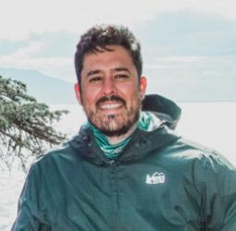

Engagement Kickoff Agenda
MEET THE TEAM
REVIEW PROJECT/ROADMAP
IDENTIFY CLIENT STAKEHOLDERS /
COMMUNICATION TOUCHPOINTS
SET UP MEETING CADENCE
PROJECT TOOLS OVERVIEW
DEFINE SUCCESS CRITERIA
CONFIDENTIAL | ‹#›
Notes:
Eli

Slide 13
System Setup
Our Tools For Collaboration
CONFIDENTIAL | ‹#›
Notes:
Eli

Slide 14

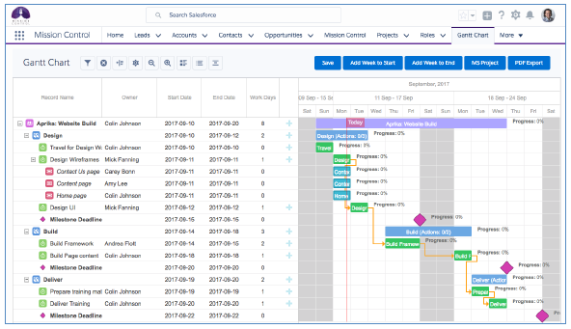
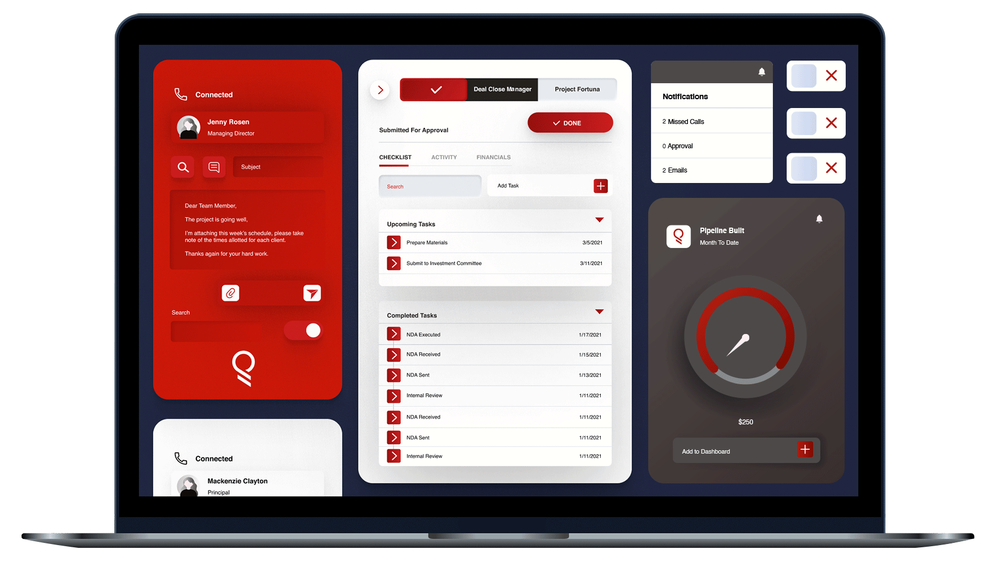

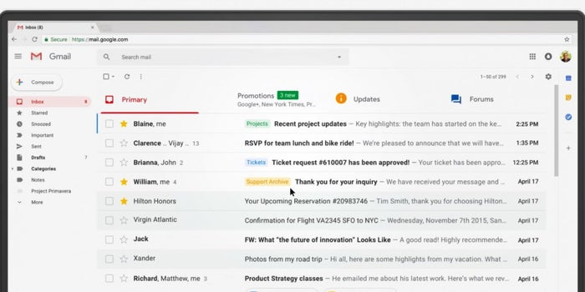



Communications Platforms
Google Meet used for video conferencing*
Email Distribution List Please cc theedge@plative.com on all emails to Plative project team members to ensure coverage
Jira will be used to collaborate on project requirements, plan and work item status
Shared Google Drive will be used to share project documents and artifacts
Slack Team Channel leveraged when high priority items need faster turn around
Note: Plative records, transcribes and produces AI summaries of all client meetings. This allows our distributed team members to stay abreast of all client meetings, decisions and action items in the most budget efficient way – i.e., without requiring every team member to be in every meeting.
Notes:
Eli
Presenter: Plative Chair
Instructions:
Make sure to replace client@plative.com with actual group email address
Stress the importance of leveraging the group email list – this is to ensure messages do not get lost due to PTO, and we don’t lose context in the event of team changes
Include Slack only for Pro or Enterprise kickoffs
Remove Slack for Basic kickoffs
Discourage direct slack messages to avoid lost communication – better to use team channel

Slide 15
Giving Us Admin Access
Plative will need Admin credentials.
Please use the following credentials:
Username: theedge@plative.com
Email: theedge@plative.com
Profile: System Administrator
If there are any 3rd Party Applications that interact with system to administer core functionality, Plative will also need a login to these systems.
CONFIDENTIAL | ‹#›
Notes:
Eli

Slide 16




Discovery and Architecture
WHAT TO EXPECT:
ARTIFACTS PRODUCED:
Up-front, business unit agnostic discovery with executive stakeholders to inform our perspective on functional business outcomes in order of priority.
Core Business Objectives Overview
Entity Relationship Diagram (LucidChart)
Integration Architecture Diagram (LucidChart)
Business unit-specific stakeholder interviews to capture real life user stories which will inform our solution design.
User Stories (JIRA)
Comprehensive Requirements List (JIRA)
Current system walkthroughs guided by client team to formulate current state for gap analysis.
Universal Process Notation Diagrams (LucidChart)
Data Migration Mapping Document (Excel)
CONFIDENTIAL | ‹#›
Notes:
Eli

Slide 17
Gathering Your Documentation
Preparing existing documentation on systems, processes, policies and configuration will help get your Plative team up to speed faster. The program team will review any documentation provided in preparation for alignment & discovery sessions.
BRD’s AND SPECIFICATIONS
SYSTEM LANDSCAPES
USER GUIDES
BUSINESS PROCESSES
ENTITY RELATIONSHIP DIAGRAMS
API REFERENCES
CONFIDENTIAL | ‹#›
Notes:
Eli

Slide 18
Action Items
Next Steps Towards a Successful Engagement
CONFIDENTIAL | ‹#›
Notes:
Eli

Slide 19
Next Steps
The Edge Next Steps
Establish project team and define collaboration rules
Prep for discovery
Surface relevant documentation
Plan for weekly / ad-hoc meetings
Provision Plative system admin access
Plative Next Steps
Debrief and Knowledge Transfer with Project Team
Schedule Kickoff Session
Plan Discovery Workshops
CONFIDENTIAL | ‹#›
Notes:
Eli

Slide 20
Questions?

Slide 21
Thank You!

