Slide 1
Brand Guidelines
Acceptable use of our brand assets
02.02.26

Slide 2
Visual Identity Overview
03
Logo Usage
07
Typography
11
Color Palette
The following sections provide guidance on how to use each element of the system.
When used properly, the visual identity provides a foundation for expressing the Plative story.
15
Graphic Assets

Slide 3
Our Logo
Plative Visual Identity System

Slide 4




Our Logo
Vertical:
Horizontal:
The Lantern:
Symbol
Horizontal
Our logo can be downloaded HERE.
Vertical
Clear Space
When using our logo, leave enough white space around it’s borders
Minimum Size

Slide 5
Logos
Link to Download Logo Files
The primary Crimson and black logo is to be used against white.
When applying the Plative logo onto a white background, standard practice is to use the crimson and black primary version.
When applying onto a dark background, use the Crimson and white version.
Do not use an all white, all black or all crimson version.
The primary Crimson and white logo is to be used against dark backgrounds.

Slide 6







Logo Misuse
Do not alter the proportions of any part of the logo.
Do not use the word
mark at an angle.
Do not add effects such
as a drop shadow or stroke
Do not add new fonts to logo.
Do not use a 1-color version
Do not place on busy backgrounds or colors.
Do not remove any parts of the logo or icon.
Do not change the colors or transparency.

Slide 7
Typography
Plative Visual Identity System

Slide 8
Typography
Title Font
Open Sans Semi Bold
Open Sans Light for Sub-Titles
The font
Open Sans is a humanist sans serif typeface designed by Steve Matteson, Type Director of Ascender Corp. This version contains the complete 897 character set, which includes the standard ISO Latin 1, Latin CE, Greek and Cyrillic character sets. Open Sans was designed with an upright stress, open forms and a neutral, yet friendly appearance. It was optimized for print, web, and mobile interfaces, and has excellent legibility characteristics in its letterforms.
Body Font
Open Sans Regular
Open Sans Semi Bold
Aa Bb Cc Dd Ee Ff Gg Hh Ii Jj Kk Ll Mm Nn Oo Pp Qq Rr Ss Tt Uu Vv Ww Xx Yy Zz
0123456789 !”#$%’&(
Open Sans Regular
Aa Bb Cc Dd Ee Ff Gg Hh Ii Jj Kk
Ll Mm Nn Oo Pp Qq Rr Ss Tt Uu
Vv Ww Xx Yy Zz
0123456789 !”#$%’&(

Slide 9
Typography: Do’s and Don’ts
Open Sans Semi Bold for Titles
Open Sans Light should be used for subtitles
Open Sans Regular should be used for body text.
Do Not Use Open Sans Light for Titles
Do Not Use Open Sans Semi Bold for Subtitles
Do not use Fjalla One, ever. We’re phasing out the font entirely.

Slide 10
Typography: Do’s and Don’ts
Use Open Sans.
The difference is small, but impactful. In addition, it ensures that our typography remains consistent across all of our assets.
Use Arial.
Arial is the default font for Google Slides. We do our best to default the body font in all of our templates to Open Sans, but sometimes it needs to be done manually.
Choose Random Fonts.
Pay close attention to the fonts you are using. Whether it’s a deck, document, digital, or physical asset, do not choose any font other than Open Sans

Slide 11
Color Palette
Plative Visual Identity System

Slide 12
Color Palette
PRIMARY BRAND COLORS
Crimson
HEX #E14136
R: 225 G: 65 B: 54
C: 0 M: 96 Y: 93 K: 0
Navy Blue
HEX #262A42
R: 38 G: 42 B: 66
C: 88 M: 81 Y: 46 K: 47
Soft Navy
Soft Navy
HEX #425582
R: 66 G: 85 B: 130
C: 86 M: 76 Y: 24 K: 7
Gold
HEX #DEAB57
R: 222 G: 171 B: 87
C: 8 M: 36 Y: 85 K: 0
Navy Blue
SECONDARY BRAND COLORS
Deep Teal
HEX #005957
R: 0 G: 89 B: 87
C: 100 M: 42 Y: 62 K: 29
Teal
HEX #0D9DA4
R: 13 G: 157 B: 164
C: 90 M: 12 Y: 38 K: 0
Soft Teal
HEX #9CDAE6
R: 156 G: 218 B: 230
C: 41 M: 0 Y: 10 K: 0

Slide 13
Color Do’s and Don’ts
Typography + Color: Do’s and Don’ts
Use Light Text on Dark Backgrounds
Use Dark Text on Light Backgrounds
Use Light Text on Dark Backgrounds
Use Dark Text on Light Backgrounds
Use Light Text on Dark Backgrounds
Use Dark Text on Light Backgrounds
Use Dark Text on Dark Backgrounds
Use Light Text on Light Backgrounds
Use Dark Text on Dark Backgrounds
Use Light Text on Light Backgrounds
Use the previous Corona Red

Slide 14
CTA: Do’s and Don’ts
On light/white backgrounds
On dark backgrounds
REGISTER NOW
REGISTER NOW
REGISTER NOW
REGISTER NOW
REGISTER NOW
REGISTER NOW
REGISTER NOW
REGISTER NOW
REGISTER NOW
On light/white backgrounds
On dark backgrounds
REGISTER NOW
REGISTER NOW
REGISTER NOW
REGISTER NOW
REGISTER NOW
REGISTER NOW
REGISTER NOW

Slide 15
Graphic Assets
Images grounded in the idea that
Plative meets you, wherever you are.

Slide 16
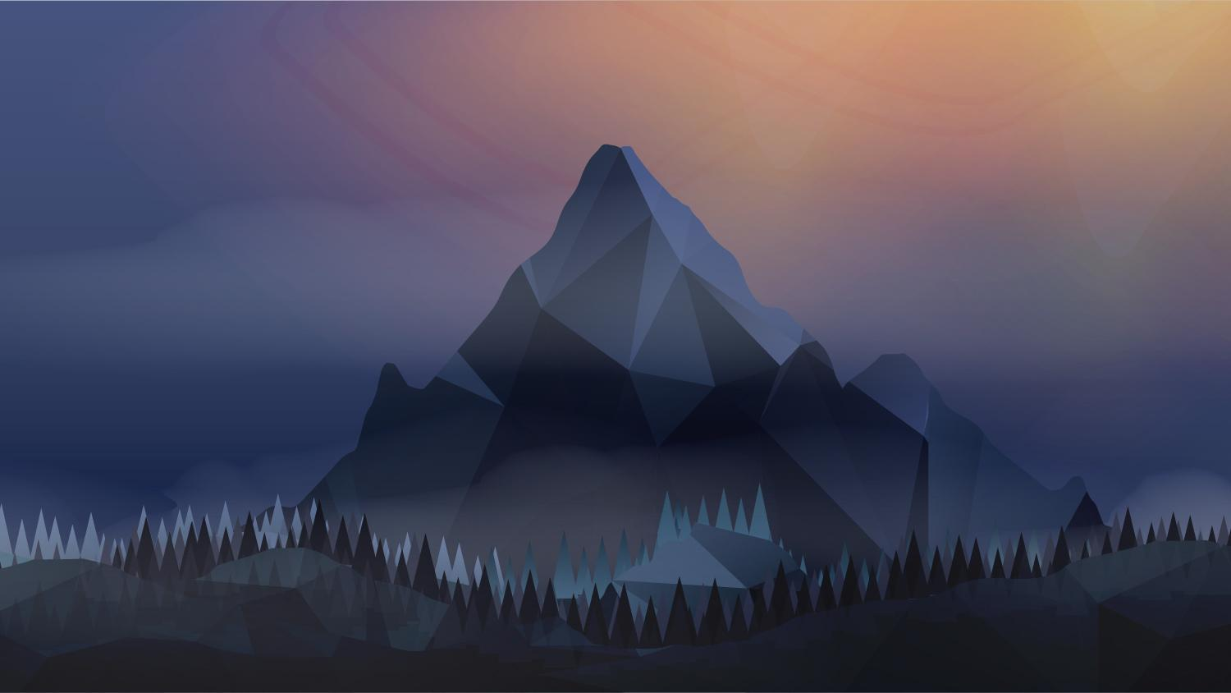




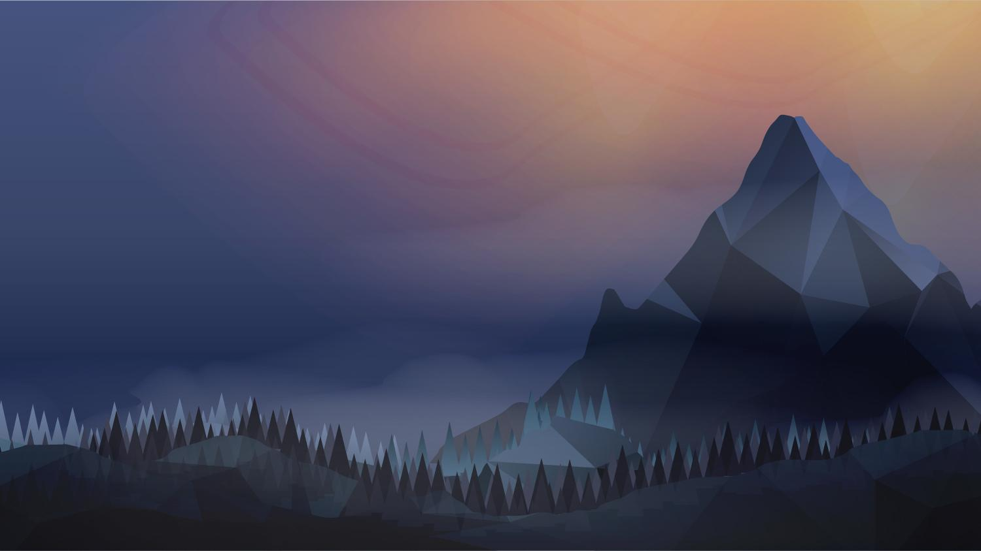




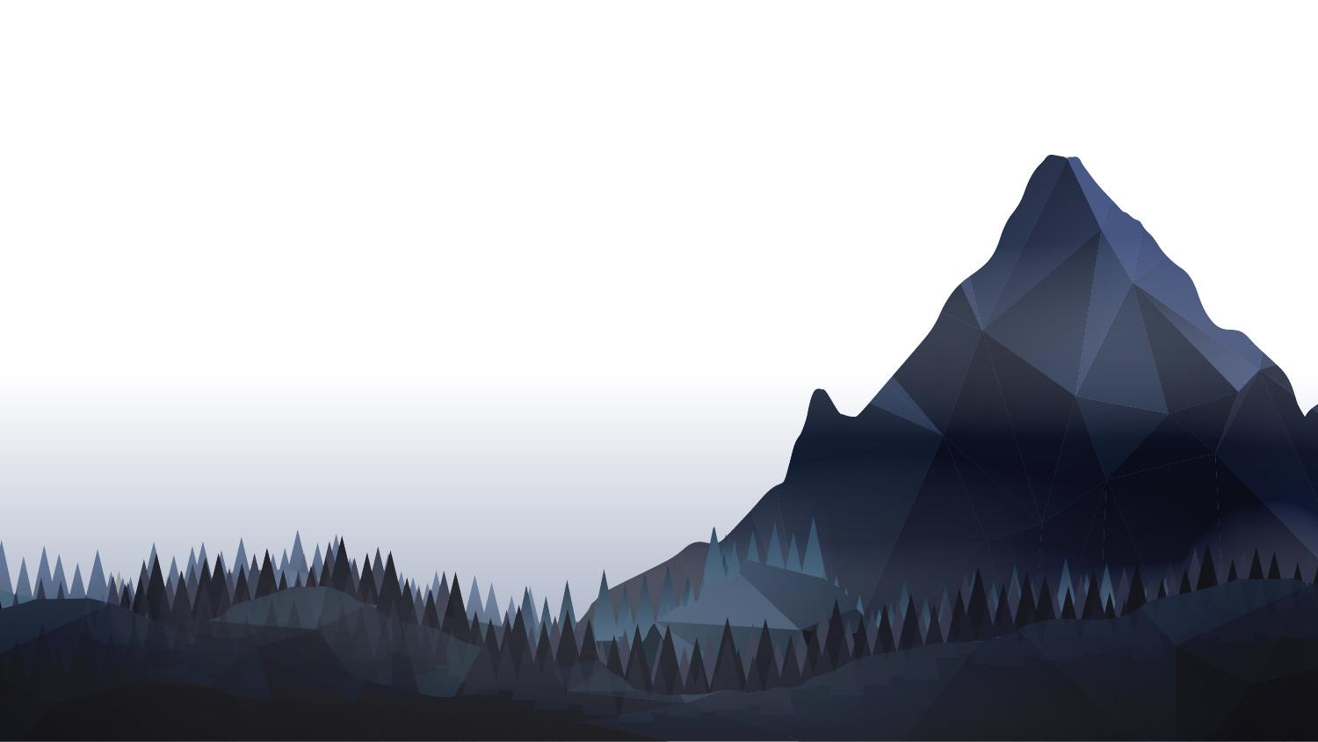



Graphic Assets
Graphic assets can be downloaded HERE.
Mountains 1
Prairie
Prairie Border
Gradient 1
Gradient 4
Mountains 2
Forest
Forest Border
Gradient 2
Gradient 5
Mountains Border
City
City Border
Gradient 3

Slide 17
Graphic: Mountains 1
Can be used as a title, transition or large callout.

Slide 18
Graphic: Mountains 2
Can be used as a title, transition or large callout.

Slide 19
Graphic: Mountain Border
Can be used with a bullet slide, or slides containing a medium amount of copy.

Slide 20
Graphic: Prairie
Can be used as a title, transition, large callout or a smaller amount of copy.

Slide 21
Graphic: Prairie Border
Can be used with a bullet slide, or slides containing a medium amount of copy.

Slide 22
Graphic: Forest
Can be used as a title, transition, large callout or a smaller amount of copy.

Slide 23
Graphic: Forest Border
Can be used with a bullet slide, or slides containing a medium amount of copy.

Slide 24
Graphic: City
Can be used as a title, transition, large callout or a smaller amount of copy.

Slide 25
Graphic: City Border
Can be used with a bullet slide, or slides containing a medium amount of copy.

Slide 26
Graphic: Gradient 1
Can be used as a end slide, transition, large callout or a medium amount of copy with the smaller copy in the darker portion of the gradient.

Slide 27
Graphic: Gradient 2
Can be used as a large callout or a medium amount of copy with the smaller copy in the darker portion of the gradient.

Slide 28
Graphic: Gradient 3
To be used with a graph, chart or larger amount of copy, as long as the font is large/legible enough to read against the blue gradient.

Slide 29
Graphic: Gradient 4
To be used with a graph, chart or larger amount of copy, as long as the font is large/legible enough to read against the blue gradient. Use this if imagery is complex, and the aurora would be distracting.

Slide 30
Graphic: Gradient 4
Graphic: Gradient 5
To be used with a graph, chart or larger amount of copy, as long as the font is large/legible enough to read against the blue gradient. Use this if imagery is complex, and the aurora would be distracting.
To be used with a graph, chart or larger amount of copy. Use this if imagery is complex, and the aurora or dark background would be distracting.

Slide 31
Photography
Photography

Slide 32
Approved Iconography
Iconography
Registration
Catering / meals
Calendar
Event
Folder / files
Email
Notify
Documents / files
Laptop
Documentation
Calls
Monitor
Configure
Settings
Global
Upload
Notification
Certified / ribbon
Apps
Bolt
Block kit
Server
Rocket
Star / spark
Calendar
Flexible
Framework
Alert
Operational agility
Check / available
Arrow
Cloud software
Secure files
User experience
Scale / growth
Always available
Code
Lightbulb
Search
Open apps
Home page
Insurance / umbrella
Trash / delete
Voice / audio
Org
Collaboration
Alignment
PDF
ID card
Battlecard
Hybrid work
Trophy
Contacts
Add video
Upload app
Quick call

Slide 33
Approved Iconography
Big Iconography (on light backgrounds)

Slide 34
Big Iconography (on dark backgrounds)

