Slide 1
Empowering Your Next
Competitive Advantage
{{date}}
Solution proposal prepared for:
Customer logo here

Slide 2
Agenda
1
Executive Summary
Re-center on the what and the why
2
What We Heard
Capability gaps, impact and prioritization
3
Solution Strategy & Architecture
Painting a clear and feasible picture of the target operating model
4
Recommended Phasing & Roadmap
Presenting the path forward, sequencing of initiatives for maximum impact
5
Investment Summary
Investment summary and quantifying value
6
Next steps
Review what’s next
Notes:
Greg

Slide 3
Executive Summary
Unlocking value by transforming Invicti’s quote to cash process
Summary
Target Business Outcomes
This is where you should insert an executive level summary. What are we doing and why?
Outcome 1
Outcome 2
Outcome 3
Outcome 4
What We Found
What We’re Recommending
Benefits You’ll Realize
The product catalogue is overly expansive due to integrator-driven SKU proliferation and inactive products.
The current buildout does not support a seamless upsell or renewal process, resulting in unnecessary pricing complications and manual workarounds.
Unnecessary friction with partners due to blunt margin rules, applying only at the quote level and not the SKU level.
Separate renewal and upsell opportunities with no invoice consolidation results in double-billing and customer confusion
Significant manual remedian required from CS and Revenue Ops related to quote, ACV and invoice correction.
Health scores are not trusted as they often contradict visible risks, and therefore are heavily driven by manual CSM sentiment.
FInancial integration flow forces all amendments to be initiated from Salesforce.
Migrate from CPQ to address inefficient sales, customer success, operations and finance processes resulting from core system limitations.
Implement Salesforce Agentforce Revenue Management (ARM) to serve as the backbone of consolidating the quote-to-cash process for Relay, for streamlined quoting, change orders, document generation, and e-signature.
Develop structure for contracted pricing by leveraging out of the box Revenue Cloud functionality, ultimately eliminating the need to reference previous contracts, agreements or partner margin workbooks to generate proposals.
Develop automated ARR calculations using a blend of out of the box RCA capabilities with some light customization in order to ensure accuracy around this key metric and the downstream reporting.
Enhance the use of Netsuite by allowing the financial system to perform finance-related remediation such as amendments to Sales Orders and generation of Invoices.
Configure automatic proration to eliminate CSM and Rev Ops intervention during upsell or renewal sales cycles.
Deploy a cohesive and action-oriented AI strategy that will layer on top of the new data infrastructure and deliver optimizations like lead scoring, quote optimization, account whitespace planning, churn risk analysis, and more.
▲ Improved foundation to realize AI benefits ▼ Reduce technical debt • Benefit from standard Salesforce release cycles
▲ ~50% Increase quoting accuracy* ▲ Increase pricing accuracy and governance ▼ Reduce overall sales cycle duration
▼ Reduce quoting errors and inaccurate pricing ▲ Improve pricing consistency across customer base
▼ Reduce manual reconciliation ▲ Improved financial forecasting ▲ Improved strategic planning capabilities
▲ Enables in-house first-party data for marketing, lessening reliance on agencies
▼ Reduce operational overhead on support ▲ Improved customer sentiment
▲ Increase opportunity close rate (deal scoring) ▼ Reduce operational overhead (customer agent)
Notes:
Greg

Slide 4
Your Presenters

Slide 5
What We Heard
Capability gaps, impact and prioritization

Slide 6
What We Heard From You
“Pull quote”
“Pull quote”
“Pull quote”
{{name}}| {{title}}
{{name}}| {{title}}
{{name}}| {{title}}

Slide 7
Your Business Imperatives
YOUR GOALS
TARGET OUTCOMES
IMPACT
z
Business challenge 1
z
Business challenge 2
Business challenge 3
SLIDE INSPIRATION:
Use this slide to illustrate business challenges we’ve uncovered and highlight what outcomes we’re going to achieve through the project that will resolve that challenge.

Slide 8
Our Assessment Of Your Capabilities
Prospect to SQL
Sales
Quote to Order
Order to Cash
Customer Success
Support
Lead Generation
Account Team Management
Electronic Signature
AR Management
Proactive Issue Identification
Case Management
Lead Management
Contact Management
Proposal Management
Revenue Recognition
Customer Health Tracking
Case Team Mgmt
Lead Routing
Opportunity Team Mgmt
Price Book Management
Tax Management
Churn Forecasting
Case Routing
Sales Cadences
Opportunity Management
Configure, Price, Quote
Order Fulfillment
Renewal Management
CSAT/Feedback Mgmt
Interaction Management
Account Management
Approval Management
Credits and Collections
Customer Portal
Task Management
Partner Sales
Contract Management
Billing Management
Knowledge Management
Sales Forecasting
Product Management
Order Management
Account Summary
ARR Forecasting & Reporting
Self Service
= Functional/Mature
= Need Improvement
= Large Gap
Low impact
Medium Impact
High Impact
Notes:
Talha & Larry

Slide 9
Solution Overview
Painting a clear and feasible picture of the target operating model

Slide 10
Solution Overview
‘Perfect Proposal’ Adherence
Pricing & Discount Governance
Opportunities for AI
(Future-Phase)
Improved Deal Velocity
Product Configurator
Pricing Rules
Amendment & Renewal Management
Agentforce “Co-Pilot”
Quoting Support Agent
Guided Selling
Approval Processes
Product Bundling
Automated Ramp Pricing
Partner Margin Module
Proration & Uplift Automation
CS Predictive Insights
Agentforce Revenue Management
Guided selling ensures consistent product and pricing mix
Configurator streamlines quoting process
Pricing automation and ramp pricing reduces lift for multi-year deals
Pricing rules automate pricing calculation to ensure accuracy and consistency
Validation ensures discount thresholds are adhered to
Partner margin module captures and applies SKU-level margin application
Reduced clicks to quote
Pricing automation eliminates need for external calculators
Proration and uplift automation simplify mid-term amendments and upsells
Quickly obtain account summaries to determine whitespace
Use an agent to support quote construction in ARM
Leverage key data points within the system to develop churn risk notifications
Notes:
Talha & Larry

Slide 11
Solution Mapping
Problem Statement
Solution Area
Business Impact
Events such as mid-term contract changes require extensive manual intervention
The ARM Amendments and Renewals module offers sophistication and flexibility around contract modifications for up-sell, cross-sell, and mid-term adjustments.
▼ Decrease cost of sale
▲ Increase deal velocity
▼ Decrease operational overhead
The sales team depends on external pricing support such as excel for upsells and custom quantities
The RCA Product Catalogue and Pricing Configurator supports robust pricing calculations and discounts, enables complex bundling capabilities and can auto-calculate uplift ensuring perfect proposal compliance.
▼ Decrease discount variance
▼ Decrease quote creation time
▼ Decrease quote errors
“Big surprises” occur when reconciling Salesforce ACV against NetSuite ARR
ARR and other key metric calculation are supported at the Order and Asset-level, auto-calculating the impact to ARR of a new order at an Account and Organization level.
▼ Decrease operational overhead
▲ Improve financial forecasting
Order processing currently creates a 1:1 ratio of orders to rev ops support tickets… Which is unsustainable
A combination of ARM Product and Pricing Configuration, custom flows and approval workflows ensures that Opportunities conform to a certain standard and are structured in a predictable way, ensuring that manual reviews are limited to true edge-cases
▼ Decrease operational overhead
▲ Increase speed to onboarding
Notes:
Talha & Larry

Slide 12




Technical Solution Overview At A Glance
Create a visio of a solution overview that outlines the core systems, modules, and integrations/migrations that will be accomplished in this project.
Member Entitlements Management
Commerce Management
Events Management
Volunteer Management
Listing Management
Fine Generation
RLS Management
Marketing Journey Management
Order & Fines Management
Integration Management
Member Servicing
Notes:
Talha & Larry

Slide 13
Our Assumptions
Partner with delivery to summarize the high level out of scope and assumptions of your project.
1. Entities
Multi-entity management and intercompany transactions will be configured for:
  GH Holdings
  GridHawk
  LineQuest
  GridHawk RE
4. Operational Assumptions
No sales commission planning necessary
No customer deposits or prepayments necessary
Revenue recognition will be upon service billing
No purchase requisitions process for phase 1
CRM functionality will include tracking lead to quote
Low volume of new customer onboarding (around 3/year)
2. Process Area Configuration
Services Premium (NetSuite SKU) will be configured for the following modules:
  Financial management
  Item management
  Basic CRM
  Order to cash
  Procure to pay
  SuiteBilling
5. Billing & Invoicing Assumptions
Invoicing will use summary data with detailed usage reports separately aggregated outside of NetSuite
Billing rates/usage will be calculated in NetSuite
Tax handling will use native NetSuite functionality
Fiscal close is 12/31
Contracts are not created in NetSuite
6. Technical Assumptions
Usage data normalization/transformation happens in Snowflake
Billing rules engine is being sunset, potentially migrating functionality to NetSuite - TBD discovery and design
Detailed billing rules will be mapped during discovery phase
3. Integrations
Data will be pulled from Snowflake data warehouse (with source data including Keystone, DigTix, and Paycor data)
No integration with Keystone system directly
Snowflake DigTix Data -> NetSuite via Celigo Integration
Discovery for Keystone & Paycor (Integration from Snowflake as needed post-discovery)
Notes:
Talha & Larry

Slide 14
Our Approach
Engagement Blueprint and Methodology

Slide 15








Transform Methodology
DISCOVERY
DESIGN
BUILD
TEST
ENABLE
DEPLOY
SUPPORT
Clarify
Build
Deep-Dive Discovery
Process Reviews
Integration Planning
User Story Compilation
Artifact Creation
Sprint Definitions
Quality Assurance
User Acceptance
Integration Testing
User Training
Documentation
Workshops
1-1 Training
Final Data Load
Deployment
Go-Live
Post-Go Live
Workshops
1-1 Sessions
Iterations
Milestone
Adjust
Demo
Notes:
Talha & Larry

Slide 16
Project Roadmap
Slide Inspiration:
Use this for a long term project where you want to separate by release/sprint
mm/dd
Kick-off
mm/dd
Milestone 1
mm/dd
Milestone 2
mm/dd
Milestone 3
mm/dd
Go-Live
Sunset
Legacy System
Nov | Dec | Jan ‘23 | Feb | Mar | Apr | May | Jun | Jul | Aug | Sep
Ramp
Include any high level commentary here as needed
Make note of any critical client date constraints, e.g. a sunset date for a legacy system, or a license renewal date on a legacy system that client is looking to avoid
Discovery & Design
Release 1 Build/Test
QA
UAT
⟳
Case Mgmt
Action Plan Mgmt
Release 2 Build/Test
QA
UAT
⟳
Doc Scanning (ImageAccess)
Telephony Integration (RingCentral)
Form/Letter Generation (Conga)
Secure Doc Mgmt (Box)
Release 3 Build/Test
QA
UAT
⟳
Data Integrations
AG Data Migration
Profiles, Permissions
& Security
E2E
QA
E2E
UAT
Training
Go Live
Notes:
Talha & Larry

Slide 17

Project Plan
= Discovery & Design
= Build Modules
= Testing Modules
= Advisory Modules
= Key Milestones
= Go-Live Modules
= Post Go-Live
W1 | W2 | W3 | W4 | W5 | W6 | W7 | W8 | W9 | W10 | W11 | W12 | W13 | W14 | W15 | W16 | W17 | W18 | W19 | W20
1. Discovery & Design
2. Build
3. UAT, Train, Go-Live
4. Support & Hypercare
Quote to Order Management
Renew & Amend Mgmt
ARR & Metrics
Agentforce Revenue Management Build
Product & Pricing
CSM
Integration Support
Base Org Restructuring
Account Plan Module
Partner Margin Module
DocGen & eSignature
Reports & Dashboards
ZenDesk Support
CPQ to ARM Data Work
Quality Assurance Testing
User Acceptance Testing
Integration Advisory
Training
NetSuite Advisory
Deploy
D&D Complete
Build Complete
Post Go-Live Support
UAT Complete
Go-Live
Notes:
Talha & Larry

Slide 18
Identifying and Mitigating Risk
# | Theme | Risk | Mitigation
1 | Schedule | Client time commitment, especially during busy season | Plan for blackouts. Meeting pre-work & clear agendas
2 | Schedule | Timezone conflicts | Collaborate in Jira; record meetings; find overlaps
3 | Schedule | 3rd party dependencies and integration points | Establish a cross-party integrated program plan
4 | Scope | Competing business reqts.; no clear decision maker | Designate business process owners/decision makers
5 | Scope | Compliance & Legal not at the table | Engage InfoSec, Data Security & Privacy etc. early
6 | Scope | More complex requirements than originally planned | Focus on MVP, and push bells & whistles to backlog
7 | Resource | Scarce resource to extract data from legacy systems | Front load data definition and extraction work
8 | Change Mgmt | Change resistance in some pockets | Establish & activate change management plan early
9 | Change Mgmt | Leadership changes during long project lifespan | Rigorous decision logging and change control
10 | Budget | No budget for post go live support | Enable client admin team throughout build/UAT
11 | Budget | Limited Training budget | Establish joint training plan / Train-the-Trainer model
12 | Budget | No data cleansing/transformation budget | Ensure client data team is equipped to prep data

Slide 19

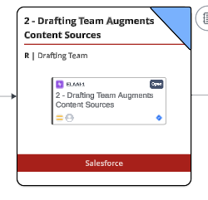
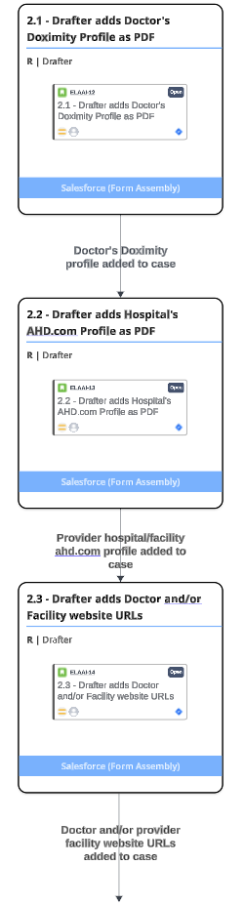
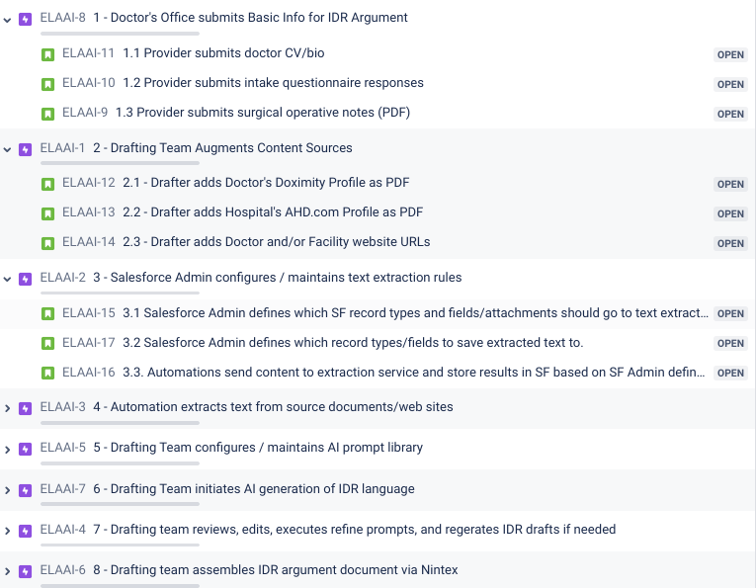
End to End Requirements Traceability

Slide 20
Program Team Roles
Remove the roles that are irrelevant to your project/program
Project Role | Role Description | Touchpoint
Director | Responsible for advising the project team throughout the project lifecycle, conducting periodic solution designs and actively identifying/ processing risks throughout the engagement. Point of escalation for both internal and client teams. | Intermittently
Delivery Manager | Responsible for advising the project team throughout lifecycle, conducting periodic solution designs and actively identifying/ processing risks throughout the engagement. Point of escalation for both internal and client teams. | Weekly
Program Manager | Responsible for overall program of work and ensuring the project team is accountable for budget, burn rate, key milestones, and staffing concurrent work-streams. Keeps client up to date and is a core point of contact throughout the engagement. | Daily-Weekly
Project Manager | Responsible for ensuring the project team is accountable for budget, burn rate, key milestones, and staffing concurrent work-streams. Keeps client up to date and is a core point of contact throughout the engagement. | Daily-Weekly
NetSuite Consultant | Responsible for bringing industry expertise and functional consulting background to engagement. Will be the primary point of contact for the NetSuite core deliverables. | Daily
Salesforce Consultant | Responsible for bringing industry expertise and functional consulting background to engagement. Will be the primary point of contact for the Salesforce core deliverables. | Daily
Business Analyst | Responsible for discovery documentation and artifacts, and maintaining project documentation. | Daily
Technical Architect | Responsible for the overarching technical solution. Will be ensuring that the build, custom development, and integrations are developed with scalability and leading practices in mind. | Intermittently
Integration Developer | Responsible for developing integration process flows, mapping endpoints, and ultimately writing code and pushing all sandbox build to the production instance. | Intermittently
Data Migration Consultant | Responsible for assisting in the migration of data from various source systems | Intermittently
Marketing Consultant | The Marketing Cloud Solutions Consultant is responsible for determining the technical requirements of the project and advanced configuration of the platform | Daily
Marketing Business Analyst | The Marketing Cloud Business Analyst is responsible for capturing functional requirements in stories and configuration of the platform | Daily
UX Design Consultant | Responsible for bringing industry and skilled experience in user experience. Will be responsible for outlining wireframes for layout, navigation, and site architecture. | Intermittently

Slide 21
Our Communication Cadence
Meeting Name | Purpose | Medium | Frequency | Client Audience / Others | Plative Audience
Project status meeting | Review status of Project - Accomplishments, Plans, Risks, Issues, Action Items, Decisions, Burn, Upcoming time away | Google Meet | Weekly 60 Minutes | Client Project Manager | Project Manager
Project status summary | Notes from status meeting and Accomplishments, Plans, Risks, Issues, Action Items, Decisions, Burn, Upcoming time away | Email | Weekly | Client Project Manager Plative Distribution list | Project Manager
Stakeholder check in | Status update, pulse check, alignment | Google Meet | Monthly 60 Minutes | Client Product Owner Client Project Manager (Optional) (Salesforce CSM / Netsuite CSM - if applicable) | Delivery Manager, Client Partner Practice Lead (Optional)
Executive Sponsor check in | Status update, pulse check, alignment | Google Meet | 4-6 weeks 30 Minutes | Client Executive Sponsor(s) | Practice Lead Practice Sales Director VP Services
Salesforce | Netsuite Stakeholder check in | Status update, pulse check, alignment | Google Meet | Montly 30 Minutes | Salesforce AE | Netsuite AE | Client Partner
CEO Sync | Status update, decision making on major topics, change order discussion | Google Meet | Request Monthly Settle for Quarterly | Client CEO / C Level Executive | Plative CEO Delivery Manager helps schedule this

Slide 22
Client Alignment Framework
Meeting | Purpose | Freq. | Plative Participants | Client Participants
Project Status Review | Review progress to plan; red/yellow/green condition and go-to-green plan if needed; align on resolution approach for risks/issues/blockers; review budget burn, forecast & invoice status, and align on change control and key decisions | 30-60 mins Weekly | PM + Lead Consultant | Client Project Lead
Delivery Leader Check-In | Share and receive feedback on project excellence. Ensure alignment on strategic decisions/change control. Elevate risks/concerns and provide leadership support as needed | 30 mins Every 2 wks | Plative Delivery Leader | Client Project Lead + Client Business Lead
Executive Check-in | Executive pulse check to elevate project team feedback in both directions, and provide executive support as needed | 30 mins Every 3-4 wks | Plative Executive Sponsor, Sales Leadership | Client Executive Sponsor(s)
Exec Steering Committee | Review overall progress, showcase what the team has delivered to-date, and align on major decision points, risks and change control | 90 mins Every 6 wks | Plative PM, Delivery Leader, Lead Consultant, Executive Sponsor, Client Partner | Client Project Sponsor + Client Project Lead + Client Executive Leadership
CEO Sync | CEO level check-in on overall sentiment and strategic direction | 30 mins 1-2x per quarter | Plative CEO | Client CEO

Slide 23
Why Plative
Partner with Confidence

Slide 24
Plative By The Numbers
XX
XX
XX

Slide 25






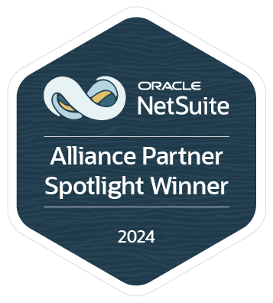














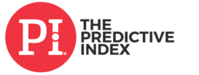




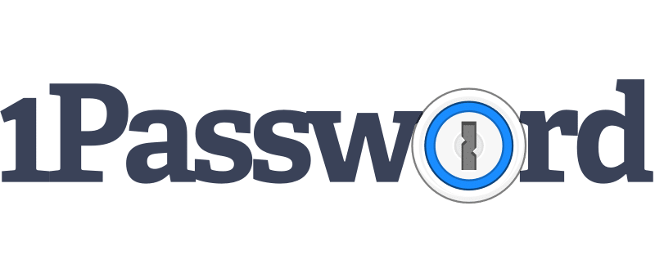


Services
Company Overview
Plative is an AI-first, multidisciplinary consulting firm specializing in CRM, CPQ, ERP, and AI solutions for high tech, manufacturing, and regulated industries.
Zero to Cloud in 60 Days
Advisory and Strategy
Implementation and Optimization
Ongoing Innovation
Expertise
Rewards & Recognition
Core ERP
Revenue Automation
Contract Automation
Sales Tax Automation
eCommerce
CRM
Artificial Intelligence
Commission
Analytics & BI
CPQ & Billing
iPaaS
Database
Select Technology Partnerships
Trusted By The World's Most Disruptive Companies

Slide 26
Services For Every Step In Your Journey
Zero to Cloud in 60 Days
Advisory and Strategy
Implementation and Optimization
Ongoing Innovation
Accelerate time to value.
Envision your future state.
Achieve your future state.
Innovation-as-a-service.
We will apply industry best practices and intellectual property developed over our 2,000 successful implementations to reduce time-to-value while increasing user adoption.
We map our your strategic priorities, align them with metrics that move the needle for your company, then produce an actionable technology roadmap to help you achieve your goals.
We combine industry expertise and a wide array of platform capabilities to deliver cross-cloud solutions that transform organizations.
We act as a strategic extension of your team by mapping out your strategic priorities and managing the technology and development roadmap in a pure agile format.

Slide 27
Investment Summary
Staffing, Allocation, and Commercials

Slide 28
Investment Summary
Statement of Work Deliverables Summary
Functional Area | Hours | Total Cost
Discovery & Design & Documentation | 81 | $18,558
Agentforce Revenue Management Configuration | 331 | $75,836
Account Plan & Partner Margin Modules | 32 | $7,332
CPQ to ARM Data Migration | 242 | $55,445
DocGen & eSign Configuration | 42 | $9,623
Reports & Dashboards | 16 | $3,666
Testing & DevOps | 164 | $37,574
Training & Enablement | 16 | $3,666
Integration Advisory | 24 | $5,499
NetSuite Advisory | 12 | $2,749
Program Management & Oversight | 194 | $44,448
Post Go-Live Support | 40 | $9,164
Project Economics
Total Hours: 1194
Timeline: 18 Weeks + 4 Weeks PGL
Total Cost: $273,560
Post-Project Managed Services
Q1 | Q2 | Q3 | Q4 | Hours | Rate | Total
60 | 60 | 60 | 60 | 240 | $225 | $56,250

Slide 29
Program Allocation
Use for Blended Rates
Q1 Allocation | Q2 Allocation | Q3 Allocation | Q4 Allocation | Total Allocation | Rate | Total Budget
xx | xx | xx | xx | xx | $xyz | $abc,xyz

Slide 30
Rate Card
Rate Card
Resource | Rate | Allocation | Total
Senior Project Manager | $265 | 106 | $28,090
Senior ARM Consultant | $285 | 443 | $126,255
Senior Business Analyst | $175 | 563 | $98,525
Senior Developer | $185 | 34 | $6,290
NetSuite Architect | $300 | 12 | $3,600
Technical Architect | $300 | 36 | $10,800
 | Avg Rate $229.11 | 1194 | $273,560

Slide 31











All Project Infrastructure, One Flat Fee
You gain access to industry-leading tools for the project duration and a library of intellectual property (IP) for unlimited, perpetual use.
Data Accelerators
Project Automation
>$100 per user per month worth of SaaS
Data migration & integration tools that save time
Enterprise-grade, proprietary Jira instance & QA automation.
Visualization Tools
Plative IP Library
Visual documentation & training.
Perpetual access to accelerators.
PLATIVE.COM/OUR-SOLUTIONS
Tens of thousands of dollars worth of SaaS access, innovative IP, one transparent fee:
$230,000
3%
$6,900
Replace with your deal’s numbers.
Project Total (Services)
Project Infrastructure Fee
Includes:
• All third party SaaS
• Accelerators for all data work
• Perpetual license for all IP deployed

Slide 32
Mutual Success Plan
Milestone | Target Date | Completed | Owner
Initial Discussion | 10/31 | Yes | Owner
Scoping Calls | 11/7 - 11/11 | Yes | Owner
Proposal Dry Run | 11/21 | Yes | Owner
Plative Sends MSA | 11/21 | Yes | Owner
Proposal Presentation | 12/2 | Yes | Owner
Feedback Due | 12/10 | No | Owner
Contracts & MSA Signed | 12/19 | No | Owner
Project Ramp | 1/5 | No | Owner
Project Kickoff | 1/19 | No | Owner

Slide 33
Mutual Success Plan

Slide 34


