Slide 1
Seattle Collisions severity recogition using Machine Learning

Slide 2
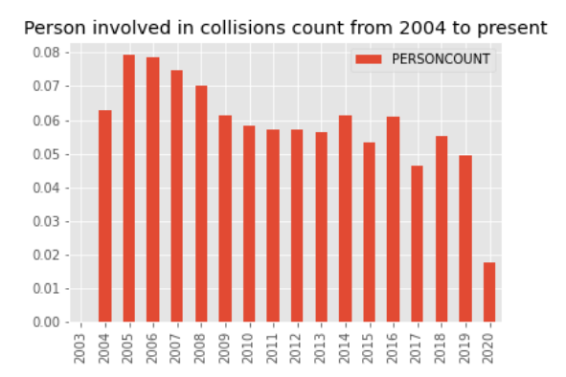
Data exploratory analysis
Incidents have decreased over the years

Slide 3
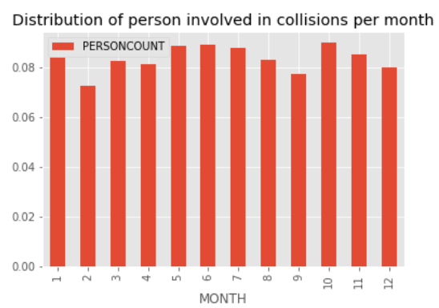
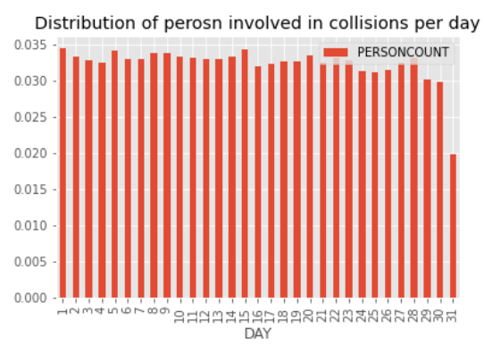
Data exploratory analysis
There is no prefered month of day
February and September have the least number of incidents

Slide 4
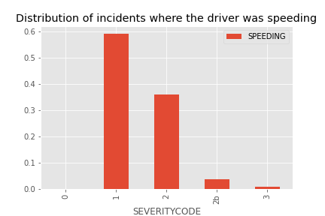
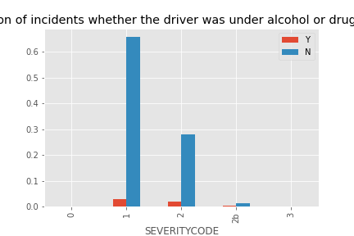
Data exploratory analysis: Driver-Pedestrian

Slide 5
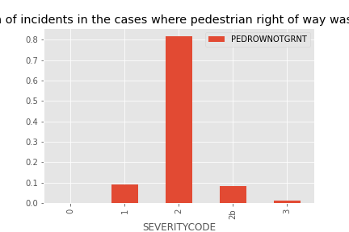
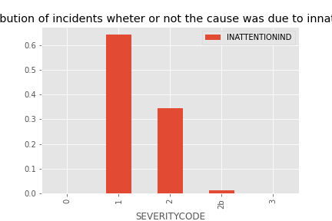
Data exploratory analysis: Driver-Pedestrian

Slide 6
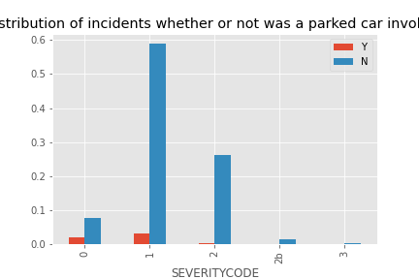
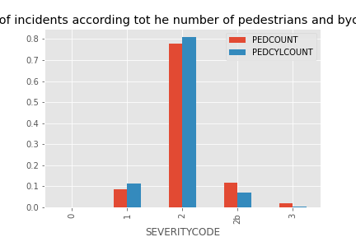
Data exploratory analysis: Driver-Pedestrian

Slide 7
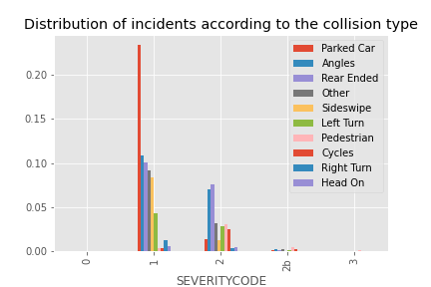
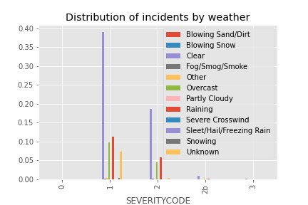
Data exploratory analysis: Environment

Slide 8
Data exploratory analysis: Environment
There is a small fatalitie percentage
Most accidents implies property damage
Just a small percetage involves serious injuries althogh the injuries percentage is quite elevated.

Slide 9
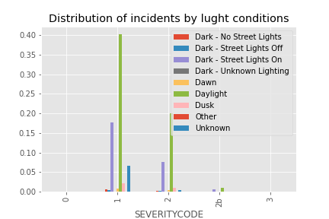
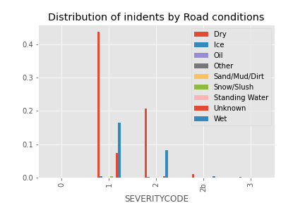
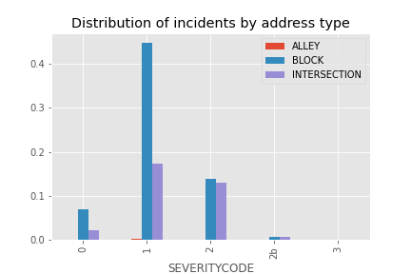
Data exploratory analysis: Environment

Slide 10
Data exploratory analysis: Environment
IT IS ALL ABOUT DRIVER RESPONSIBILITY!!

Slide 11
Modeling
Decision tree algorithm was accurate
Other algorithms take high computing times

Slide 12
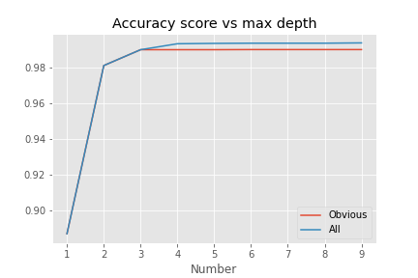
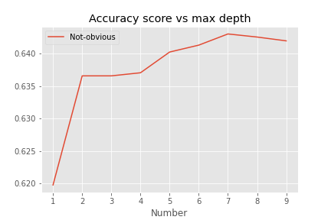
Modeling: Numerical Attributes

Slide 13
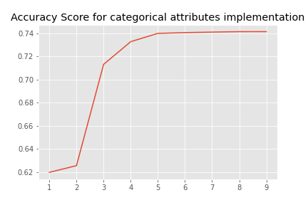
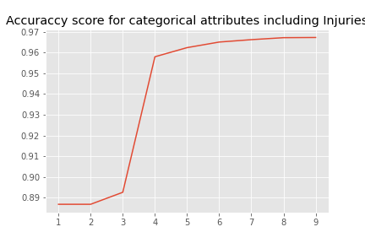
Modeling: Categorical Attributes
Including injuries highly improve accuracy!

Slide 14
Conclusions
Incidents have decreased over the years
There is no prefered month of day
February and September have the least number of incidents
There is a small fatalitie percentage
Most accidents implies property damage
Just a small percetage involves serious injuries althogh the injuries percentage is quite elevated.
Most collisions occurs in good environmental conditions, so they are a result of a lack of responsibility
Decision tree algorithm was accurate
One can either model with numerical or categorical attributes with high accuracies.
Modeling with attributes improves its accuracy by including injuries rather than fatalities
A tree depth between 5 and 7 is optimal

