Slide 1
CPO OE Droid RAZR
Production Request
Job # | 270VZWM161 – BANNERS and MOBILE 270VZWM169 – BANNER FARM 270VZWM245 – BILINGUAL BANNERS
Client | Verizon Wireless – Value (Gordon N.)
Creation Date | 7/11
Due Date | Updated HPs due 7/12 by NOON EST.
Launch Date | 7/16
PM | Kyle / Jillian / Andrea
Creative Lead | Katie/Josh

Slide 2
HPP’s BuildOut
Hpp’s BO
SOURCE FILES:
\\Filer-atl1-mox\verizonwireless_2012\root\all_data_located_here\2012_HQ_Value\Projects\0712 - 7.23 CPO OE $99 Droid Razr\Creative So
ASSETS:
Device:
\\Filer-atl1-mox\verizonwireless_2012\root\all_data_located_here\2012_HQ_Value\Projects\0712 - 7.23 CPO OE $99 Droid Razr\Creative So
Fonts:
\\Filer-atl1-mox\verizonwireless_2012\root\all_data_located_here\2012_HQ_Value\Projects\0712 - 7.23 CPO OE $99 Droid Razr\Creative So
REFERENCE:
\\Filer-atl1-mox\verizonwireless_2012\root\all_data_located_here\2012_HQ_Value\Projects\0712 - 7.23 CPO OE $99 Droid Razr\Creative Source
PUT NEW FILES HERE:
\\Filer-atl1-mox\verizonwireless_2012\root\all_data_located_here\2012_HQ_Value\Projects\0712 - 7.23 CPO OE $99 Droid Razr\Creative Source

Slide 3
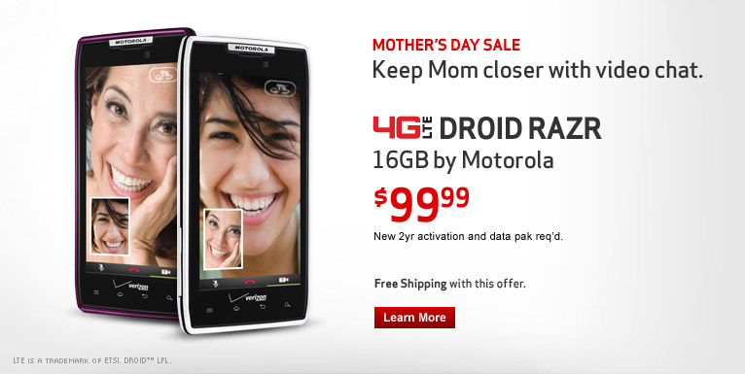
Instructions
Hpp’s BO
Replace the Mother’s Day headline and subhead with
CERTIFIED PRE-OWNED
Online Exclusive
Make sure the UI screens have the Droid Eye (\\Filer-atl1-mox\verizonwireless\root\all_data_located_here\PHONES-MASTER (do not delete)\Motorola RAZR)
Device legal should read: NEW 2YR ACTIVATION REQ’D.
Free Shipping line should only read: Free Shipping.
Please also add the CPO seal (we are still waiting on the updated version) around the devices
Please have the devices on the right-hand side and the copy on the left-hand side

Slide 4
Naming Convention
Hpp’s BO
Personal HP Assets:
cpodroidrazr_120723.jpg/psd 766x385 size
personal_cpodroidrazr_backup.jpg/psd 766x466 size
My Verizon HP Assets:
cpodroidrazr_120723.jpg/psd 766x385 size
myaccount_cpodroidrazr_backup.jpg/psd 766x466 size
Tab Image:
cpodroidrazr_120723_tab.jpg 52x66
Comments
* Please make sure PSDs are as small as possible.
* JPGs up to 60K

Slide 5
Banner’s Build Out
Banner’s BO
SOURCE FILES:
\\Filer-atl1-mox\verizonwireless_2012\root\all_data_located_here\2012_HQ_Value\Projects\0712 - 7.23 CPO OE $99 Droid Razr\Creative So
ASSETS:
Device:
\\Filer-atl1-mox\verizonwireless_2012\root\all_data_located_here\2012_HQ_Value\Projects\0712 - 7.23 CPO OE $99 Droid Razr\Creative So
Fonts:
\\Filer-atl1-mox\verizonwireless_2012\root\all_data_located_here\2012_HQ_Value\Projects\0712 - 7.23 CPO OE $99 Droid Razr\Creative So
REFERENCE:
\\Filer-atl1-mox\verizonwireless_2012\root\all_data_located_here\2012_HQ_Value\Projects\0712 - 7.23 CPO OE $99 Droid Razr\Creative Source
PUT NEW FILES HERE:
\\Filer-atl1-mox\verizonwireless_2012\root\all_data_located_here\2012_HQ_Value\Projects\0712 - 7.23 CPO OE $99 Droid Razr\Creative Source

Slide 6
Instructions
Banner’s BO
Here you can put all the requirements for the build out….

Slide 7
Naming Convention
Banner’s BO
English : 300X250_VZW_AQ_FREE-RHYME_OMNI-CHANNEL_RHYME_FREE_7112
Bilingual : 300X250_VZW_MU_FREE-RHYME_OMNI-CHANNEL_RHYME_FREE_7112
Specs
Ad Size | JPG File Size (k) | Flash File Size | Flash Type | Looping Requirements | File Type
728x90 | 20 | 35 | Flash 8 | 15 sec max. | .swf / .jpg backup
160x600 | 20 | 35 | Flash 8 | 15 sec max. | .swf / .jpg backup
300x250 | 20 | 35 | Flash 8 | 15 sec max. | .swf / .jpg backup
Comments
* This is an example of where you can put your comments..
* This is a important requeriment, please …. Use …. This … add …

Slide 8
Static’s BuildOut
Static’s BO
SOURCE FILES:
\\Filer-atl1-mox\verizonwireless_2012\root\all_data_located_here\2012_HQ_Value\Projects\0712 - 7.23 CPO OE $99 Droid Razr\Creative So
ASSETS:
Device:
\\Filer-atl1-mox\verizonwireless_2012\root\all_data_located_here\2012_HQ_Value\Projects\0712 - 7.23 CPO OE $99 Droid Razr\Creative So
Fonts:
\\Filer-atl1-mox\verizonwireless_2012\root\all_data_located_here\2012_HQ_Value\Projects\0712 - 7.23 CPO OE $99 Droid Razr\Creative So
REFERENCE:
\\Filer-atl1-mox\verizonwireless_2012\root\all_data_located_here\2012_HQ_Value\Projects\0712 - 7.23 CPO OE $99 Droid Razr\Creative Source
PUT NEW FILES HERE:
\\Filer-atl1-mox\verizonwireless_2012\root\all_data_located_here\2012_HQ_Value\Projects\0712 - 7.23 CPO OE $99 Droid Razr\Creative Source

Slide 9
Instructions
Static’s BO
Here’s where you can put all the requirements for the build out….

Slide 10
Naming Convention
Static’s BO
Banner Farm JPGs: fp_size.jpg
Specs
Ad Size | Gif File Size (k) | Flash File Size | File Type
120x90 | 7 | N/A | .jpg only
88x31 (logo only) | 7 | N/A | .jpg only
125x125 | 7 | N/A | .jpg only
120x60 | 7 | N/A | .jpg only
234x60 | 20 | N/A | .jpg only
728x90 | 20 | N/A | .jpg only
160x600 | 20 | N/A | .jpg only
300x250 | 20 | N/A | .jpg only
350x350 | 40 | N/A | .jpg only
Comments
* This is an example of where you can put your comments..
* This is a important requirement, please …. Use …. This … add …

Slide 11
General Notes.
Do not leave old instructions that do not apply to the new requirement.
Use the correct path for each thing.
Have the name of the ticket same with the name of the PR.
In the first slide remove PD and put PM and there is where we should put the name of each person who’s in charge of that PR.
Explanation of the Path’s:
Assets: Is this material we need to build out.
Reference: Is where we can see other banner’s to get an reference of it.
SOURCE FILES: Is where we can take the banner to build out the others.
PUT NEW FILES: Is where we will put the new build out

