Slide 1
Of Frogs and Fungi
A Transcriptome Project on Batrachochytrium dendrobatidis
Jose Sanchez

Slide 2
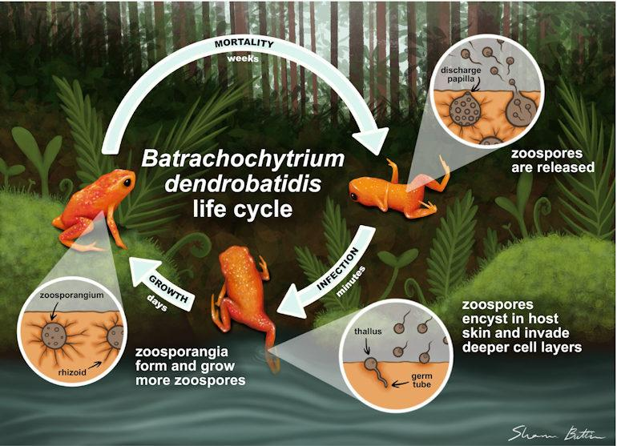

Introduction
B. dendrobatidis (Bd)
Causes chytridiomycosis (skin disease, leads to death)
Affects amphibians (500 spp. declined, 90 extinctions)^{1,2}
Degrades keratin layer in skin => disrupts skin function
Reproductive structures:
Sporangia: Where spores are formed
Zoospore: Flagellated fungal units of reproduction
Image from American Society for Microbiology¹

Slide 3

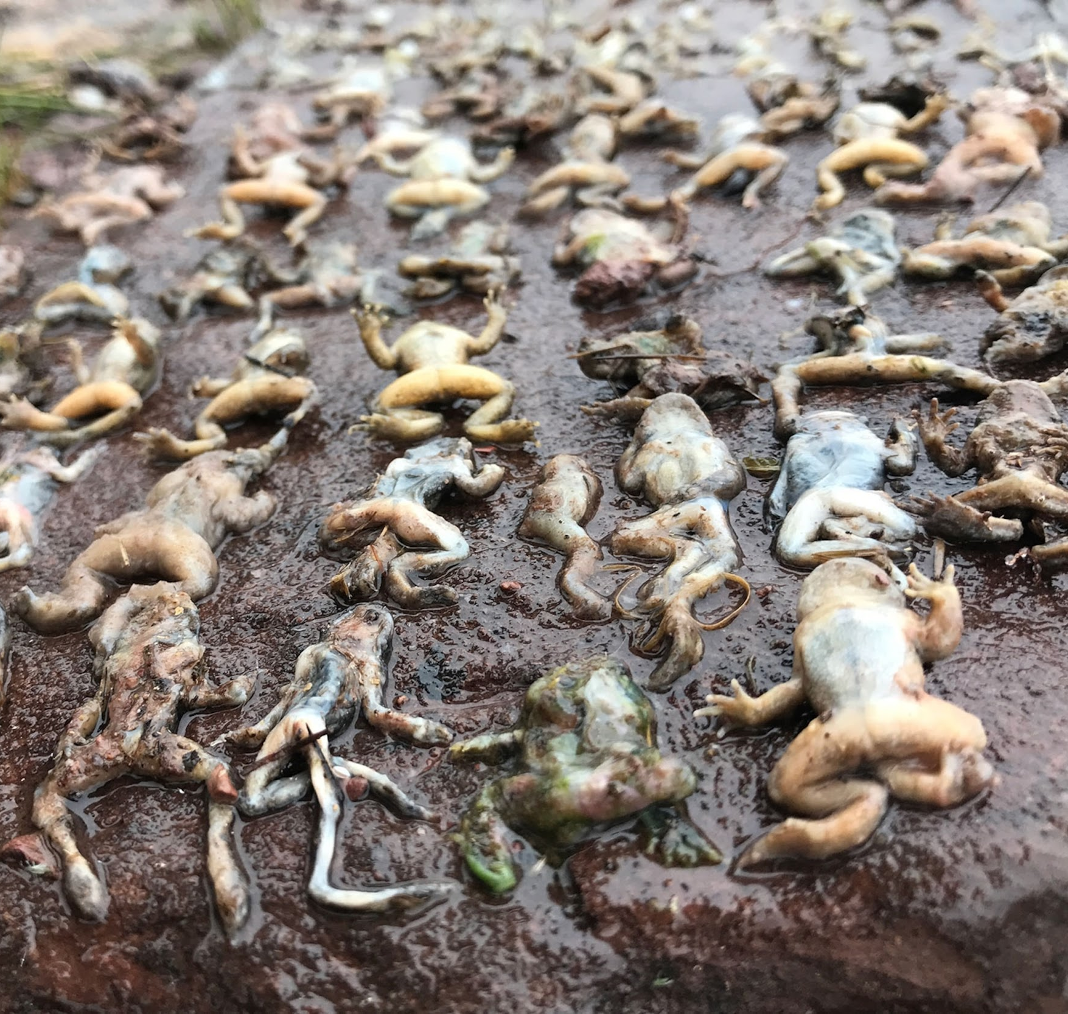


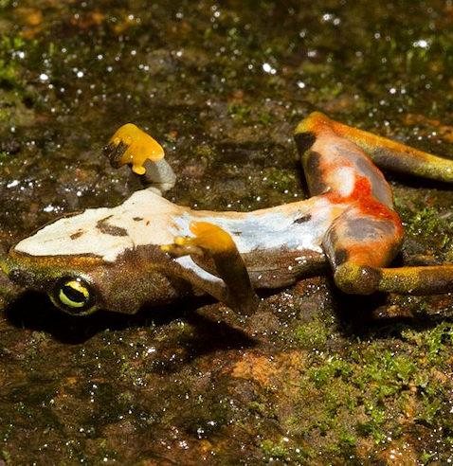

Purpose
Perform a transcriptome analysis to visualize gene expression.
(Provide insight into potential virulence factors.)

Slide 4

Methods
General Workflow ( usegalaxy.eu):
Falco => Fastp => HISAT2 => StringTie => StringTie Merge => featureCounts => (1) DESeq2 => Filter => Volcano Plot => Join Two Datasets => Cut => (2) Heatmap2 => Filter => Cut => Convert => Replace Text => Cut => (3) Join Two Datasets
(1): Takes the replicates of the two different conditions and compares them. Used to determine relative changes in gene expression.
(2): Visualizes the expression of a gene using a color gradient.
(3): Combined separate datasets to have comprehensive list of ID, function, and gene statistics.

Slide 5
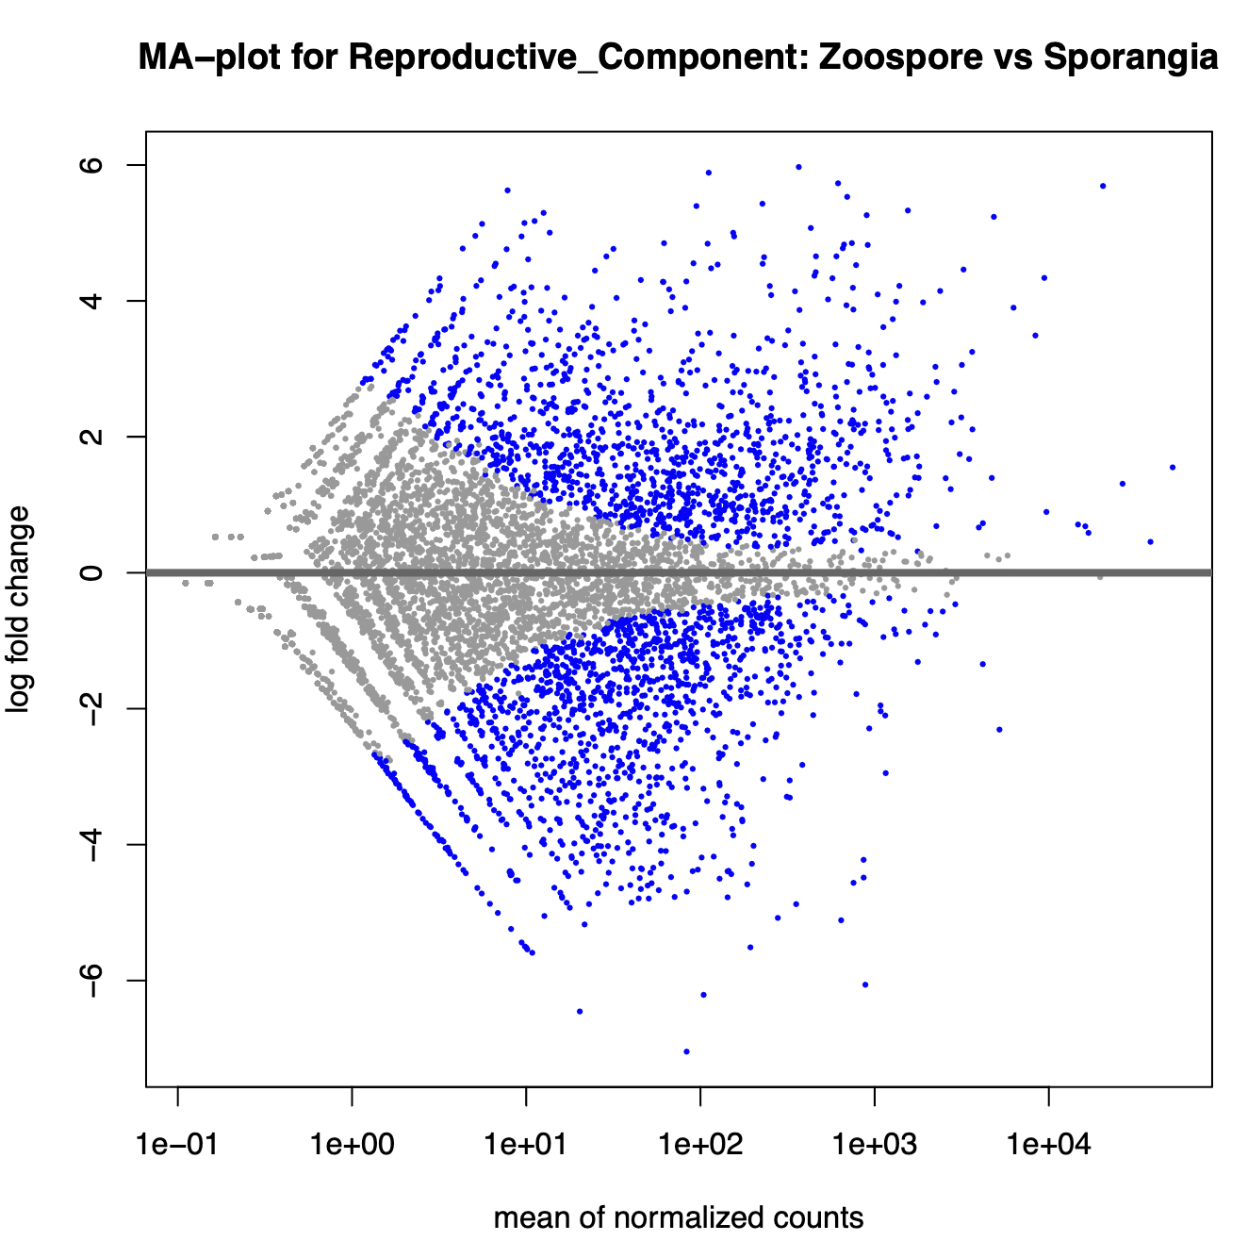
Results (DESeq2)
Up-regulated in Zoospore = +log fold change; Up-regulated in Sporangia = -log fold change
Blue = significant difference in expression
Confirms certain gene expression levels vary in different reproductive structures.

Slide 6
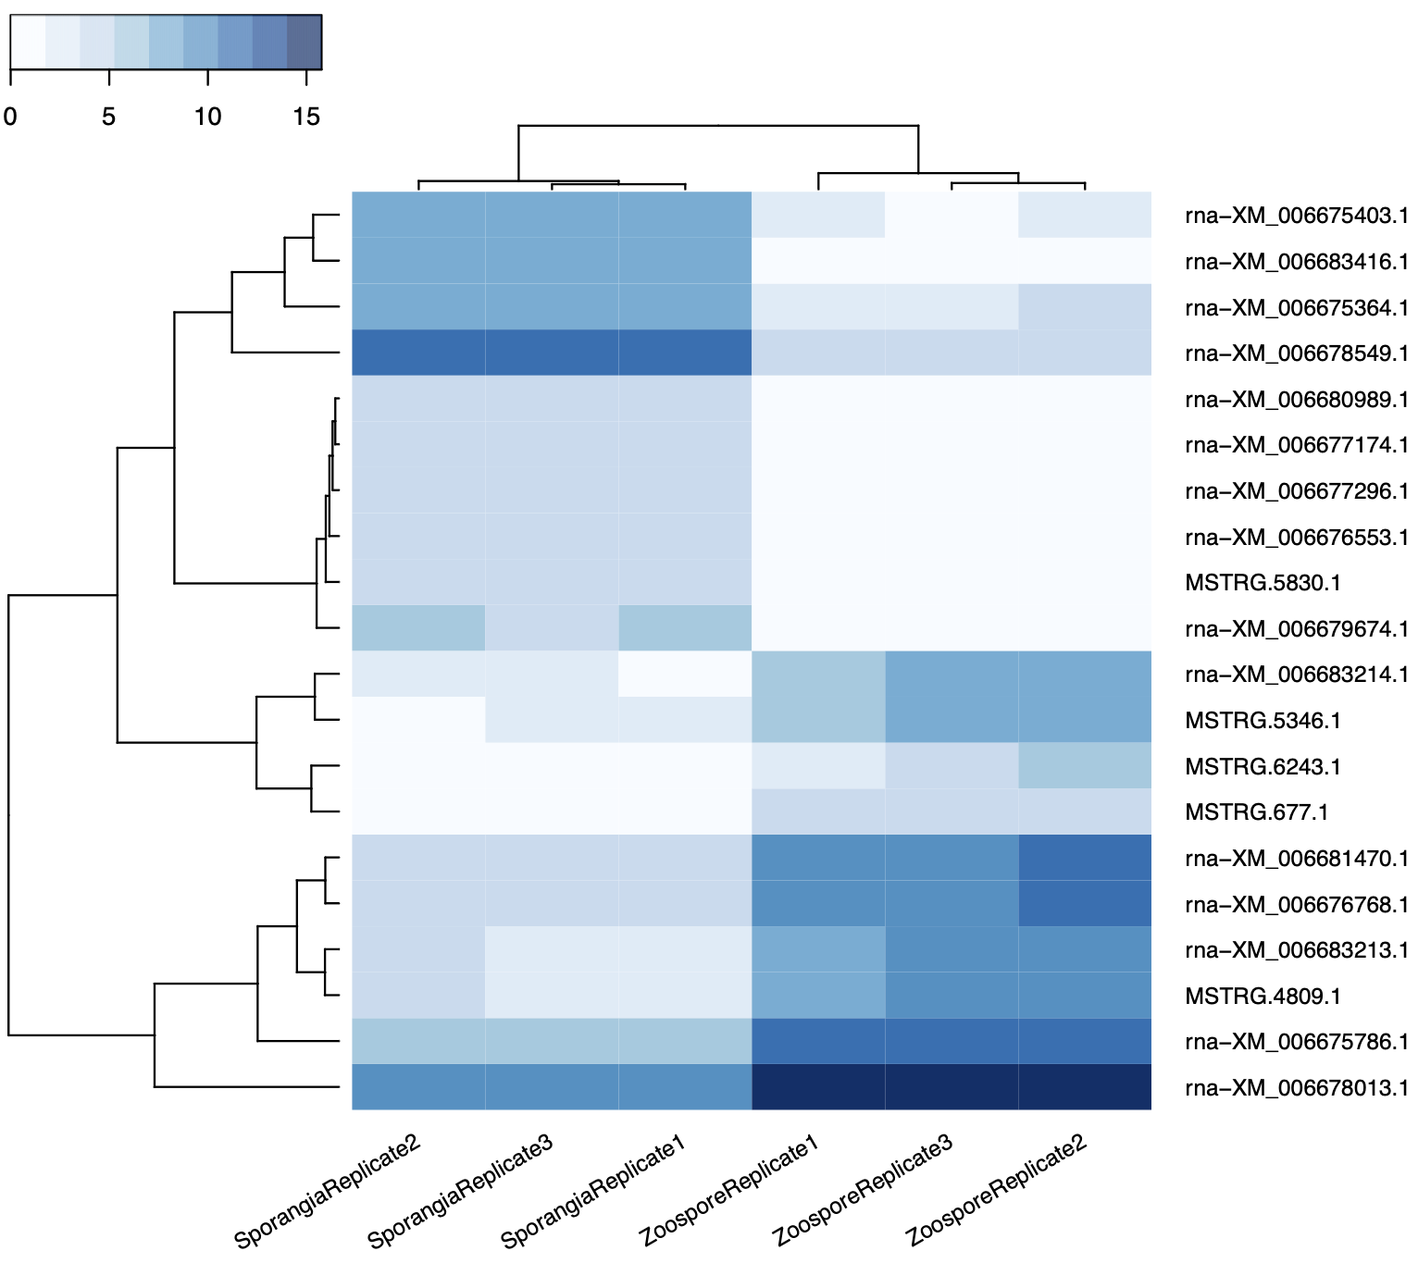
Results (Heatmap2)
Visualizes the expression of a gene for each replicate
Darker blue = greater expression of gene
Light blue/white = little to no expression
Similar expression levels among the replicates
Noticable differences among different conditions
Differences in expression are potential subjects in later analysis

Slide 7
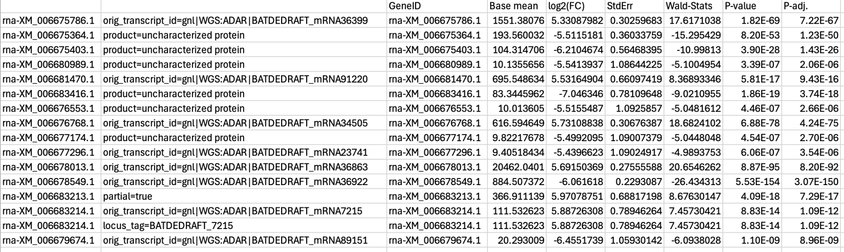
Results (Join Two Datasets)
Final table: Gene products and statistics for top 10 genes
Some uncharacterized proteins
Others had an unknown function (purpose not identified in NCBI database)
Currently uncharacterized => future research for ID and analysis?

Slide 8
Thank You!
References
Hockman, Megan. “Skin Deep: How Bd and Bsal Fungi Threaten Amphibian Health.” ASM.Org, American Society for Microbiology, 2025, asm.org/magazine/2025/fall/skin-deep-how-bd-and-bsal-fungi-threaten-amphibian.
Greshko, Michael. “Ground Zero of Amphibian ‘Apocalypse’ Finally Found.” National Geographic, 10 May 2018, www.nationalgeographic.com/animals/article/amphibians-decline-frogs-chytrid-fungi-bd-animals-science.

