Slide 1

CS 422: UI Design and Programming
Graphic Design
Notes:
HCI is the study of how people uses computer technologies and in turn how we can design user-friendly computer technologies. HCI drives innovation at the intersection of people and computers

Slide 2
Housekeeping
GR3 is due on 3/7. Rubric and examples will be posted on Piazza.
You should already be working on PS2.
Expect PS1 grades by March 6.
Lots of issues with team members. From GR3 onwards, 10% of your grade will be awarded by your peers—anonymously—via peer reviews. Details will be posted on Piazza.
Graduate students: Note upcoming assignments.
Let’s briefly review GR3.

Slide 3
Where are we?
Basics of Usability
Learnability
Efficiency
Safety
UI Prototyping
UI Software Architecture
Input
Output
Basics of Visual Design
Graphic Design
Layout
Color
Typography
Advance topics on usability
Learnability
Efficiency
Safety

Slide 4
Graphic Design

Slide 5
Why should software engineers have to learn this stuff at all?
In a commercial environment, you should hire experienced graphic designers.
One reason this course is useful is that you can appreciate what UI experts do and evaluate their work, which will help you work on a team with them (or supervise them).
It’s also worth learning these principles because you can apply them yourself on smaller-scale problems.
Finally, you should know when to leave it to the experts, but you should be able to do a creditable job yourself too, when the job is yours to do.

Slide 6
Today we’ll learn the following:
Simplicity
Contrast
Grouping and Hierarchy
Balance and Symmetry
Alignment and Grids

Slide 7
Simplicity
“Perfection is achieved not when there is nothing more to add, but when there is nothing left to take away.”
Designing for simplicity is a process of elimination, not accretion.
Simplicity is in constant tension with other design guidelines that might otherwise encourage you to pile more and more elements into a design, “just in case.”
Simplicity forces you to have a good reason for everything you add, and to take away anything that can’t survive hard scrutiny.

Slide 8
Simplicity in interface as well as interaction design
The value of simplicity to user interface design is much broader than graphic design.
Keeping the interaction design simple, with as few parts and pieces as you can, tends to improve a design on all our usability dimensions: learnability, efficiency, and safety.

Slide 9
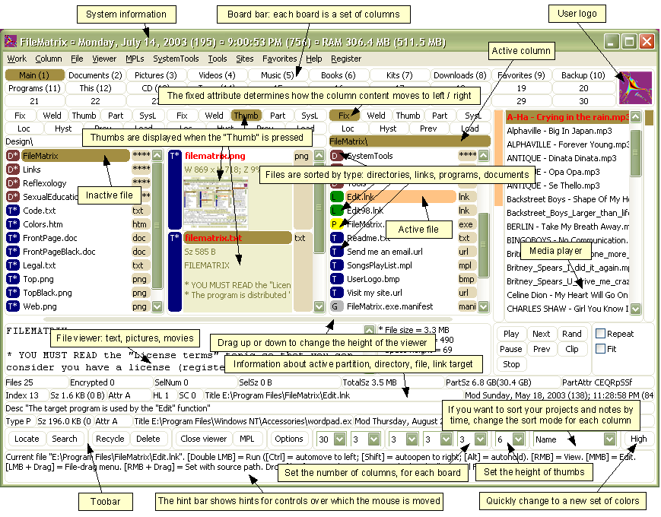
Notes:
Here’s a counterexample to illustrate. This is a program called FileMatrix.
I have no idea what it does, but it seems to do it all. The complexity of this interface actually interferes with a lot of our usability goals: it’s less learnable (because there are so many things you have to learn), less efficient (because cramming all the functions into the window means that each button is tiny), and less safe (because so many things look alike, hence description slips are easy).
Incidentally, this may be a good example of designing for yourself, rather than for others. The programmer who wrote this probably understands it completely, and maybe even uses a significant fraction of those features; but few other users will need that much, and it will just interfere with their ability to use it.

Slide 10

Example

Slide 11
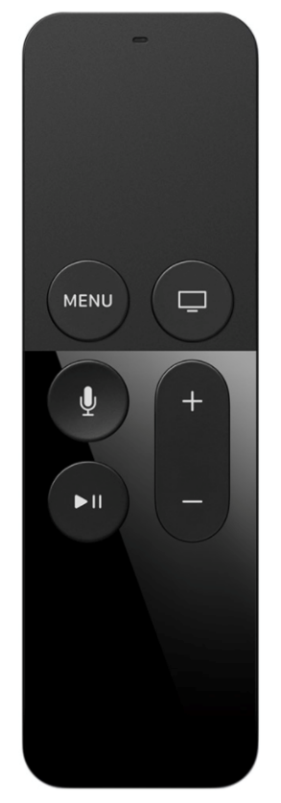
How to achieve simplicity?
Reduction:
Remove inessential elements
Remove inessential features
Even if it seems essential, try removing it anyway, to see if the design falls apart.
We’re focusing on graphic design today (visual appearance here), but you can generalize these rules easily to other aspects of a design
Examples: The Google home page or Apple TV remote.

Slide 12
How to achieve simplicity?
Regularity: For the essential elements that remain, consider how you can minimize the unnecessary differences between them with regularity.
Use the same font, color, line width, dimensions, orientation for multiple elements.
Irregularities in your design will be magnified in the user’s eyes and assigned meaning and significance.
Use a regular pattern
Limit inessential variation among elements

Slide 13
How to achieve simplicity?
Double-Duty: Try to combine elements to make them serve multiple roles in the design.
Desktop and web interfaces have a number of patterns in which elements have multiple duties.
For example, a window’s title bar plays several roles: label, dragging handle, window activation indicator, and location for window control buttons.

Slide 14
How to achieve simplicity?
Reduction
Regularity
Double-duty

Slide 15
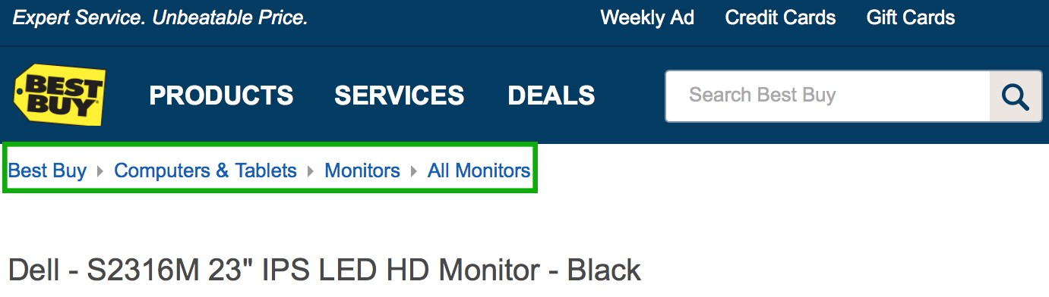
Breadcrumbs pattern creates simplicity via (choose most appropriate)
Double-duty
Regularity
Reduction
Safety

Slide 16
Breadcrumbs pattern creates simplicity via (choose most appropriate)
Double-duty
Regularity
Reduction
Safety

Slide 17


Breadcrumbs and Pagination
The breadcrumbs pattern and the pagination pattern also do double duty, not only showing you where you are but also providing an affordance for navigating somewhere else.
Pagination links, like a scrollbar, may also show you how many pages there are.

Slide 18
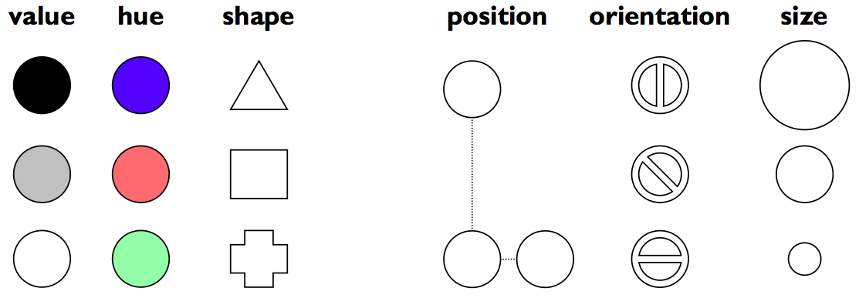
Contrast | visual variables
Contrast encodes information along visual dimensions.
Simplicity says we should eliminate unimportant differences.
Once we’ve decided that a difference is important, however, we should choose the dimension and degree of contrast in such a way that the difference is salient, easily perceptible, and appropriate to the task.
Hue is pure color; value is the brightness or luminance of color.

Slide 19
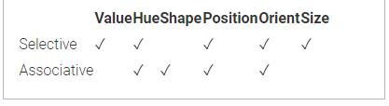
Selectivity & Associativity
Selective perception
Can attention be focused on one level of the variable, excluding other variables and levels?
Shape doesn’t “pop out”
Associative perception
Can variable be ignored while looking at other variables?
Small size and low value interfere with ability to perceive hue, value, and shape
Notes:
Selectivity is the degree to which a single level of the variable can be selected from the entire visual field. Most variables are selective: e.g., you can locate green objects at a glance, or tiny objects. Shape, however, is not selective in general. It’s hard to pick out triangles amidst a sea of rectangles.
Associativity refers to how easy it is to ignore the variable, letting all of the distinctions along that dimension disappear. Variables with poor associativity interfere with the perception of other visual dimensions. In particular, size and value are dissociative, since tiny or faint objects are hard to make out.

Slide 20
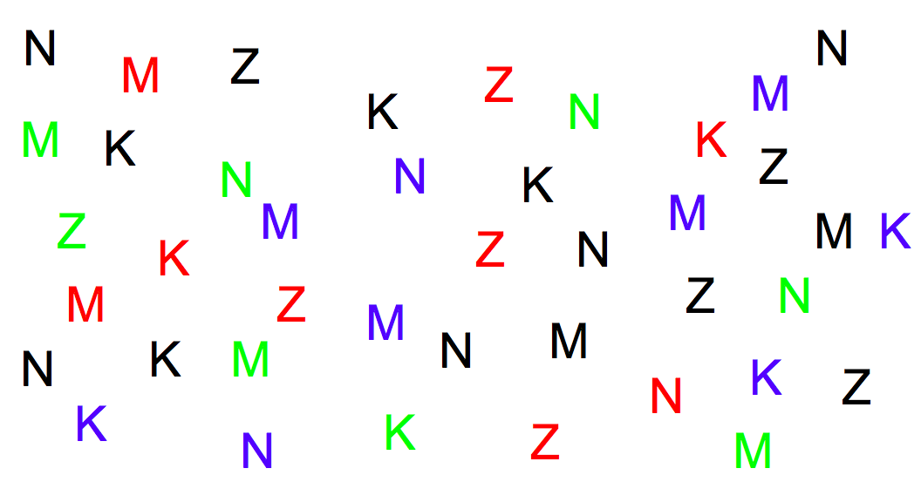
Try this:
find all the letters on the right edge of the page (position)
find all the red letters (hue)
find all the K’s (shape)

Slide 21
Which felt easy, which felt hard?
find all the letters on the right edge of the page (position)
find all the red letters (hue)
find all the K’s (shape)
The easy ones are
selective visual variables.

Slide 22
Techniques for Contrast
Choose appropriate visual variables
Use as much range as possible
Sharpen distinctions for easier perception
Multiplicative scaling, not additive
Redundant coding where needed
The title of a document is not only larger (size), but it’s also centered (position), bold (value), and maybe a distinct color as well.
Cartoonish exaggeration where needed
Use the “squint test”
Notes:
Range or the length of a variable is the number of distinguishable levels that can be perceived. We can recognize a nearly infinite variety of shapes, so the shape variable is very long, but purely nominal. Position is also long, and particularly fine-grained. Orientation, by contrast, is very short; only a handful of different orientations can be perceived in a display before confusion starts to set in. The other variables lie somewhere in between, with roughly 10 useful levels of distinction, although size and hue are somewhat longer than value.

Slide 23


Slide 24
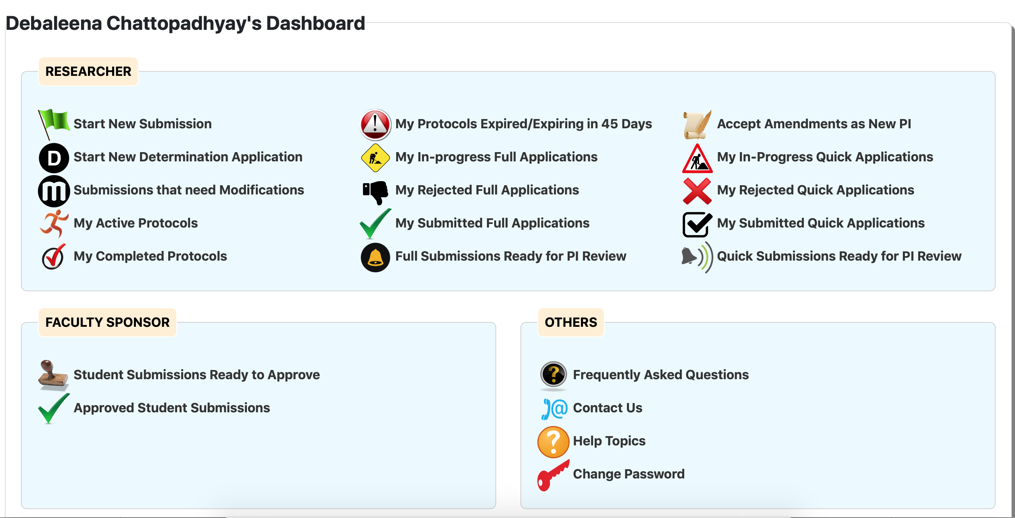
A UI where researchers submit research proposals with human subjects. Proposals are either approved, recommended revision, or rejected.
This is the landing page

Slide 25
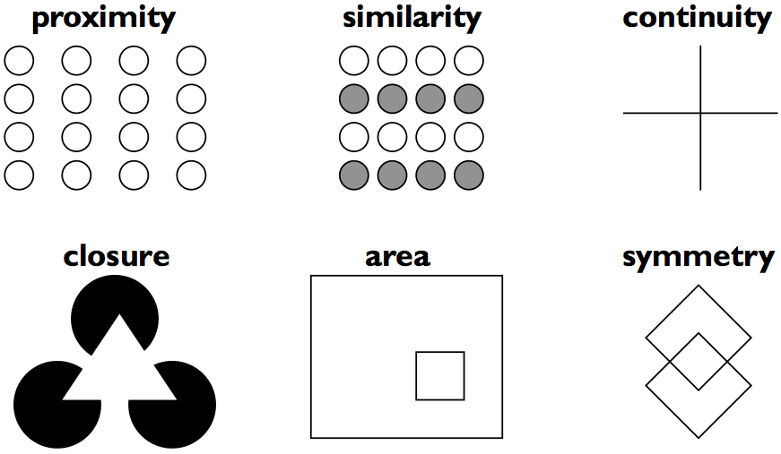
Grouping and Hierarchy
The Gestalt Principles of Grouping
Gestalt principles explain how the eye creates a whole (
gestalt
) from parts

Slide 26
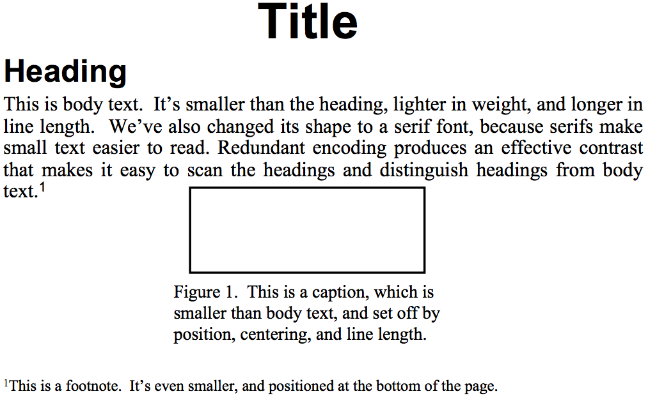
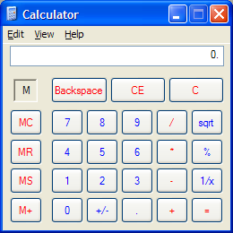
Grouping and Hierarchy
Use Gestalt principles to visually group related items.
Establish a hierarchy of importance among items in the design

Slide 27
Balance & Symmetry
Whitespace:
Use white space for grouping, instead of lines
Use margins to draw eye around design
Integrate figure and ground
Object should be scaled proportionally to its background
Don’t crowd controls together
Crowding creates spatial tension and inhibits scanning

Slide 28
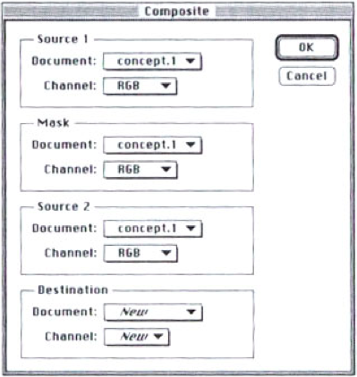
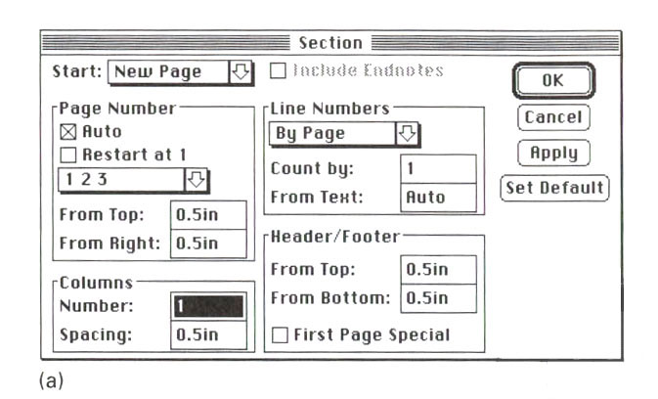
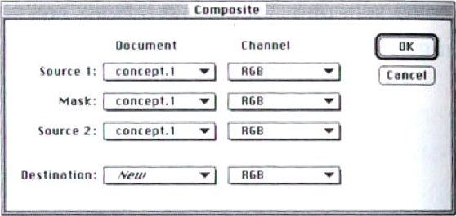

Slide 29
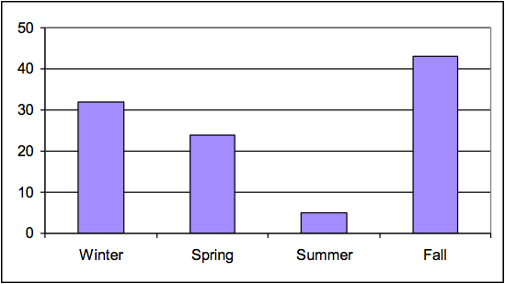
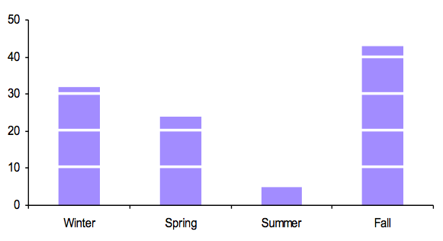
White Space Avoids Visual Noise

Slide 30
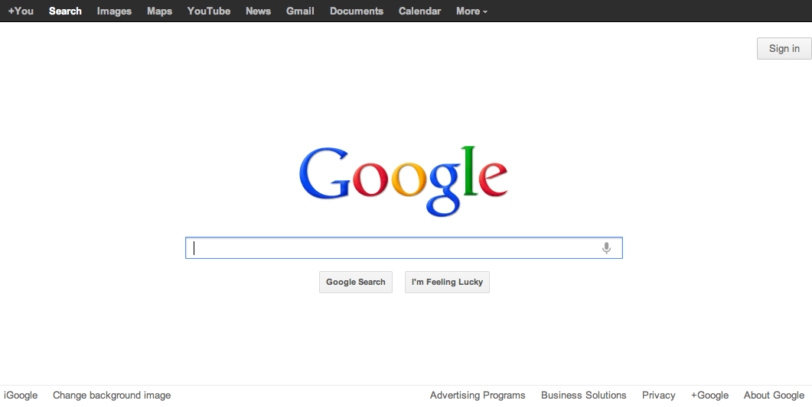
Balance & Symmetry
Choose an axis (usually vertical)
Distribute elements equally around the axis
Equalize both mass and extent

Slide 31
Alignment and Grids
Align labels on left or right
Align controls on left and right
Expand as needed
Align text baselines

Slide 32
Labels
There are two schools of thought about label alignment:
one school says that the left edges of labels should be aligned, and
the other school says that their right edges (i.e., the colon following each label) should be aligned.
Both approaches work
Both approaches also fail when long labels and short labels are used in the same display.
You’ll get best results if you can make all your labels about the same size, or else break long labels into multiple lines.

Slide 33
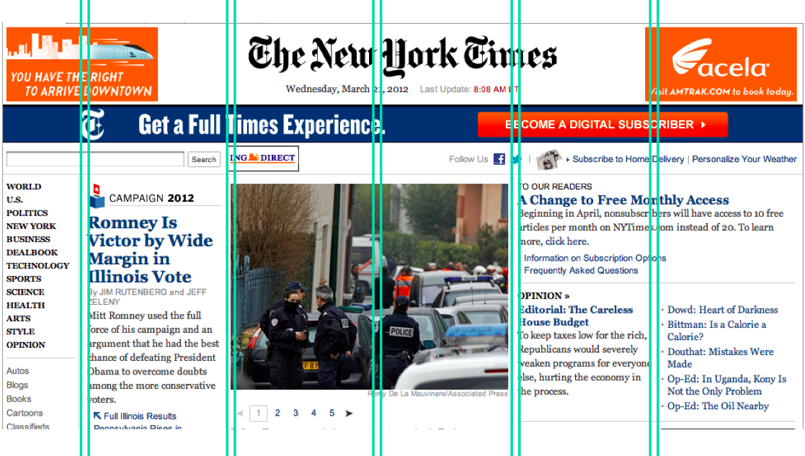
Grid-Based Design
A grid is one effective way to achieve both alignment and balance, nearly automatically.
A grid means that you divide the user interface into equal-width columns
separated by gaps, and with margins on both sides of the window
align content and controls on the column boundaries.
Some elements may span multiple columns, but they align (start or end at) column boundaries

Slide 34
What technology did we learn in last weeks that can help us achieve a grid-based design?
HTML
Bootstrap
JavaScript
Safety

Slide 35

What technology did we learn in last weeks that can help us achieve a grid-based design?
HTML
Bootstrap
JavaScript
Safety

Slide 36
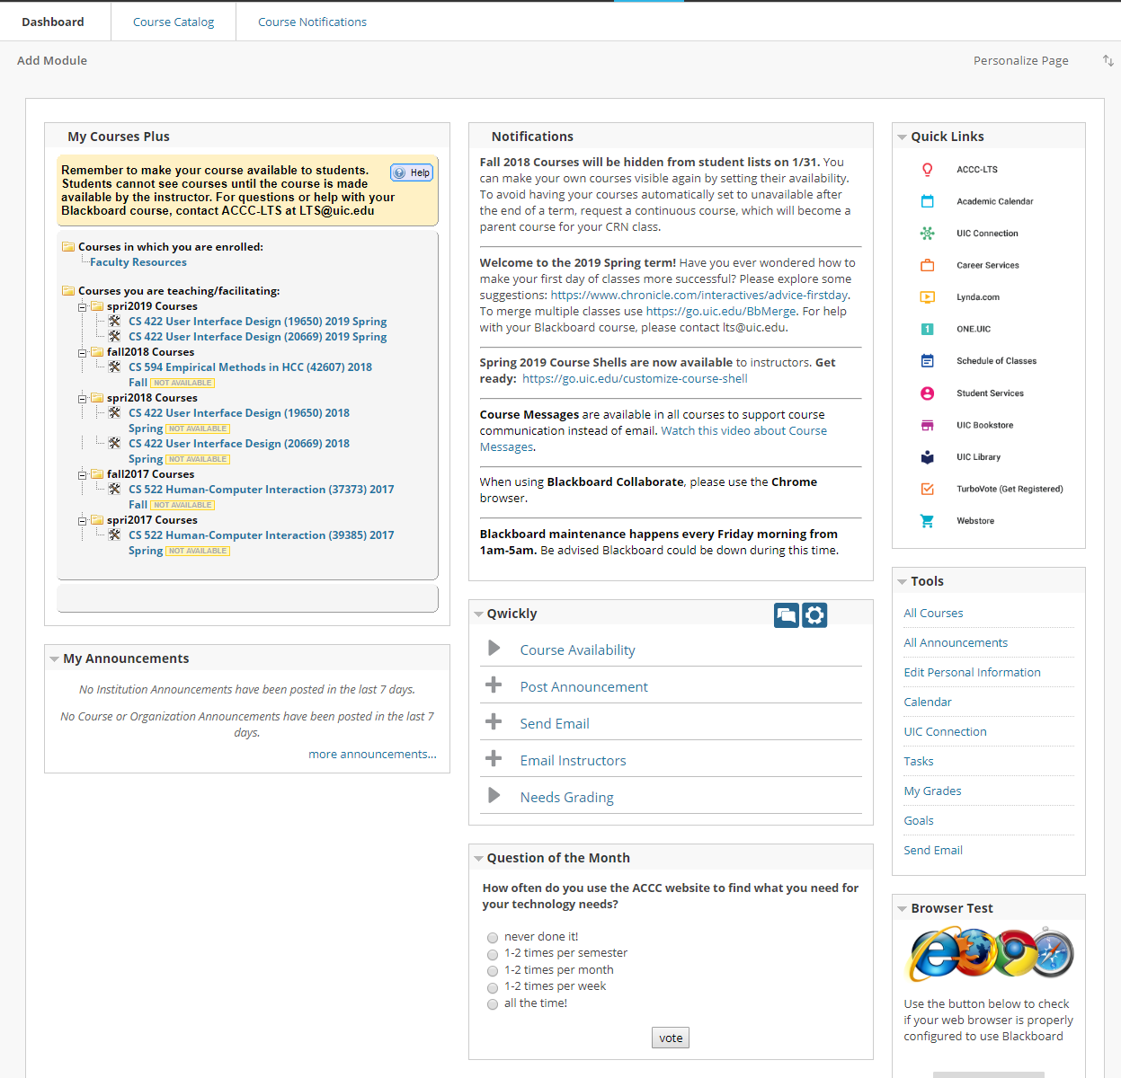
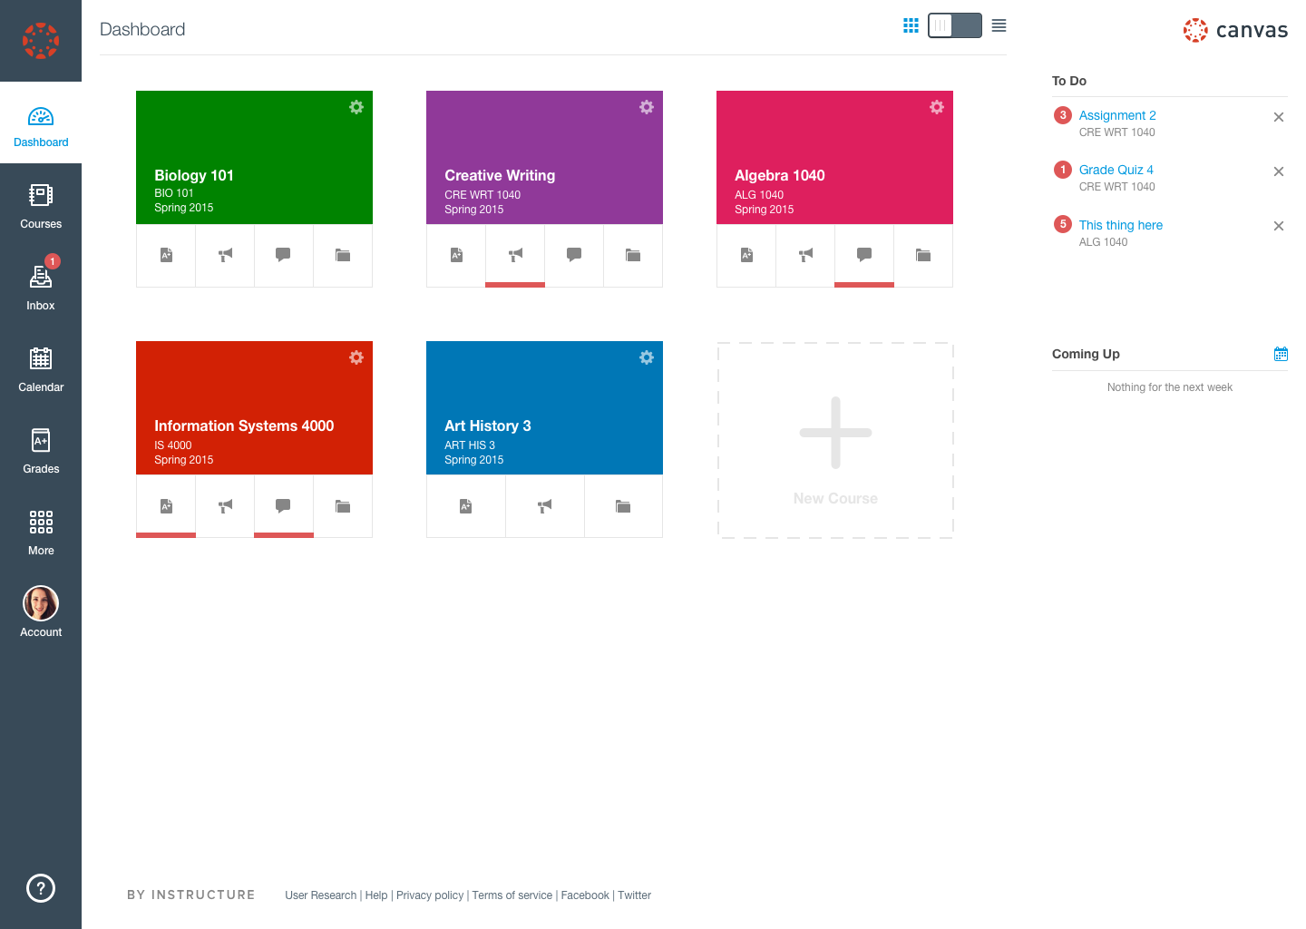
Canvas
Blackboard

Slide 37

Next class
User Testing

