Slide 1

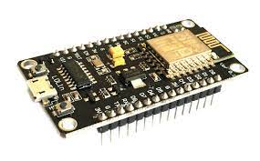

VM Admosis
VM Admosis
Broker
(Mosquitto)
TCP : 8080
Django web
project
MCU V3
topic
topic
App
temperature/<<location>>/<<login>>
topic
TCP : 8080
moisture/<<location>>/<<login>>
topic
MCU V3
topic
subscriber
topic
MCU V3
http : 8081

Slide 2

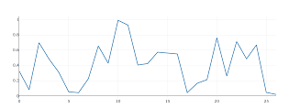
Monitoring App
Realtime data
Historic data
Temperature
Location:
User:
Moisture
Location:
User:

Slide 3
Monitoring App
Realtime data
Historic data
Temperature
Location:
Moisture
Location:
Download txt

