Slide 1
UE24CS352A · MACHINE LEARNING MINI-PROJECT
Link Failure Prediction & Localization in Cloud-Scale Networks
Supervised learning on optical-line telemetry: Logistic Regression · GDA · Linear SVM
fibre span ● amplifier ● the orange one is failing — can we spot it from telemetry?
Team: Member 1 (SRN) · Member 2 (SRN)
Notes:
Introduce the team and the problem: we reproduce and extend a Stanford paper that predicts optical link failures from span-loss and amplifier-gain telemetry, and then localises the failing span.

Slide 2
The problem: failing links hurt customers
Every E2E link crosses 19 fibre spans and amplifiers — any one can degrade
▸ Cloud services ride on IP-over-optical links spanning hundreds of km
▸ Fibres age, bend or get cut; amplifiers lose gain; connectors flap
▸ Each fault lowers the OSNR until traffic fails
▸ Reactive repair = outage + long maintenance window + hard to find where
▸ Goal: flag marginal links before the outage and localise the faulty span
What the network gives us every 2 minutes
1
Span loss
measured fibre attenuation
2
Target span loss
planned value
3
Amplifier gain
measured
4
Target gain
planned value
× 19 spans × 20 links → can ML read link health from this?
2
Notes:
Explain why proactive detection matters for cloud providers. The four raw metrics are exactly the ones the paper uses.

Slide 3
Dataset: same shape as the paper
Live operator data is private, so we built a physics-based telemetry simulator
20
19
6,000
24.5%
directional E2E links
spans per link
samples (2-min bins)
labelled not healthy
Injected faults (with ground-truth span)
Labels from OSNR (as in the paper)
▸ Fibre degradation 1–14 dB, ramps or steps (1538 bins)
▸ Amplifier degradation gain ↓, noise figure ↑ (1165)
▸ Flapping connector intermittent loss (368)
▸ Fibre cut +40 dB, no loss reading / LOS (224)
▸ Generalised OSNR = ASE noise + GN-model nonlinear noise over all 19 amplifiers
▸ Not healthy if OSNR < 17 dB, Rx power > 7 dB low, or loss of signal
▸ Realistic mess: 0.12 dB noise, ~2 % missing cells, missing bins, no data during cuts
▸ 75 / 25 split → 4500 train, 1500 test
3
Notes:
Q&A prep: Why simulate? The paper's data is from a private time-series DB and its appendix link is dead. The simulator reproduces the paper's format exactly and gives ground-truth fault locations, which the paper never had, so localisation can be scored. Physics: constant-gain amplifiers, so a power deficit propagates downstream; ASE OSNR per amp = 58 + P_in - NF; NLI via GN model.

Slide 4
Preprocessing & feature engineering
Paper §III: from 4 × 19 raw values to 2 features per link per bin
1
2
3
4
5
Fibre-cut fill
Interpolate
Span diffs (Eq. 1)
Aggregate (Eq. 2)
Join labels
LOS-flagged gaps ← target + 40 dB
linear in time, per link direction & span
x1 = gain − target gain
x2 = target loss − span loss
X1 = Σ x1 , X2 = Σ x2
over 19 spans
OSNR-based y ∈ {0, 1}
Why these two features?
X1 + X2 is the net optical power the link has lost versus its design. A healthy link sits near (0, 0); fibre problems push X2 negative, amplifier problems push X1 negative. The features are independent of each link's absolute span lengths, so one model works for every link.
4
Notes:
Walk through linkfail/preprocessing.py. Mention the fibre-cut special case is straight from the paper: missing because of a root-cause failure is filled with the expected cut value, not interpolated.

Slide 5
Three linear classifiers, written from scratch
NumPy implementations in linkfail/models.py, checked against scikit-learn
Logistic Regression
GDA
Linear SVM
DISCRIMINATIVE
GENERATIVE
MAX-MARGIN
▸ J(θ) = −1/n Σ [y log h + (1−y) log(1−h)]
▸ Newton's method: θ ← θ − H⁻¹∇J
▸ Converged in 11 iterations, J = 0.0662
▸ y ~ Bernoulli(φ), x | y ~ N(μ_y, Σ)
▸ Closed-form MLE for φ, μ₀, μ₁, shared Σ
▸ Shared Σ ⇒ linear boundary at p(y|x) = 0.5
▸ min λ/2‖w‖² + 1/n Σ max(0, 1 − y(wᵀx + b))
▸ Mini-batch Pegasos sub-gradient solver
▸ Iterate averaging, 200 epochs
sklearn agreement: 99.8%
sklearn agreement: 100.0%
sklearn agreement: 100.0%
All three take raw (X1, X2); LR and SVM standardise internally and report θ in raw dB units.
5
Notes:
Q&A prep: Why Newton? Two features means a 3×3 Hessian, so each step is cheap and convergence is quadratic. GDA vs LR: GDA makes stronger assumptions (Gaussian classes), which help when true, hurt when not. Pegasos: projected stochastic sub-gradient on the primal; step 1/(λt).

Slide 6
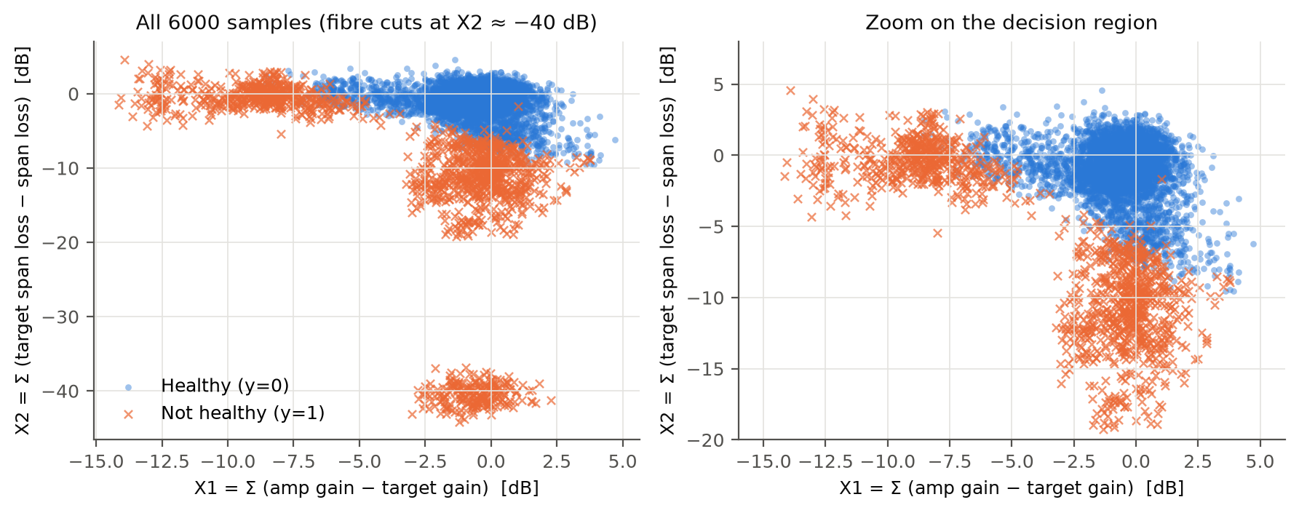
What the data looks like
Each dot is one link in one 2-minute bin
▸ Healthy links cluster at (0, 0)
▸ Amplifier faults spread left (X1 ≪ 0)
▸ Fibre faults spread down (X2 ≪ 0)
▸ Fibre cuts form a separate cluster at X2 ≈ −40 dB
▸ The boundary is nearly linear, but points near it overlap
6

Slide 7
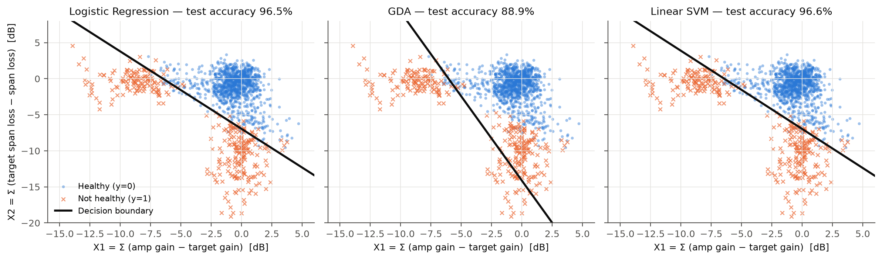
Results: decision boundaries on the test set
1500 held-out samples; compare with Fig. 4–5 of the paper
96.5%
88.9%
96.6%
Logistic Regression (paper: 99 %)
GDA (paper: 97 %)
Linear SVM (paper: 99 %)
7
Notes:
LR coefficients θ = (-10.44, -1.61, -1.50). θ1 ≈ θ2, so the learnt rule is 'alarm when X1 + X2 is below about −7 dB', i.e. net power deficit, which is the physically right rule.

Slide 8
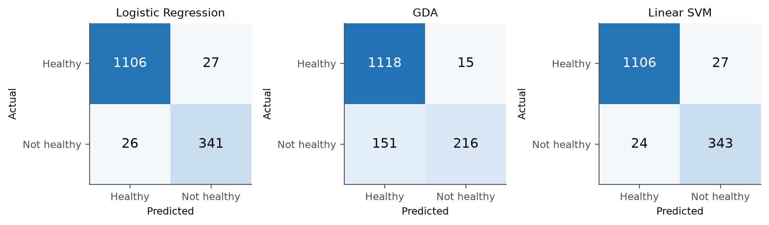
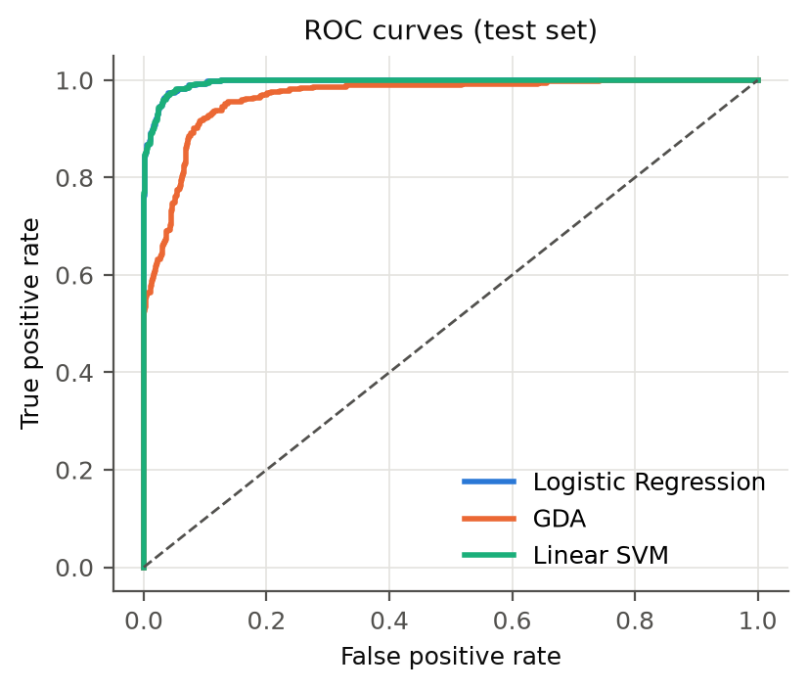
Beyond accuracy: robust on unseen links
Precision/recall on the test set, and cross-validation over the whole dataset
Classifier | Acc. | Precision | Recall | F1 | AUC | 5-fold CV | Unseen routes
Logistic Regression | 96.5% | 0.927 | 0.929 | 0.928 | 0.995 | 97.0% ± 0.7 | 96.9% ± 0.8
GDA | 88.9% | 0.935 | 0.589 | 0.722 | 0.964 | 89.9% ± 1.0 | 89.9% ± 2.9
Linear SVM | 96.6% | 0.927 | 0.935 | 0.931 | 0.995 | 97.0% ± 0.6 | 96.9% ± 0.8
8
Notes:
Unseen routes = GroupKFold where entire fibre routes (both directions) are held out, so this is the accuracy on a link the model has never seen. GDA's precision is fine but recall is only 0.59: it misses many failures.

Slide 9
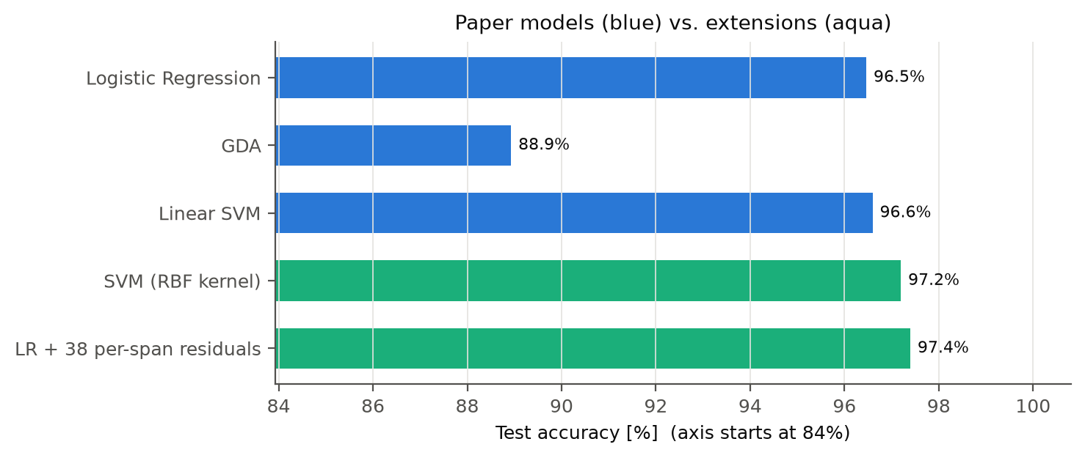
Why GDA trails — and why we're below 99 %
The ranking matches the paper; the gap has a physical cause
GDA's assumption breaks
'Not healthy' is not one Gaussian: amplifier, fibre and cut clusters stretch the shared Σ and tilt the boundary, so recall falls to 0.59.
Σ over spans hides where the fault is
A 7 dB loss in span 1 degrades all 19 downstream amplifiers; the same loss in span 19 affects only one. The RBF SVM adds just 0.6 pts, while per-span features reach 97.4%.
9
Notes:
Key Q&A point: our labels come from a real OSNR link budget, in which the position of the fault matters. The aggregated features cannot see position, so a fraction of the boundary points are ambiguous. That is information loss, not a failure of linear models: the nonlinear RBF SVM barely helps.

Slide 10
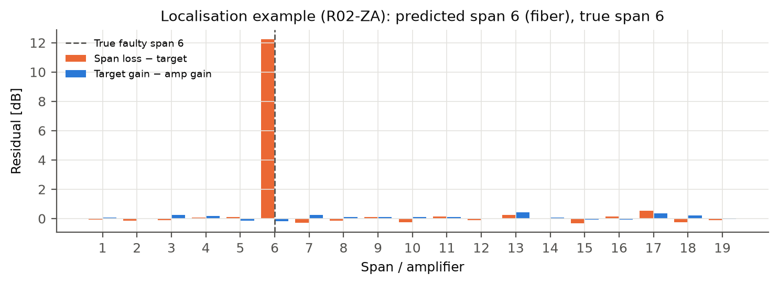
Localisation, flapping & early warning
Turning a red flag into a work order
100.0%
span + element correct (n = 341 detected failures)
9/9
flapping events caught (7.1% false-alarm rate)
Rule: the faulty element is the span with the largest positive residual — loss residual means fibre, gain residual means amplifier, ≥ 25 dB means cut.
Flapping: ≥ 4 health toggles within 30 minutes.
18/18
outages flagged in time (12 early, mean 8 min ahead)
Harder test, every fault incl. minor ones: 91.6% span accuracy · learnt multinomial-LR localiser: 99.7%
10

Slide 11
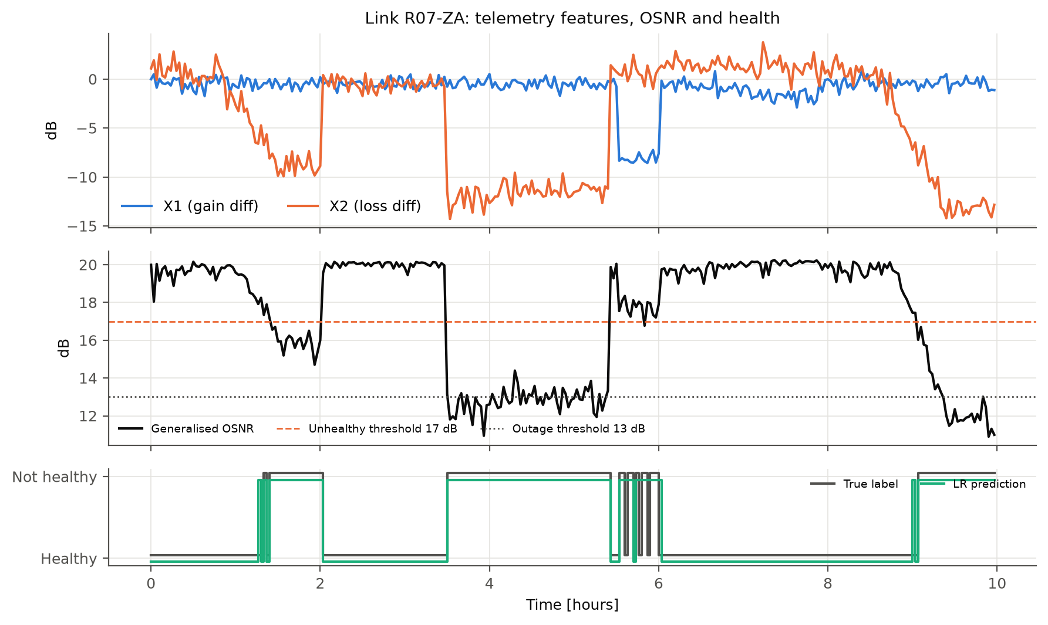
Live demo
streamlit run app.py
1
Fault injection
Pick a fault type, span and severity → see each model's verdict, the point on the decision boundaries, and the localised span
2
Network replay
10 h of any link with out-of-fold predictions and flapping alarms
3
Model performance
Metrics table and every figure
4
CLI fallback
python predict.py --snapshot examples/degraded_span7.csv
Replay view: the model tracks a slow fibre degradation, a hard outage and a flapping amplifier.
11
Notes:
Demo script: (1) none → all healthy. (2) fiber_degradation span 8, 4 dB → healthy; raise to 9 dB → LR & SVM flag it, localised to span 8. (3) Same severity at span 19 → OSNR barely moves (position effect). (4) amplifier_degradation 6 dB → borderline, GDA disagrees. (5) fiber_cut → everyone flags, 'fiber_cut' localised. Then switch to Network replay R07-ZA.

Slide 12
Implementation & repository
One command reproduces every number in this deck
▸ Reproducible: fixed seed, whole pipeline in ~20 s
▸ Validated: our models agree with scikit-learn on 99.8–100 % of test predictions
▸ Tested: physics, interpolation, Eq. 2 identity, localisation
▸ Honest evaluation: held-out test set, 5-fold CV, unseen-route CV, out-of-fold timeline
▸ Contributions: Member 1 — simulator, preprocessing, localisation, demo · Member 2 — models, evaluation, extensions, report
run_pipeline.py one-command experiment
app.py Streamlit live demo
predict.py CLI inference
linkfail/
simulator.py telemetry + link budget
preprocessing.py Eq. 1 / Eq. 2 features
models.py LR · GDA · SVM
localization.py span + flapping
evaluation.py metrics, lead time
pipeline.py CV, extensions
tests/ 12 pytest tests
docs/ write-up + slides
12

Slide 13
Conclusions
1
Two telemetry features + a linear model
detect failing links at 96.6% accuracy, and are just as accurate on links never seen in training
2
Paper's ranking reproduced
LR ≈ Linear SVM > GDA; GDA's Gaussian assumption fails on multi-modal faults
3
Localisation is nearly free
per-span residuals pinpoint the span and the element (fibre, amplifier or cut)
4
Future work
OSNR forecasting for longer lead time · position-aware features · real operator data
Thank you — questions?
13

