Slide 1
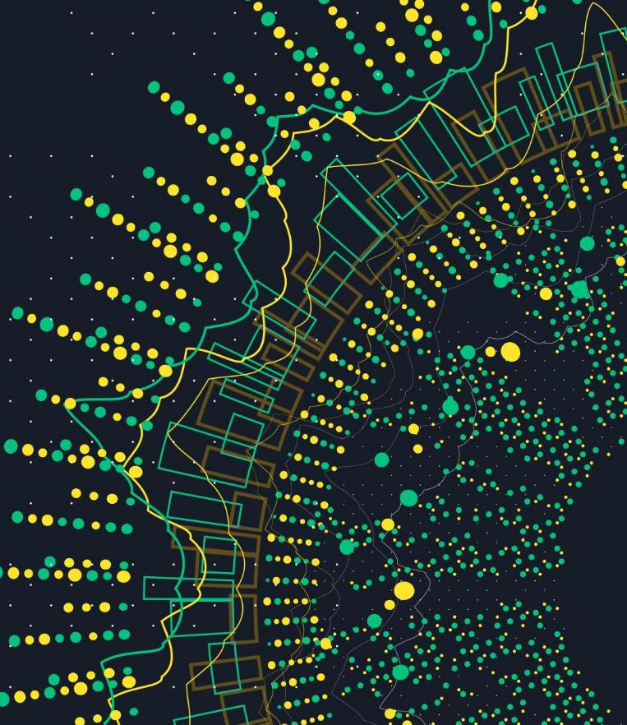
Applied DL Project: Generating Your Own Meme Caption
Jonathan Santoso
Video Link: https://www.youtube.com/watch?v=kncLdXz73sc&ab_channel=JonathanIrvinSantoso
Github Link: https://github.com/jsantoso2/meme_generator_text

Slide 2


Introduction
Compare Human vs Machine Generated Meme Captions
Text Generation using Character Embeddings
Why Character Embeddings?
Spelling Mistakes and Slang words

Slide 3






Data OVERVIEW Tools
100 Most Popular Meme Images from ImgFlip.com
~575k Caption from these 100 images in JSON
(Extracted: ~Apr 2020)
Tools: Python, Jupyter Notebook, Pytorch, Google Colab, React
Dataset: https://github.com/schesa/ImgFlip575K_Dataset

Slide 4
Data Preprocessing
Filter data with ideal no. of boxes
Remove non-english characters, emojis, links, etc.
Limit to 200 characters or less
Lower Case characters (72 Characters)
~310k data points from 100 meme images
~88k data points from 100 meme images
filtering
sampling
Unbalanced!
Example: <start>apple should make a big screen tv <sep> and call it the big mac<end>
Model1
Model2
Input | Label | Image Index
“<start>” | a | 0
“<start>a” | p | 0
“<start>ap” | p | 0
Input | Label | Image Index
“<start>apple should make a big screen …..big mac” | “apple should make a big screen ….. big mac<end>” | 0
Pre-padding to length 128 (Why? – Divisible by 2)
95% Training + 5% Validation (~5M Training, ~260k Validation)
Post-Padding to length 199 (Why? - Max Length)
95% Training + 5% Validation (~83k Training, ~4.5k Validation)

Slide 5
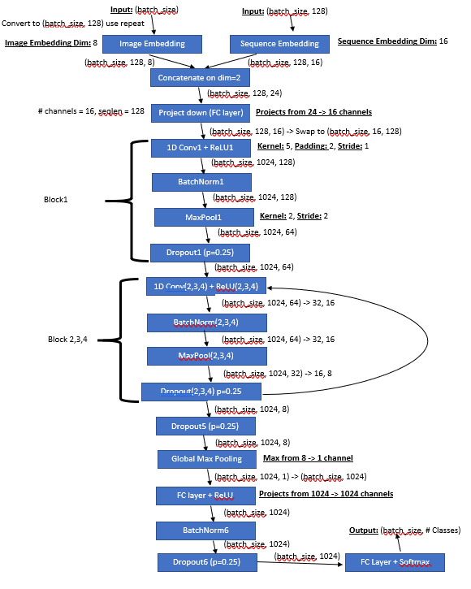
Model 1 - CNN
Inputs: Img_Index (batch_size), Input _Sequence (batch_size, 128)
Outputs: Probabilities of next character (batch_size)
Loss: Cross Entropy Loss
Metrics: Validation Accuracy
Description
Character Embeddings combined with Image Embeddings
Use 1D Convolution, ReLU, Max Pooling, BatchNorm, Dropout
Similar to CNN for Image Classification

Slide 6
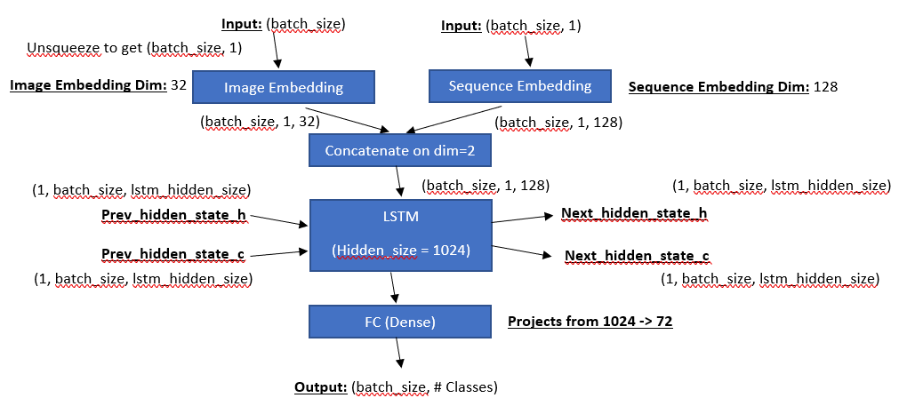
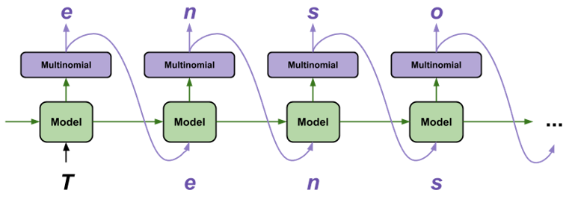
Model 2 - LSTM
Inputs: Img_Index (batch_size), Input _Sequence (batch_size, 128)
Outputs: Probabilities of next character (batch_size)
Loss: Cross Entropy Loss
Metrics: Validation Accuracy
Description
Character Embeddings combined with Image Embeddings
Simple LSTM network
Training takes actual label, Evaluation takes previous predicted output
https://www.tensorflow.org/tutorials/text/text_generation

Slide 7
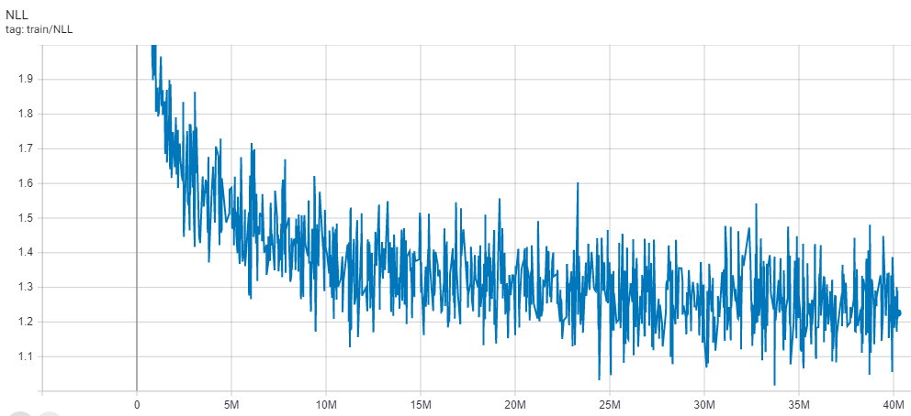
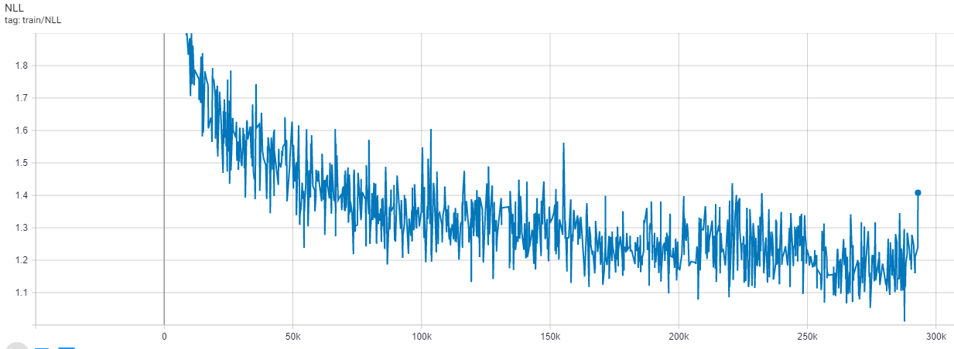
Model Results
Model1 - CNN
Model2 - LSTM
Step | Val Loss | Val Acc |  | Step | Val Loss | Val Acc |  | Step | Val Loss | Val Acc
2M | Large | 50.65% |  | 16M | 1.26 | 61.53% |  | 30M | 1.21 | 63.03%
4M | 1.46 | 56.27% |  | 18M | 1.35 | 61.75% |  | 32M | 1.21 | 63.12%
6M | 1.38 | 58.34% |  | 20M | 1.24 | 62.02% |  | 34M | 1.20 | 63.26%
8M | 1.35 | 59.38% |  | 22M | 1.24 | 62.26% |  | 36M | 1.20 | 63.31%
10M | 1.32 | 60.16% |  | 24M | 1.23 | 62.48% |  | 38M | 1.20 | 63.42%
12M | 1.29 | 60.71% |  | 26M | 1.25 | 62.66% |  | 40M | 1.19 | 63.61%
14M | 1.46 | 60.89% |  | 28M | 1.22 | 62.83%
Step | Val Loss | Val Acc |  | Step | Val Loss | Val Acc |  | Step | Val Loss | Val Acc
30k | 1.52 | 55.28% |  | 120k | 1.29 | 61.46% |  | 210k | 1.24 | 62.91%
60k | 1.39 | 58.97% |  | 150k | 1.27 | 62.14% |  | 240k | 1.23 | 63.13%
90k | 1.33 | 60.49% |  | 180k | 1.25 | 62.57% |  | 270k | 1.20 | 63.35%
All models was trained for 8 hours (8 epochs for CNN, 4 epochs for LSTM)
Evaluated every 2M samples for CNN and 90k samples for LSTM

Slide 8
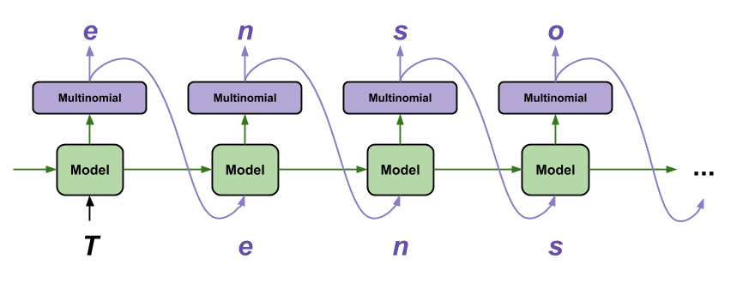
Prediction/Inference
Add <start> token initially + any other characters supplied
Feed into network and get one next character -> Generate text until <end> is reached
Methodology:
Greedy -> Same result every time!
Sampling -> Varying Result based on probabilities
Beam Search -> Select most probable output considering search on (k=3) timesteps
https://www.tensorflow.org/tutorials/text/text_generation

Slide 9
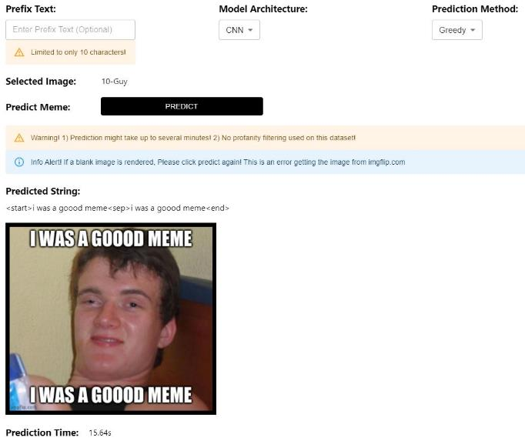
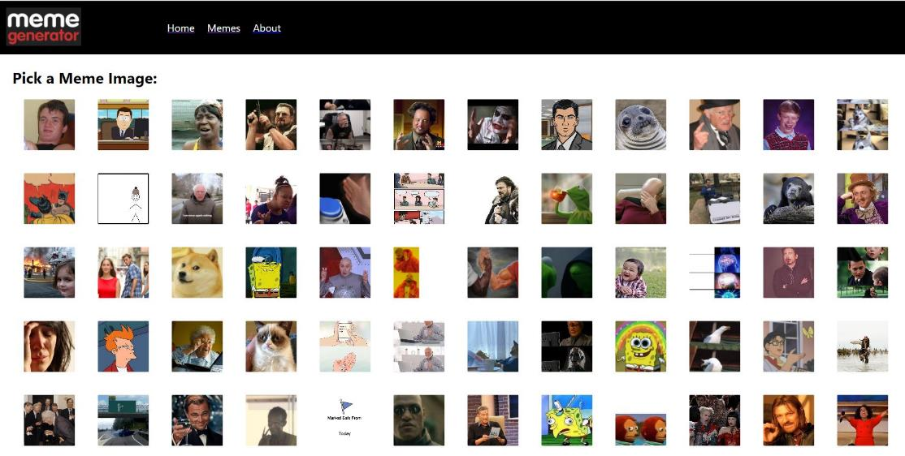
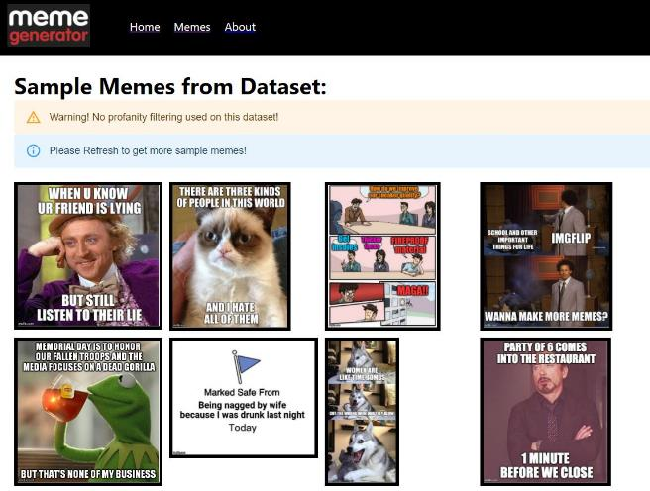
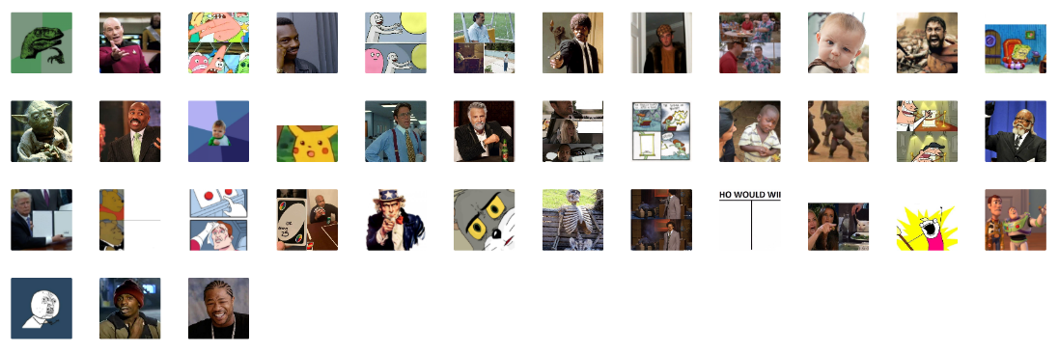
Demo
App Link: https://meme-generator-nn-app.herokuapp.com/

Slide 10
Conclusion/Future Work
CNN performed better
Coherent captions can be generated
Human generated memes are still better!
Future Work
Attention with LSTM + Other Variants (Stacked, Bidirectional, etc.)
Include CNN to generate captions from Custom Images
Profanity Filters added

Slide 11
References
http://karpathy.github.io/2015/05/21/rnn-effectiveness/
https://github.com/schesa/ImgFlip575K_Dataset
https://towardsdatascience.com/meme-text-generation-with-a-deep-convolutional-network-in-keras-tensorflow-a57c6f218e85
https://pytorch.org/tutorials/intermediate/char_rnn_generation_tutorial.html
https://web.stanford.edu/class/archive/cs/cs224n/cs224n.1184/reports/6909159.pdf

Slide 12
Thank You!
Video Link: https://www.youtube.com/watch?v=kncLdXz73sc&ab_channel=JonathanIrvinSantoso
Github Link: https://github.com/jsantoso2/meme_generator_text

