Slide 1

A Simple Matching Model
by Jasprit Singh Aujla
December 11, 2023
Completion Exercise for MSS Program

Slide 2
Introduction
Simple framework to model two-sided matching problems
Applications include matching consumers to ads, users on social media sites, recruiters to job candidates etc.
Framework considers 2 simpler problems
e.g., in the context of matching consumers to ads, we model
Probability that consumer i likes ad j; and
Probability that the company bidding on ad space for ad j likes consumer i

Slide 3
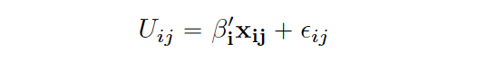
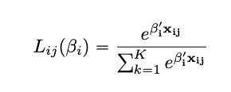
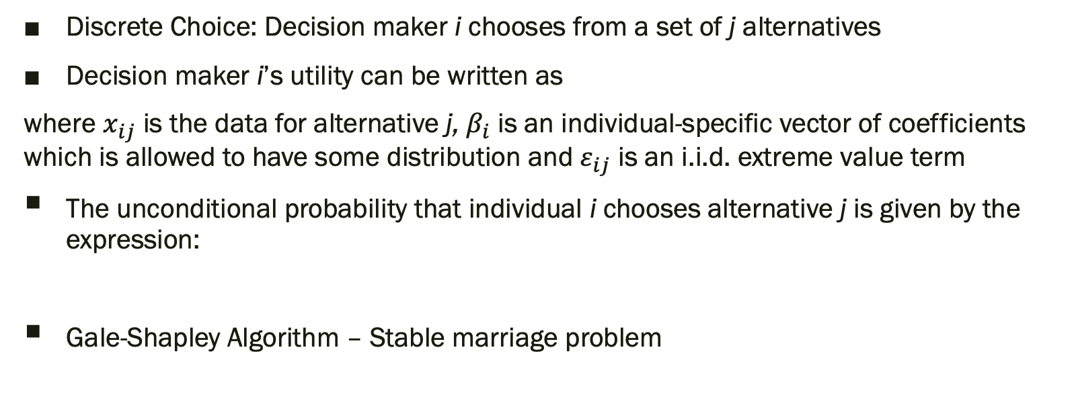
Discrete Choice & Gale-Shapley Algorithm
Discrete Choice: Decision maker i chooses from a set of j alternatives
Decision maker i’s utility can be written as
where $x_{ij}$ is the data for alternative j, $β_{i}$ is an individual-specific vector of coefficients which is allowed to have some distribution and $ε_{ij}$ is an i.i.d. extreme value term
The unconditional probability that individual i chooses alternative j is given by the expression:
Gale-Shapley Algorithm – Stable marriage problem
Notes:
Discrete choice example: choosing a mode of transport to work

Slide 4

Model Outline
Imagine you run an advertising agency with access to many ads and the ability to purchase
ad space targeting many different consumers
You choose which ads to show which consumers to maximize click-through rate (CTR) for example
One way to achieve this is to maximize the match between consumer and the ad
Define the following quantities:
Match consumer i to ad j if the product of these probabilities is relatively large

Slide 5

Toy Example: Tesla Ads
Consumer’s problem:
Covariates (at the consumer’s level):
Income (in tens of thousands)
Age
Gender (0 for male, 1 for female)
Car owner (0 = No, 1 = Yes)
Has a friend or family member who owns a Tesla (0 = No, 1 = Yes)
Lives close to a Tesla dealership (0 = No, 1 = Yes)
Is environmentally conscious (0 = No, 1 = Yes)
Works in the tech industry (0 = No, 1 = Yes)

Slide 6

Toy Example: Tesla Ads
Advertiser’s problem:
Covariates (at the consumer’s level):
Income (in tens of thousands)
Age
Gender (0 for male, 1 for female)
Car owner (0 = No, 1 = Yes)
Consumer’s online activity score (1-10 where 1 = inactive, 10 = very active)
Is environmentally conscious (0 = No, 1 = Yes)

Slide 7
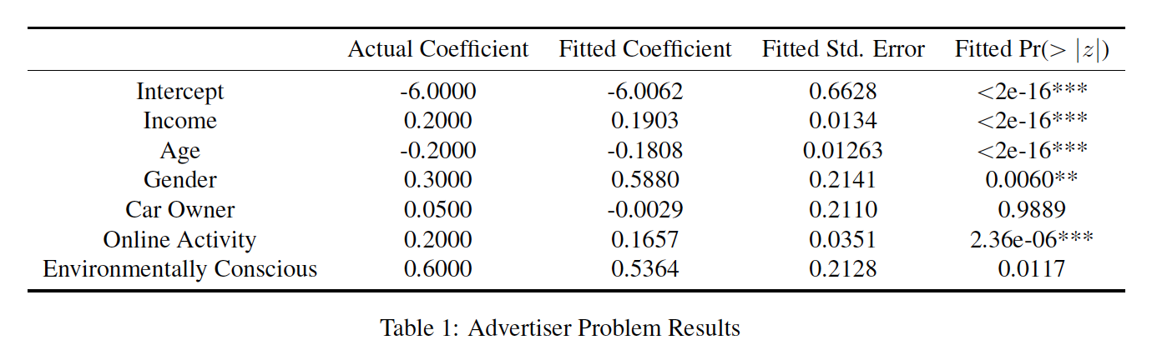
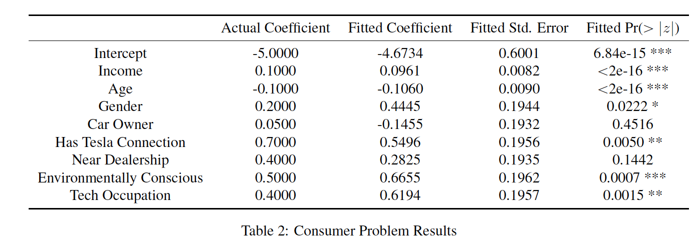
Simulation Results
Notes:
Mention AUCs as well

Slide 8
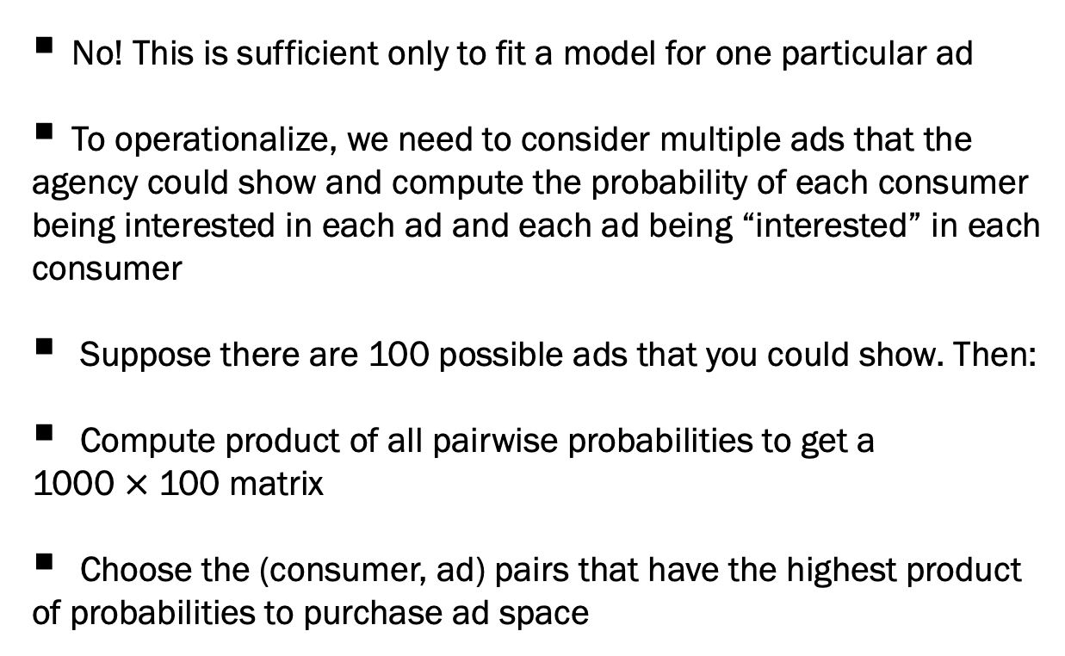

Is that it?
Product of probabilities
0.9828541
0.9790074
0.9773679
0.9744478
0.9649730
0.9631780
0.9588885
0.9442256
0.9388751
...
No! This is sufficient only to fit a model for one particular ad
To operationalize, we need to consider multiple ads that the
agency could show and compute the probability of each consumer
being interested in each ad and each ad being “interested” in each
consumer
Suppose there are 100 possible ads that you could show. Then:
Compute product of all pairwise probabilities to get a
1000 $×$ 100 matrix
Choose the (consumer, ad) pairs that have the highest product
of probabilities to purchase ad space
1000 $×$ 1 vector

Slide 9
Application: Facebook Friend Recommender System
Imagine you are building a recommendation system for Facebook to recommend friends
You have information about users’ demographic information
Assume for simplicity that you do not make use of mutual friend information
Data:
Facebook friendship networks at Duke in September 2005
Consists of a data frame with demographic information (e.g., student/faculty status, gender, major, type of residence etc.)
And a sparse matrix encoding the connections between individuals

Slide 10
Methods – Data Processing
Second major/minor was dropped as a covariate due to large number of missing values because it was unlikely to be a strong predictor
Observations with at least one missing value were dropped
Observations with fewer than 50 connections were dropped
Final data set had 3,247 observations

Slide 11
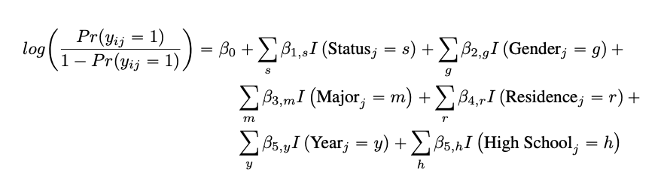
Methods – Model Specification
1st problem: Probability that individual i likes individual j
2nd problem: Probability that individual j likes individual i (symmetric in this case)

Slide 12
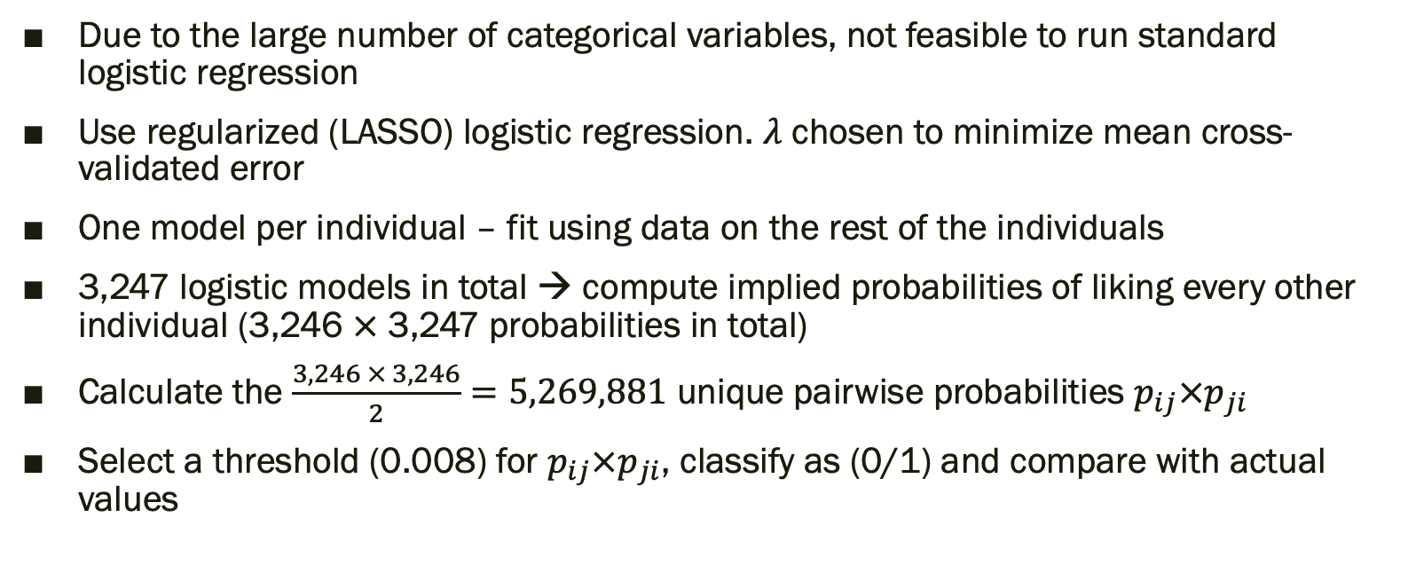
Methods – Model Fitting
Due to the large number of categorical variables, not feasible to run standard logistic regression
Use regularized (LASSO) logistic regression. $λ$ chosen to minimize mean cross-validated error
One model per individual – fit using data on the rest of the individuals
3,247 logistic models in total → compute implied probabilities of liking every other individual (3,246 $×$ 3,247 probabilities in total)
Calculate the $\frac{3,246 × 3,246}{2}=5,269,881$ unique pairwise probabilities $p_{ij}×p_{ji}$
Select a threshold (0.008) for $p_{ij}×p_{ji}$, classify as (0/1) and compare with actual values

Slide 13
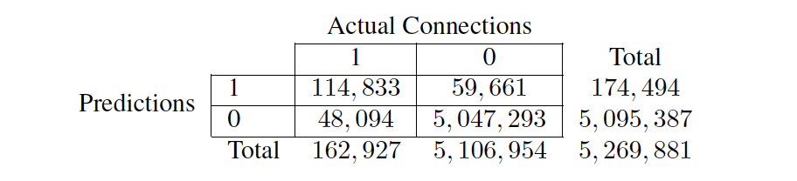
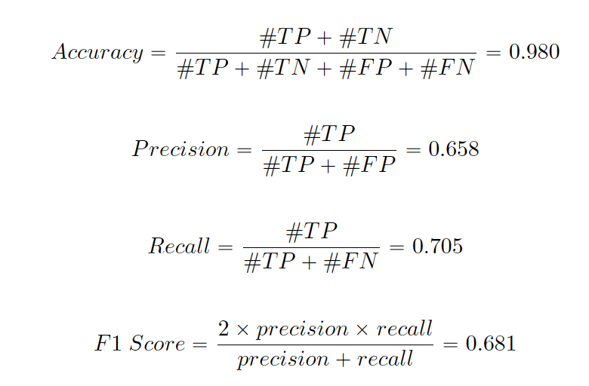
Results
Confusion matrix:
Metrics:
Notes:
Mention AUC

Slide 14
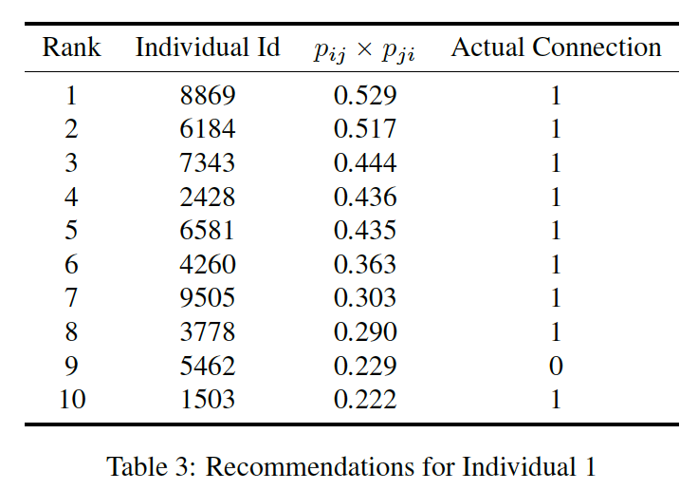
Results
Since we are building a recommendation system it might be more relevant to consider metrics like precision at cut-off k
Suppose k is 10, these are the recommendations we would make for individual 1
Based on this, can compute precision at 10 which = 0.9
Can also compute Average Precision which is 0.979 here
Taking the mean of Average Precision across all individuals gives Mean Average Precision (MAP) which is 0.626

Slide 15
Discussion
Model performance is good, but this is a relatively favorable setting
Academic major and place of residence are likely to be highly predictive of whether two users are friends on Facebook
Other settings likely to be less favorable. Nevertheless, initial results are promising.
Test set?

Slide 16
Conclusion
Proof of concept for the model using an example in computational advertising – matching ads to consumers and for a social media recommendation system – matching users to other users
Model is simple and easy to interpret
Can be applied to similar two-sided matching problems

Slide 17
Thank You

