Slide 1
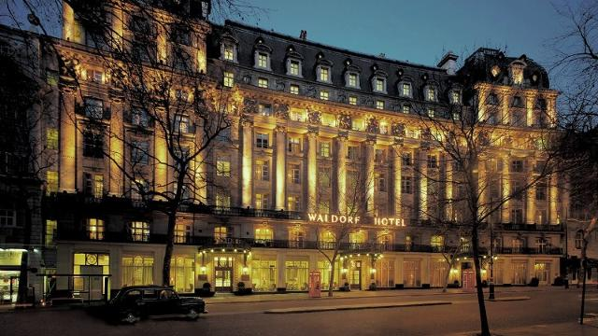
Customer Sentiment Analysis for the Hotel’s UK Division

Slide 2
Contents
Part 1 - Quantitative Analysis
Linear Regression: Identifying underlying assumptions to work with
Part 2 - Qualitative Analysis
SWOT Analysis: Breaking Down Strenghts Weaknesses, Opportunities, Threats of Business

Slide 3
QUANTITATIVE ANALYSIS

Slide 4
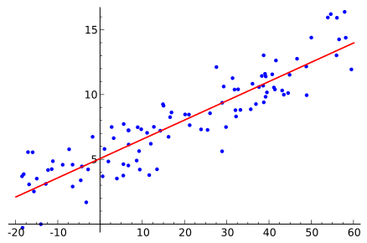

Quantitative Analysis Methodology: Customer Review data was analyzed through a Logistic Regression Model to determine the Top 3 words associated with positive and negative reviews respectively.

Slide 5
Quantitative Analysis
Top 3 Most Positive Words | Top 3 Most Negative Words
‘Location’ : 1.984 | ‘Room’ : - 0.761185
‘Comfortable’ : 0.975 | ‘Bathroom’ : - 0.738
‘Clean’ : 0.876 | ‘Expensive’ : - 0.677

Slide 6
QUALITATIVE ANALYSIS

Slide 7

Qualitative Analysis Methodology: SWOT Analysis

Slide 8
Strengths

Slide 9
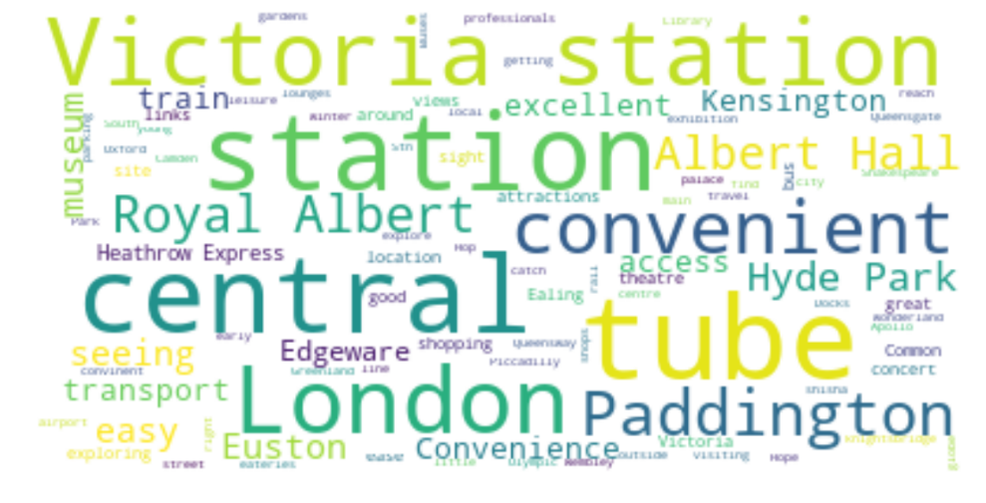
Location

Slide 10
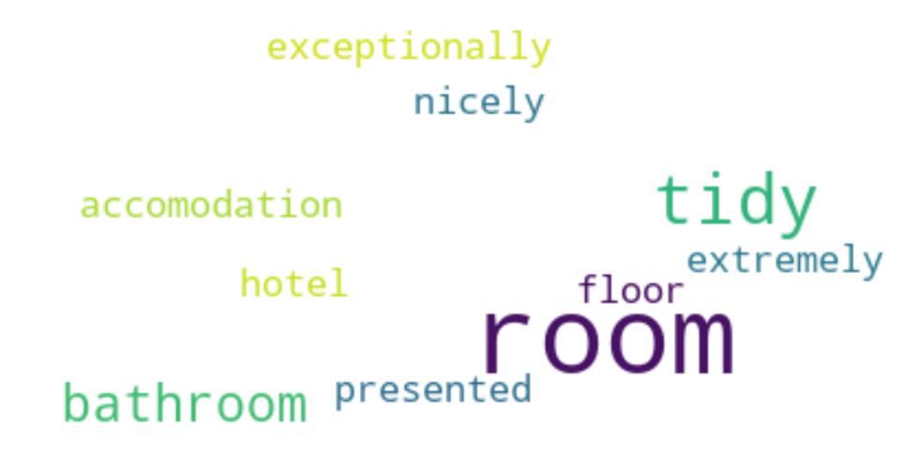
Room Cleanliness
Service

Slide 11
Weaknesses

Slide 12
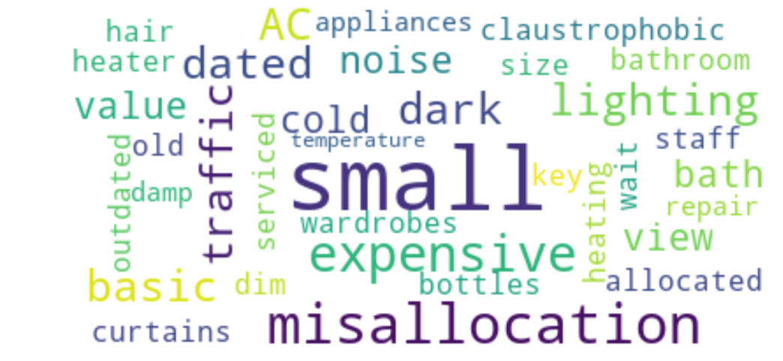
Room Processing

Slide 13
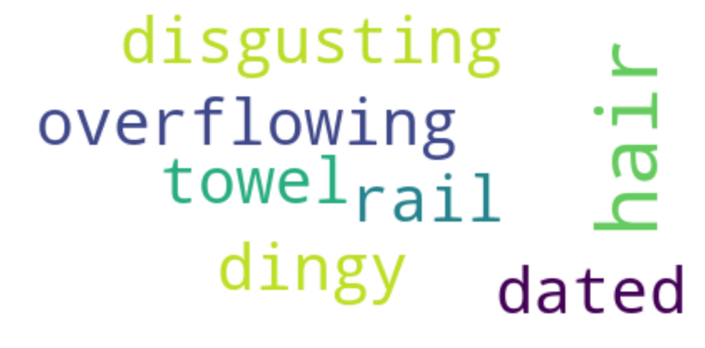
Bathroom

Slide 14
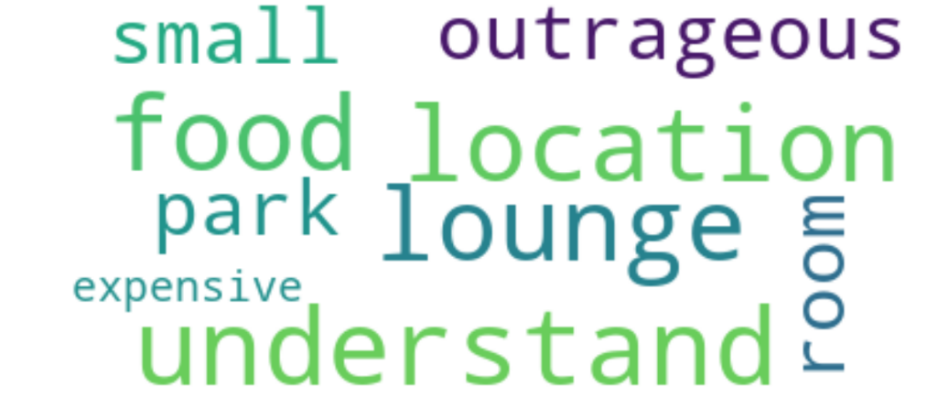
Price

Slide 15
Opportunity

Slide 16
Opportunity: Drill down deeper into particular market segment
Recommendation: Target marketing material to those who most likely need easy access to locations in London i.e. business travelers, tourists interested predominantly in culture

Slide 17
Threats

Slide 18
Prescription: Make bathrooms a point of emphasis with cleaning staff
Clean
Bathroom

Slide 19

Prescriptions: Examine booking process, potential solutions of customer discomfort

