Slide 1
Top 5 U.S. Zipcodes for Investment

Slide 2
Investment Strategy

Slide 3




Assumption: Defensive Investment Strategy
Our algorithm favors conservative, steady gains over volatile high risk/high reward investments

Slide 4
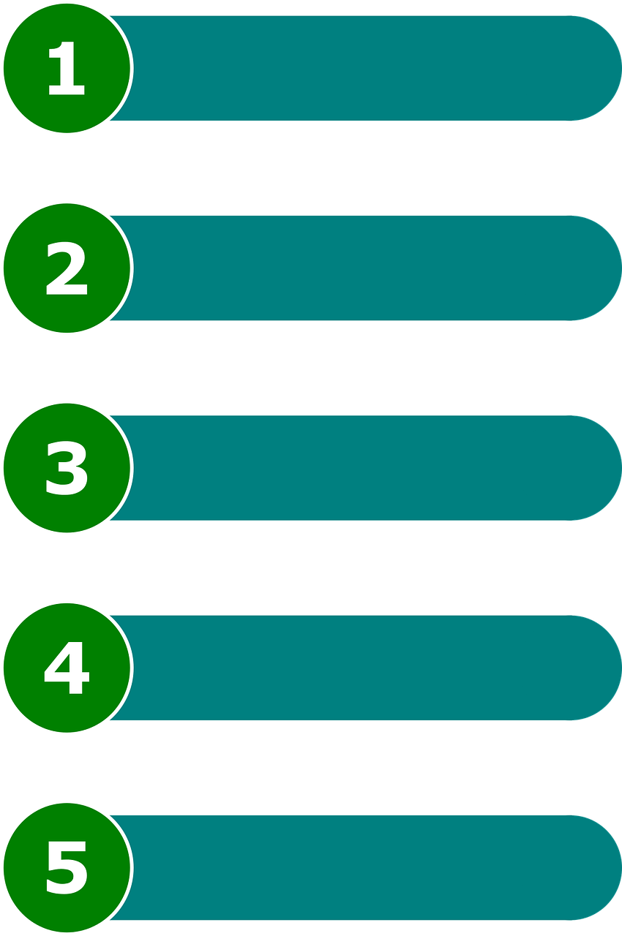
Formula (basic)
Zipcode a
Profitability
Zipcode b
=
Risk
Zipcode c
Zipcode d
Zipcode e

Slide 5
Profitability

Slide 6

Profitability - Absolute vs. Percentage
Absolute
Percentage
Investment 1: New York, NY
Investment 2: Kings, NY
$3,676,700
$7,386,600
$133,200
$1,623,700
1996
2018
1996
2018
% Profit: 100.9%
Gross Profit: 3,709,000
% Profit: 1119.0%
Gross Profit: 1,490,500

Slide 7
Profitability - the case for % profit
Assumption: Our defensive investor wants to grow his money
Scenario: The market takes a downturn and demand for housing falls. Housing prices in the area fall by 10%.

Slide 8
Profitability - the case for % profit
Investment 1: Original
Investment 2: Original
$3,676,700
$7,386,600
$133,200
$1,623,700
1996
2018
1996
2018
$3,709,000
$1,490,500
Investment 1: Post downturn
Investment 2: Post downturn
$3,676,700
$6,647,940
$133,200
$1,461,330
1996
2019
$2,971,240
1996
2019
$1,328,130

Slide 9
Risk

Slide 10
Risk Evaluation Methodology: Assessing Variability
Measurement Technique 1: Standard Deviation
How much price fluctuates from mean on average
Most statistically robust way to test for variability for normal distributions
Commonly used in investments
Measurement Technique 2: Interquartile Range (IQR)
How the dispersion that takes place in the middle 50% of the data
Statistically robust way to test for variability for non-normal distributions

Slide 11
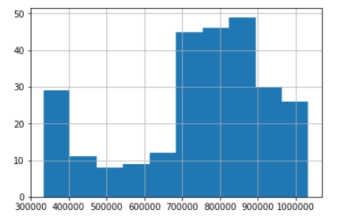
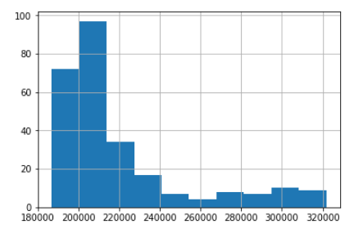
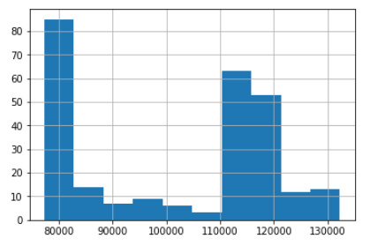
Risk Measurement Technique Assessment
Standard Deviation
Unmet assumption: Housing price data is normally distributed
Cook, IL
Collin, TX
Harris, TX
Since our data does not meet a fundamental assumption needed to use standard deviation, the Interquartile Range will be used to assess risk

