Slide 1

All-Star Prediction Fan Guide

Slide 2
Scenario: You are having a fantasy draft with your friends for who will make this year’s NBA All-Star team and you are looking to gain a competitive advantage

Slide 3

Narrative
Zipcode a
Counting Stats
Advanced Stats
Zipcode b

Slide 4
Narrative

Slide 5
Counting Stats

Slide 6
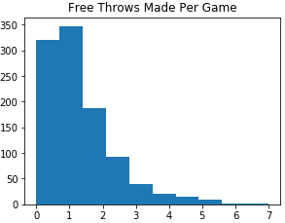
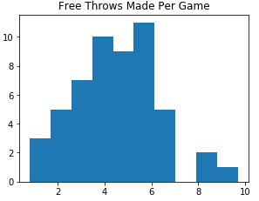
Free Throws Made
All-Star
Non All-Star

Slide 7
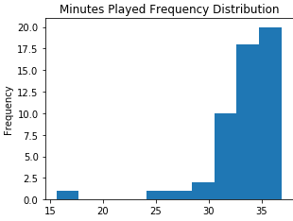
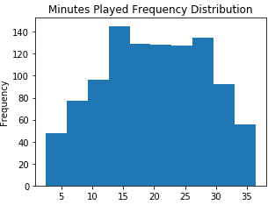
Minutes Played
All-Star
Non All-Star

Slide 8
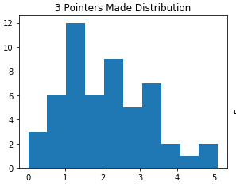
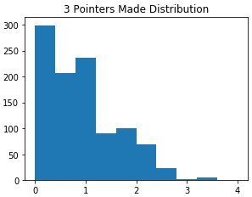
Three Pointers Made
All-Star
Non All-Star

Slide 9
Advanced Stats

Slide 10
Profitability - the case for % profit
Assumption: Our defensive investor wants to grow his money
Scenario: The market takes a downturn and demand for housing falls. Housing prices in the area fall by 10%.

