Slide 1
Spotify Data engineering
Group Members:
Jai Saxena (Roll No. 50)
Muhammad Armughan Yaqoob (Roll No. 68)
Jefferey Lin (Roll No. 27)

Slide 2
INTRODUCTION
This project aims to implement a comprehensive data engineering solution leveraging AWS cloud services. The objective is to build a robust ETL pipeline that processes raw Spotify data into a structured format, allowing for insightful business analytics. The project will encompass data ingestion, transformation, storage, and visualization, using AWS Glue, Athena, QuickSight, and S3.
Project Objectives:
1. Data Ingestion and Storage
Ingest raw Spotify data into AWS S3.
Organize data into staging and data warehouse buckets.
2. Data Transformation
Utilize AWS Glue to create an ETL pipeline for transforming raw data.
Ensure accurate data transformation by handling necessary joins and data cleaning.
3. Data Querying
Use AWS Athena to query the transformed data.
4. Data Visualization
Leverage AWS QuickSight to create visualizations and gain business insights from the data.

Slide 3
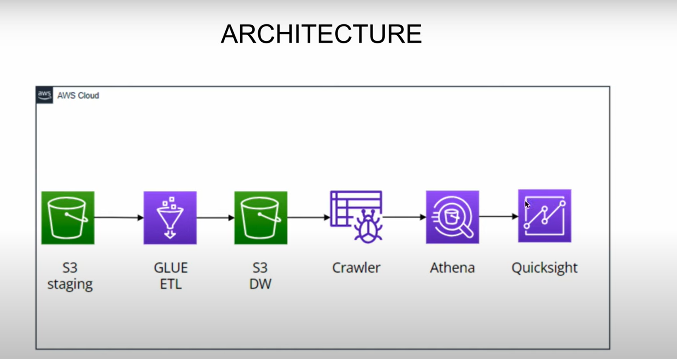
Architecture and Workflow:

Slide 4
Architecture and Workflow:
1. Data Storage
AWS S3: Data will be stored in S3 buckets divided into 'staging' and 'data warehouse' folders. Raw CSV files will be uploaded into the staging folder.
2. ETL Pipeline
AWS Glue: Create a Glue ETL job to process data from the staging bucket, apply necessary transformations, and load it into the data warehouse bucket. This includes:
Data Crawling: Use AWS Glue Crawlers to scan data in S3, creating metadata tables in the AWS Glue Data Catalog.
Data Transformation: Employ AWS Glue's visual ETL interface to join datasets (albums, artists, tracks) and perform data cleaning operations.
Data Storage: Save transformed data in Parquet format in the data warehouse bucket for efficient querying.
3. Data Querying
AWS Athena: Query the data stored in the data warehouse bucket using SQL queries. Athena will utilize the metadata created by the Glue Crawler.
4. Data Visualization
AWS QuickSight: Connect QuickSight to Athena to build dashboards and reports, providing insights into Spotify data such as album popularity, artist metrics, and track features.

Slide 5
PROCESS
1. Setting Up AWS Environment:
Create IAM users with appropriate permissions for S3, Glue, Athena, and QuickSight.
Set up S3 buckets with 'staging' and 'data warehouse' folders.
2. Data Preparation:
Upload the Spotify dataset CSV files (albums, artists, tracks) to the S3 staging folder.
Preprocess the data as necessary, including cleaning and structuring it.
Building the ETL Pipeline:
3. Create Glue Crawler:
Set up a Glue Crawler to create a metadata catalog of the data stored in S3.
Develop Glue ETL Job:
Use AWS Glue's visual ETL to drag and drop data sources, define transformation logic, and configure the target output format (Parquet).
Run and Monitor Glue Job:
Execute the Glue job and monitor its performance and success. Troubleshoot any issues related to data access or transformation.
4. Query and Analysis:
Set Up AWS Athena: Configure Athena to query the data catalog created by the Glue Crawler.
Perform SQL Queries: Write and execute SQL queries to extract meaningful insights from the transformed data.
5. Visualization:
Configure AWS QuickSight: Connect QuickSight to Athena and create visualizations.
Develop Dashboards: Build interactive dashboards that visualize trends and insights from the Spotify dataset.

Slide 6
Dataset Description
The Spotify dataset consists of five CSV files:
Albums: Details of albums, including release dates and track information.
Artists: Information on artists, including names, number of followers, and genres.
Spotify Data: Metadata on album popularity and related attributes.
Spotify Features: Metrics such as danceability, energy, loudness, and Shazam rating.
Tracks: Track IDs, popularity, and explicit content.
Expected Outcomes:
Successful Data Ingestion and Storage: Raw data successfully uploaded to and organized within AWS S3.
Effective ETL Pipeline: Data transformation from raw to structured format with accurate joins and cleaning.
Queryable Data: Data available for querying through AWS Athena with correct metadata.
Insightful Visualizations: Interactive dashboards in AWS QuickSight providing actionable business insights.

Slide 7
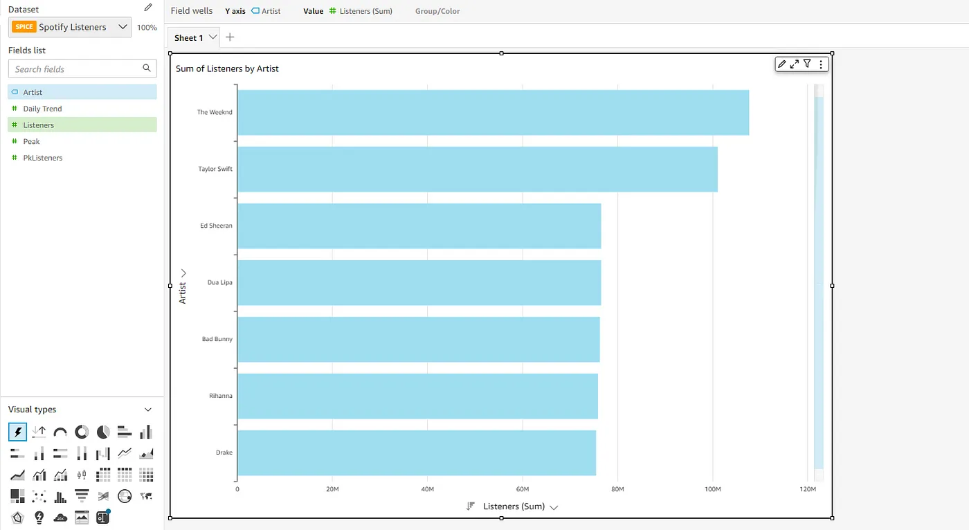
VISUALIZATION OUTPUT

Slide 8
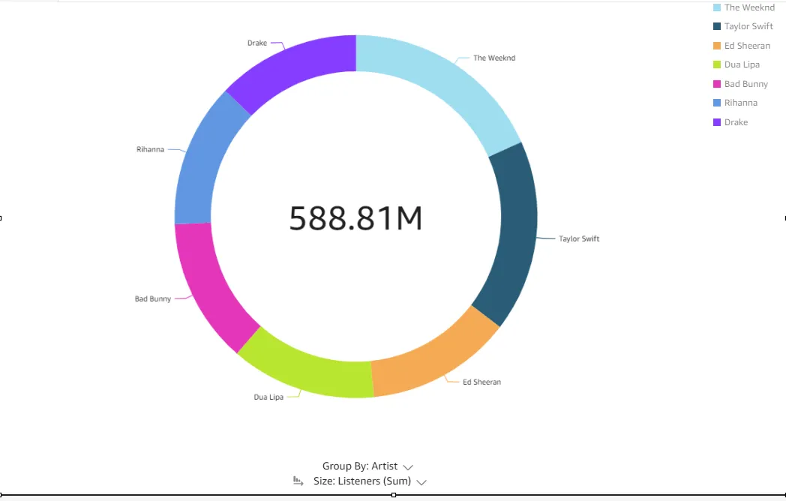
VISUALIZATION OUTPUT

Slide 9
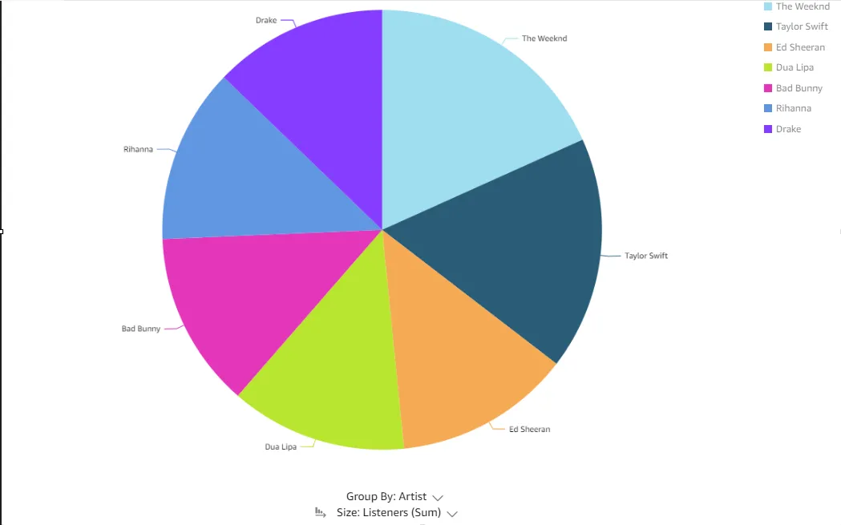
VISUALIZATION OUTPUT

Slide 10
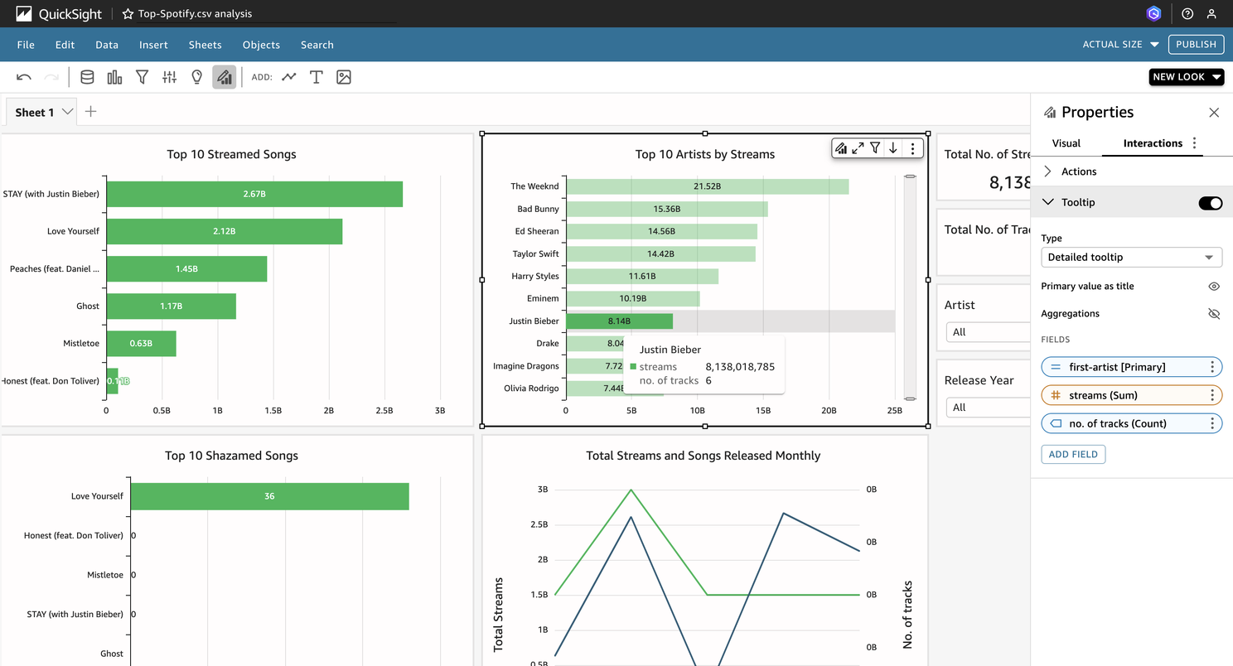
VISUALIZATION OUTPUT

Slide 11
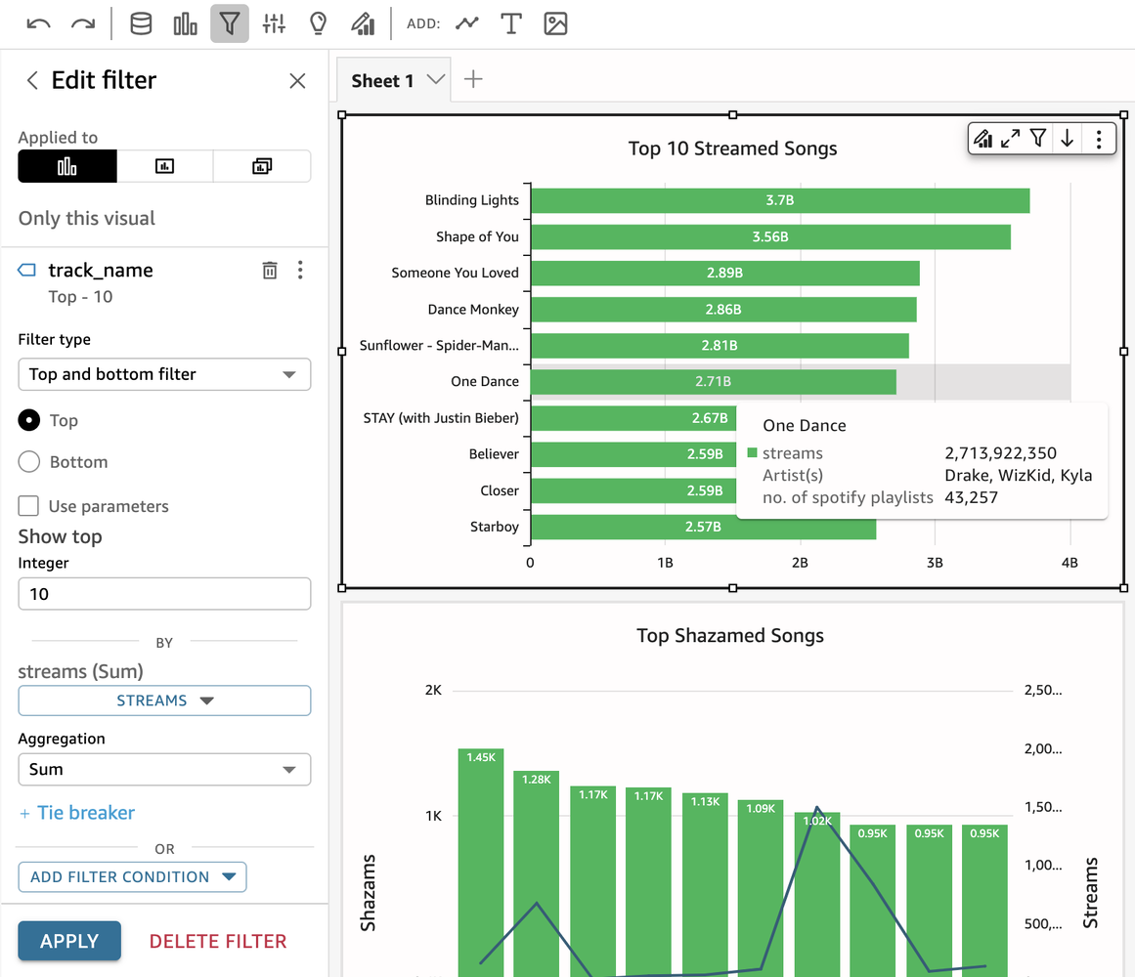
VISUALIZATION OUTPUT

Slide 12
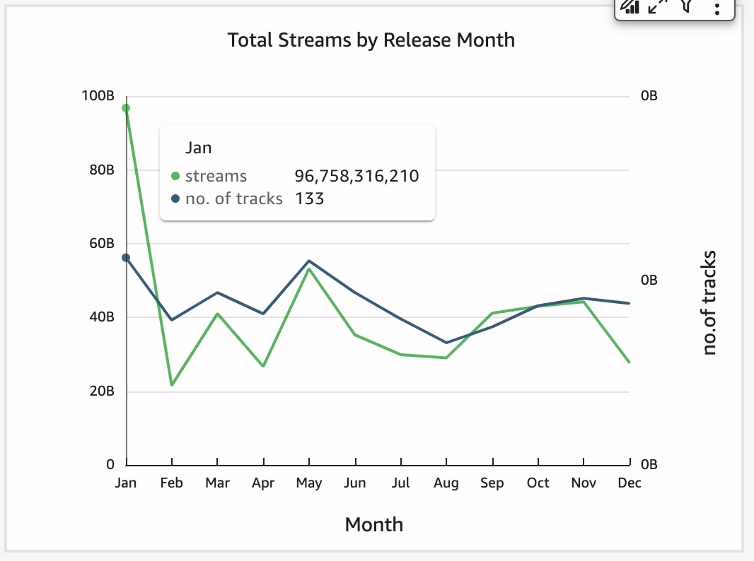
VISUALIZATION OUTPUT

Slide 13


