Slide 1

Market Analysis and Performance Review: Manufacturer 1 (MFR 1) in the OTC Analgesics and Upper Respiratory Categories
By –Junaid Ali Sayyed

Slide 2
Key Insights
Throughout this presentation, we have examined MFR 1's performance in the analgesics and upper respiratory markets. Key insights from our analysis include:
MFR 1 has a total market share of approximately 11.42% in the analgesics category, ranking third among its competitors.
MFR 1's performance in the analgesics category has seen a decline of $19,729,111 compared to the previous year, with Brand 3 experiencing a particularly steep decline.
MFR 1's market share in the upper respiratory category is not as dominant as some of its competitors, which could limit its ability to influence pricing and other industry trends.
MFR 1's market share in the upper respiratory category has increased from 8.32% to 9.36%, indicating positive performance.

Slide 3
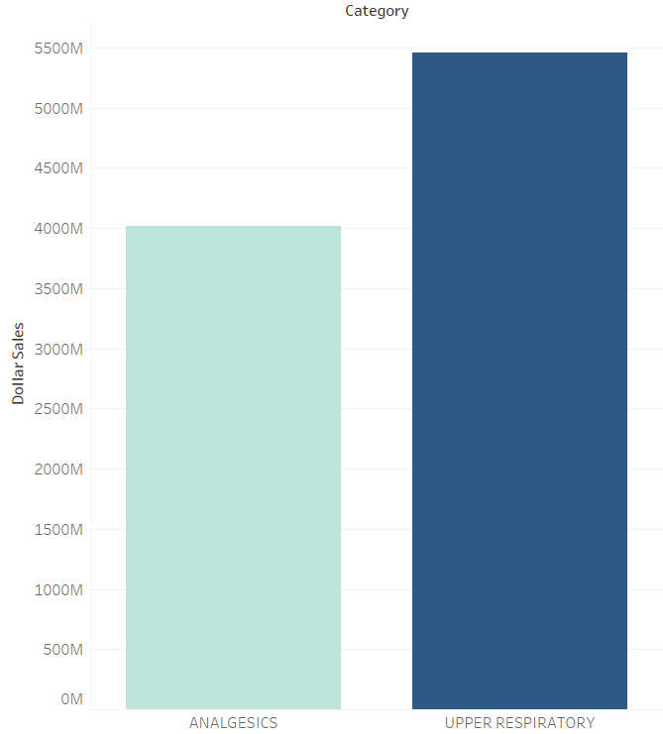
Overview of the Market
The OTC analgesics and upper respiratory markets are highly competitive, with several brands and manufacturers vying for market share
The total market size for analgesics was $4,015,331,261 and for upper respiratory products, it was $5,456,420,688.

Slide 4
MFR 1's Market Position
Manufacture Market Share
MFR 1 is one of the leading manufacturers in the over-the-counter (OTC) pharmaceutical industry ranked second after MFR 3, operating in both the analgesics and upper respiratory categories. MFR 1 competes with several other manufacturers in each category, and its performance and market share vary across brands and products.

Slide 5
MFR 1's Analgesics Brands
Sales by brand
MFR 1 has two brands in the analgesics category, Brand 3 and Brand 5. Brand 3 generated $260,846,516 in sales, while Brand 5 generated $197,902,439 in sales
Brand 3 experienced a decline of $25,812,108 in sales compared to the previous year.
Brand 5, on the other hand, saw an increase of $6,089,597 in sales compared to the previous year
Overall, MFR 1 saw a decline of $19,729,111 in the analgesic category compared to the previous year, which can be attributed to the decline in sales of Brand 3.

Slide 6
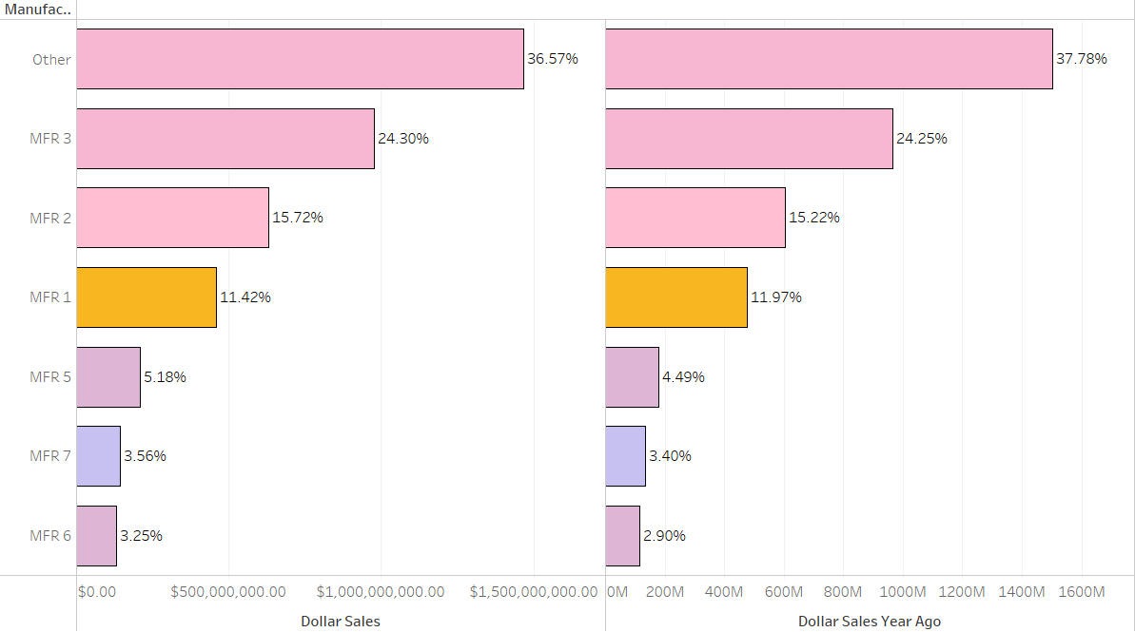
MFR 1's Analgesics Brands
Current Market share
Previous Market share
MFR 1 holds a market share of approximately 11.42% in the analgesics category, making it the third-largest player in the market after MFR 3 and MFR 2.
The decline in overall sales is a concern, as it suggests that MFR 1 may be losing market share to other manufacturers. Market share went down to 11.42% from 11.97%
For Eg:- MFR 2 increased their revenue for both their brands (Brand 2 and Brand 8) with an increase of $25,461,729 over past year

Slide 7
MFR 1's Upper Respiratory Brands
MFR 1 has one brand in the upper respiratory category, Brand 13, which generated $510,499,643 in sales. This gives MFR 1 a market share of approximately 9.36% in the upper respiratory category.
MFR1 currently ranks 4th in Upper respiratory department

Slide 8
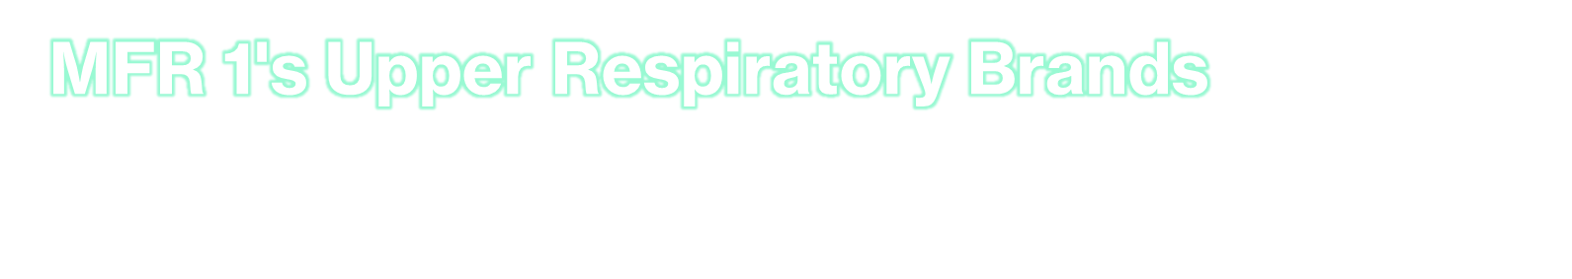

Previous Market share
Brand 13's increased sales suggest that it remains a popular option among consumers.
MFR 1's market share in the upper respiratory category is not as strong as some of its competitors, which could impact its ability to shape pricing and other industry trends.
MFR 1's market share in the upper respiratory category rose from 8.32% to 9.36%, indicating that the brand is performing well in the market

Slide 9

Conclusion
In conclusion, MFR 1's performance in the analgesics and upper respiratory markets has been mixed. While the brand has a respectable market share in the analgesics category, it has seen a decline in performance compared to the previous year. Additionally, its market share in the upper respiratory category is not as dominant as some of its competitors, although it has experienced positive growth. These insights suggest that MFR 1 may need to focus on strengthening its position in the analgesics market while continuing to build its presence in the upper respiratory market to remain competitive.

