Slide 1
Model_prac.h5

Slide 2
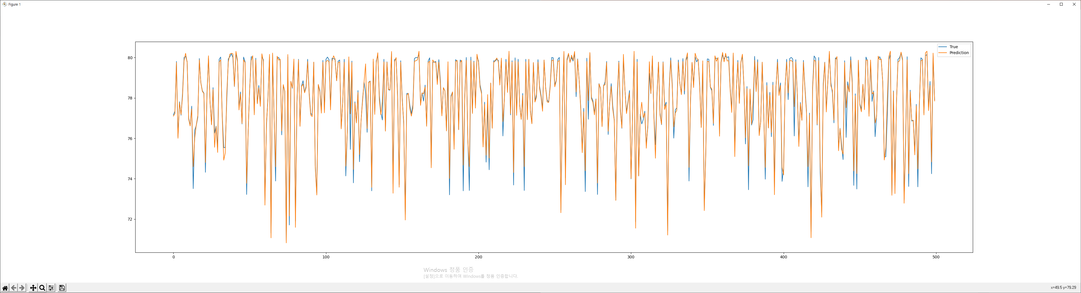
node0

Slide 3
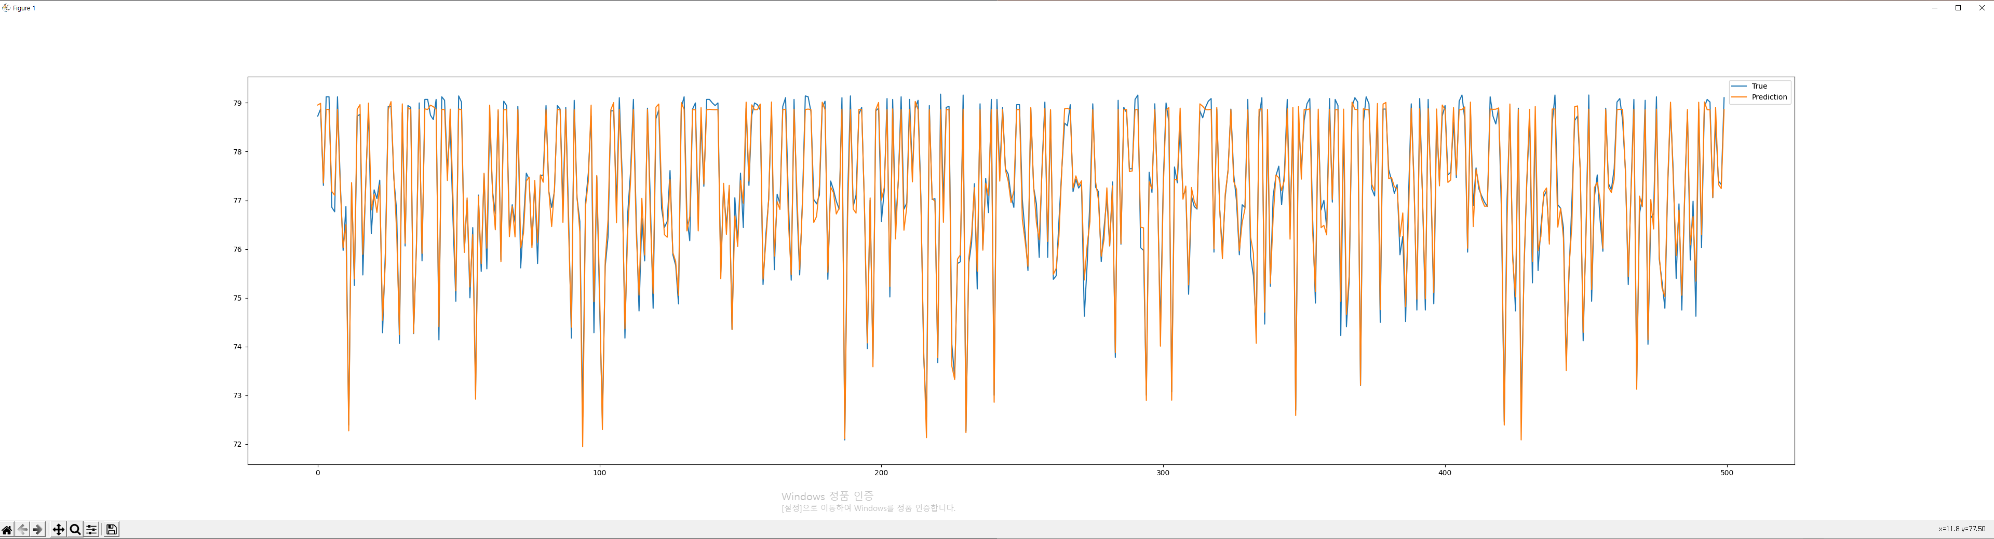
node1

Slide 4
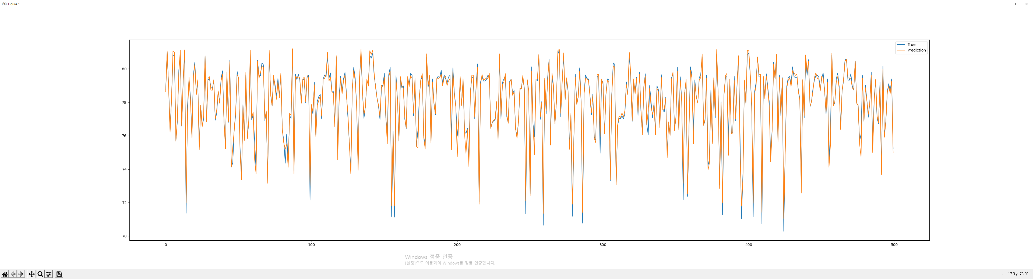
node2

Slide 5
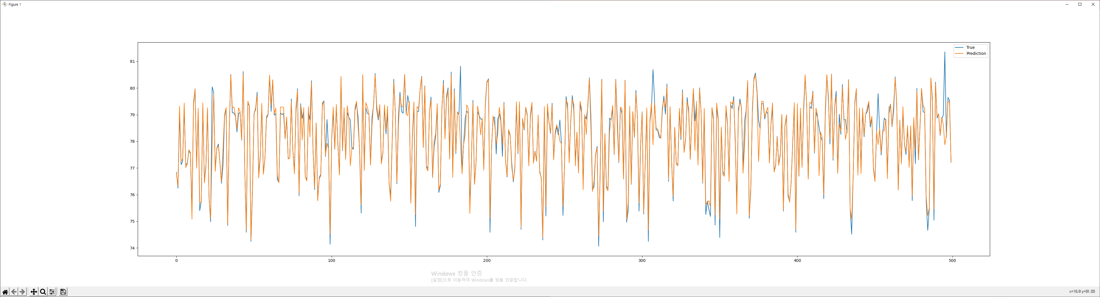
node3

Slide 6
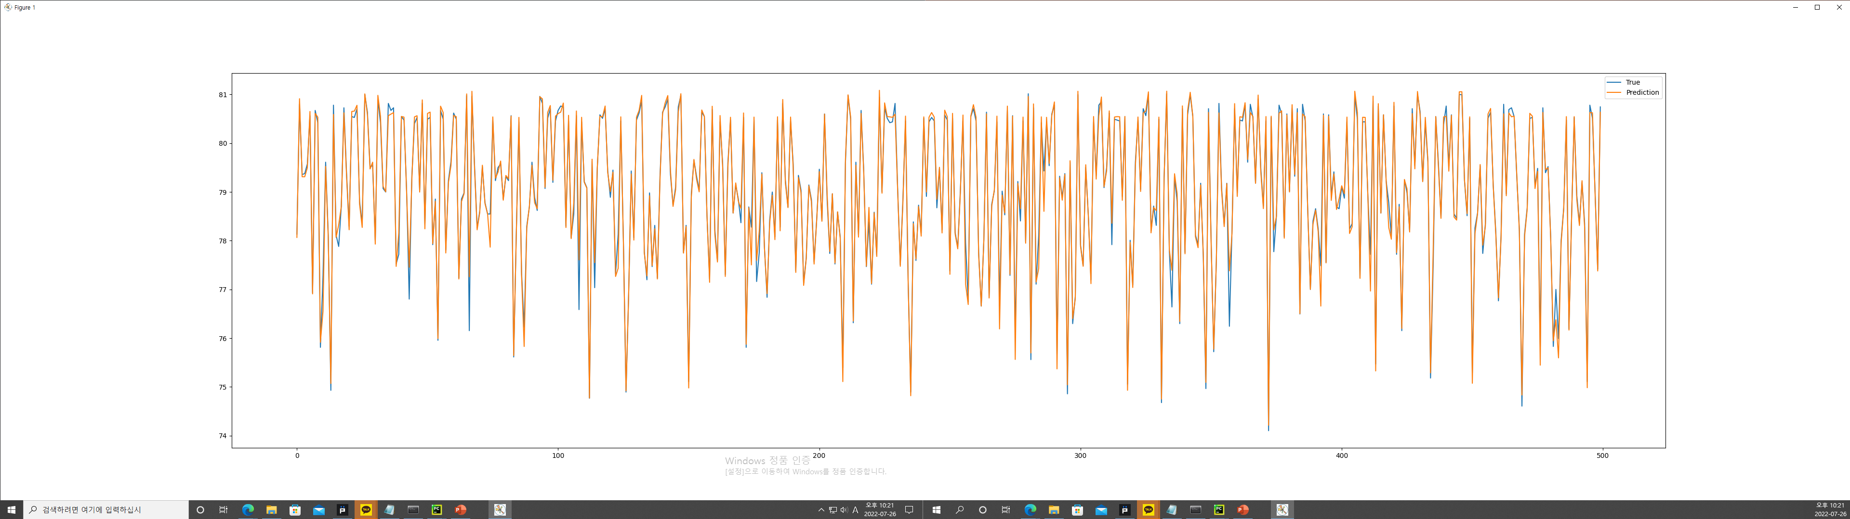
node4

Slide 7
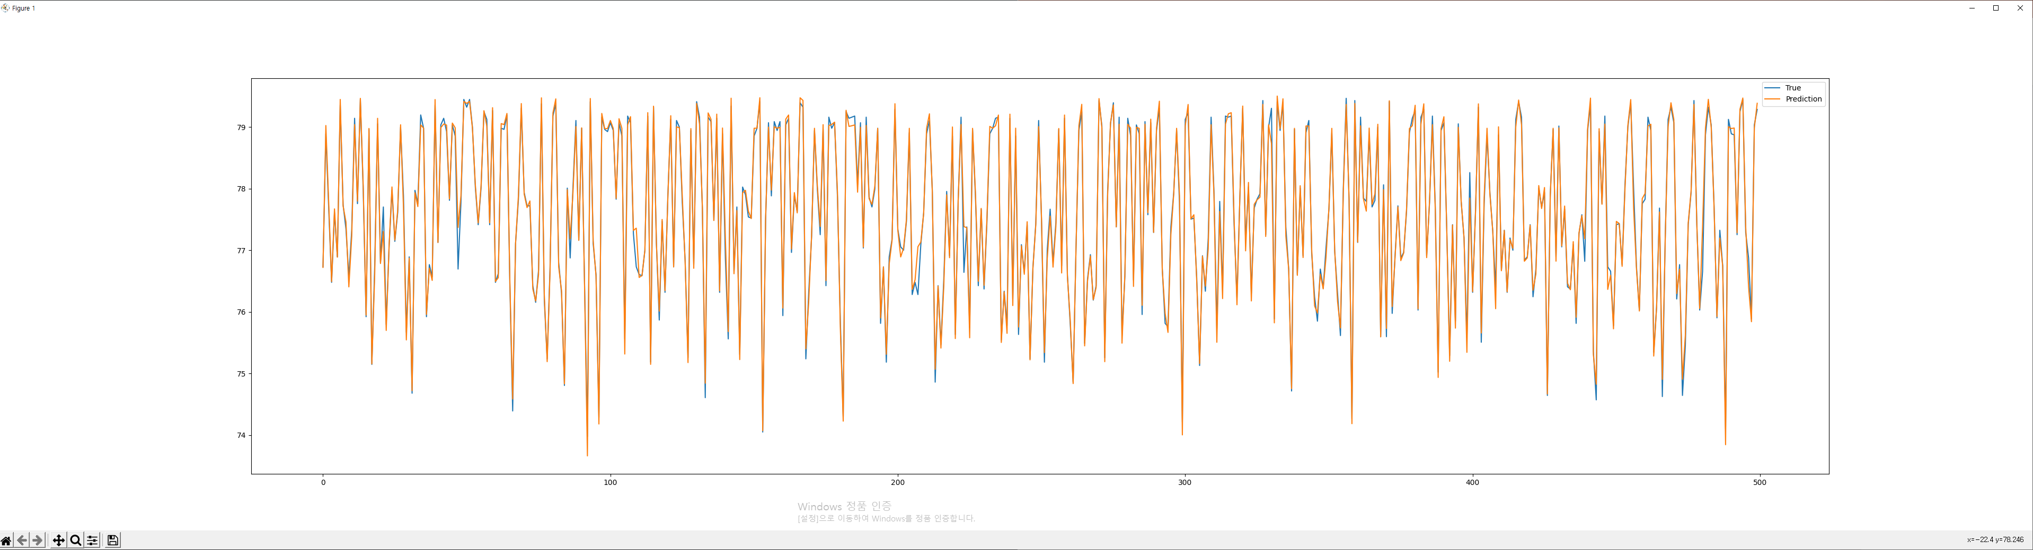
node5

Slide 8
model | LSTM1 | LSTM2 | Batch_size | epochs | accuracy | loss
model_LSTM_50_64_64_30.h5 | 50 | 64 | 64 | 30 | 89.43 | 0.1548
model_LSTM_50_64_32_30.h5 | 50 | 64 | 32 | 30 | 92.26 | 0.038
model_LSTM_50_64_32_50.h5 | 50 | 64 | 32 | 50 | 96.83 | 0.0172
model_LSTM_50_64_32_60.h5 | 50 | 64 | 32 | 60 | 97.28 | 0.0232
model_LSTM_50_64_32_100.h5 | 50 | 64 | 32 | 100 | 97.25 | 0.006
model_LSTM_100_128_32_60.h5 | 100 | 128 | 32 | 60 | 96.82 | 0.0152
model_LSTM_100_128_64_60.h5 | 100 | 128 | 64 | 60 | 94.00 | 0.016
model_LSTM_50_64_32_60_early.h5 | 50 | 64 | 32 | 60 | 95.81 | 0.0087
model_LSTM_50_128_32_60_early.h5 | 50 | 128 | 32 | 60 | 95.71 | 0.0107
model_LSTM_30_64_32_30_early.h5 | 30 | 64 | 32 | 30 | 94.69 | 0.0302
model_LSTM_50_128_32_60_early.h5 | 50 | 128 | 32 | 60 | 96.39 | 0.0083
model_LSTM_50_64_32_60_early_drop(0.2, 0.2).h5 | 50 | 64 | 32 | 60

Slide 9
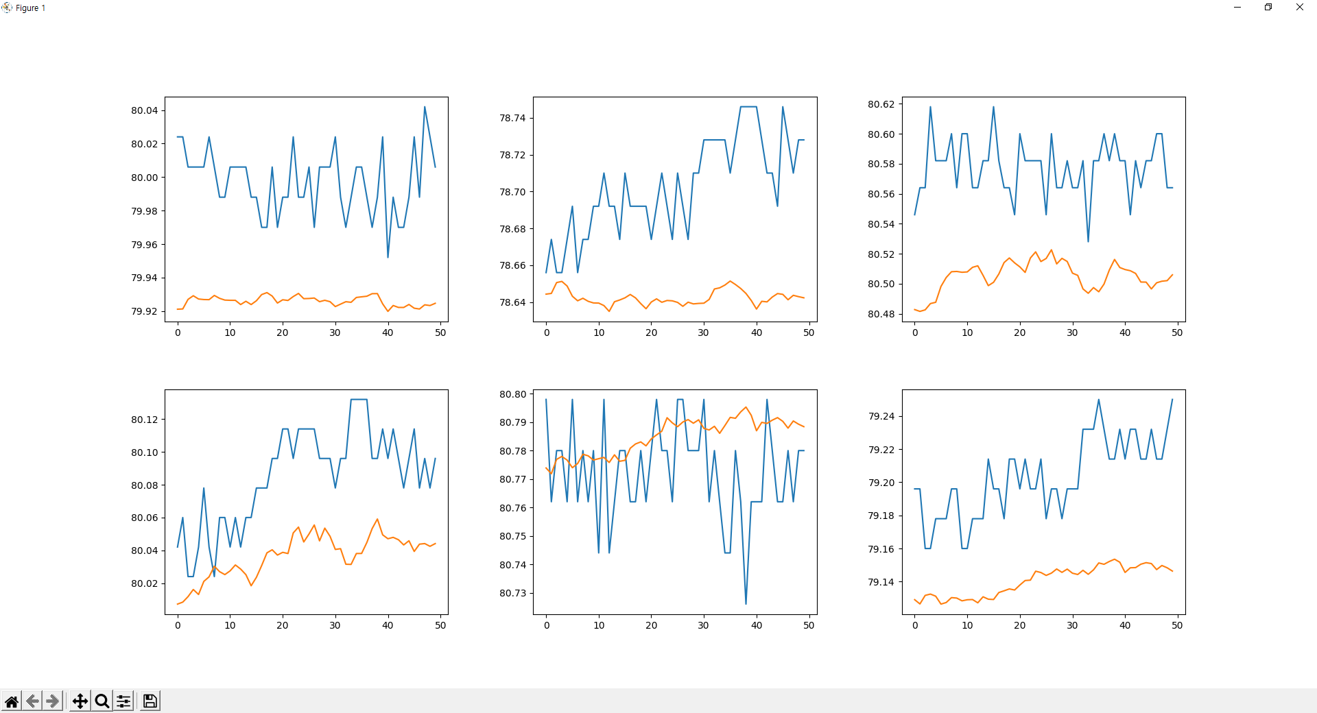

Slide 10
