Slide 1
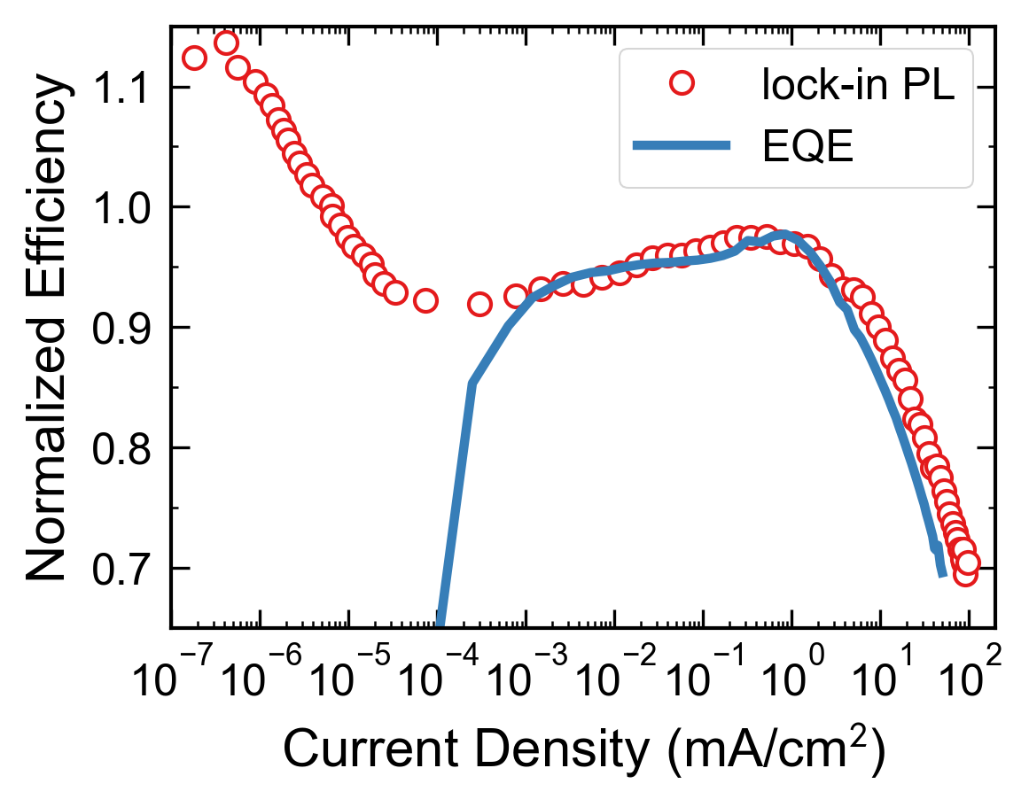
Chopper wheel
Beam Expander
λ = 405 nm laser
ND Filter
V
Lock-in amplifier
450 nm Longpass + Amplified Si PD

