Slide 1

Data Lake Value Proposition
Medical Data Processing Company
Juan Barbosa
Udacity IPS Version 1.0

Slide 2
Agenda
What is a Data Lake
Components of a Data Lake
Data Lake vs Data Warehouse
Business Value of Data Lake Solution
Proposed Data Lake Architecture for Medical Data Processing system
Udacity IPS Ver. 1 2/2020

Slide 3
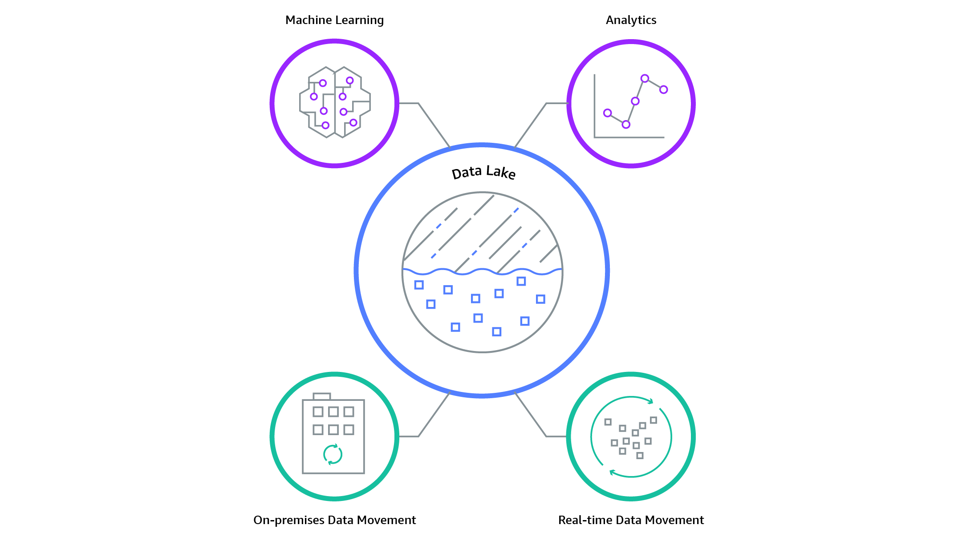
What is a Data Lake
Executive summary
Central place where we can bring together data, Machine Learning, and Analytics
Data can store data of any type, including tables, documents, and videos
Can handle scaling of any size
https://d1.awsstatic.com/AWS_Analytics_2021_LakeHouse.337c5d294eae24fe954c1d2e93fcda03233dfba4.png

Slide 4
Components of Data Lake
Ingestion
Storage
Serving
Processing
Where and how data will be stored
Data is transformed to value
How data is uploaded to the data lake
Are there any transformations to be made in the data
https://assets-global.website-files.com/60494527fea68422687bfcf1/60620c1b4240dfcdb0c2aef0_Data-Lake-Layers-v4-1.png

Slide 5
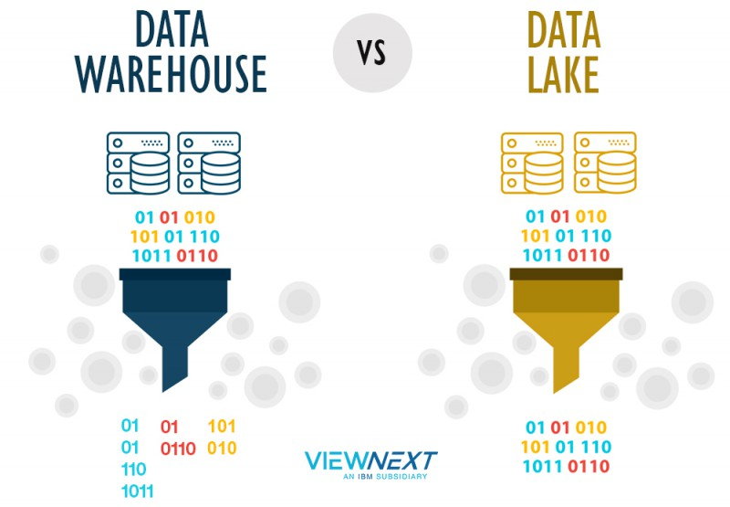
Data Lake vs Data Warehouse
https://www.viewnext.com//wp-content/uploads/2019/08/datawarehouselake-800x555.jpg

Slide 6
Data Warehouse
Data Lake
Tables
Columns must be defined at the beginning
Mostly used for business analysts
Used for historical analysis
Unites data from multiple but similar sources
Any type of data
Structure is defined at the end
Wider range of users
Used in predictive analytics and machine learning
Connects various types of data from a wide variety of sources
Udacity IPS Ver. 1 2/2020

Slide 7

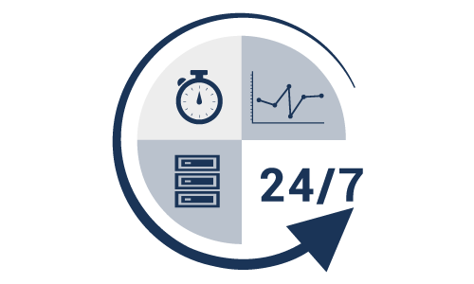


Business Value of Data Lake
Higher data
Increased speed
High availability
Lower costs
https://www.ispreview.co.uk/wp-content/uploads/2_speed_metre_broadband_and_mobile_UK.jpg
https://image.shutterstock.com/image-vector/this-database-icon-created-vector-260nw-2104885598.jpg
https://www.robotron.de/fileadmin/Robotron_DE/Images/support/robotron_icon_hochverfuegbarkeit.png

Slide 8
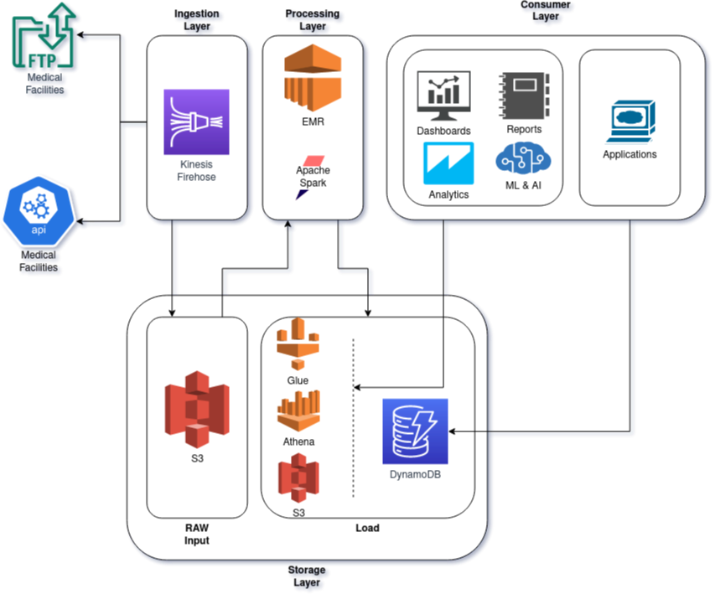
Data Lake Architecture
Easy to scale
Distribution of points of failure
Multiple Clients
The solution is based on Amazon Web Services

Slide 9
THANK YOU
Udacity IPS Version 1.0

