Slide 1


Data Governance @ SneakerPark
Prepared by: Juan Barbosa
Submitted on: 2022/06/07

Slide 2
Background
SneakerPark is an online shoe reseller that allows people to buy and sell used and new shoes. Buyers can bid for shoes or buy them outright, and sellers can set a price or sell to the highest bidder.
Each buyer and seller must have an active account in order to sell, bid, or purchase sneakers using SneakerPark’s website.
SneakerPark authenticates the shoes before shipping them to the buyer, so before listing an item, the seller must ship it to SneakerPark’s warehouse. Upon receipt, SneakerPark assigns an item number to each pair of sneakers and notifies the seller that they are now free to list their item. If the item is not listed within 45 days, SneakerPark returns it to the seller and sends an invoice to the seller for the shipping cost.
If the item is found to be inauthentic or in an unacceptable condition, it is also returned back to the seller in a similar fashion.
When the item sells, the buyer’s account is credited with the purchase price minus the SneakerPark service fee and shipping fees to deliver the item to the buyer.
Currently, SneakerPark only supports sales within the United States.

Slide 3
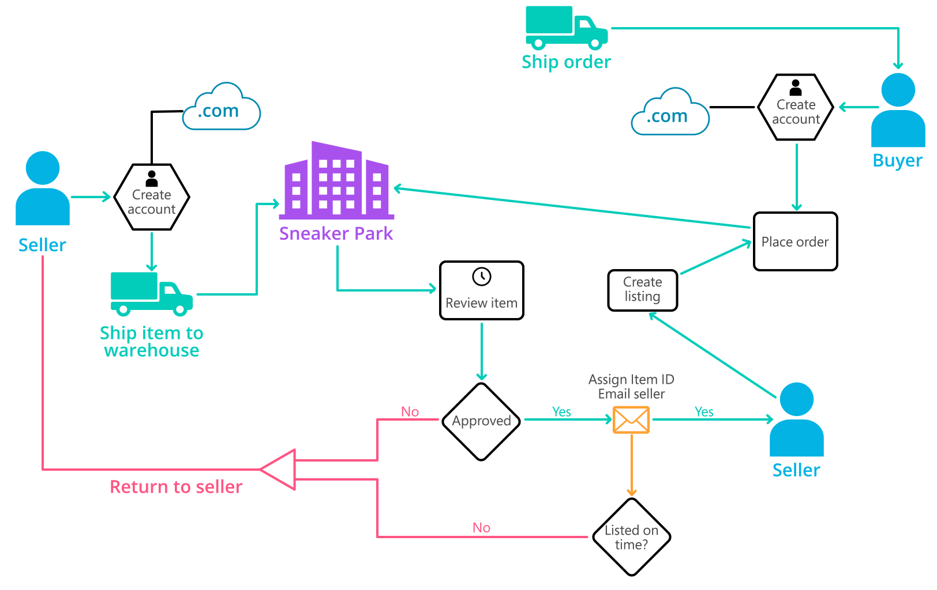
Background (cont’d)
Below you can see a diagram that will hopefully help you visualize some of SneakerPark's business processes. Keep in mind that it does not capture ALL processes and every nuance, but simply serves as another artifact to use in your project.

Slide 4
Step 1
Enterprise Data Catalog Part 1: Enterprise Data Model

Slide 5
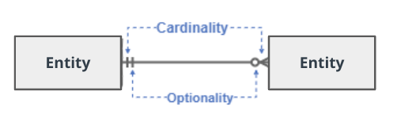
Create a conceptual data model that will provide SneakerPark with a holistic view of its data systems and help you grasp the organization's important entities and relationships, which will be instrumental as you move further in the project. You can use Lucidchart or any other diagramming tool of your choice, but please use the Crow’s Foot/IE Notation and please be sure to indicate both cardinality (the type of a relationship such as 1:N or N:N) and optionality (whether the relationship is optional or mandatory).

Slide 6
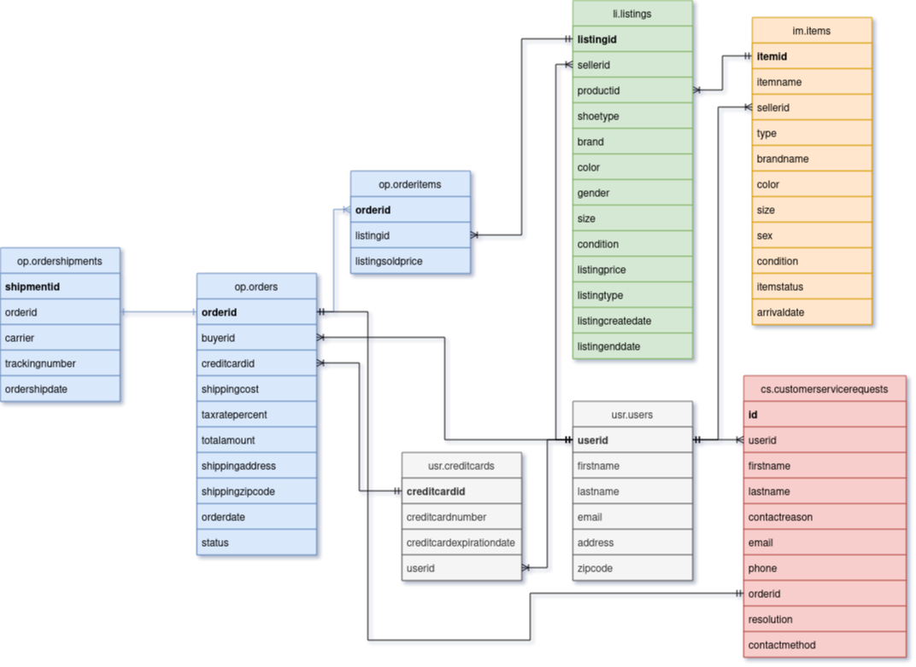
Replace the example below with your own solutions (obviously feel free to take more space):

Slide 7
Step 2
Enterprise Data Catalog Part 2: Metadata

Slide 8
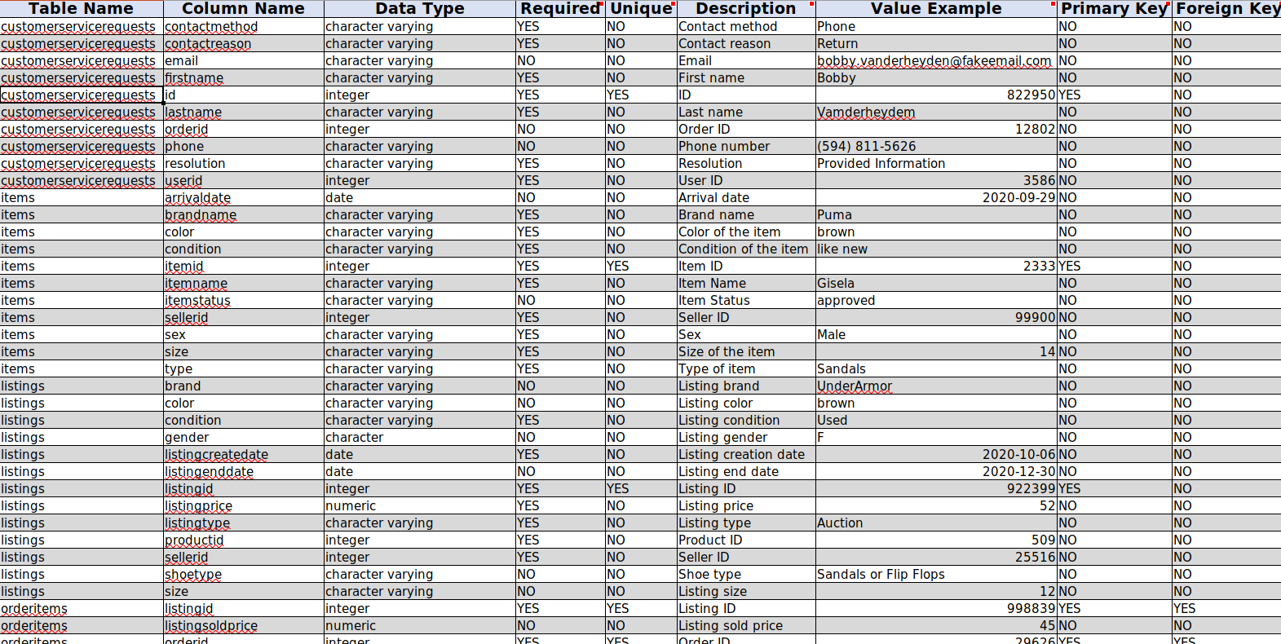
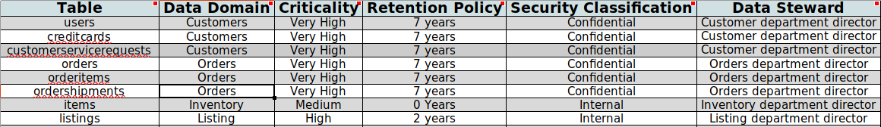
Create the first version of the Metadata Catalog by documenting the metadata from all systems in the "Data Dictionary" and the “Enterprise Data Catalog” tabs of the provided Sheets template.
Please note that you are required to fill out all fields in both tabs.
Data Dictionary
Business Metadata

Slide 9
Step 3
Data Quality
Part 1: Profiling and Cleansing

Slide 10
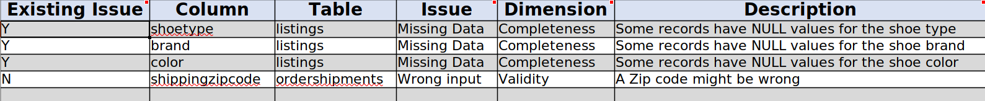
Profile the data to identify at least 3 data quality issues you see in the data. Also provide at least 1 data quality issue that you haven’t yet seen in the data, but can foresee occurring in the future. Based on the issues you’ve identified, come up with the data quality rule for each data quality issue, including for the one that you foresee.
Make sure you fill out all columns in the "Data Quality Issues" tab with your answers in the provided Sheets template.

Slide 11
Step 4
Data Quality
Part 2: Monitoring

Slide 12
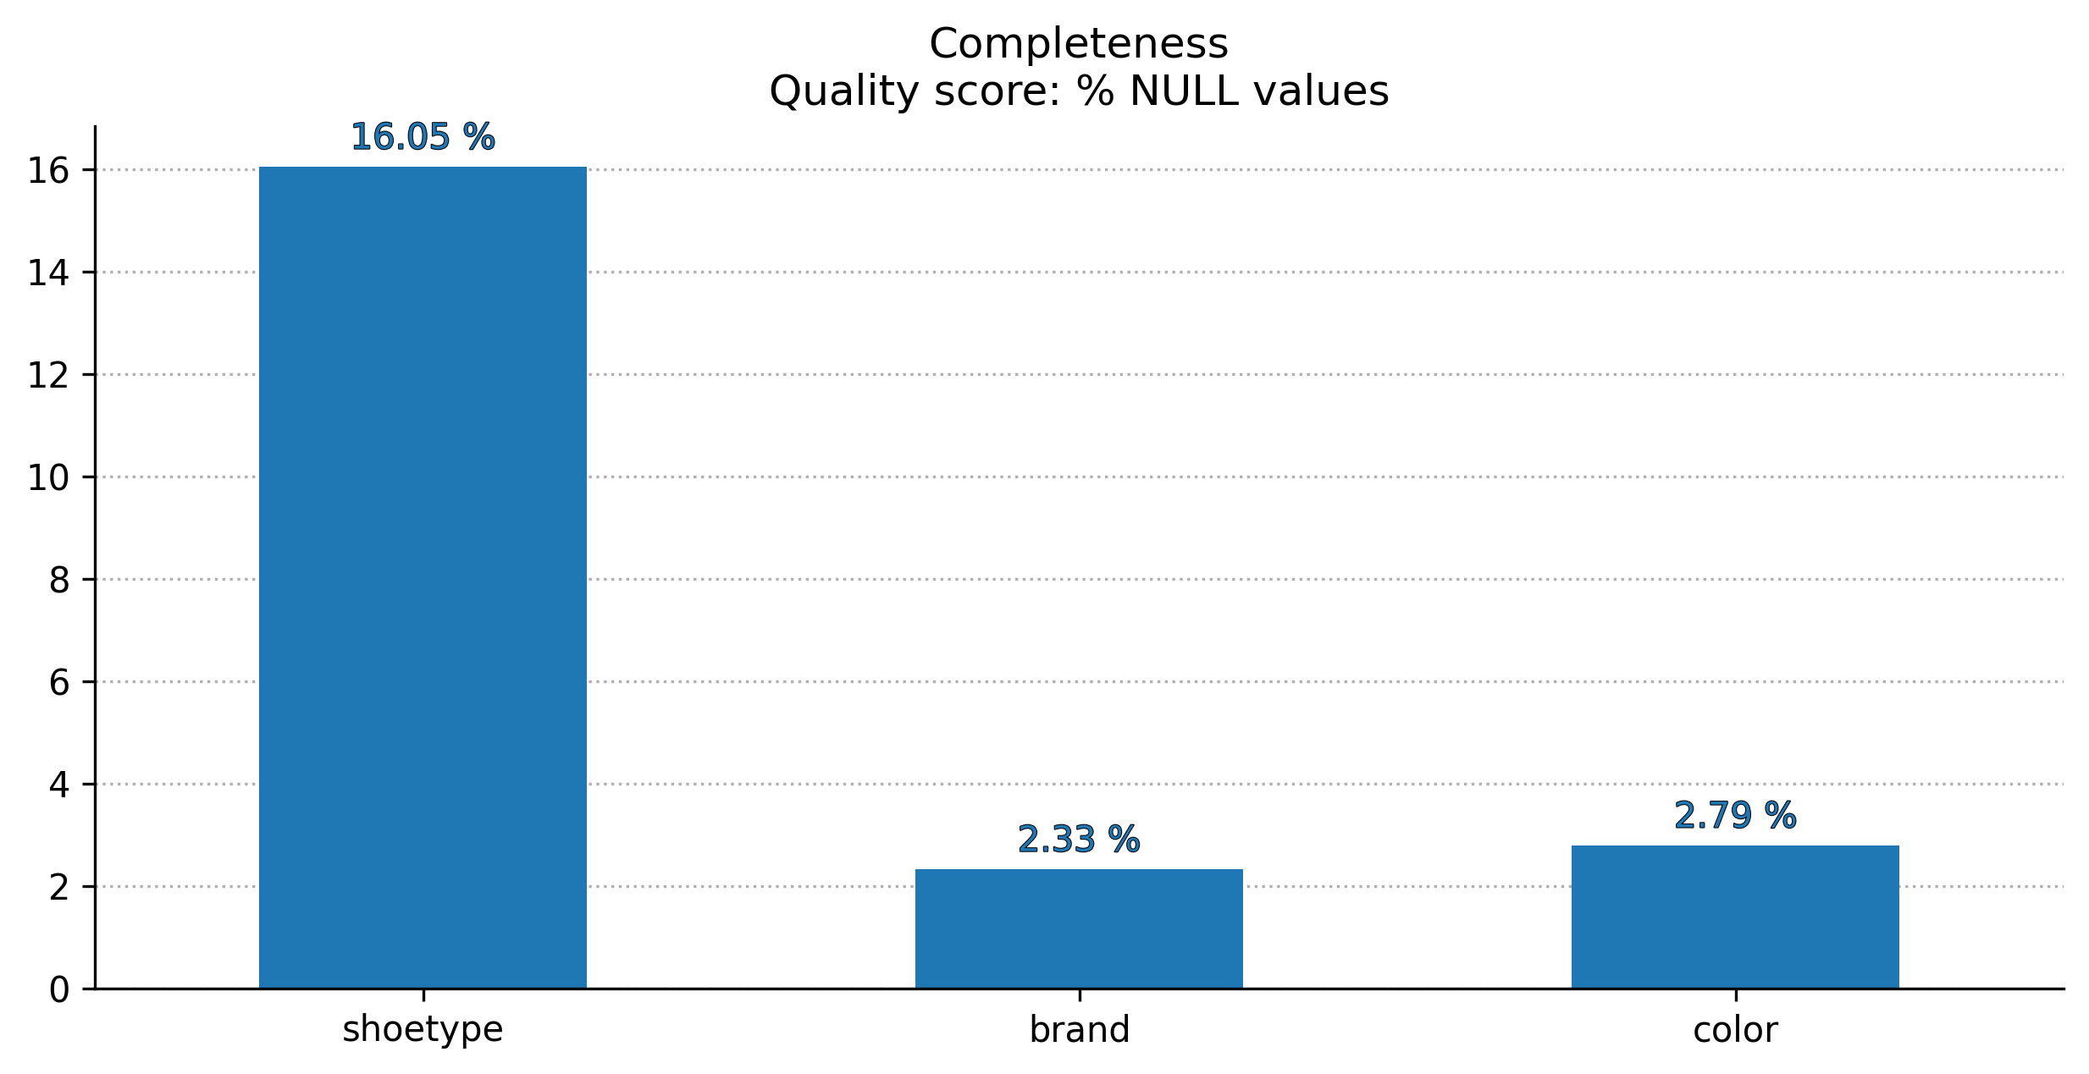
Using the metrics you've created in the last step, please create a mock-up of a data quality monitoring dashboard that will be used to monitor the data to ensure compliance with your data quality rules.
Please make sure to label your metrics clearly on your mock-up.
Replace the example dashboard below with your own. (obviously feel free to take more space).

Slide 13
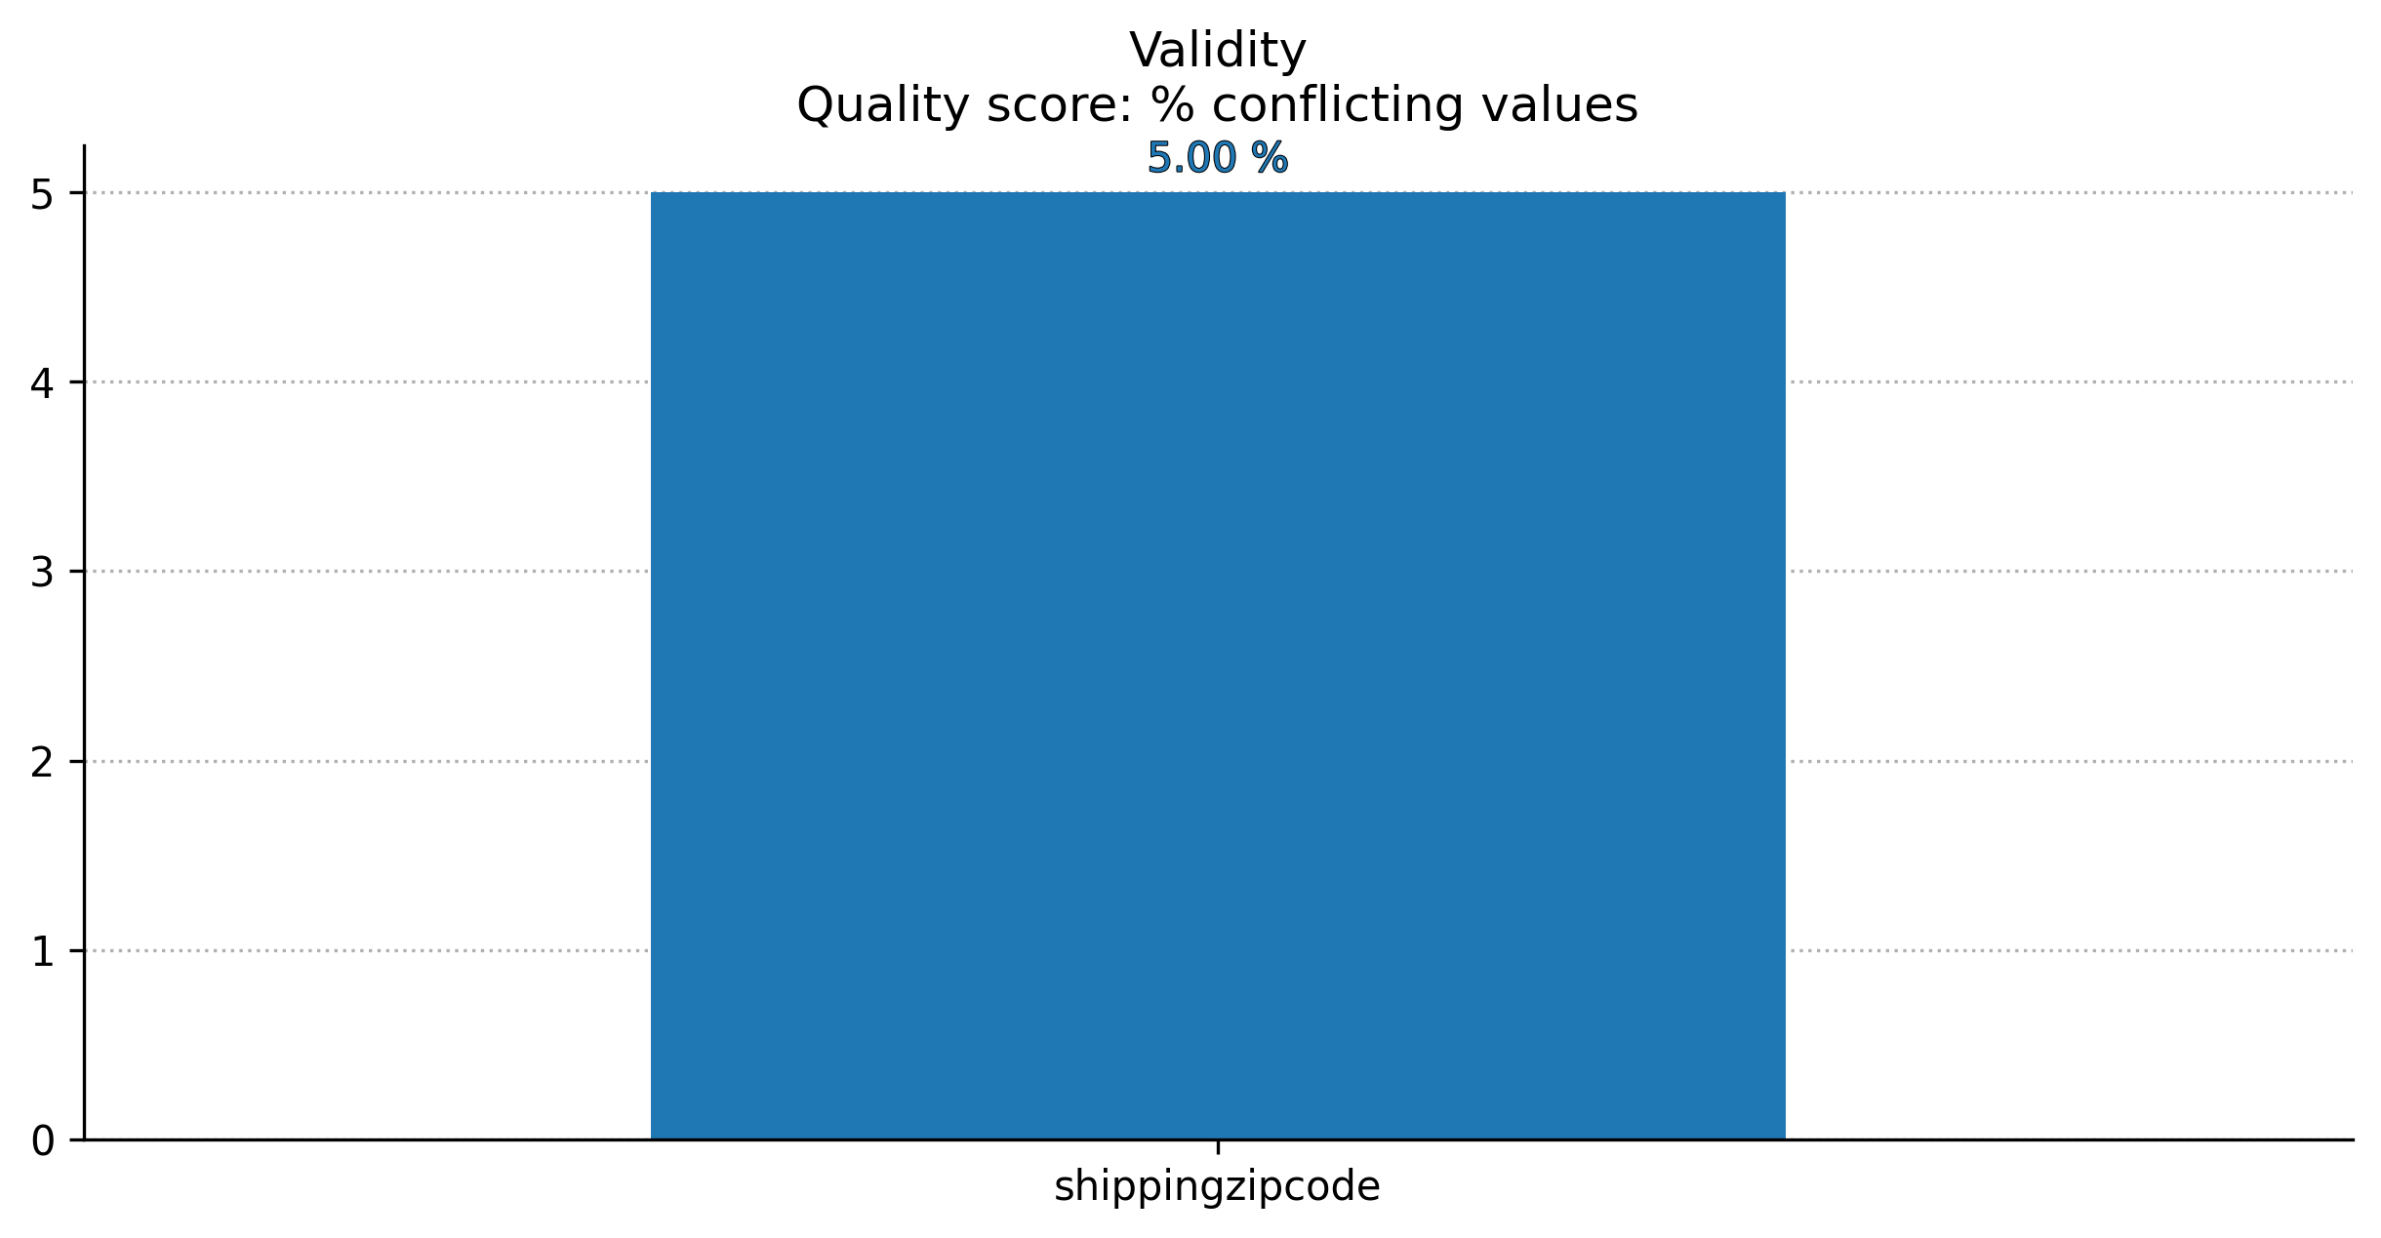

Slide 14
Step 5
Master Data Management
Part 1: MDM Architecture

Slide 15
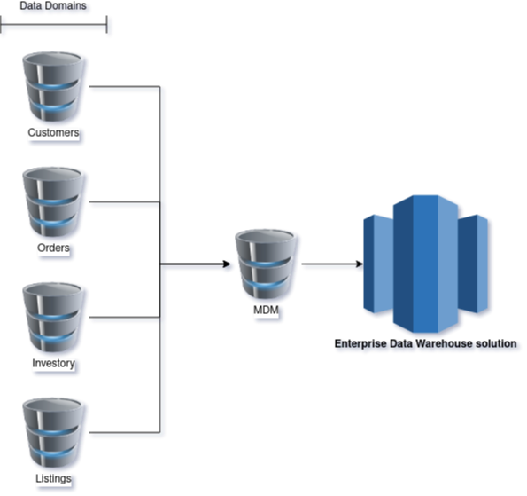
Consolidated architecture

Slide 16
A consolidated architecture is the easiest Master Data Management architecture that supports and MDM HUB. This is very important since it is the first time a data governance program is put in place in the company. Data governances programs come at a high costs, thus, starting from the bottom is a lower risk decision. Furthermore, as the HUB is right in the middle of the architecture, fields can be cleaned and verified before being sent into the data warehouse system to be built in the phase 2 of the project. Considering the operation of the company, it is also important to keep in mind how the implementation of the MDM might affect existing systems. By using a consolidated architecture, a medium-low disruption of the current systems is expected.
Explanation:

Slide 17
Step 6
Master Data Management
Part 2: Master Record

Slide 18
The following matching rules will be used by the SneakerPark's MDM Hub to match item and customer entities between the company's different systems.
Items and listings are to be matched using the itemid and the productid. Also color, brand name, gender/sex, size and condition are to be matched to uniquely represent the characteristics of an item.
Listings and orderlistings are to be matched using listingid
Customer data is to be merged using the userid fields from the user table and the customerservicerequest. Firstname, lastname and email should uniquely identify a user
Customer data is to be matched using the userid field and the sellerid from listings and items
Customer data is to be marched using the creditcardid fields

Slide 19
Step 7
Data Governance:
Roles and Responsibilities

Slide 20
As part of the implementation of the data governance project, the names of the data stewards must be included in the Business Metadata. They role is crucial for the success of the implementation of the project, by overseen data quality and standardizing data from each data domain. Fuerthermore, metadata management is to be constantly reviewed for changes in any of the data domains.
Since a consolidated architecture was proposed, metadata management because more important as it ensures that information can be integrated and mantained in the MDM HUB.
Data Quality Management is also important to keep a healthy system, if data is no overseen, thrust in the data can be easily lost.
Finally, Jake can take the role of metadata manager, as he knows every field in the multiple databases. Jessica can take the role of SME. Nevertheless, as they are currently very busy, the company needs to make new hires to replace them in the roles they currently have.

