Slide 1
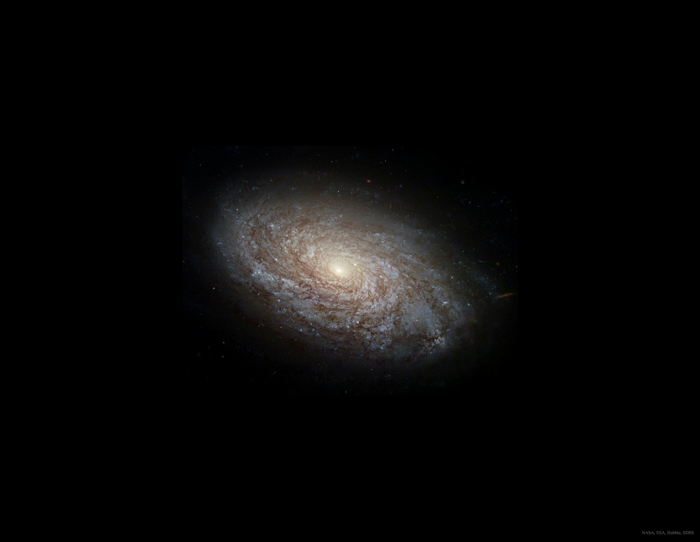
Dark matter halo:
NFW
+
Stars:
Hernquist
Baryonic
Distribution
Gas:
Power law

