Slide 1

Notes:
Good morning. Today I'll present our work on sparse index tracking — the problem of replicating the S&P 500 with a much smaller portfolio. We compare three approaches: Lasso regression, a mixed-integer quadratic program solved with CVXPY, and a constraint-programming model in OR-Tools' CP-SAT. The goal is to understand what each method buys us in terms of tracking accuracy and operational realism.

Slide 2
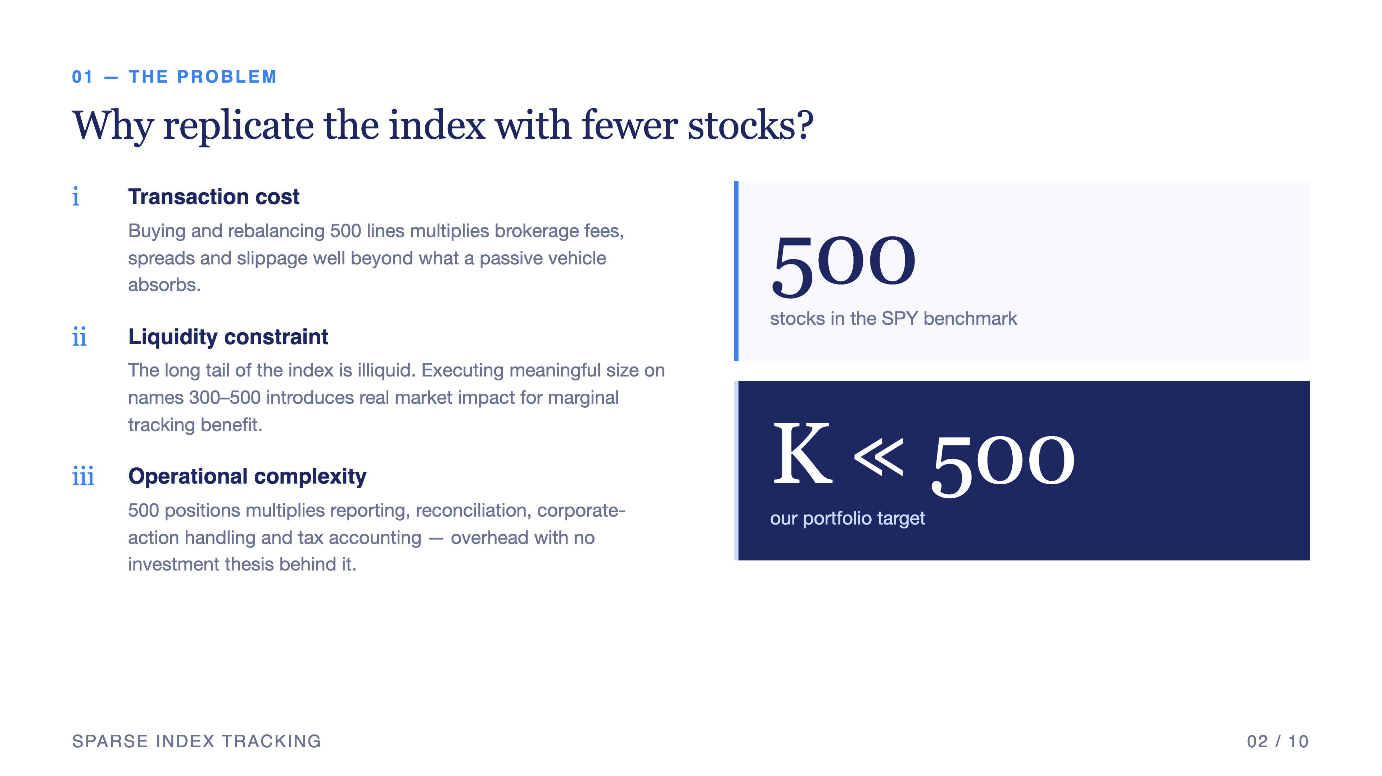
Notes:
Why do this at all? The S&P 500 is, by construction, a basket of five hundred names. Replicating it one-to-one means paying transaction costs on five hundred lines, managing liquidity on each, and rebalancing the full set every period. Our objective is to find a much smaller portfolio — K well below 500 — that tracks the index closely enough that the savings in cost and complexity outweigh the tracking error we accept.

Slide 3
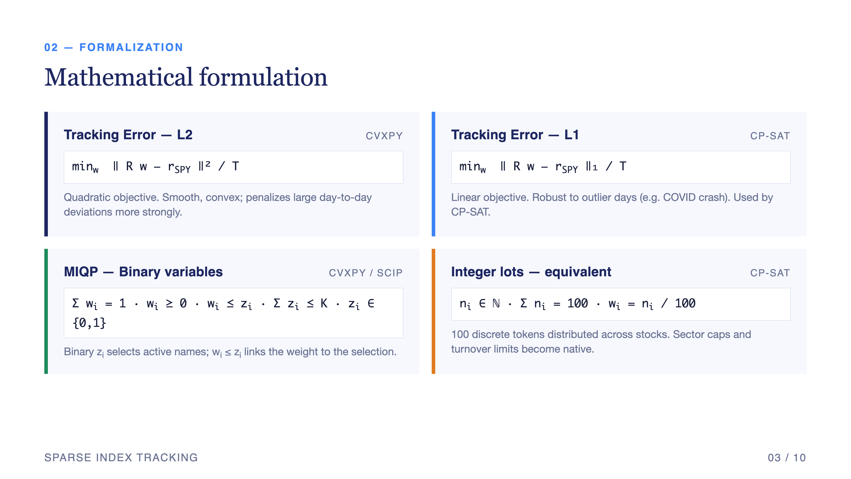
Notes:
Formally, we minimize the tracking error between our portfolio returns R w and the SPY returns r_SPY, in either L2 or L1 norm. To enforce sparsity we introduce binary selection variables z_i and constrain their sum to K. Weights are non-negative and sum to one — long-only and fully invested. For CP-SAT we go further and discretize into integer lots: one hundred lots distributed across selected stocks, which lets us add realistic integer constraints the convex formulation cannot express.

Slide 4
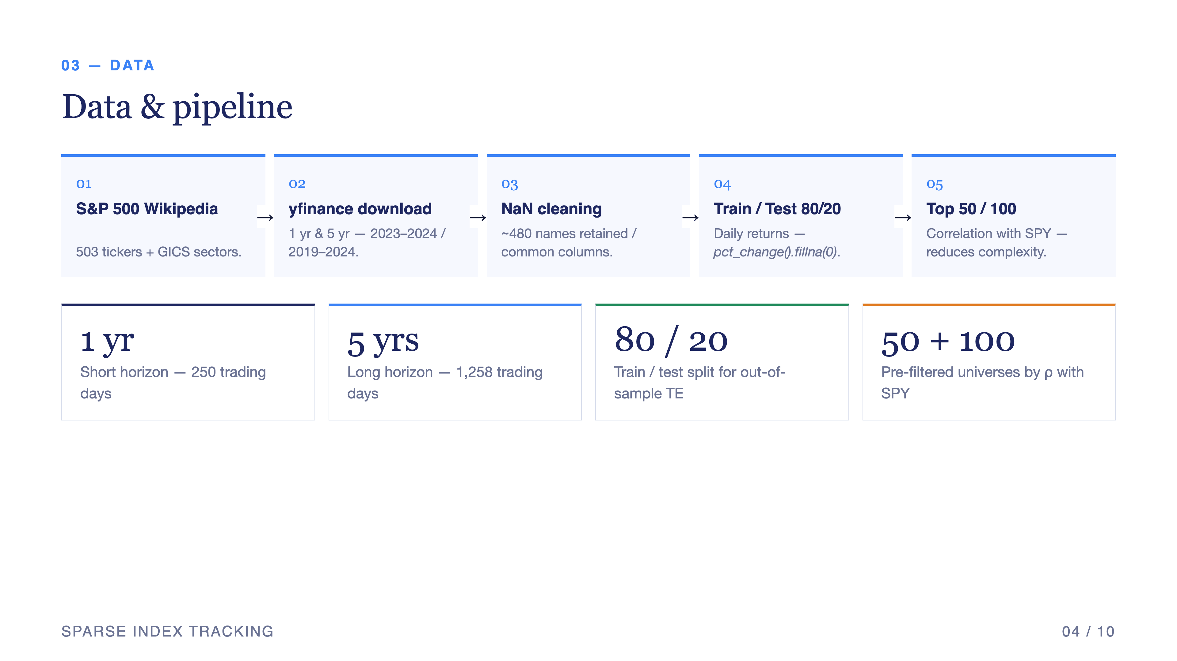
Notes:
Our pipeline starts from the S&P 500 component list scraped from Wikipedia, downloads adjusted closes via yfinance, drops columns with more than five percent missing data, and splits eighty-twenty into train and test. To make the optimization tractable we pre-filter to the top fifty or top one hundred stocks most correlated with SPY before running the optimizer. We work on two horizons — one year and five years — to test stability across regimes.

Slide 5
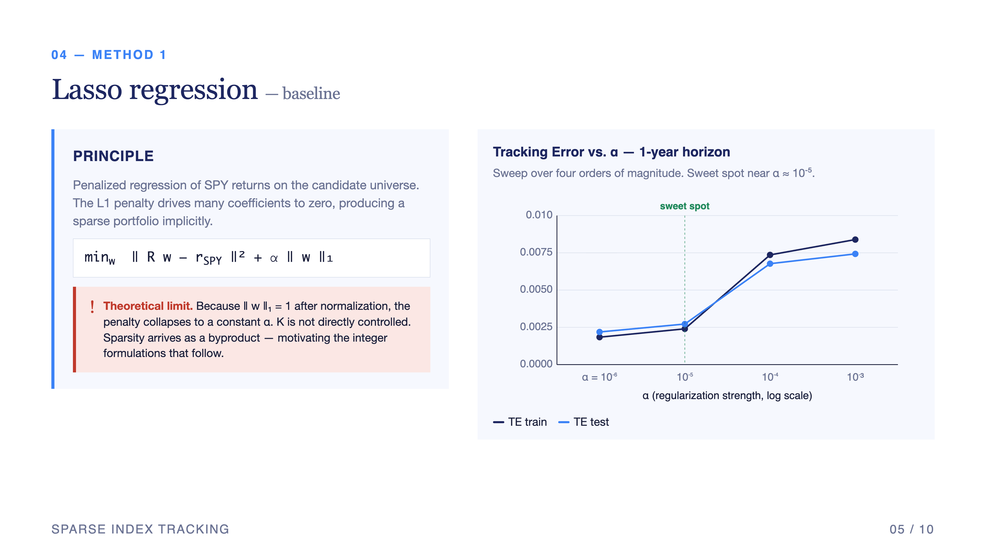
Notes:
Lasso is our baseline. We sweep alpha across four orders of magnitude. The expected behavior — small alpha gives dense, accurate portfolios; large alpha gives sparse but inaccurate ones — is confirmed. The catch is theoretical: because we normalize weights so their L1 norm equals one, the Lasso penalty term becomes a constant and contributes nothing to the optimization. Lasso gives us sparsity as a side effect, not as an explicit decision variable. We need a method that controls K directly.

Slide 6
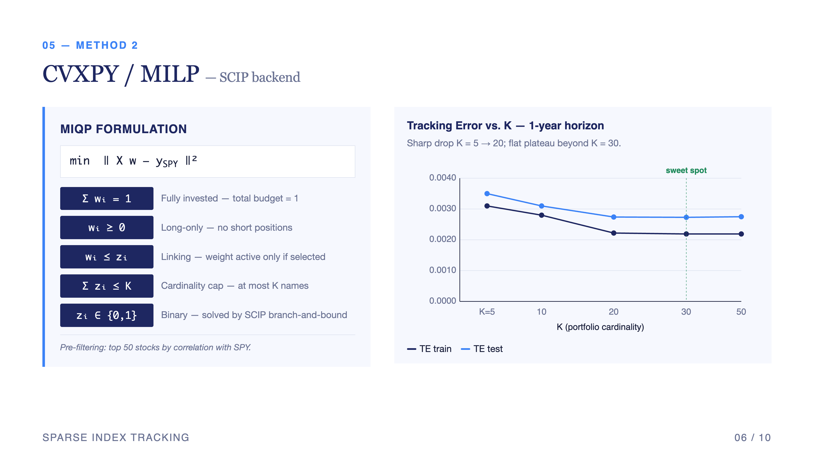
Notes:
CVXPY with the SCIP backend gives us exactly that. We write the mixed-integer quadratic program: minimize L2 tracking error subject to budget, no-shorts, the linking constraint w_i bounded by z_i, and a cardinality cap. Sweeping K from five to fifty we see tracking error drop sharply from K equals five to K equals twenty, then plateau. Adding more names beyond thirty buys us essentially no improvement on the test set.

Slide 7
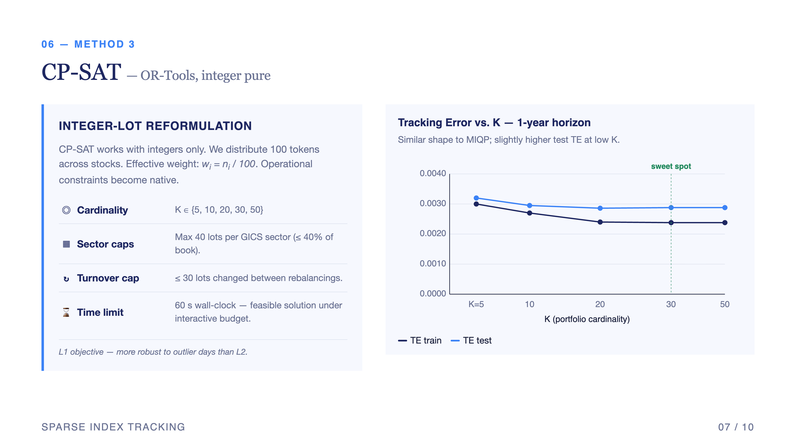
Notes:
CP-SAT reformulates the problem in integers — one hundred lots distributed across the universe. This is operationally meaningful: it mirrors how a real portfolio manager would allocate capital in discrete units. It also lets us add constraints CVXPY cannot handle elegantly: sector caps at forty lots, a turnover cap of thirty lots between rebalances, and a sixty-second time limit. CP-SAT uses an L1 objective, which is more robust to outlier days such as the COVID crash.

Slide 8
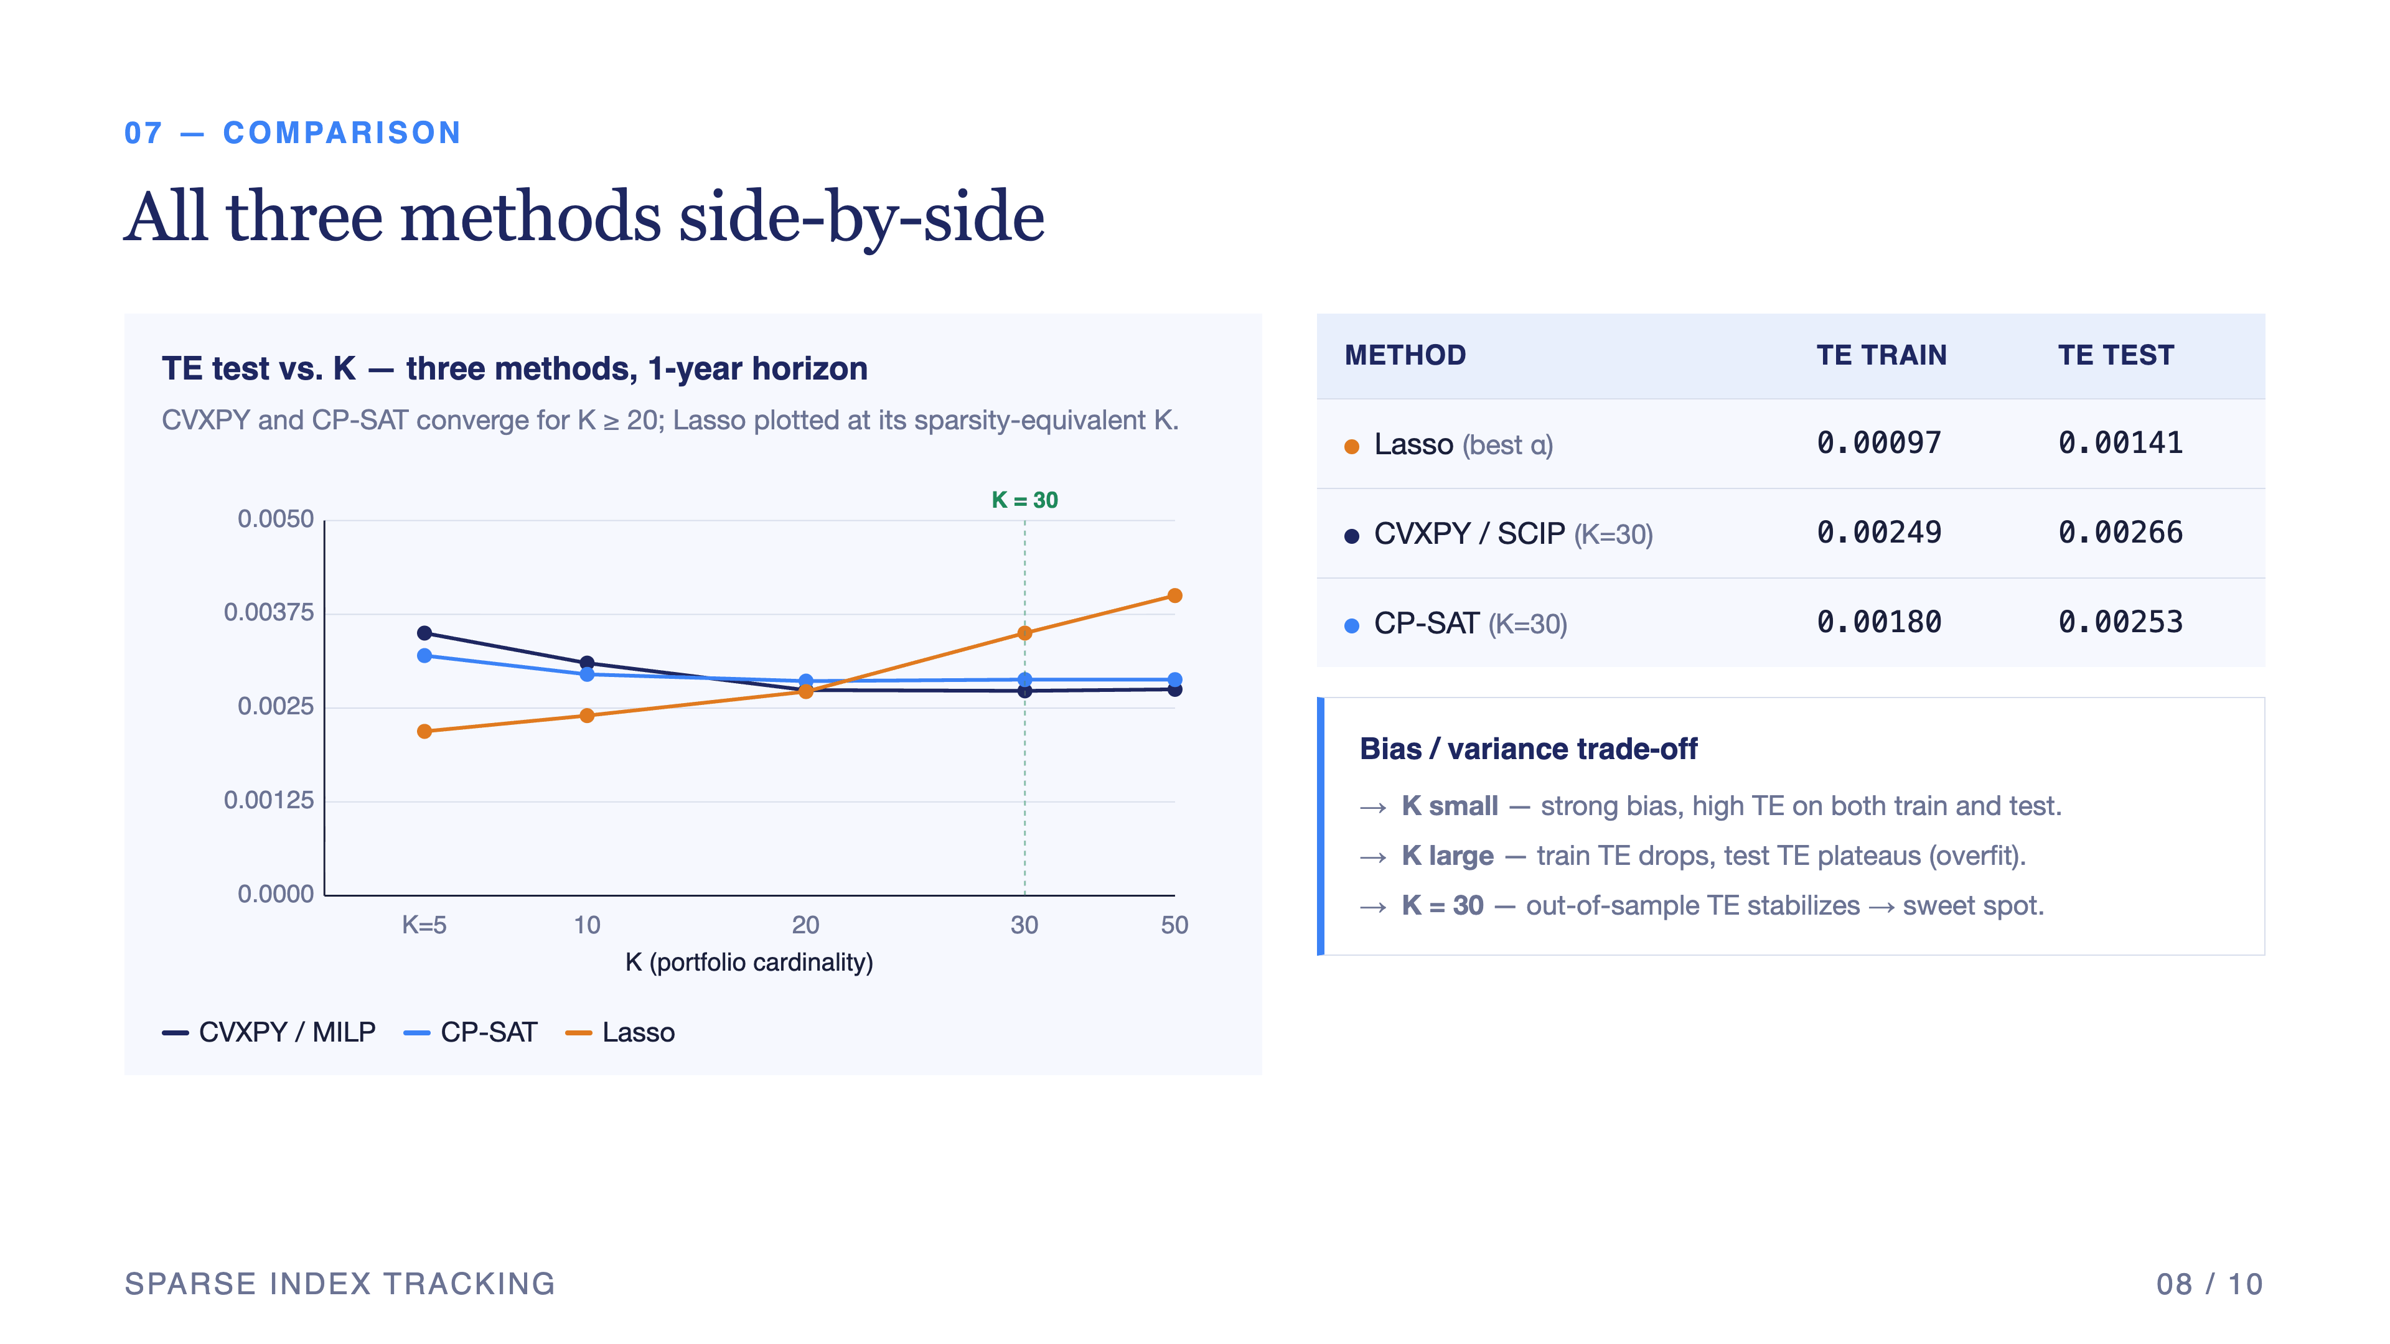
Notes:
Putting the three methods side by side at K equals thirty: Lasso gives the lowest tracking error in-sample but cannot guarantee K directly. CVXPY and CP-SAT converge to similar test-set performance, around twenty-five basis points. The bias-variance picture is clear: small K means bias, large K means overfit, and K equals thirty is the sweet spot where out-of-sample tracking error stabilizes.

Slide 9
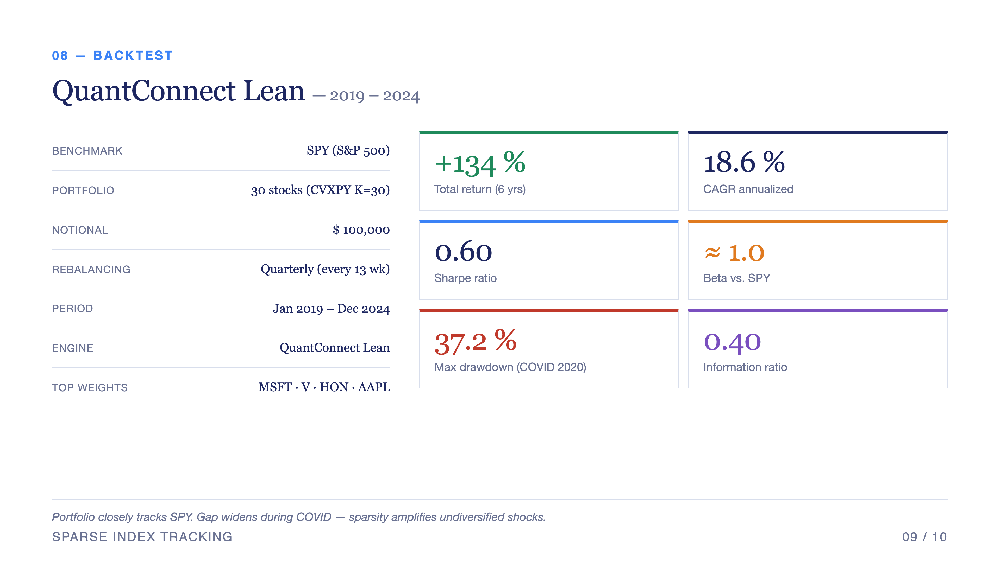
Notes:
We then took the CVXPY K equals thirty portfolio — the top names being Microsoft, Visa, Honeywell, Apple — and ran it on QuantConnect from January 2019 through December 2024. Benchmark SPY, one hundred thousand dollars notional, quarterly rebalancing. Over that window the portfolio returned one hundred and thirty-four percent, an eighteen-point-six percent CAGR, with a beta close to one and a thirty-seven percent max drawdown driven by the COVID crash. The Sharpe is moderate at zero-point-six; the information ratio is positive but modest.

Slide 10
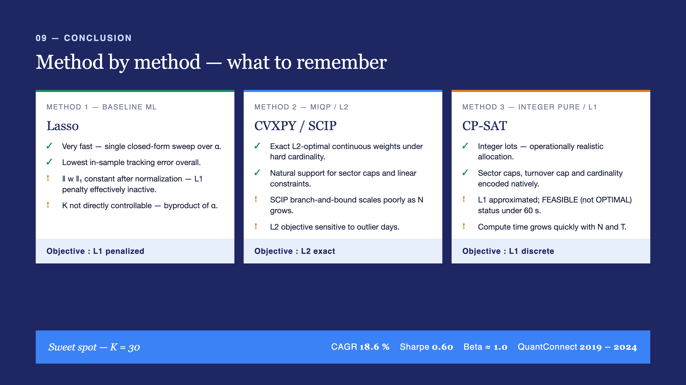
Notes:
To conclude: each method has a role. Lasso is fast and pedagogically clean but cannot enforce K. CVXPY-MILP gives exact L2-optimal weights with explicit cardinality. CP-SAT delivers operational realism — integer lots, sector caps, turnover limits — at the cost of using L1 rather than L2. Across all three the sweet spot is consistent: thirty stocks, CAGR around eighteen-point-six percent, Sharpe around zero-point-six, beta close to one. Thank you — happy to take questions.

