Slide 1

Ph.D. in Psychology
Acquisition of Social Network Graphs
UCSD
B.S. in Computer Science
Wash U
Web development company
Won the San Diego Entrepreneur Weekend Challenge

Slide 2

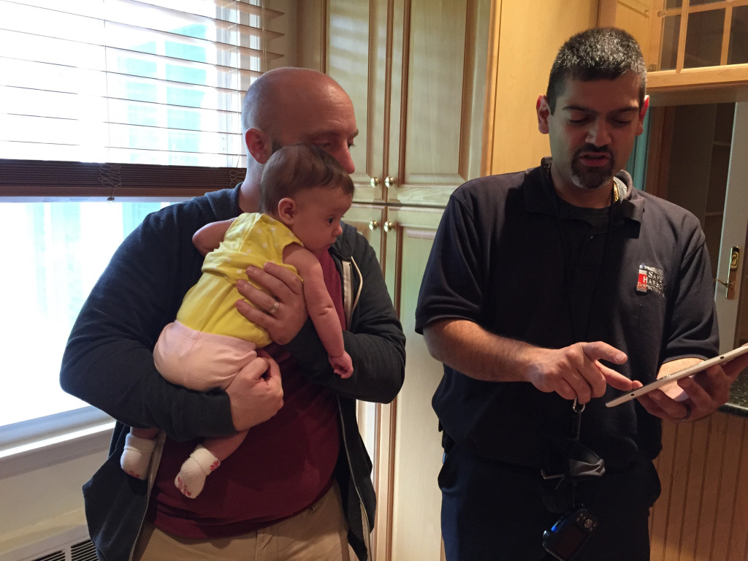

Slide 3
Estimating Cognitive Ability with Social Media Data
Jason J. Jones
7/15/2015

Slide 4
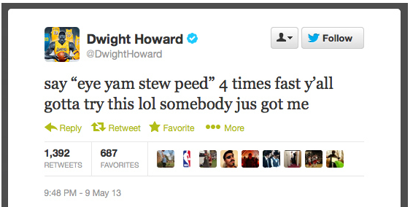

Slide 5
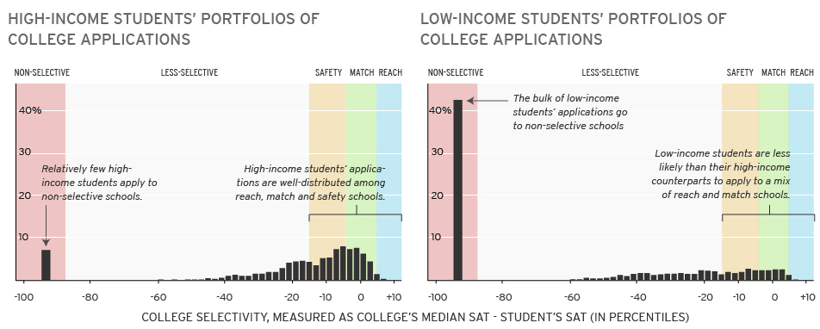
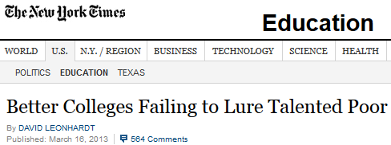
Brookings Institution
Notes:
Harvard free under $40k. Admissions believes there aren’t any unrecruited high-achieving poor students. This is the why? Slide.

Slide 6
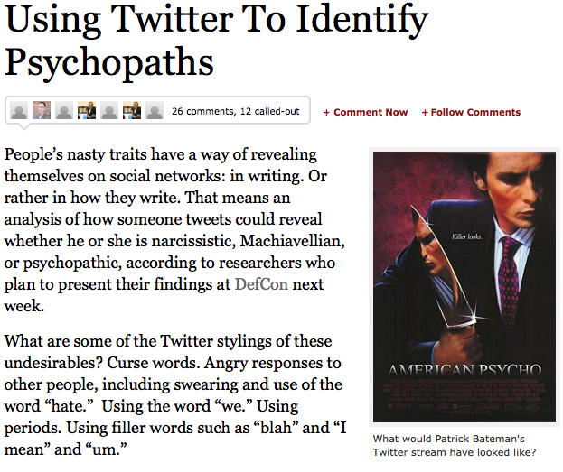

Slide 7
Friendship Lever
Friends’ data is more predictive than users’ own data
Ruths ideology
Fowler flu and hashtags
Vazire self vs. others’ judgments of personality
Give me a place to stand and with a lever I will move the whole world. -Archimedes

Slide 8
Estimating Cognitive Ability with Social Media Data
Administer test of cognitive ability to Twitter users.
Raven’s Progressive Matrices
Construct features predictive of cognitive ability with Twitter data.
Relate features to test outcomes. Fit models and evaluate.

Slide 9
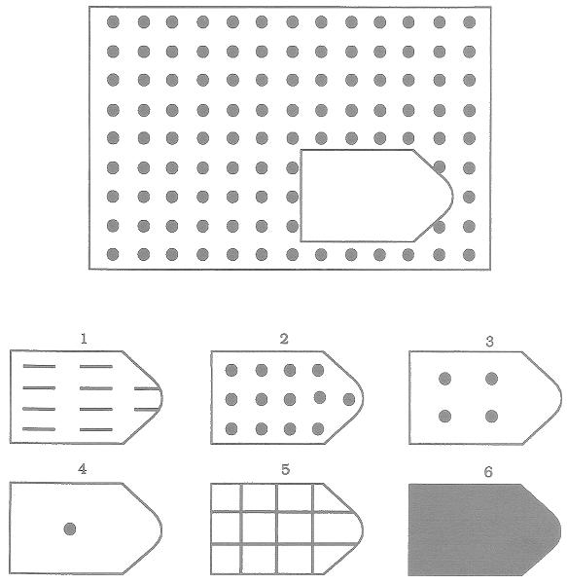
Raven’s 1 here
Notes:
60 questions. Normed on thousands of people in several different countries.

Slide 10
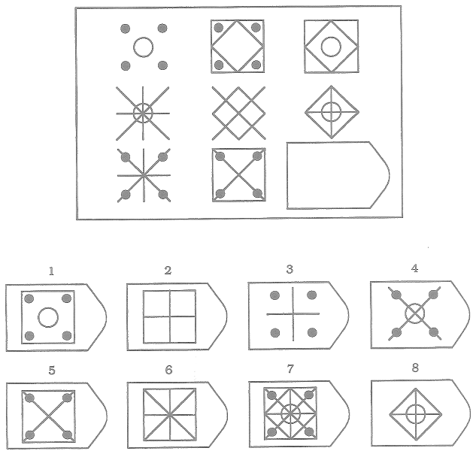

Slide 11
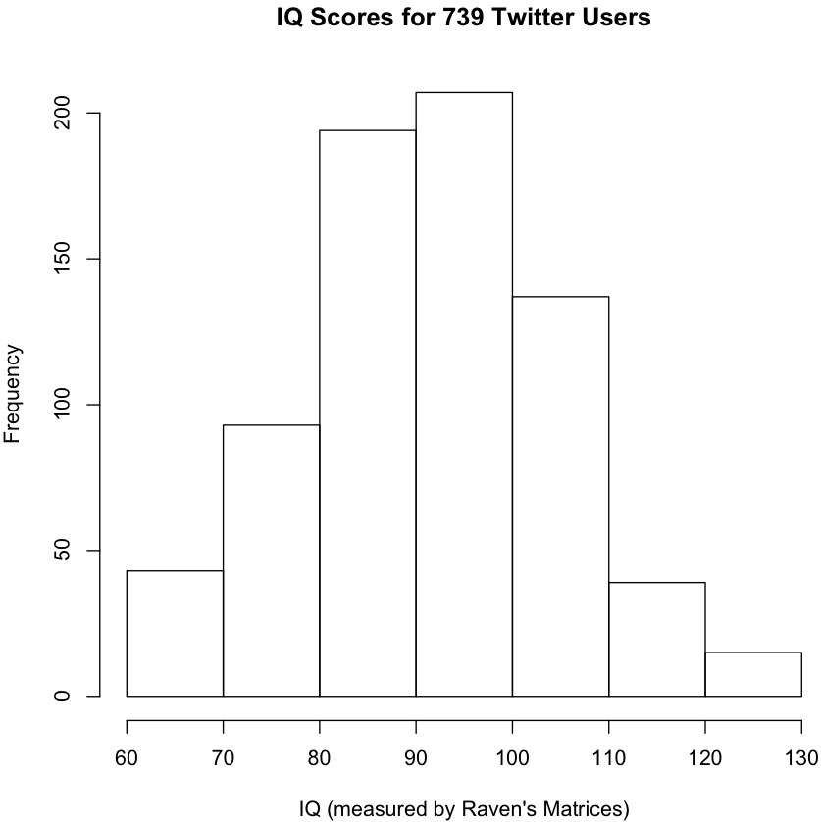
M = 93
SD = 14
Notes:
Take a score out of 60, convert to percentile, convert percentile to IQ.

Slide 12
Predictive Features from Twitter Data
Writing
Unique Words
Word Length
Spelling Errors
Signal Words
Entropy
Sentence Complexity
Reading
Unique Words
Word Length
Spelling Errors
Grammar
Network
Betweenness
Transitivity
Brokerage
Follows who
Twitter Usage
Tweet Count
Friends Count
Favorites Count
Twitter Age
Hashtags, URLs, Mentions
Influence
Follower Count
Retweeted Count
Favorited Count
Mentioned Count
Listed Count

Slide 13
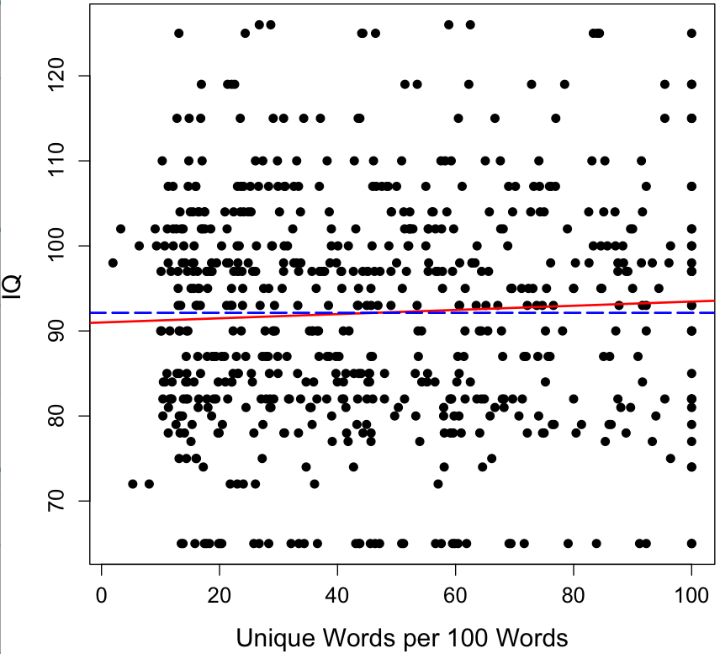
r = 0.05

Slide 14
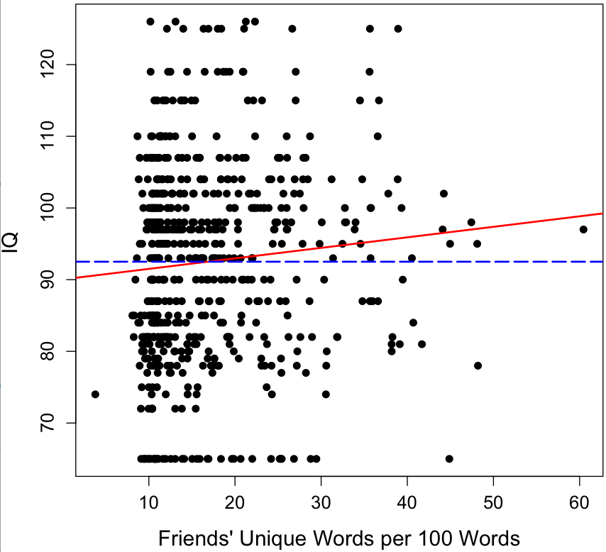
r = 0.09
*

Slide 15
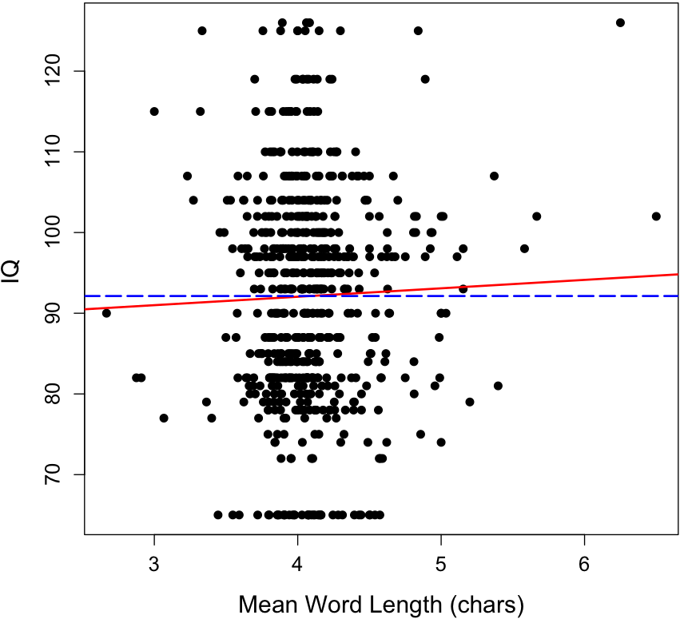
r = 0.03

Slide 16
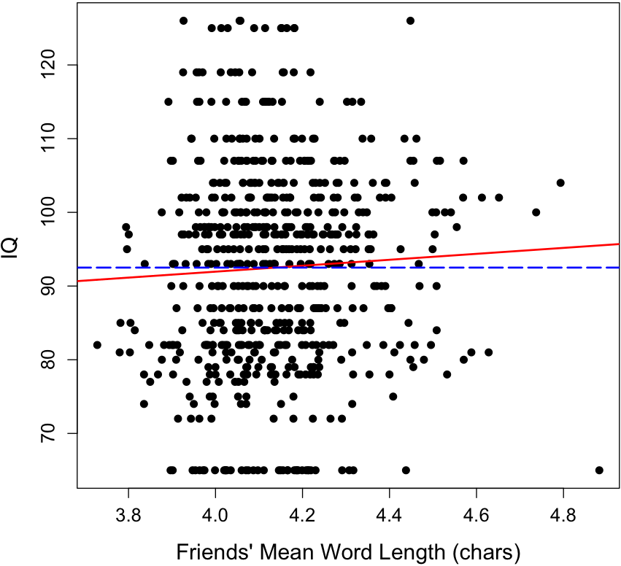
r = 0.05
*

Slide 17
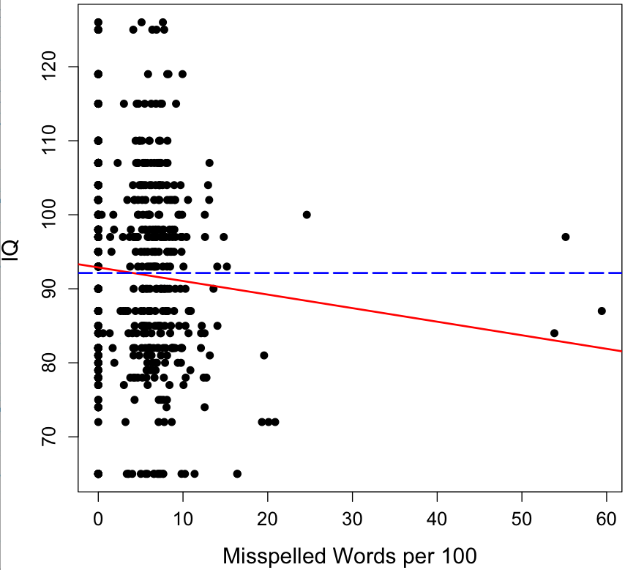
r = -0.09
*

Slide 18
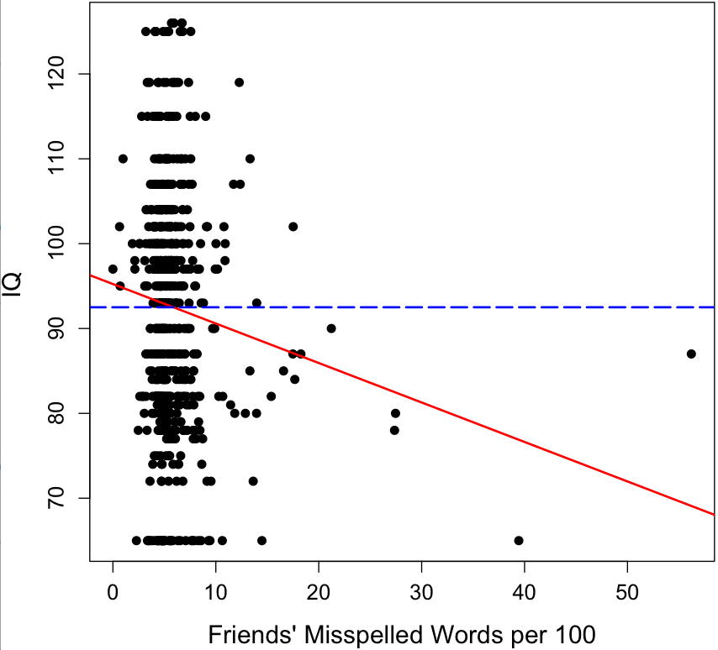
r = -0.11
*

Slide 19
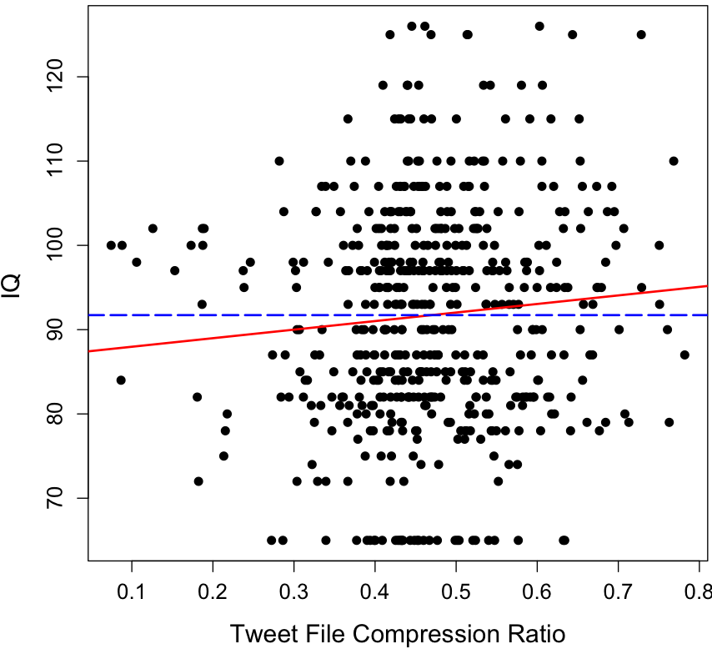
r = 0.09
*

Slide 20
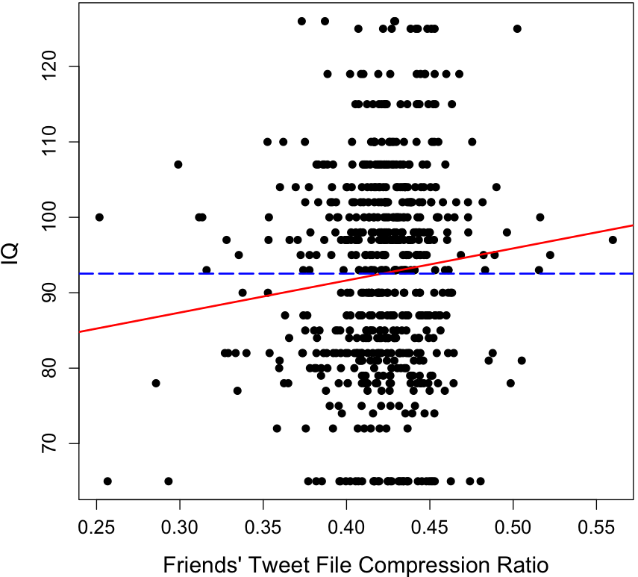
r = 0.10
*

Slide 21
Friendship Lever
Friends’ tweet data is consistently more predictive of IQ than one’s own tweet data.
Is this simply a matter of more data allowing better inference?
Would the effect hold up if friends’ data was sampled down to the same N as own data?

Slide 22
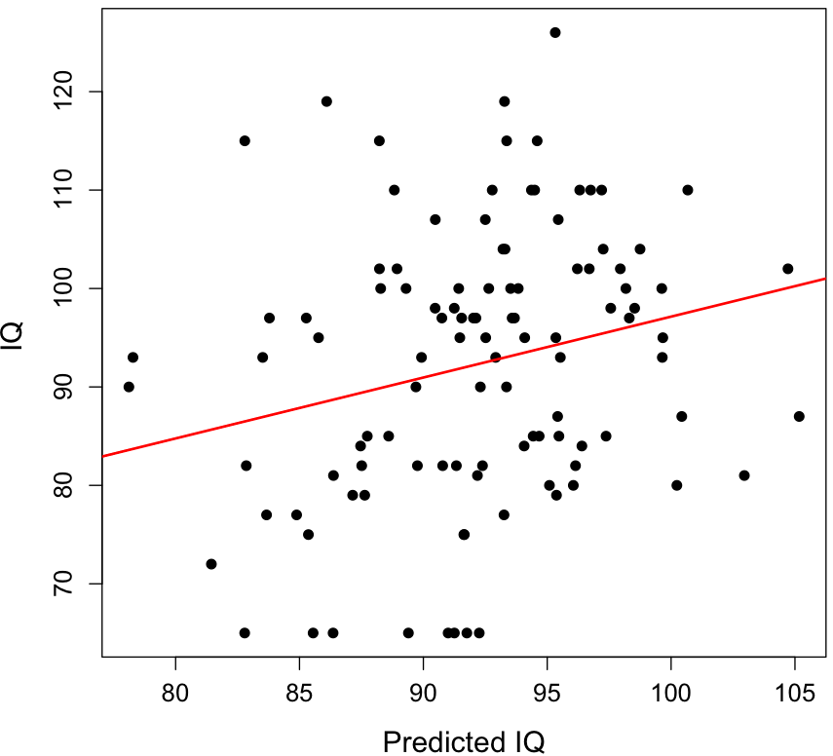
Random Forest Regression 5-Fold X-Validate
r = 0.23
RMSE = 13.50

Slide 23
Facebook + SAT Scores
6 million 19-year-olds
3 million identify which college or university they attend
SAT data from IPEDS

Slide 24
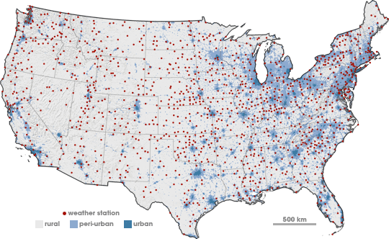
The “Local Warming” Effect

Slide 25
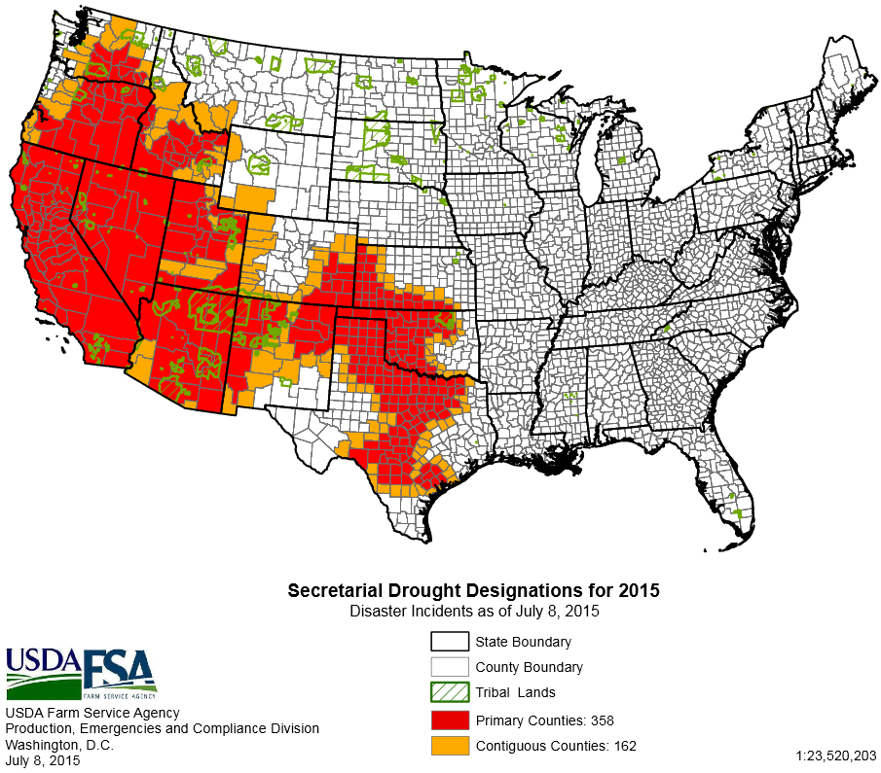
The “Local Warming” Effect

Slide 26
The “Local Warming” Effect
Correlate time-series data for
Temperature
Precipitation
Twitter discussion of climate change
Hypothesis:
People will be less likely to deny climate change and more likely to support environmental legislation when they personally experience extreme weather.

Slide 27
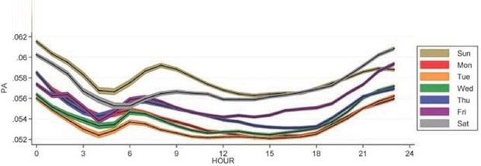
Twitter Project
Tap into the global conversation
Use the Twitter API to collect tweets
Analyze positive and negative sentiment
Plot activity over time, location
Test your own hypotheses

Slide 28
Twitter Project Details
Sentiment Analysis on a Topic of Your Choice
Sign up for or log in to your Twitter account
Find a hashtag that is interesting to you
Browse through some tweets
Now log in to the Twitter developer website https://dev.twitter.com/rest/public
Create a Twitter application
Get the API tokens for your application
Download a twitter library for Python (examples: twython or tweepy)
In the Twitter API documentation, find the endpoint that allows you to perform a hashtag search
Use the API to perform a search and view the results
Download the positive and negative sentiment word dictionaries
Count the positive words and negative words in your set of tweets
Plot positivity and negativity over time

