Slide 1
DEMUX and RATE CONVERTER
By: Jean-Serge Cardinal

Slide 2
Introduction
This presentation will present various architectures for the DEMUX and RC (Rate Converter) along with the performance that can be achieved.
The complexity of the implementation inside an FPGA for the architectures will not be addressed here.
The performance analysis comes from a special tool that can fully characterize the DEMUX/RC by sweeping a tone across the frequency of interest. It is not using a modulated signal nor noise sources.

Slide 3
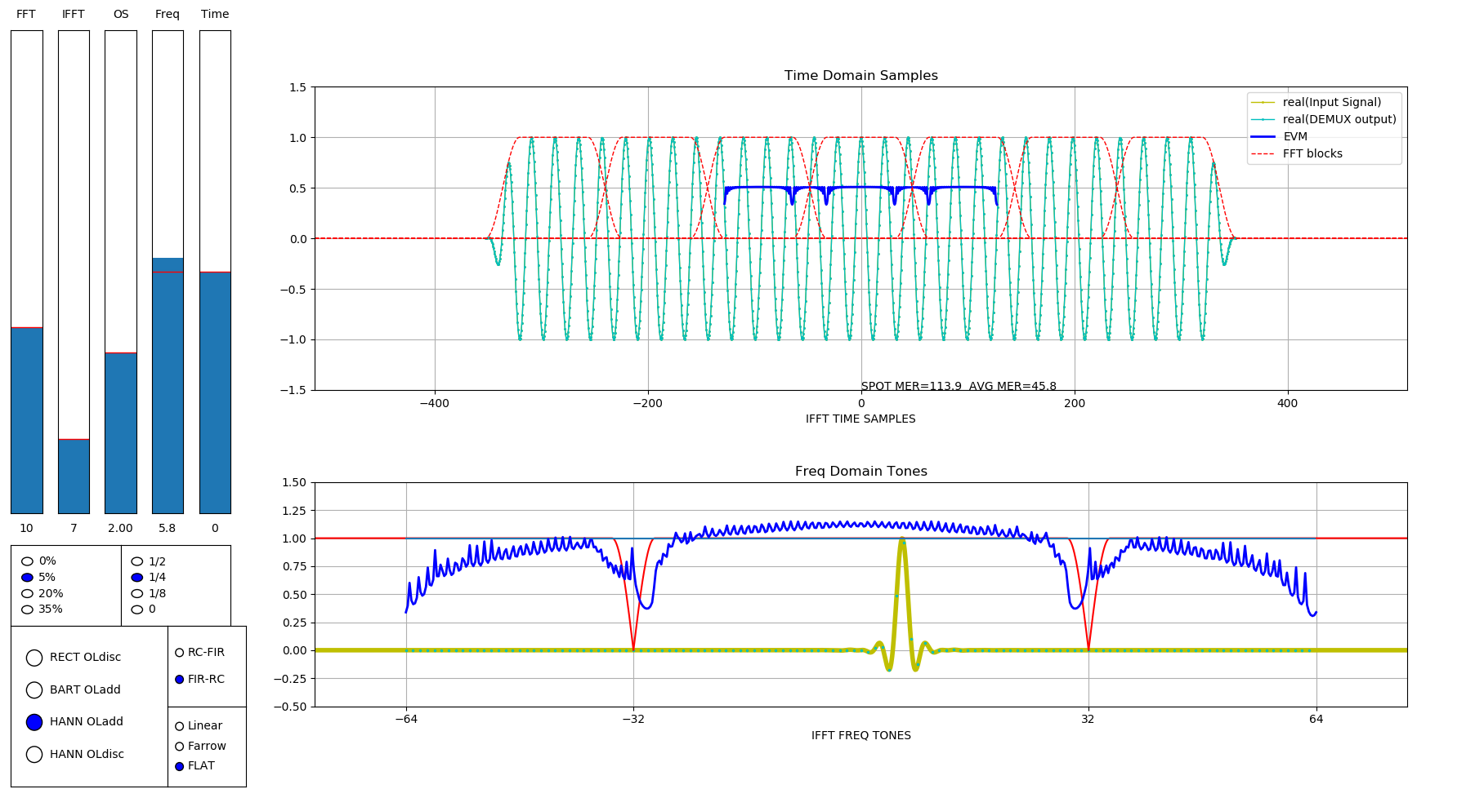
DEMUX/RC Analysis tool

Slide 4
Properties of the DEMUX/RC
WIN
IFFT
OL
RC
RRC
The DEMUX/RC is a filter bank.
Each filter is linear but time variant.
Since it's time variant it cannot be analyse with an impulse since the impulse reponse will vary depending on where the pulse is located
Therefore, the filters are characterized by sweeping a CW tone across the frequency of interest.
Since it is linear, the overlap of all the tones and their errors gives the EVM performance that will be obtained if averaging the EVM of a modulated signal over an infinite time.
FFT
WIN
IFFT
OL
RC
RRC
WIN
IFFT
OL
RC
RRC

Slide 5
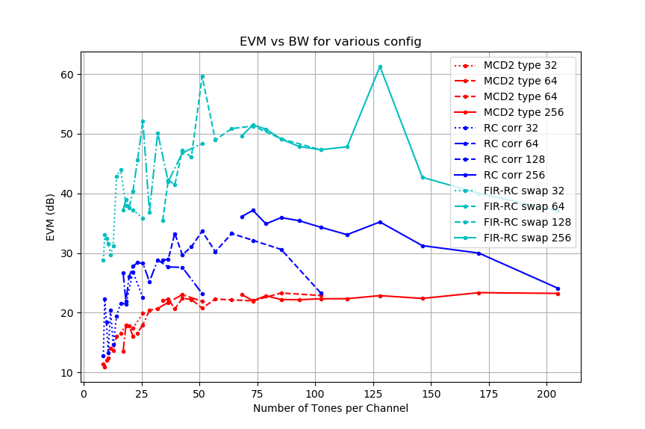
FFT
REC
IFFT
OLD
R-C
RRC
FFT
REC
IFFT
OLD
R-C
FIR
FFT
RRC
IFFT
OLD
FIR
R-C

Slide 6
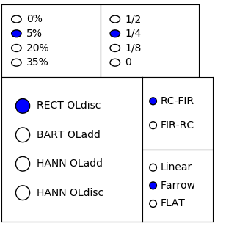
Simulation options
There are three types of RC, linear, Farrow as in MCD2, and FLAT. FLAT is a Farrow interpolator but compensated by the RRC filter.
RRC filter size is about IFFTsize x 7
There's a new Overlap and Discard mode using Hanning window.
Adjacent channels have equal amplitude
Simulation of 7 consecutive FFT frames

