Slide 1
Evaluation of machine learning approaches for building models to select quality candidate molecules in drug discovery.
Joseph Scavetta
Notes:
On average, it takes at about ten years for a drug to go from an initial discovery to the marketplace. The average cost to research and develop a drug is estimated to be about $2.6 billion.

Slide 2
Overview
Can machine learning differentiate between a compound and drug?
Introduction and history of drug development
Methodology; Machine learning approaches
Results and conclusions

Slide 3
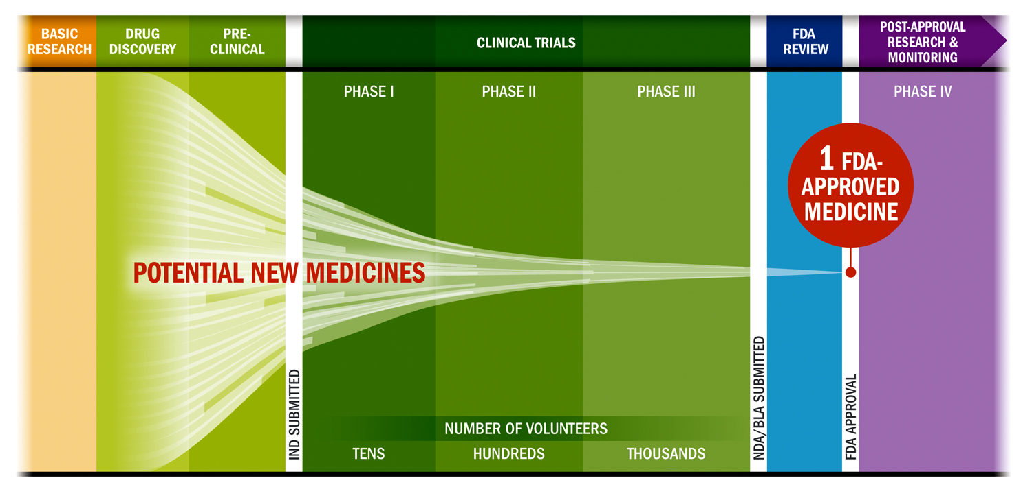
Drug Discovery and Why Drugs Fail
https://www.phrma.org/images/main/Clinical-Trial-Chart.jpg
Phase I trials – toxicity
Phase II and Phase III trials – efficacy and toxicity
To reduce costs and development time, which drugs should be evaluated further, dropped, or reworked
Absorption, distribution, metabolism, excretion, and toxicity data (ADMET)
Drug-like properties

Slide 4
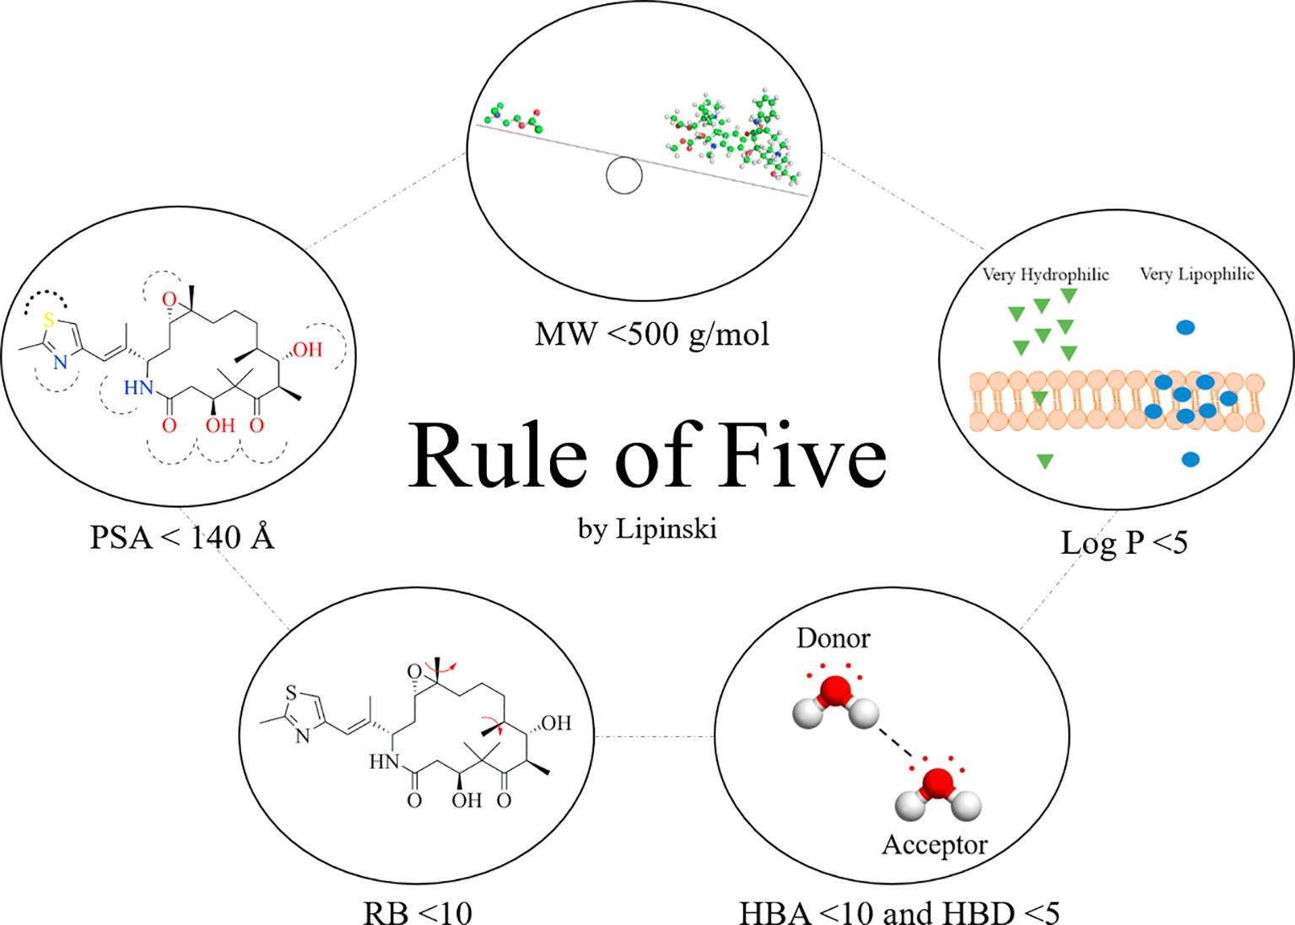
Rule-Based Drug Optimization
Which physiochemical properties, and their values, we should expect from a successful drug, compared to a less effective drug candidate?
Lipinski’s rule of 5
Sets upper bounds on a few physiochemical properties
Issues
Strict cutoffs (discrete in their effects)
Generated from properties that successful drugs have in common; does not consider the properties’ distributions in non-drugs
Drug metabolites and their effects on the development of adverse reactions: Revisiting Lipinski’s Rule of Five

Slide 5
Applying Machine Learning to Drug Discovery
Machine learning applications
Predicting ADMET properties
Ligand-based visual screening
Match a drug to some query out of a database of compounds
Support Vector Machines and Random Forest
Deep learning
Drug data is limited: development and testing is long and costly
Recent experimentation with one-shot learning

Slide 6
Aims and Goals
Evaluate the usefulness of various druglike properties in the drug candidate space
Evaluate and compare machine learning approaches in the task of
classifying approved drugs from non-approved candidate drugs
classifying drugs that have remained on the market from drugs that have been discontinued
Machine Learning Approaches:
Logistic Regression
Support Vector Machine
Random Forest
Neural Network

Slide 7
Methodology and Workflow
ChEMBL database
Publicly available data on drugs and drug-candidates
1.8 million distinct compounds, including about 11 thousand approved drugs
ChEMBL
Passed Phase 4
Not withdrawn
Have not passed Phase 2
Passed Phase 4
Was withdrawn
Approved Drugs
Non-Approved Drugs
Withdrawn Drugs
3,092
1,696,443
233

Slide 8
Methodology and Workflow
Remove non-numeric features
15 predictors
Remove samples with >5 missing features
Replace missing data
Generalized mean imputation
Approved Drugs
Non-Approved Drugs
Withdrawn Drugs
2,702
1,668,411
230

Slide 9
Methodology and Workflow
Non-Approved Drugs
Approved Drugs
Withdrawn Drugs
Approved vs Non-Approved
Approved vs Withdrawn
Balanced classes using random under-sampling
Balanced classes using random under-sampling
Random stratified split
1:4 test to train
Random stratified split
1:4 test to train
Test
Train
Test
Train

Slide 10
Methodology and Workflow
Test
Train
Mean centered and normalized in variance
Projected to less dimensions using PCA
Hyperparameter Optimization
10-fold cross-validation
Validation
Train

Slide 11
ChEMBL Data Analysis

Slide 12
Important Drug-like Properties
Notes:
general polarity of a compound (polar surface area and hydrogen bond donor and acceptors),
the structure of a compound (rotatable bonds, molecular weight, number of heavy atoms),
the aromaticity of a compound.

Slide 13
Algorithm Performance

Slide 14
Algorithm Performance

Slide 15
Algorithm Performance

Slide 16
Algorithm Performance

Slide 17
Overall Results

Slide 18
Case Studies: Model Selections
All have passed phase IV trials
One phenyl or phenyl derivative,
Few if any atoms that are not carbon, hydrogen, nitrogen, or oxygen
Low molecular weights
Have not been tested in any clinical trials
Many ring structures
Have one or more halogen atoms
Higher molecular weights
Notes:
Approved vs. Non-approved
Using Random Forest

Slide 19
Next Steps
Performance is a good start, but not enough for pharmaceuticals
Better than Lipinski's Rule of 5
More drug-like properties will need to be evaluated
New algorithms which perform better on smaller sample sizes should be explored
Reliable models could
speed up drug discovery
reduce unnecessary costs attached to a poor drug candidate
reduce poor or harmful compounds reaching late phase trials or public market
https://github.com/jscavetta95/Machine-learning-approaches-to-select-candidate-molecules

