Slide 1
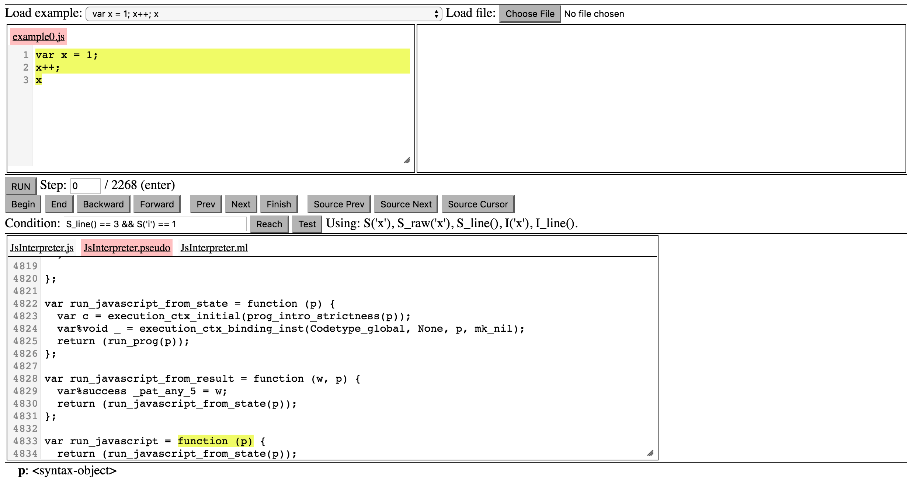
Program Selection
Current Program
Program Heap State
Navigation Panel
Interpreter
Interpreter State

