Slide 1
Semi-automatic flow direction corrections
Sept. 12, 2017

Slide 2
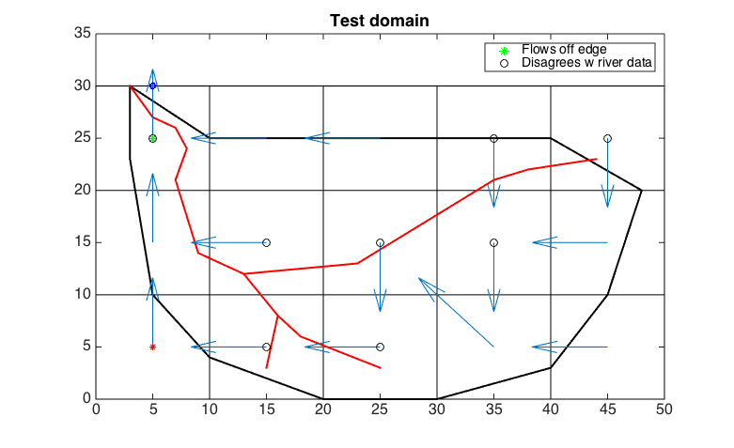

Slide 3
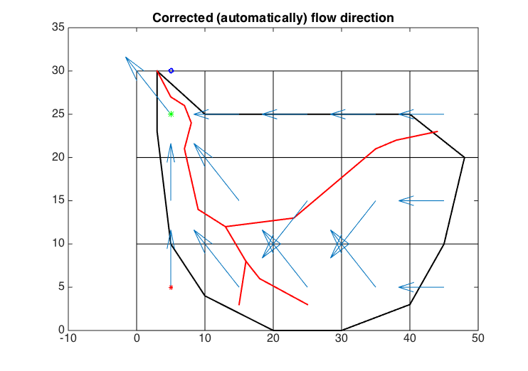

Slide 4
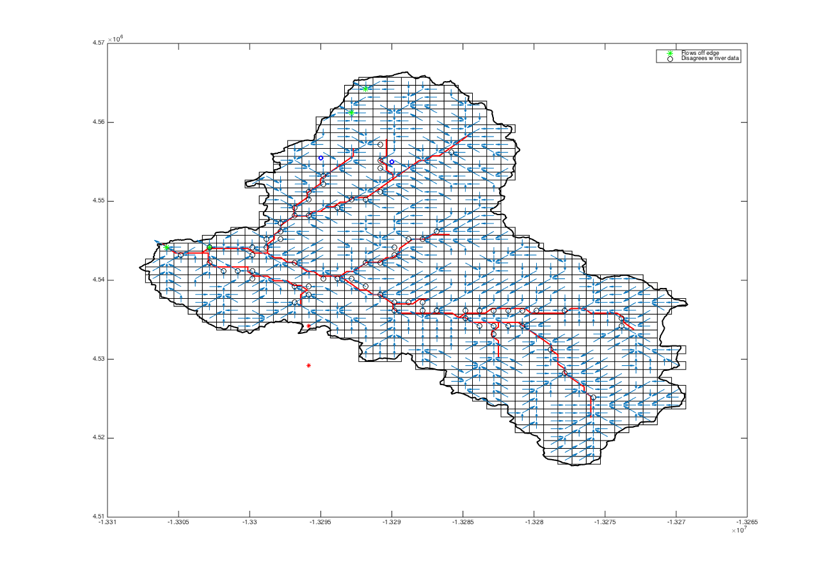
Tuolumne headwater basin – marked for corrections

Slide 5
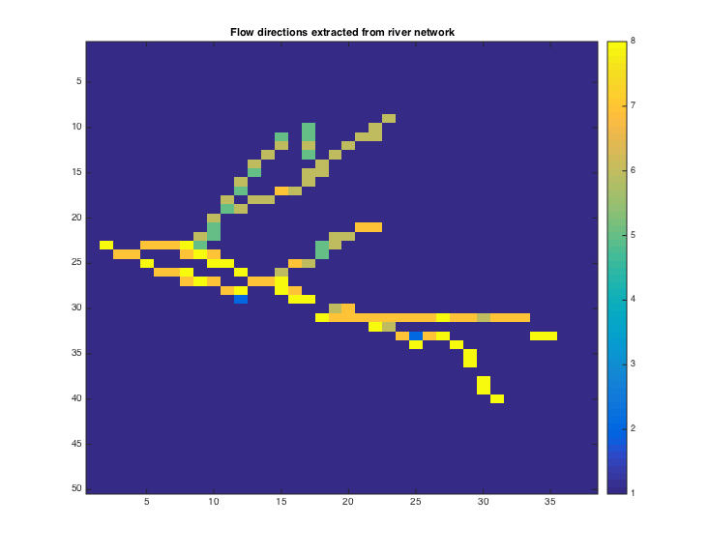
Extracted flow directions (it is continuous, but the dark blue for “up” matches NaN background color)

Slide 6
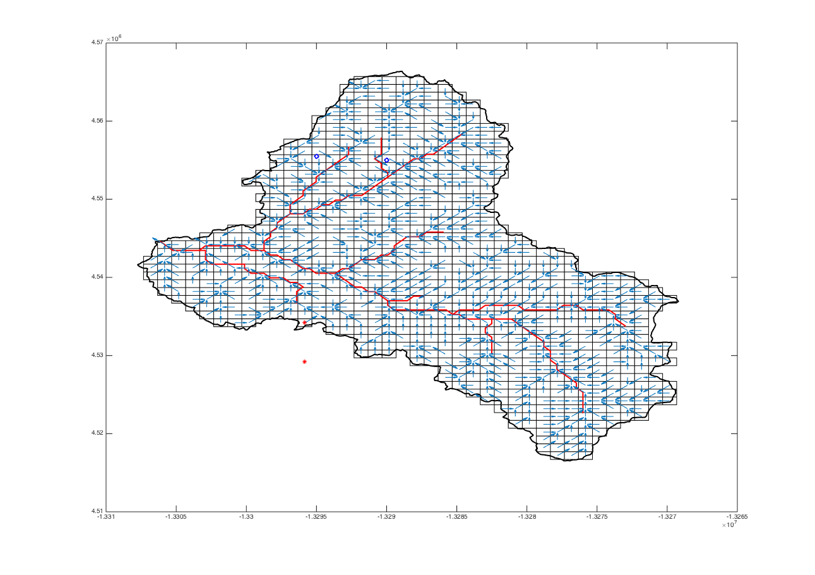
Tuolumne headwater basin – after corrections

Slide 7
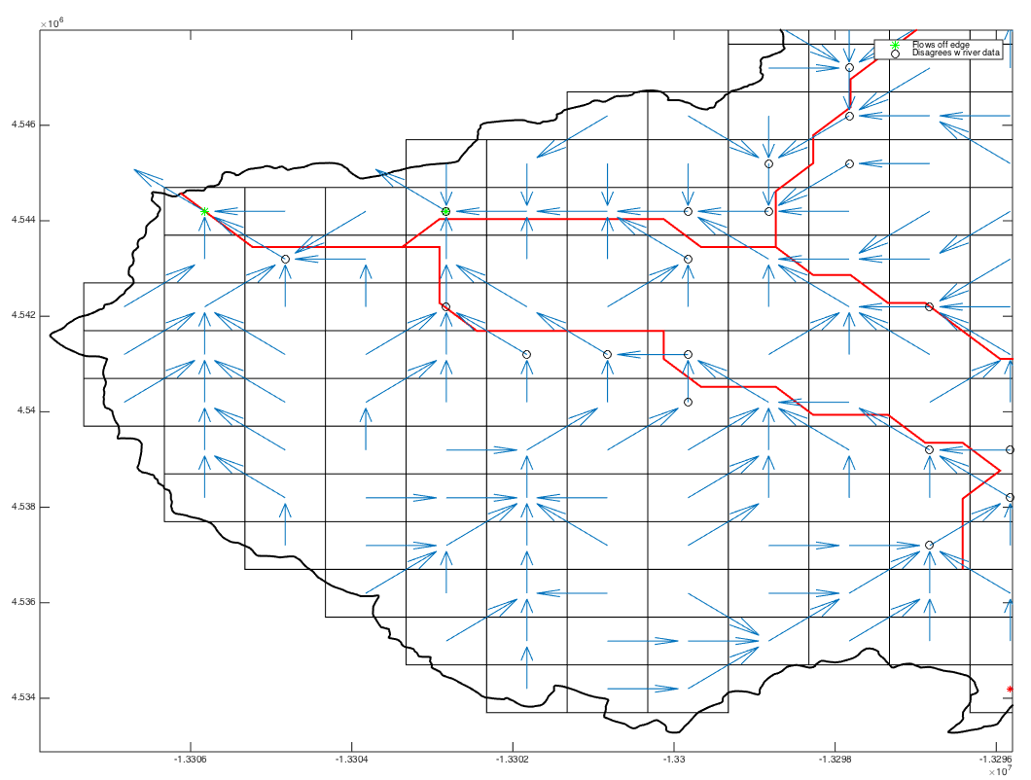
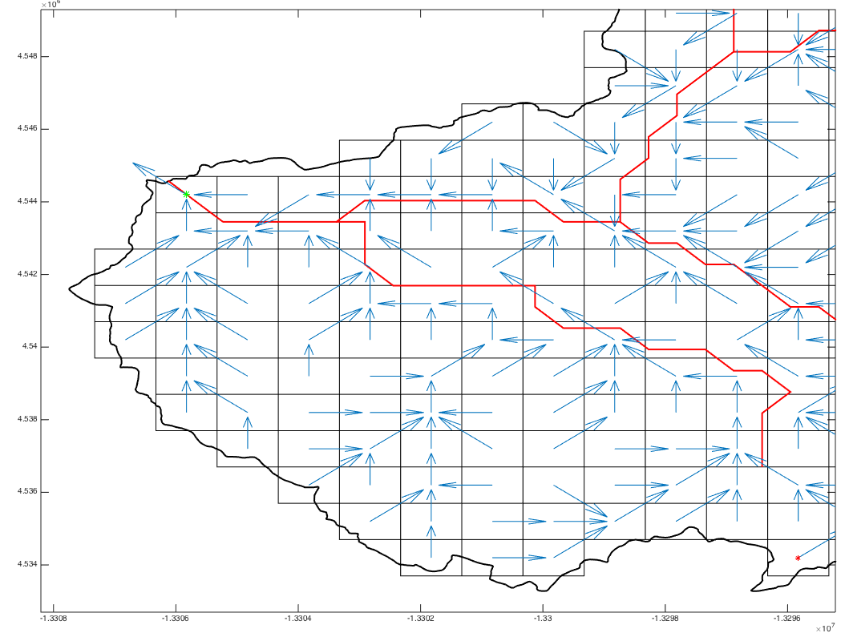
Before corrections
After corrections

Slide 8
Future work
Try out the algorithms from Arora and Harrison (2007) and Wu et al. (2011)
Address the issue of too many cells being identified as “the wrong direction” compared to the river network -> instead of looking at the direction between the entrance and exit to a grid cell, look at the direction between the centroids of adjacent grid cells. This is a major overhaul, though.
The most useful part of the code as it is -> flagging cells that flow outside the domain
Add functionality to detect nontrivial loops

Slide 9
IRB delineation

Slide 10
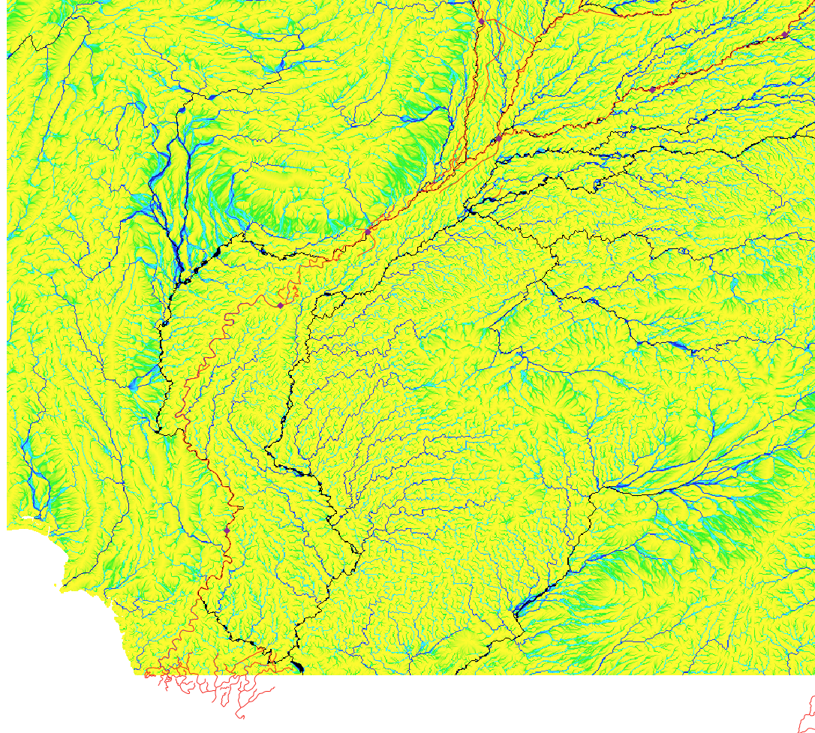
Finding the outlet
Indus
Chenab
Satluj
Kotri Barrage
Panjnad

Slide 11
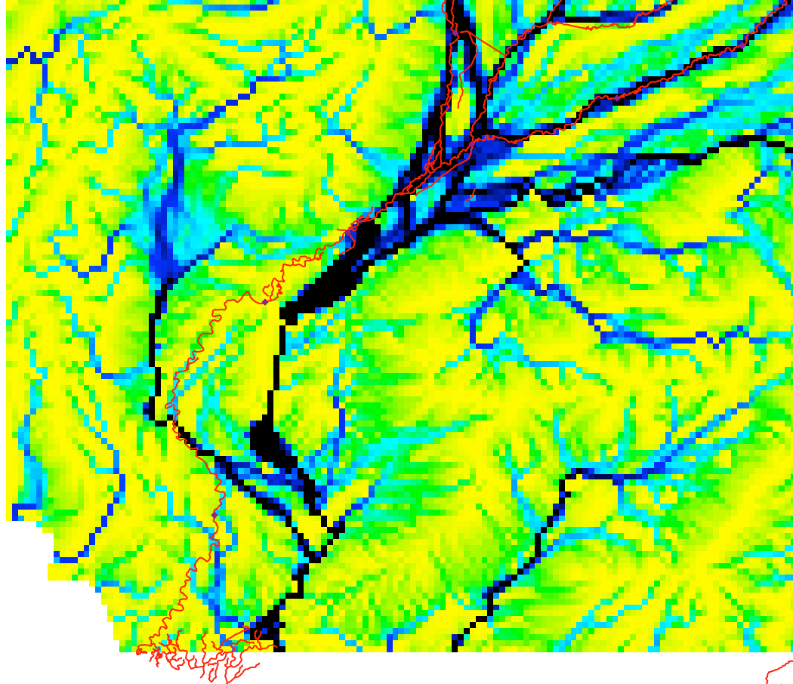
Finding the outlet
Indus
Chenab
Satluj
Kotri Barrage
Panjnad

Slide 12
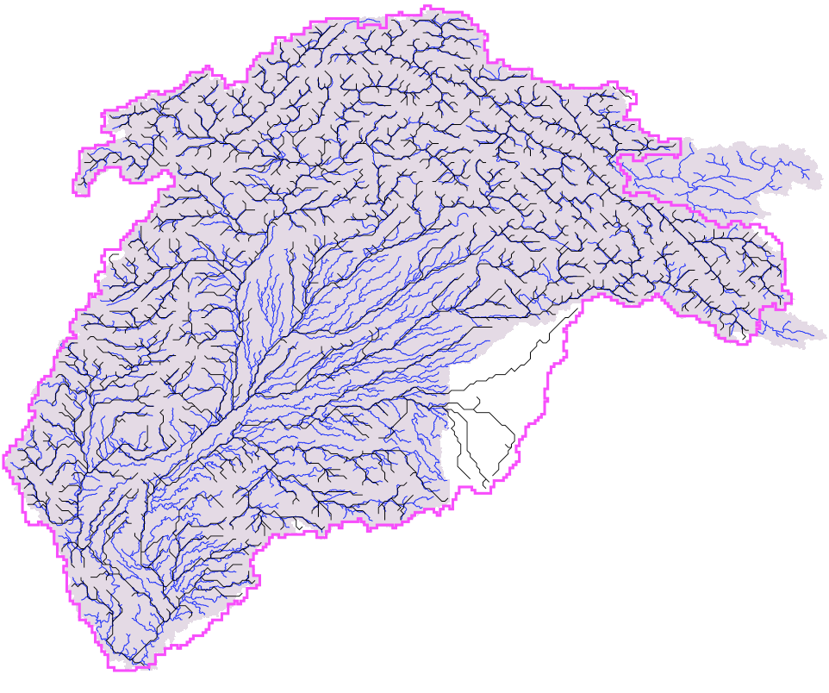
Basin (1/16 deg)
Basin (30 as)
River network (1/16 deg)
River network (30 as)

Slide 13
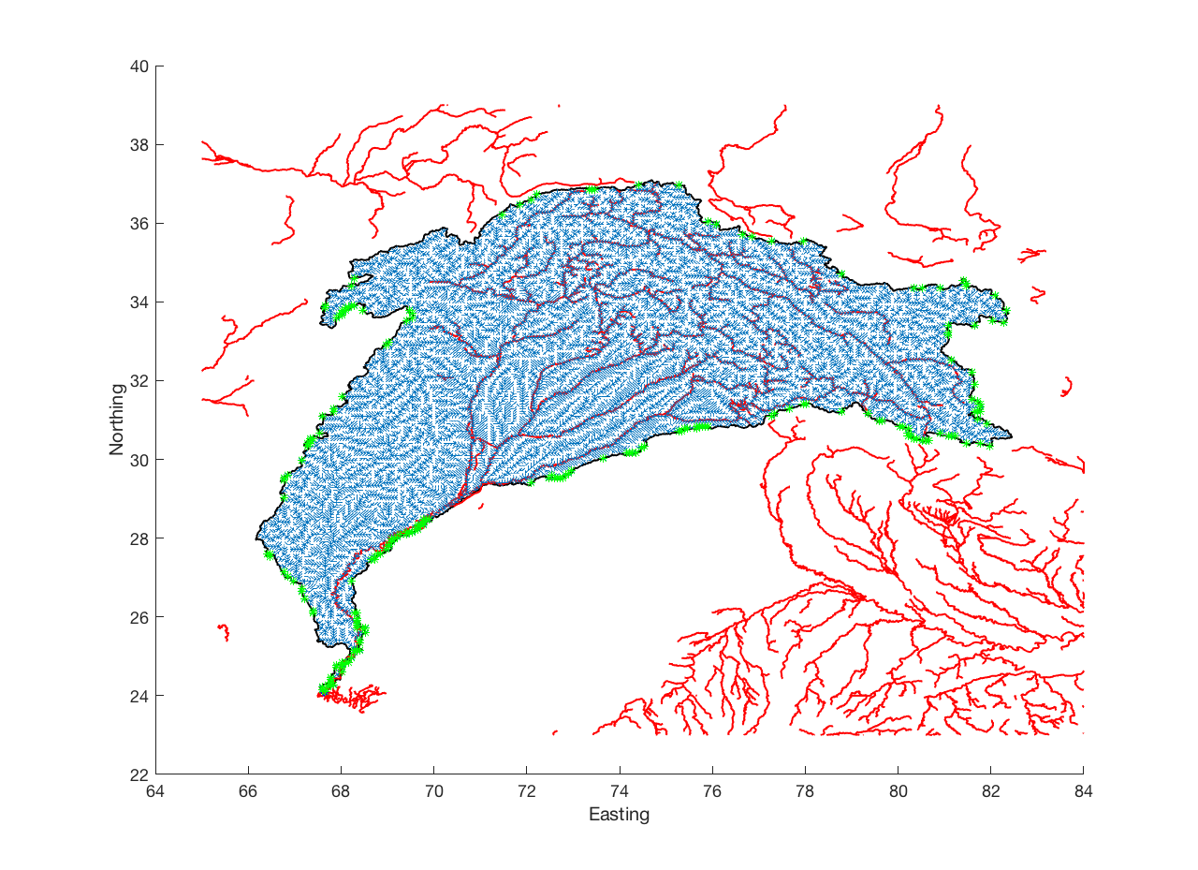
Coarse flow directions
”True” basin boundary
“True” river network
Locations for manual flow direction corrections
No need to correct this area – it is not actually part of the IRB, according to Khan et al. (2014)

