Slide 1


Pumping Iron on the web
by Jimmy Schementi
jimmy.schementi.com
IronRuby
IronPython

Slide 3


Slide 5
Pumping Iron on the web

Slide 7
by Jimmy Schementi
jimmy.schementi.com

Slide 8
IronRuby
IronPython

Slide 9
iron?

Slide 10
Implementation
Running
On dot
NET

Slide 12
embracing dynamic languages on the web

Slide 14
simple programming models

Slide 15


















Waves

Slide 16
getting things done

Slide 17
choice

Slide 18
power is in the programming language

Slide 19

Waves

Slide 20






JavaScript
Ruby
Waves
Smalltalk

Slide 21

JavaScript
Ruby
Smalltalk

Slide 22
.NET developers want to get things done too …

Slide 23
what .NET language choices are there?

Slide 24
C#
F#
VB
JavaScript
not .NET based, but it’s used …

Slide 25
why static vs. dynamic ?

Slide 26
what if .NET provided language choice …

Slide 27
C#
VB
PHP
F#
Ruby
Python
JavaScript

Slide 28
Waves

Slide 29
oh wait, it does

Slide 30
C#
VB
F#
Phalanger
IronRuby
IronPython
IronJS

Slide 31
embracing dynamic languages on the web

Slide 33
why?

Slide 35
making your entire web development experience simpler

Slide 36
server-side
& Ruby/Python 101

Slide 37

Sinatra

Slide 38
get '/' do
"Hello, World" end

Slide 39
get('/') {
"Hello, World"
}
Or for those who like curly braces …

Slide 40
def verbose() return "Verbose, World" end get('/', method('verbose'))
Without any Ruby language features …

Slide 41
@get("/") def index(resp): resp.write("Hello, World")
Python is beautiful too …

Slide 42
def get(uri): def __get(func): sinatra.register('get', uri, func) return func
@get is a decorator; here’s its definition …

Slide 43
def index(resp): resp.write("Hello, World") get('/')(index)
Without using the decorator syntax …

Slide 44
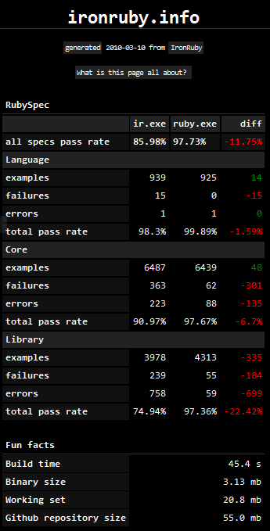

Slide 45
class PostsController < ActionController::Base
def index
@posts = Post.all
end
def show
@post = Post.find(params[:id])
end
def create
@post = Post.new(params[:post])
unless @post.save
flash[:error] = @post.error
redirect_to :index
end
end
end

Slide 46
class CreateDB < ActiveRecord::Migration def up create_table :posts do |t| t.string 'title' t.text 'body' end create_table :comments do |t| t.text 'body' t.integer 'post_id' end end def down drop_table :posts end end

Slide 47
class Post < ActiveRecord::Base has_many :comments end class Comment < ActiveRecord::Base belongs_to :post end

Slide 48
Demo: pictures

Slide 49
http://ironruby.net/documentation/rails

Slide 50
ASP.NET
MVC

Slide 51
TODO: CODE!

Slide 52
ASP.NET

Slide 53
<%@ Page Language="IronPython"
CodeFile="hello-webforms.aspx.py" %>
Enter your name:
<asp:TextBox ID="TextBox1" runat="server">
</asp:TextBox>
<asp:Button ID="Button1" runat="server"
Text="Submit" OnClick="Button1_Click"/>
<p>
<asp:Label ID="Label1" runat="server"
Text="Label">
</asp:Label>
</p>

Slide 54
def Page_Load(sender, e): if not IsPostBack:
Label1.Text = "...Your name here..." def Button1_Click(sender, e):
Label1.Text = Textbox1.Text

Slide 55
Demo: pictures

Slide 56
TODO: PHP-like code

Slide 57
<asp:Repeater ID="ThumbnailList" runat="server">
<ItemTemplate>
<a href='<%# Link %>'>
<img alt='<%# Alt %>' src='<%# Src %>' width='<%# Width %>' height='<%# Height %>'/>
</a>
</ItemTemplate>
</asp:Repeater>

Slide 58
client-side
Silverlight

Slide 59
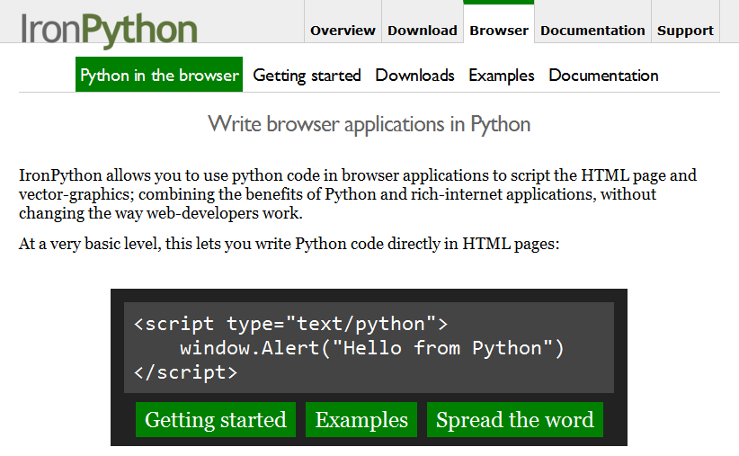

Slide 60
<script type="text/python"> window.Alert("Hello from Python!")
</script>

Slide 61
<script type="text/ruby" src="foo.rb"></script>

Slide 62
>>> def say_hello(o, e):
... document.message.innerHTML =
... "Hello %s" % document.name.value
...
>>> document.message.events.onclick += say_hello

Slide 63
<script type="application/xml+xaml" id="xaml1" width="100" height="100">
<Canvas>
<TextBlock Name="message" Text="Loading ..." />
</Canvas>
</script>
<script type="application/ruby" class="xaml1"> xaml1.message.Text = "Hello from Ruby!"
</script>

Slide 64
<script type="text/javascript"> window.DLR = {autoAdd: false}
</script>
<script type="text/javascript" src="dlr.js"></script>
<script type="text/javascript">
DLR.createSilverlightObject({width: '100%', height: '100%'})
</script>
<script type="application/xml+xaml">
<Canvas>
<TextBlock Name="message" Text="Loading ..." />
</Canvas>
</script>
<script type="text/python"> from System.Windows.Application import Current as app app.LoadRootVisualFromString(document.xaml1.innerHTML)
</script>
<script type="text/ruby"> xaml1.message.Text = "Hello from Ruby!"
</script>

Slide 65
import clr clr.AddReferenceToFile("bin/mandelbrotbase.dll") import mandelbrotbase mandelbrotbase.GenerateMandelbrot( int(self.Content.FractalArea.Width), int(self.Content.FractalArea.Height), self.CurrentXS, self.CurrentYS, self.CurrentXE, self.CurrentYE
)

Slide 66
vidBrush = VideoBrush() vidBrush.SetSource(_CaptureSource) xaml.WebcamCapture.Fill = vidBrush if CaptureDeviceConfiguration.AllowedDeviceAccess or
CaptureDeviceConfiguration.RequestDeviceAccess():
_CaptureSource.Start()

Slide 67
<% if @flickr.stat == "ok" && @flickr.photos.total.to_i > 0 %>
<div class='images'>
<% @flickr.photos.photo.each do |p| %>
<div class='image'>
<a href="<%= flickr_source(p) %>.jpg" title="<%= encode("<a href='#{flickr_page(p)}' target='_blank'>#{ p.title }</a>") %>" rel="lightbox[<%= @tags %>]"
><img src="<%= flickr_source(p) %>_s.jpg" /></a>
</div>
<% end %>
</div>
<% else %>
No images found!
<% end %>

Slide 68
if document.overlay && document.lightbox document.overlay.parent.remove_child document.overlay document.lightbox.parent.remove_child document.lightbox end window.eval "initLightbox()"

Slide 70
static languages still have to deal with dynamic environments

Slide 71
describe '.NET Stack instantiation' do it 'can create an empty stack' do stack = Stack.new stack.should.be_kind_of Stack stack.count.should == 0 end it 'can create a stack from an array' do stack = Stack.new [1,2,3] stack.should.be_kind_of Stack stack.count.should == 3 end end

Slide 72
class DotNetStackInstantiation < Test::Unit::TestCase def test_creating_empty_stack stack = Stack.new assert(stack.kind_of? Stack) assert(stack.count == 0) end def test_creating_stack_from_array stack = Stack.new [1,2,3] assert(stack.kind_of? Stack) assert(stack.count == 3) end end

Slide 73
var engine = Python.CreateEngine(); dynamic scope = engine.CreateScope(); scope.page = this; engine.Execute(
"page.Message.Text = 'Hello from Python!'", scope);

Slide 74
var runtime = ScriptRuntime.CreateFromConfiguration(); var engine = ScriptEngine.CreateEngine("IronPython"); dynamic scope = engine.CreateScope(); scope.page = this; engine.Execute(
"page.Message.Text = 'Hello from Python!'", scope);

Slide 76
allowing others to extend your applications will make them more powerful

Slide 78
does providing language choice simplify .NET?

Slide 79
lack of language choice limits productivity

Slide 80
embrace dynamic languages

Slide 81
make getting things done simpler and more focused

Slide 82
ironruby.net
IronRuby website & download ironpython.net
IronPython website & download jimmy.schementi.com my blog & this talk

Slide 83
how will you
get things done
?

