Slide 1
IronRuby
1.0 is around the corner

Slide 2


open-source Ruby implementation
integrated with

Slide 3

Microsoft Public License
(MS-PL)

Slide 4
Expressiveness of Ruby to .NET
Capability of .NET to Ruby

Slide 5
Agenda
Road to 1.0
Cross-platform, cross-browser Ruby implementation
Detour: Gestalt
Dynamic and static language interop
Compatibility and Performance
Interesting IronRuby usages
How you can help

Slide 6
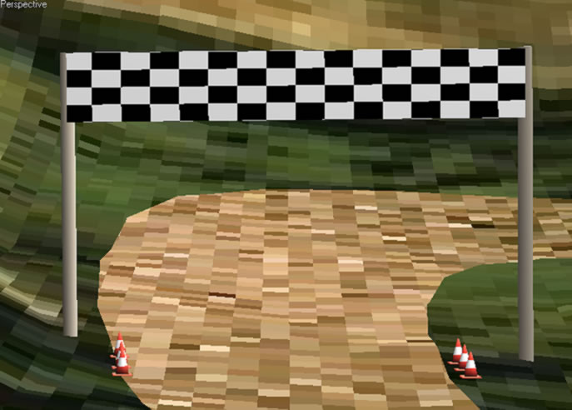

Slide 7
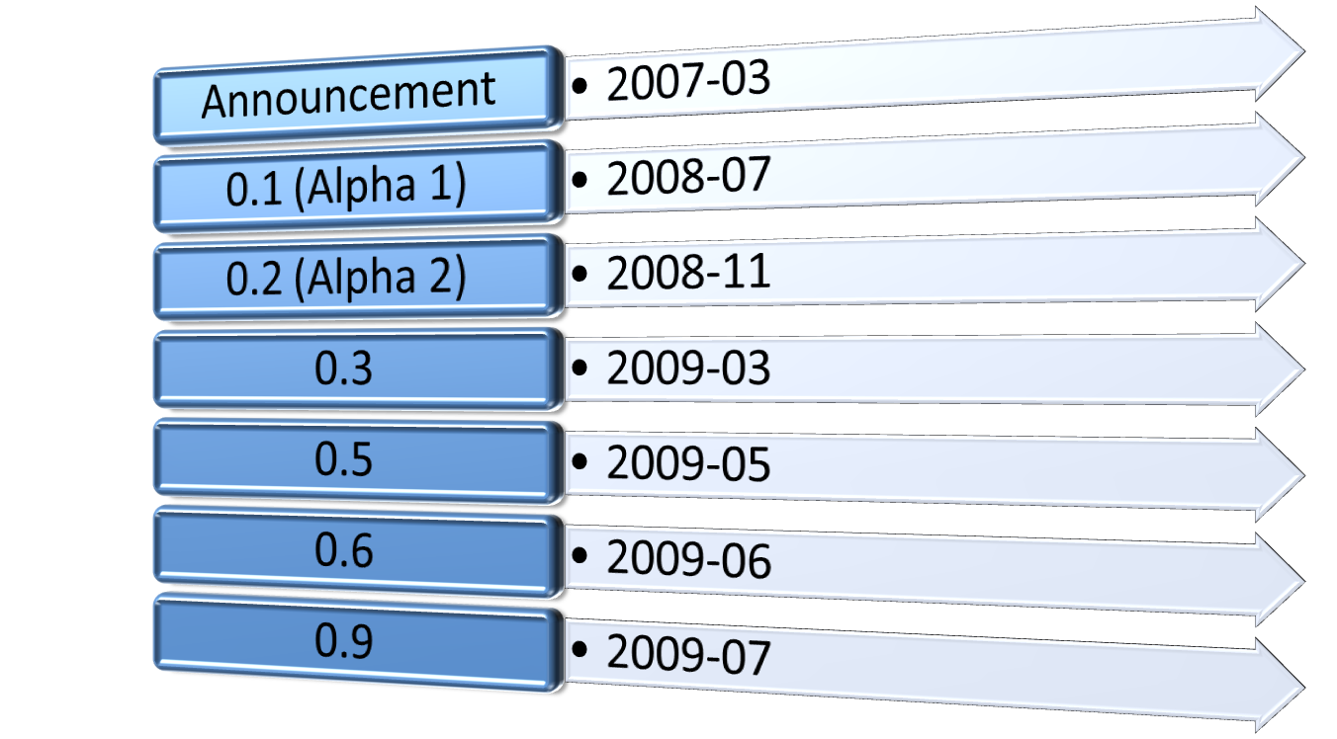

Slide 8
a cross-platform cross-browser Ruby implementation

Slide 9

Gestalt
Ruby and Python in the browser, again

Slide 10
dynamic and static languages can play nicely too

Slide 11
Road to 1.0

Slide 12
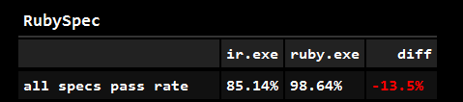
from http://ironruby.info

Slide 13
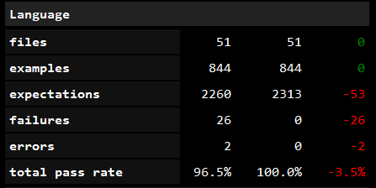

Slide 14
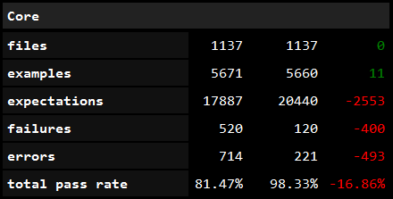

Slide 15
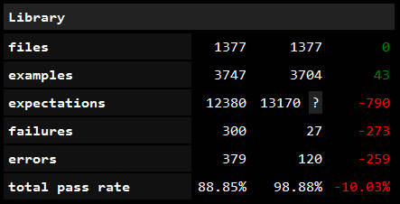

Slide 16
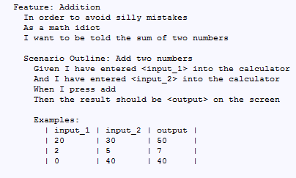

Slide 17
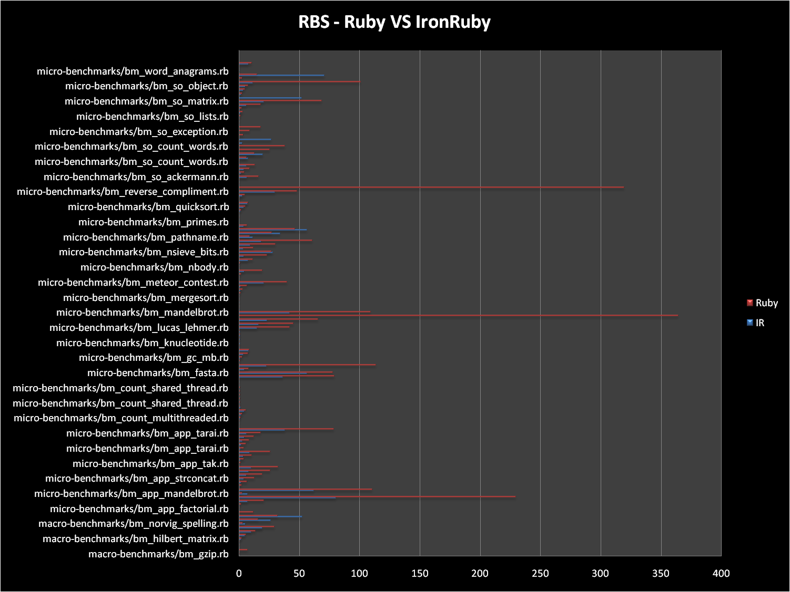

Slide 18
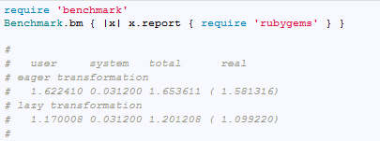

Slide 19
Lastest Community usages
AutoCAD scripting – Kean Walmsley
“Magic” DSL for Windows UI – Thibaut
Automated conversion of a in-house language app (running on FORTRAN77) and MOTIF UI → IronRuby and WPF – Robert Brotherus
Point of Sale application based on WPF, IronRuby, and FoxPro – Nick Rickets

Slide 20

You can help!

Slide 21
http://ironruby.net
Jimmy Schementi
http://blog.jimmy.schementi.com

