Slide 1

jimmy schementi
railsconf-2009
2009-05-06

Slide 2
jimmy schementi
http://blog.jimmy.schementi.com
@ jschementi

Slide 3



Slide 4


Slide 5



Slide 6




Slide 7
Why the hell are you here?
Notes:
Poll audience: How many folks are already a .NET shop? How many are just curious? Implementers? Others: why the hell are you here?

Slide 8
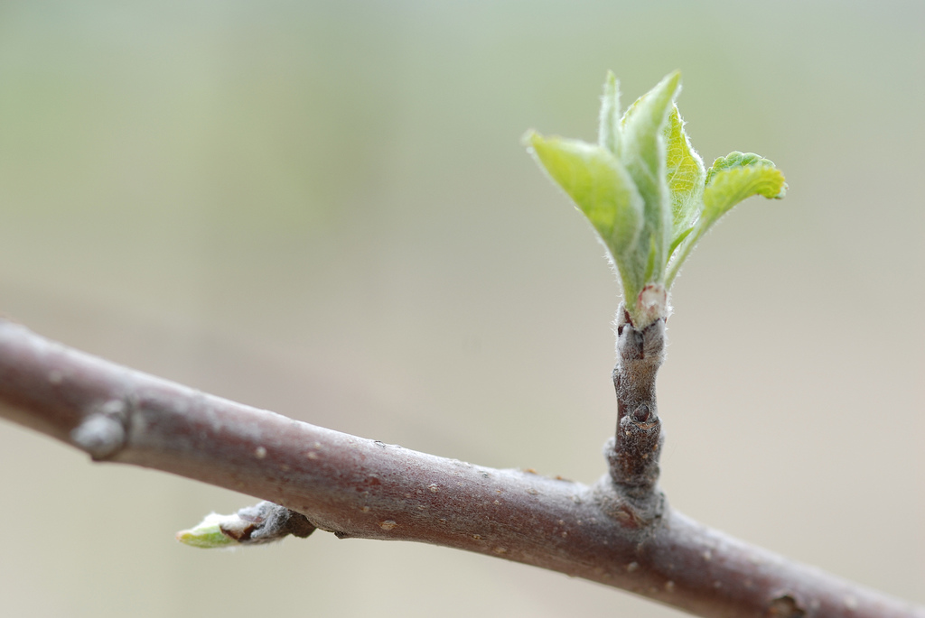
http://www.flickr.com/photos/bonguri/128765190/
Notes:
Last year, IronRuby was much like a sprout on a tree. Much of the plumbing and infrastructure for leaves were there, but it has only just begun to sprout.

Slide 9

http://www.flickr.com/photos/jeffjackson/2306771206/
Notes:
And growing up is hard to do. This was probably IronRuby around RailsConf 2008, the same as the treebud. It’s just starting to run Rails, and experience all the stresses of the world around it.

Slide 10

Notes:
Today, IronRuby more resembles a 13-year old, just starting to grow into their body, richly interact with the world around them, and begin to get good at things. Though this kid creeps me out, so bad analogy. Point is IronRuby is growing up fast.

Slide 11

http://cyrusfirstofearth.blogspot.com/2007_06_01_archive.html
Notes:
Working in the real world, for some definition of the real world.

Slide 12

http://imagecache2.allposters.com/images/pic/38/018_3345~Childhood-Tom-is-a-True-Mack-Daddy-Pimp-Tom-Pimp-Posters.jpg
Notes:
And we’re starting to get some love from the community.

Slide 13
growing up
Notes:
- Quick REPL demo
Rails Scaffold demo
Rack, Sinatra
Real applications …

Slide 14
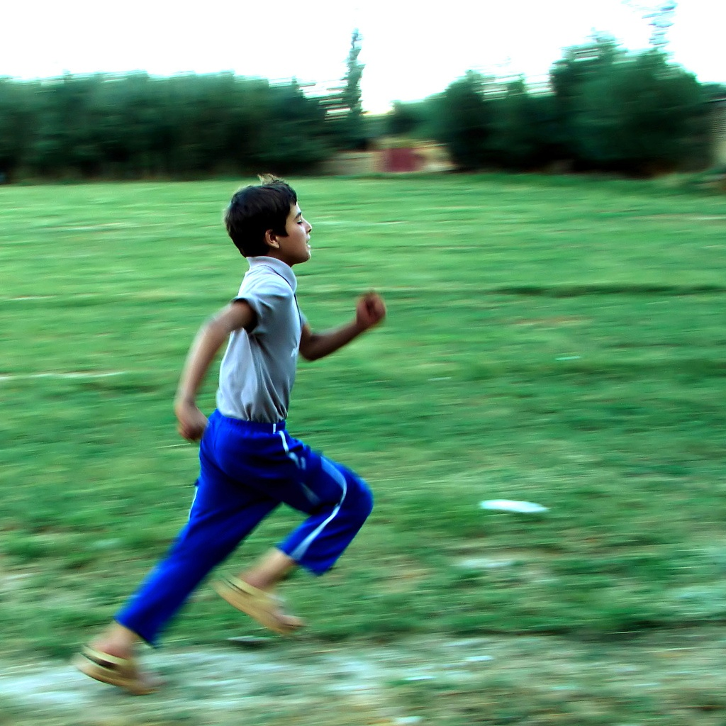
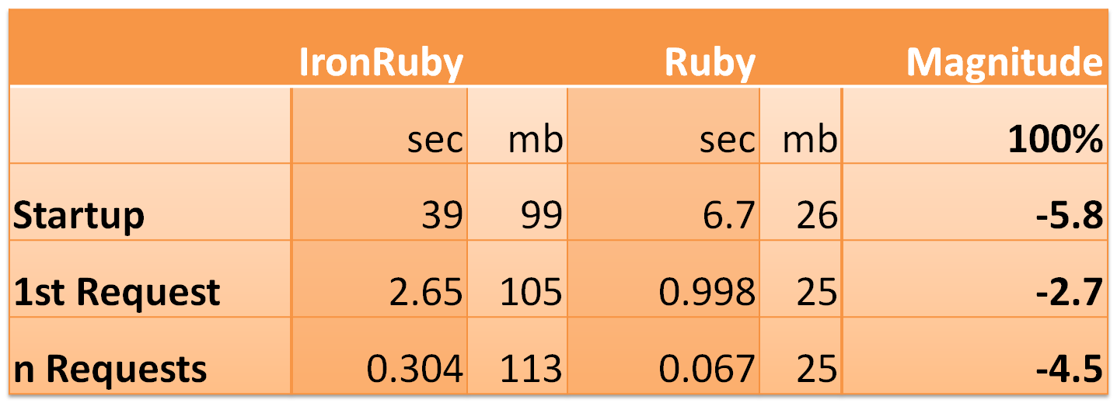
performance
Numbers may vary in a couple days due to IronRuby now having Adaptive Compilation support

Slide 15
the real world
Notes:
The “real world” is why you should care about IronRuby. Especially if you are already a windows shop.

Slide 16
rack
Rack provides an minimal interface between web servers supporting Ruby and Ruby frameworks.

Slide 17
ironruby-rack
Rack interface between IIS and IronRuby

Slide 18
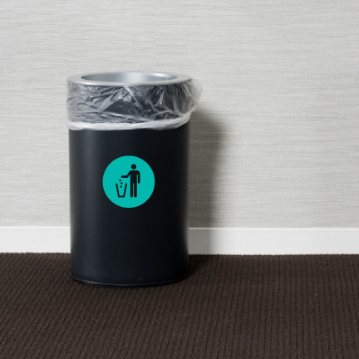
http://www.flickr.com/photos/29116324@N04/2810080286/

Slide 19

esplain?
http://upload.wikimedia.org/wikipedia/commons/1/1b/DesiArnaz.jpg
Notes:
Walk-through of how it all works. Emphasis on hosting API. Also show deployment.

Slide 20

Request/Response
WEBrick
WEBrick
Rack Handler
Rack
Application
(Rails, etc)

Slide 21
Request/Response
IIS
HttpHandler
IronRuby.Rack.dll
IronRuby
Rack
Application
(Rails, etc)

Slide 22
http://www.flickr.com/photos/hamed/258971456/
Notes:
Performance

Slide 23
System::Console.write_line "hello"
Notes:
Make the .NET fx look like just another Ruby library. Internal DSL idea -> show wpf window / magic?
Show Databinding ActiveRecord
Show ASP.NET MVC
Calculator silverlight app
- testing
- scripting
Quick segway to Silverlight
- Plug BoF at 9.

Slide 24
getting noticed

Slide 25
rails unit tests
Controllers and Views
94% Pass Rate
  2306 tests, 10539 assertions, 85 failures, 50 errors
ActiveRecord
29% Pass Rate (!)
  287 tests, 307 assertions, 22 failures, 182 errors
  Most failures due to 1 YAML bug

Slide 26
community
Patches:
http://github.com/nrk
Jirapong Nanta (RubyGems, OpenSSL)
Thibaut Barrère (IO.popen)
Mono build:
Michael Letterlee
Ivan Porto Carrero
Core Team:
Shri Borde
Tomas
Jim Deville
Jimmy Schementi
http://wiki.github.com/ironruby/ironruby/contributing

Slide 27
ironruby-contrib
IronRuby MVC - Ivan Porto Carrero
silverline – Silverlight + Rack
ironnails – Pretty WPF/SL DataBinding
magic – DSL for UI development (winforms, WPF, Silverlight)
irdb – Ruby database layer for System.Data.SqlClient.
Hpricot, JSON - Daniele Alessandri
IRDB - Ray Vernagus

Slide 28
ironruby-0.5 released http://ironruby.net/Download

Slide 29
Backup

Slide 30
server | fx | benchmark | ir | mb | ruby | mb | diff
WEBrick | Rack | Startup | 7.2 | 36 | 0.6 | 8 | -12.0
WEBrick | Rack | 1st Request | 0.162 | 36.5 | 0.01 | 8 | -16.2
WEBrick | Rack | n Requests | 0.012 | 36 | 0.003 | 12 | -4.0
WEBrick | Sinatra | Startup | 6.8 | 34 | 0.7 | 8 | -9.7
WEBrick | Sinatra | 1st Request | 0.147 | 38 | 0.003 | 8 | -49.0
WEBrick | Sinatra | n Requests | 0.079 | 41 | 0.001 | 8 | -79.0
WEBrick | Rails | Startup | 39 | 99 | 6.7 | 26 | -5.8
WEBrick | Rails | 1st Request | 2.65 | 105 | 0.998 | 25 | -2.7
WEBrick | Rails | n Requests | 0.304 | 113 | 0.067 | 25 | -4.5
IIS | Rack | Startup
IIS | Rack | 1st Request
IIS | Rack | n Requests
IIS | Sinatra | Startup
IIS | Sinatra | 1st Request
IIS | Sinatra | n Requests
IIS | Rails | Startup
IIS | Rails | 1st Request
IIS | Rails | n Requests

Slide 31
rails scenarios http://ironruby.net/Documentation/Rails

Slide 32
irails foo
> irails foo
create
create app/controllers
create app/helpers
create app/models
create app/views/layouts
create config/environments
create config/initializers
create config/locales
create db
create doc
create lib
create lib/tasks
create log
create public/images
create public/javascripts
create public/stylesheets
create script/performance
create test/fixtures
create test/functional
create test/integration
create test/performance
create test/unit
create vendor
create vendor/plugins
create tmp/sessions
create tmp/sockets
create tmp/cache
create tmp/pids
create Rakefile
create README
create app/controllers/application_controller.rb
create app/helpers/application_helper.rb
create config/database.yml
create config/routes.rb
create config/locales/en.yml
create config/initializers/backtrace_silencers.rb
create config/initializers/inflections.rb
create config/initializers/mime_types.rb
create config/initializers/new_rails_defaults.rb
create config/initializers/session_store.rb
create config/environment.rb
create config/boot.rb
create config/environments/production.rb
create config/environments/development.rb
create config/environments/test.rb
create script/about
create script/console
create script/dbconsole
create script/destroy
create script/generate
create script/runner
create script/server
create script/plugin
create script/performance/benchmarker
create script/performance/profiler
create test/test_helper.rb
create test/performance/browsing_test.rb
create public/404.html
create public/422.html
create public/500.html
create public/index.html
create public/favicon.ico
create public/robots.txt
create public/images/rails.png
create public/javascripts/prototype.js
create public/javascripts/effects.js
create public/javascripts/dragdrop.js
create public/javascripts/controls.js
create public/javascripts/application.js
create doc/README_FOR_APP
create log/server.log
create log/production.log
create log/development.log
create log/test.log

Slide 33
ir script\generate
> ir script\generate scaffold post title:string body:text published:boolean
create app/models/
exists app/controllers/
exists app/helpers/
create app/views/posts
exists app/views/layouts/
exists test/functional/
create test/unit/
create test/unit/helpers/
exists public/stylesheets/
create app/views/posts/index.html.erb
create app/views/posts/show.html.erb
create app/views/posts/new.html.erb
create app/views/posts/edit.html.erb
create app/views/layouts/posts.html.erb
create public/stylesheets/scaffold.css
create app/controllers/posts_controller.rb
create test/functional/posts_controller_test.rb
create app/helpers/posts_helper.rb
create test/unit/helpers/posts_helper_test.rb
route map.resources :posts
dependency model
exists app/models/
exists test/unit/
create test/fixtures/
create app/models/post.rb
create test/unit/post_test.rb
create test/fixtures/posts.yml
exists db/migrate
create db/migrate/20090422182202_create_posts.rb

Slide 34
irake db:migrate
c:\dev\railsconf09\pictures>irake db:migrate
(in c:/dev/railsconf09/pictures)
== CreatePictures: migrating ======================
-- create_table(:pictures)
-> 0.1260s
-> -1 rows
== CreatePictures: migrated (0.1780s) =============
== CreatePeople: migrating ========================
-- create_table(:people)
-> 0.0640s
-> -1 rows
== CreatePeople: migrated (0.0870s) ===============
== CreateTags: migrating ==========================
-- create_table(:tags)
-> 0.0380s
-> -1 rows
== CreateTags: migrated (0.0550s) =================
== CreateTaggings: migrating ======================
-- create_table(:taggings)
-> 0.0470s
-> -1 rows
== CreateTaggings: migrated (0.0570s) =============
== CreateFriendships: migrating ===================
-- create_table(:friendships)
-> 0.0530s
-> -1 rows
== CreateFriendships: migrated (0.0650s) =====================================
== AddEmailToPeople: migrating ===============================================
-- add_column(:people, :email, :string)
-> 0.0170s
-> -1 rows
== AddEmailToPeople: migrated (0.0290s) ======================================
== RenameFriendships: migrating ==============================================
-- rename_table(:friendships, :follows)
-> 0.0110s
-> -1 rows
== RenameFriendships: migrated (0.0210s) =====================================
== AddDataToPictures: migrating ==============================================
-- add_column(:pictures, :data, :binary)
-> 0.0060s
-> -1 rows
== AddDataToPictures: migrated (0.0160s) =====================================
== AddFilenameToPictures: migrating ==========================================
-- add_column(:pictures, :filename, :string)
-> 0.0080s
-> -1 rows
== AddFilenameToPictures: migrated (0.0180s) =================================
== MungeFollowsColumns: migrating ============================================
-- rename_column(:follows, :friend_id, :following_id)
-> 0.0070s
-> -1 rows
-- rename_column(:follows, :originator_id, :follower_id)
-> 0.0040s
-> -1 rows
== MungeFollowsColumns: migrated (0.0240s) ===================================
== CreateComments: migrating =================================================
-- create_table(:comments)
-> 0.0160s
-> -1 rows
== CreateComments: migrated (0.0270s) ========================================
== CreateAlbums: migrating ===================================================
-- create_table(:albums)
-> 0.0190s
-> -1 rows
== CreateAlbums: migrated (0.0300s) ==========================================
== AddAlbumIdToPictures: migrating ===========================================
-- add_column(:pictures, :album_id, :integer)
-> 0.0060s
-> -1 rows
== AddAlbumIdToPictures: migrated (0.0190s) ==================================
== AddPersonIdToTaggings: migrating ==========================================
-- add_column(:taggings, :person_id, :integer)
-> 0.0040s
-> -1 rows
== AddPersonIdToTaggings: migrated (0.0150s) =================================
== AddThumbnailDataToPictures: migrating =====================================
-- add_column(:pictures, :thumbnail_data, :binary)
-> 0.0050s
-> -1 rows
== AddThumbnailDataToPictures: migrated (0.0160s) ============================

Slide 35
ir script\server
> cd IronRubyOnRails
> ir script\server
=> Booting WEBrick
=> Rails 2.3.2 application starting on http://0.0.0.0:3000
=> Call with -d to detach
=> Ctrl-C to shutdown server
[2009-04-22 13:55:50] INFO WEBrick 1.3.1
[2009-04-22 13:55:50] INFO ruby 1.8.6 (2008-05-28) [i386-mswin32]
[2009-04-22 13:55:50] INFO WEBrick::HTTPServer#start: pid=2928 port=3000
Processing Rails::InfoController#properties (for 127.0.0.1 at 2009-04-22 14:20:50) [GET] Completed in 152ms (View: 128, DB: 0) | 200 OK [http://localhost/rails/info/properties]
IronRuby ? s
Ruby ? s
-??x

Slide 36
ir script\console
> ir script\console
Loading development environment (Rails 2.3.2)
>> Post.all
=> [#<Post id: 2, title: "Post from IronRuby!", body: "IronRuby runs Rails, still!">, #<Post id: 3, title: "Second post from IronRuby!", body: "IronRuby still runs Rails, still!">]
>> Post.find_by_title("foo")
=> #<Post id: 1, title: "foo", body: "bar">
>> Post.count
=> 3
IronRuby ? s
Ruby ? s
-??x

