Slide 1

jimmy schementi
railsconf-2009
2009-05-06
Notes:
Welcome! I want to make sure to finish on time for Robert Martin’s “What killed Smalltalk could kill Ruby too talk”, so let’s get started.

Slide 2
jimmy schementi
http://blog.jimmy.schementi.com
@ jschementi
Notes:
’m Jimmy Schementi and I work on

Slide 3
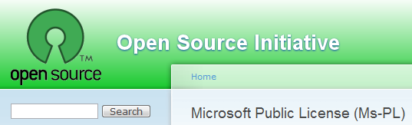

Notes:
IronRuby, an open-source implementation of Ruby 1.8.6 for the .NET Framework

Slide 4

Notes:
… erm,

Slide 5

Notes:
ugh, must have been a projector malfunction

Slide 6



Notes:
In short, I get paid to work on open-source, and in light of recent events is especially awesome.

Slide 7
Why are you here?
Notes:
Quick poll: How many are part of .NET shops currently, or have moved from .NET to Rails? Just curious about IronRuby? Implementers? Others: see slide =) seriously though, let me know what you want to get out of this.

Slide 8

http://www.flickr.com/photos/bonguri/128765190/
Notes:
Last year, IronRuby was much like a sprout on a tree. Much of the “xylem and phloem” was there, but it has only just begun to stretch towards the sun. Ok, I’m done with this fuckin’ metaphor. Try again.

Slide 9

http://www.flickr.com/photos/jeffjackson/2306771206/
Notes:
<>And growing up is hard to do. This was probably IronRuby right after RailsConf 2008. It’s just starting to run Rails, and experience all the stresses of the world around it.

Slide 10

Notes:
The good news is that today, IronRuby is growing in, meaningfully interacting with the world around it, and begin to get good at things. Though this kid creeps me out, so bad analogy. Again, point is IronRuby is running real Ruby programs, like Rails and Sinatra, to name a few relevant to RailsConf.

Slide 11

http://cyrusfirstofearth.blogspot.com/2007_06_01_archive.html
Notes:
However, to work in the real world, where the real world is defined as the .NET framework (which is not the real world, but just an illusion pulled over Microsofty’s eyes), IronRuby needs to stretch out and be good at other things than its parent is (MRI). At a basic form this means accessing the .NET framework just like it was a set of Ruby libraries, but extends much further than that. Today I’ll show IIS running IronRuby-based applications, and other examples of how .NET makes Ruby better (but not at the price of breaking!)

Slide 12

http://imagecache2.allposters.com/images/pic/38/018_3345~Childhood-Tom-is-a-True-Mack-Daddy-Pimp-Tom-Pimp-Posters.jpg
Notes:
And lastly, people are starting to notice us. Community involvement is starting to pick up, and our “real Ruby implementation” status is getting closer and closer.

Slide 13
growing up
Notes:
If you haven’t met IronRuby before, let’s do so.
Quick REPL demo
Ok, let’s cut to the chase: IronRuby running Rails.
>>> http://localhost:3000, click around on everything. Also switch to script\console and show stuff there too.
activerecord-mssql-adapter.gem
>>> http://github.com/jschementi/activerecord-mssql-adapter/blob/cd1a04953b5a1c745a6318439b7eac1fc575c26f/mssql_adapter.rb
That database adapter is a IronRuby ActiveRecord adapter for SqlServer; or any database which provides an implementation of the .NET System::Data::SqlClient API, like the .NET version of db4o. Special thanks to Ray Vernagus for helping out on this. He’ll also be abstracting this work to support and ORM, like DataMapper.
We also run Sinatra:
>>> http://localhost:4567, click around.
Which means we run “Rack”, since Rails and Sinatra depend on it, but we’ll come back to that.
Let’s see a kinda-real application.
>>> http://localhost:4568
This was written by Chad Fowler, Rich Kilmer, and myself as a demo initially intended for Windows Azure, but useful as a semi-real app IronRuby can showcase.

Slide 14
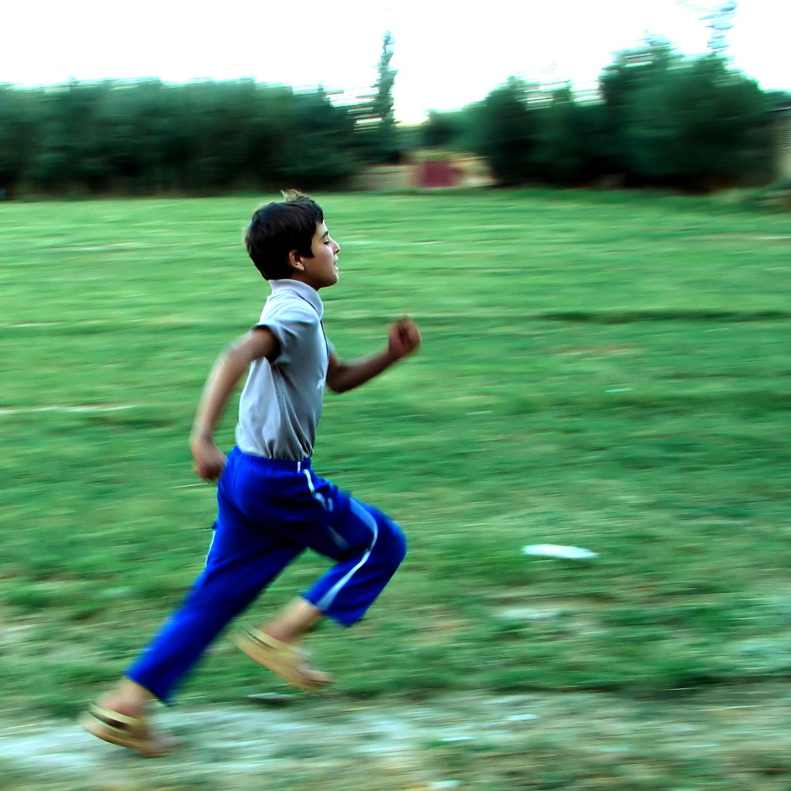
rails performance webrick + production
 | IronRuby (s) | Ruby (s) | IronRubyDiff
Startup | 34.63 | 6.593 | -5.2x
1st Request | 1.956 | 0.439 | -4.4
n Requests | 0.056 | 0.022 | -2.5

Slide 15
rails unit tests
ActionPack
94% Pass Rate
2306 tests, 10539 assertions, 85 failures, 50 errors
ActiveRecord
29% Pass Rate (!)
287 tests, 307 assertions, 22 failures, 182 errors
Most failures due to a couple small bugs
ActiveSupport
90% Pass Rate
1659 tests, 6842 assertions, 69 failures, 84 errors

Slide 16
the real world
Notes:
The “Real World” is why you should care about IronRuby, especially if you are already a Windows or .NET shop. None of the benefits of IronRuby would be possibly if you couldn’t deploy your apps on web servers your infrastructure supports.

Slide 17
rack
Rack provides an minimal interface between web servers supporting Ruby and Ruby frameworks.
Notes:
I mentioned “rack” before; it’s simply a layer between web servers and Ruby frameworks. Since IIS is programmable through .NET code (ASP.NET), and IronRuby runs Rack, we just need glue between IIS and Rack, which Rack calls a “Handler”. That’s exactly what I’ll be demonstrating.

Slide 18
ironruby-rack
Rack interface between IIS and IronRuby
Notes:
>>> Navigate to http://localhost/RackApp, then http://localhost/SinatraApp. Then walk-through it. Focus on hosting API use.

Slide 19
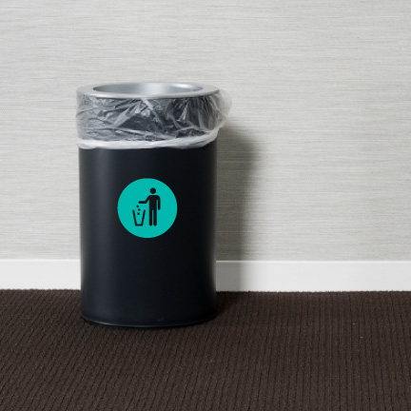
http://www.flickr.com/photos/29116324@N04/2810080286/
Notes:
The point of doing this, rather than just setting up Apache and Mongrel on Windows, despite the Windows performance implications, it’s a people issue: if your organization has an IIS knowledgebase, you’ll want to utilize it. Deploying this way requires no retraining, as this solution is purely ASP.NET based; no throwing away of experience. It’s also a great way to sneak Ruby into your organization =)
>>> Show how to deploy the app easily, with a Ruby script.

Slide 20
The Cloud
Request/Response
WEBrick
WEBrick
Rack Handler
Rack
Application
(Rails, etc)

Slide 21
The Cloud
Request/Response
IIS
HttpHandler
IronRuby.Rack.dll
IronRuby
Rack
Application
(Rails, etc)

Slide 22
http://www.flickr.com/photos/hamed/258971456/
Notes:
Performance

Slide 23

System::Console.write_line "hello"
Notes:
Pimp.NET
The next couple of demos are purely to Pimp .NET, so you’ve been warned. If I had a pimp I’d be wearing it. The point of all these demos is to show how IronRuby makes the .NET platform look just like Ruby code.
DSLs
<> Ruby’s beautiful “Internal DSL” ability is very useful in frameworks which weren’t designed for Ruby. A small number of methods and you’ve got a DSL for creating WPF UIs. Thaibut has taken this a step further and is creating the same DSL for building WinForms, WPF, and Silverlight UIs. Pretty awesome stuff.
ActiveRecord and Databinding
I remember the first time I used ActiveRecord outside Rails, and it was awesome. Taking that a step further, using ActiveRecord to “data bind” to WinForms UI elements makes UI creation stupid-simple.
> rc09
> cd ardb
> ir app.rb
ASP.NET MVC
Ivan Porto Carrero, Phil Haack, and I have been building a nice Ruby API around the new ASP.NET MVC framework, which is very much influenced by Merb. The building of this API has helped inform the MVC team about places where they were killing extensibility, so the project benefited everyone. And because the whole web stack is compiled code, it’s the fastest Ruby web framework I’ve shown. =P
:: Show calculator Silverlight app ::
Silverlight
The calculator in the previous app was written in Silverlight, but tested with IronRuby and Bacon in IN THE BROWSER. For people who still love static languages, Ruby can be extremely useful for testing and scripting scenarios.
:: Show tests ::
I’ve got a BoF session tonight at 9pm to elaborate a bit more about IronRuby in the browser, so if you’re interested in this please attend.

Slide 24
form = Magic.build do
@menu = main_menu do
menu_item "&File" do
menu_item "&New"
menu_item("&Quit").click { Application.Exit }
menu_item("&Other Quit", :click => lambda {
Application.Exit
})
end
end
form :text => "Title", :menu => @menu do
flow_layout_panel :dock => :fill do
button(:text => "Click me!").click do
MessageBox.Show "Hello from button!"
end
end
end
end
Notes:
Magic

Slide 25
getting noticed

Slide 26
RubySpec http://ironruby.info

Slide 27
100_000.times{|i| i + 1}
Ruby:
user system total real
0.078000 0.000000 0.078000 ( 0.080000)
0.078000 0.000000 0.078000 ( 0.084000)
0.094000 0.000000 0.094000 ( 0.082000)
IronRuby:
user system total real
0.093601 0.000000 0.093601 ( 0.090000)
0.265202 0.000000 0.265202 ( 0.154004)
0.093601 0.000000 0.093601 ( 0.080000)
0.046800 0.000000 0.046800 ( 0.075001)
0.078000 0.000000 0.078000 ( 0.062001)
Notes:
Ruby vs. IronRuby method invocation. IronRuby gets better over time.

Slide 28
community
Active Contributors
Michael Letterlee
Ivan Porto Carrero
Jirapong Nanta
Daniele Assessandri
Thibaut Barrere
Ray Vernagus
Core Team
John Lam
Shri Borde
Tomas
Jim Deville
Jimmy Schementi

Slide 29
ironruby-contrib
IronRuby MVC
silverline – Silverlight + Rack
ironnails – Pretty WPF/SL DataBinding
Magic - DSL for UI development (winforms, WPF, Silverlight)
irdb – Ruby database layer
Hpricot, JSON
IRDB
Ironruby-rack

Slide 30
ironruby-0.5 release this friday http://ironruby.net/Download

Slide 31
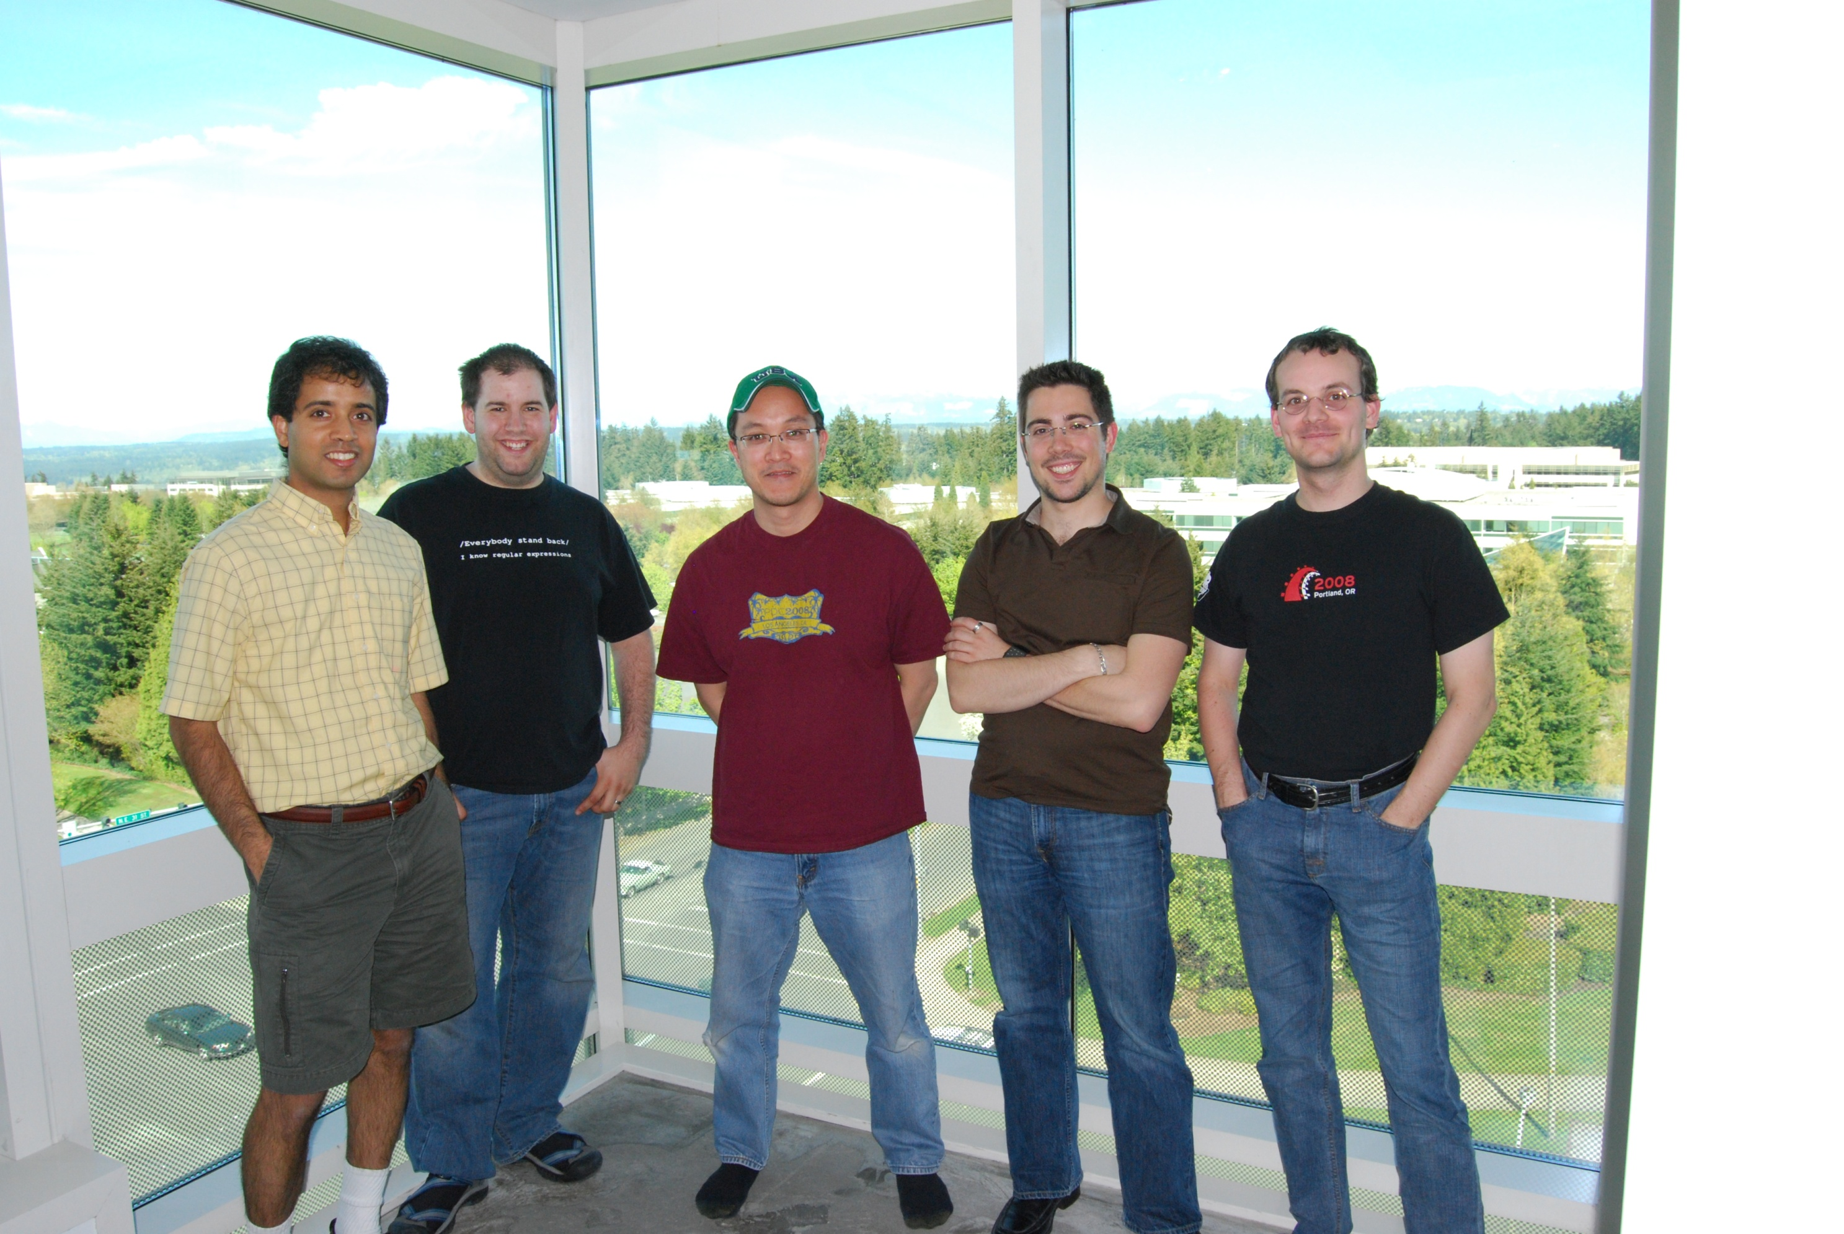
Thanks!

Slide 32
Backup

Slide 33
rails scenarios http://ironruby.net/Documentation/Rails

Slide 34
irails foo
> irails foo
create
create app/controllers
create app/helpers
create app/models
create app/views/layouts
create config/environments
create config/initializers
create config/locales
create db
create doc
create lib
create lib/tasks
create log
create public/images
create public/javascripts
create public/stylesheets
create script/performance
create test/fixtures
create test/functional
create test/integration
create test/performance
create test/unit
create vendor
create vendor/plugins
create tmp/sessions
create tmp/sockets
create tmp/cache
create tmp/pids
create Rakefile
create README
create app/controllers/application_controller.rb
create app/helpers/application_helper.rb
create config/database.yml
create config/routes.rb
create config/locales/en.yml
create config/initializers/backtrace_silencers.rb
create config/initializers/inflections.rb
create config/initializers/mime_types.rb
create config/initializers/new_rails_defaults.rb
create config/initializers/session_store.rb
create config/environment.rb
create config/boot.rb
create config/environments/production.rb
create config/environments/development.rb
create config/environments/test.rb
create script/about
create script/console
create script/dbconsole
create script/destroy
create script/generate
create script/runner
create script/server
create script/plugin
create script/performance/benchmarker
create script/performance/profiler
create test/test_helper.rb
create test/performance/browsing_test.rb
create public/404.html
create public/422.html
create public/500.html
create public/index.html
create public/favicon.ico
create public/robots.txt
create public/images/rails.png
create public/javascripts/prototype.js
create public/javascripts/effects.js
create public/javascripts/dragdrop.js
create public/javascripts/controls.js
create public/javascripts/application.js
create doc/README_FOR_APP
create log/server.log
create log/production.log
create log/development.log
create log/test.log

Slide 35
ir script\generate
> ir script\generate scaffold post title:string body:text published:boolean
create app/models/
exists app/controllers/
exists app/helpers/
create app/views/posts
exists app/views/layouts/
exists test/functional/
create test/unit/
create test/unit/helpers/
exists public/stylesheets/
create app/views/posts/index.html.erb
create app/views/posts/show.html.erb
create app/views/posts/new.html.erb
create app/views/posts/edit.html.erb
create app/views/layouts/posts.html.erb
create public/stylesheets/scaffold.css
create app/controllers/posts_controller.rb
create test/functional/posts_controller_test.rb
create app/helpers/posts_helper.rb
create test/unit/helpers/posts_helper_test.rb
route map.resources :posts
dependency model
exists app/models/
exists test/unit/
create test/fixtures/
create app/models/post.rb
create test/unit/post_test.rb
create test/fixtures/posts.yml
exists db/migrate
create db/migrate/20090422182202_create_posts.rb

Slide 36
irake db:migrate
c:\dev\railsconf09\pictures>irake db:migrate
(in c:/dev/railsconf09/pictures)
== CreatePictures: migrating ======================
-- create_table(:pictures)
-> 0.1260s
-> -1 rows
== CreatePictures: migrated (0.1780s) =============
== CreatePeople: migrating ========================
-- create_table(:people)
-> 0.0640s
-> -1 rows
== CreatePeople: migrated (0.0870s) ===============
== CreateTags: migrating ==========================
-- create_table(:tags)
-> 0.0380s
-> -1 rows
== CreateTags: migrated (0.0550s) =================
== CreateTaggings: migrating ======================
-- create_table(:taggings)
-> 0.0470s
-> -1 rows
== CreateTaggings: migrated (0.0570s) =============
== CreateFriendships: migrating ===================
-- create_table(:friendships)
-> 0.0530s
-> -1 rows
== CreateFriendships: migrated (0.0650s) =====================================
== AddEmailToPeople: migrating ===============================================
-- add_column(:people, :email, :string)
-> 0.0170s
-> -1 rows
== AddEmailToPeople: migrated (0.0290s) ======================================
== RenameFriendships: migrating ==============================================
-- rename_table(:friendships, :follows)
-> 0.0110s
-> -1 rows
== RenameFriendships: migrated (0.0210s) =====================================
== AddDataToPictures: migrating ==============================================
-- add_column(:pictures, :data, :binary)
-> 0.0060s
-> -1 rows
== AddDataToPictures: migrated (0.0160s) =====================================
== AddFilenameToPictures: migrating ==========================================
-- add_column(:pictures, :filename, :string)
-> 0.0080s
-> -1 rows
== AddFilenameToPictures: migrated (0.0180s) =================================
== MungeFollowsColumns: migrating ============================================
-- rename_column(:follows, :friend_id, :following_id)
-> 0.0070s
-> -1 rows
-- rename_column(:follows, :originator_id, :follower_id)
-> 0.0040s
-> -1 rows
== MungeFollowsColumns: migrated (0.0240s) ===================================
== CreateComments: migrating =================================================
-- create_table(:comments)
-> 0.0160s
-> -1 rows
== CreateComments: migrated (0.0270s) ========================================
== CreateAlbums: migrating ===================================================
-- create_table(:albums)
-> 0.0190s
-> -1 rows
== CreateAlbums: migrated (0.0300s) ==========================================
== AddAlbumIdToPictures: migrating ===========================================
-- add_column(:pictures, :album_id, :integer)
-> 0.0060s
-> -1 rows
== AddAlbumIdToPictures: migrated (0.0190s) ==================================
== AddPersonIdToTaggings: migrating ==========================================
-- add_column(:taggings, :person_id, :integer)
-> 0.0040s
-> -1 rows
== AddPersonIdToTaggings: migrated (0.0150s) =================================
== AddThumbnailDataToPictures: migrating =====================================
-- add_column(:pictures, :thumbnail_data, :binary)
-> 0.0050s
-> -1 rows
== AddThumbnailDataToPictures: migrated (0.0160s) ============================

Slide 37
ir script\server
> cd IronRubyOnRails
> ir script\server
=> Booting WEBrick
=> Rails 2.3.2 application starting on http://0.0.0.0:3000
=> Call with -d to detach
=> Ctrl-C to shutdown server
[2009-04-22 13:55:50] INFO WEBrick 1.3.1
[2009-04-22 13:55:50] INFO ruby 1.8.6 (2008-05-28) [i386-mswin32]
[2009-04-22 13:55:50] INFO WEBrick::HTTPServer#start: pid=2928 port=3000
Processing Rails::InfoController#properties (for 127.0.0.1 at 2009-04-22 14:20:50) [GET] Completed in 152ms (View: 128, DB: 0) | 200 OK [http://localhost/rails/info/properties]

Slide 38
ir script\console
> ir script\console
Loading development environment (Rails 2.3.2)
>> Post.all
=> [#<Post id: 2, title: "Post from IronRuby!", body: "IronRuby runs Rails, still!">, #<Post id: 3, title: "Second post from IronRuby!", body: "IronRuby still runs Rails, still!">]
>> Post.find_by_title("foo")
=> #<Post id: 1, title: "foo", body: "bar">
>> Post.count
=> 3

