Slide 1
What makes a great running shoe?
By: Jack Schiavone
Notes:
What makes a good running shoe to me.
Add more here

Slide 2
The Question
Can runrepeat.com, provide insight into what runners are looking for in a shoe without explicitly saying?
We can attempt to answer this question by comparing ratings, reviews, price, brands and different categorical features of a shoe.
Notes:
-Expert Reviewers are selected by the people who run the site, they are mostly elite runners, or runners who have run many races.
-Users can only leave a score review

Slide 3
The Website
Runrepeat.com curates reviews from both people they deem as ‘experts’ and users. Experts are able to leave a detailed review and users can leave a number from 1 to 5.
They are independent and make money through user purchases through affiliate links on their website
They boast over 7 million reviews across all categories of shoes and 12,000 expert contributions

Slide 4
The Dataset
2201 different shoes
33 brands
Trail and road running shoes
13 different features
‘Core Score’
Expert Score
Retail Price
Sale Price
Weight
Heel to Toe drop
Arch Support
Notes:
Heel to top drop means that the heel is higher than the toe, typically anywhere from 0 to 10 mm. Some brands only make 0mm drop shoes.
‘Core score’ is a metric created by runrepeat.com and is a combination of expert, user and number of reviews. It is important to note that because we don’t exactly know how it is found it could lead to a false conclusion.
-Expert Reviewers are selected by the people who run the site, they are mostly elite runners, or runners who have run many races.
-Users can only leave a score review

Slide 5
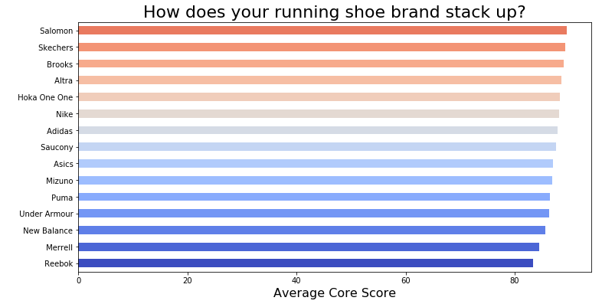
The Analysis
Notes:
If you want to take a moment to see how your favorite brand compares bye core score on the left and expert score on the right.
You may already notice that there is not much difference in mean core scores between brand (reebok at 83.4 and salomon at 89.6)

Slide 6
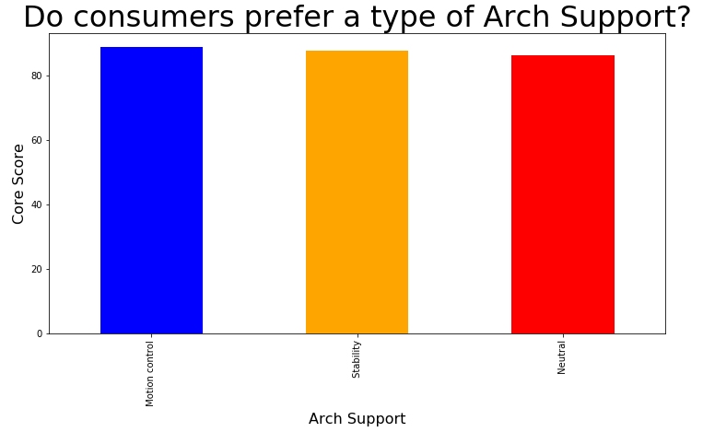
Notes:
Green = stability
Red = neutral
Blue = motion control
Although, motion control is the highest rated it is not much higher than stability and neutral shoes
Change chart to match arch support

Slide 7
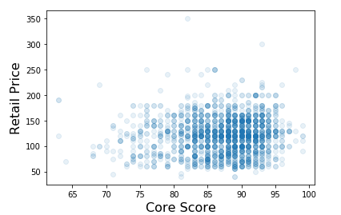
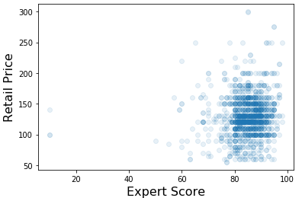
Do more expensive shoes lead to better ratings?
Notes:
There is no correlation between a more expensive shoe and receiving a higher rating both in the core score and just among expert reviews.

Slide 8
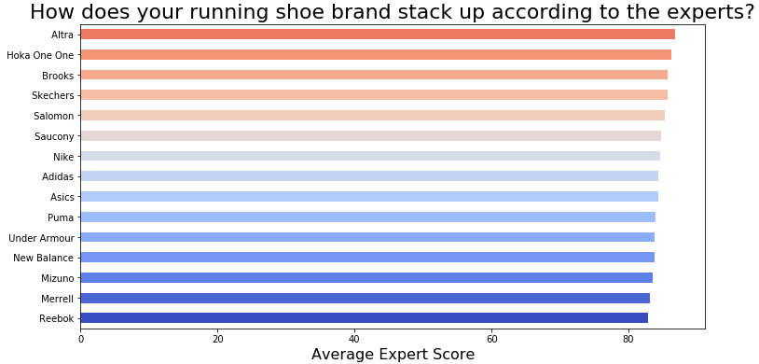
Notes:
Although only a slight difference, the top brand according to expert ratings is Altra. What makes this interesting in that Altra is the only shoe company on the list that makes exclusively zero drop shoes and they have a distinctive wide toe box. One possible reason for this, is that zero drop shoes initially put more strain on your achilles than a typical runner may be used to. It is recommend that after switching to a zero drop shoe, that you reduce the length of your runs to not injure yourself. This could be important information that Altra may want to consider pointing out to adapters of their sneaker to avoid new customers from thinking the shoe is giving them pain.

Slide 9
Next Steps
After considering different features from weight, arch support, terrain, retail price, brands it became clear that no feature leads to a better rated shoe.
To further look into what runners look for in a shoe, the summary and expert reviews could provide an opportunity using Natural Language Processing.

Slide 10
Questions?

