Slide 1
What makes a great running shoe?
By: Jack Schiavone
Notes:
As an avid runner myself and I have researched running shoes a lot trying to figure out what was best for me. Running stores try to help you get the best sneaker but that doesn’t always go as planned and what felt good at the store can be awful after your first couple runs.

Slide 2
The Question
Can runrepeat.com, provide insight into what runners are looking for in a shoe without explicitly saying?
Can we find a change in what features users are looking for in running shoes over the past 7 years?
We can attempt to answer this question by comparing ratings, reviews, price, brands and different categorical features of a shoe.
Notes:
The purpose of this analysis was to see if there were features about a running shoe, such as weight or arch support, that lead to a higher rating on runrepeat.com by their users and experts and could a company capitalize on the trends that have made a shoe highly rated.

Slide 3
The Website
Runrepeat.com curates reviews from both people they deem as ‘experts’ and users. Experts are able to leave a detailed review and users can leave a number from 1 to 5.
They are independent and make money through user purchases through affiliate links on their website
They boast over 7 million reviews across all categories of shoes and 12,000 expert contributions
Notes:
The data to try and answer this question was scraped from runrepeat.com which claims to be independent from any shoe company, they make money when users buy products after they have clicked a link from a product page.

Slide 4
The Dataset
2201 different shoes
33 brands
Trail and road running shoes
13 different features
‘Core Score’
Expert Score
Retail Price
Sale Price
Weight
Heel to Toe drop
Arch Support
Release Date
Notes:
The dataset contains 2200 different shoes, across 33 brands. I scraped 13 different features of trail and road running shoes.
‘Core score’ is a metric created by runrepeat.com and is a combination of expert, user and number of reviews. It is important to note that because we don’t exactly know how it is calculated.
-Expert Reviewers are selected by the people who run the site who have reviewed many different products already.
-Regular Users can only leave a score review from 1 to 5

Slide 5
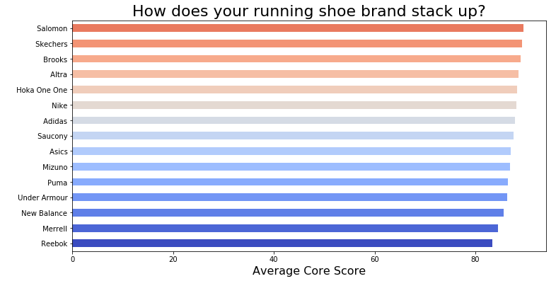
The Analysis
Notes:
If you want to take a moment to see how your favorite brand compares by core score on the left and expert score on the right.
You may already notice that there is not much difference in mean core scores between brand (reebok at 83.4 and salomon at 89.6)

Slide 6
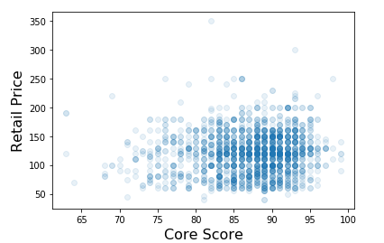
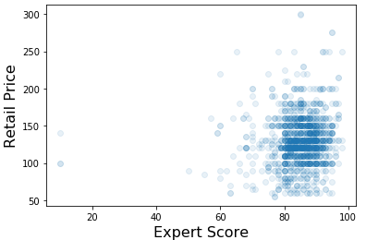
Do more expensive shoes lead to better ratings?
Notes:
There is no correlation between a more expensive shoe and receiving a higher rating both in the core score and just among expert reviews.

Slide 7
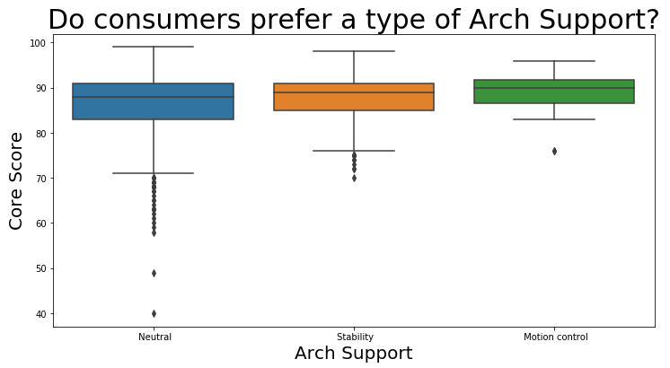
Notes:
We can see the median of each arch support is very close, interestingly, Motion Control has the least variation but is the smallest sample, only 22 shoes were classified as motion control. Most shoes were classified as Neutral. There is not any real difference.

Slide 8
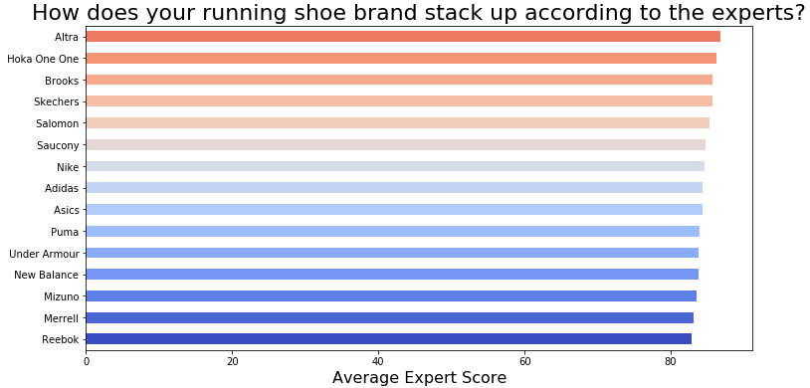
Notes:
Although only a slight difference, the top brand according to expert ratings is Altra. What makes this interesting in that Altra is the only shoe company on the list that makes exclusively zero drop shoes and they have a distinctive wide toe box. One possible reason for this, is that zero drop shoes initially put more strain on your achilles than a typical runner may be used to. It is recommend that after switching to a zero drop shoe, that you reduce the length of your runs to not injure yourself. This could be important information that Altra may want to consider pointing out to adapters of their sneaker to avoid new customers from thinking the shoe is giving them pain.

Slide 9
Conclusions
No one specific feature, correlates to a higher rated shoe on runrepeat.com
Companies who focus on a specific type on shoe, will most likely only keep a small market share because consumers are looking for a wide range of products.
Educating consumers may help a convert new customers to their products.
To further look into what runners look for in a shoe, the summary and expert reviews could provide an opportunity using Natural Language Processing
Notes:
So I looked at all the features I had scraped and found no correlation. Every graph looked like the ones I have shown. There was no correlation between a feature and core score, expert score or price. What this proves to me though is that the wide range of products are there not to confuse consumers but to allow consumers to find the product they would want the most.

Slide 10
Questions?

