Slide 1

From Collocated Servers to Windows Azure Web Sites in Three Days
Joey Schluchter
@sonofjorel
Notes:
Talk about nukleus
Colo sitiuation
Azure as a backbone
5 min tops

Slide 2
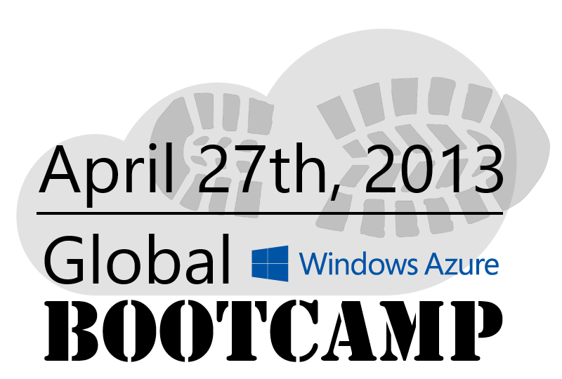
Windows Azure Global Bootcamp
Over 60 community-led Windows Azure training events worldwide! http://globalwindowsazure.azurewebsites.net
Notes:
Look up more info on this 1-2 minutes tops

Slide 3
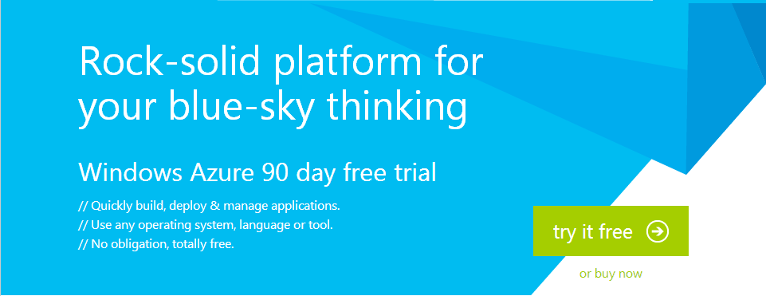
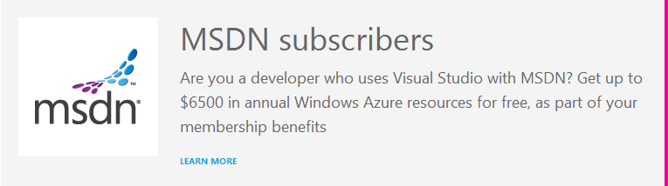
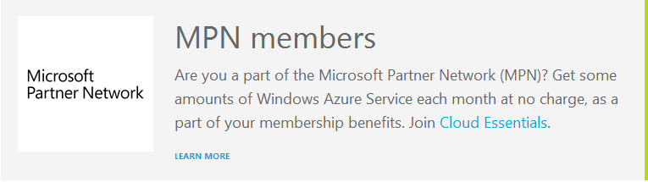

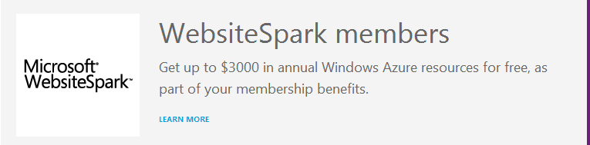
Get started with a 90 day free trial
http://aka.ms/AzureConf-FreeTrial
Or, use your existing benefits…
http://aka.ms/AzureConf-MemberOffers
Notes:
1-2 minutes on this and nukleus BizSpark

Slide 4
Or : How I learned to stop worrying and love Windows Azure Web Sites
Joey Schluchter
@sonofjorel
Notes:
Talk about nukleus
Colo sitiuation
Azure as a backbone
5 min tops

Slide 5
Agenda
Collocation and the infinite sadness
Why we love Windows Azure Web Sites
Deploying Windows Azure Web Sites
Integrate Table & Blob Storage with your Web Site
Scaling your Web Site
Review
Talk about our feelings

Slide 6
Collocation and the infinite sadness
Notes:
Colo:
Why collocation?
PRO
Out of the local network, reduce traffic issues
CON
Costs
Licensing
Someone has to update the server
Hardware issues
Scalability
Single Point of Failure
Downtime issues

Slide 7
Collocation Pros and Cons
The Good
Network and site security.
Connectivity and power.
You own the hardware and the software.
The Bad
Limited access.
Upgrades, patches and hotfixes are a pain.
Limited scalability.
You own the hardware and the software!
Notes:
Pro
On-site security, badge access etc
Network firewalls and intrusion detection
Better network backbone and on-demand increase of bandwidth
Con
Limited access times (in most cases) if you need direct access to the box
Updates and Patches are difficult and somewhat unpredictable (Reference SQL Update story that wiped out db’s)
Limited scalability and creating a farm compounds the above cons. You can’t just throw hardware at a scale problem.
YOU OWN THE HARDWARE AND SOFTWARE

Slide 8
So how did this affect us?
Our Collocated Dilemma
The problem was that our platform was slow and couldn't support the growth we expected.
We knew we needed to move the platform to the cloud and in a timely manner.
After moving our core platform to Windows Azure, we decided to experiment with Windows Azure Web Sites for some of the platform features.
For our 'Showcase' Facebook app we chose node.js.

Slide 9
Why we love Windows Azure Web Sites

Slide 10
Build better software faster
Create and deploy quickly
ASP.NET, PHP & Node.js.
Git or TFS Source Control.
Plethora of Free & Paid Web Apps Available.
Free, Shared & Dedicated options.
The Windows Azure backbone.

Slide 11
Deploying a Windows Azure Web Site with MVC & TFS
Notes:
Deploy with .NET & TFS
Walk through the creation of the website
TFS Continuous Integration

Slide 12
Deploying a Windows Azure Web Site with Node & Git
Notes:
Deploy with Nodejs & Git
Walk through the creation of the website
Git remote add & Git push a hello world

Slide 13
Demo: Data access with Table & Blob Storage with our Facebook App
Notes:
Demo / Snippets

Slide 14
Scaling your Web Site
Notes:
Demo / Snippets

Slide 15
How did Windows Azure Web Sites help us?
We can prototype and deploy quickly
We started coding on a Friday and had a working demo the following Wednesday.
Table & Blob Storage are easy to use and fast
A centralized, scalable out of the box data solution.
Scalability solved
A slider in the management interface can add instances as needed.
We are saving money
No more collocation. No more hardware issues. No more software issues.
Notes:
----- Meeting Notes (4/16/13 12:30) -----
74% of IT Costs are spent on infrastructure.

Slide 16
Review
Notes:
Talk about moving from collocated to azure and the ease of development.

