Slide 1
Stream I/O and Memory Management
Dr. B
CS 392: Systems Programming
Spring 2020

Slide 2
C Stream I/O
On Linux, input and output are mapped into logical data streams
To or from physical devices such as terminals and tape drives
To or from files supported on structured storage devices
Operations on data streams are with uniform interfaces, regardless of types of source and destination.
Through FILE objects and file pointers FILE *
Three standard streams defined by POSIX (all defined in stdio.h)
stdin
file descriptor 0; used by scanf
stdout
file descriptor 1; used by printf
stderr
file descriptor 2; used by perror

Slide 3
Open a Stream
FILE *fopen(const char *path, const char *mode)
Opens the file/device whose name is in the string pointed to by "path"
The opened file/device is associated with a stream and represented by the returned FILE* pointer
The string pointed to by "mode" specifies the mode in which to open the file
// openfile.c
#include <stdio.h>
int main (int argc, char **argv) {
FILE *fp;
fp = fopen("/path/to/your/file", "r");
// open the file at "/path/to/your/file" to read
return 0;
}
// openfile.c
#include <stdio.h>
int main(int argc, char **argv) {
FILE *fp;
fp = fopen("/dev/stdin", "r");
// open the standard input device to read
// no difference from file based stream
return 0;
}

Slide 4
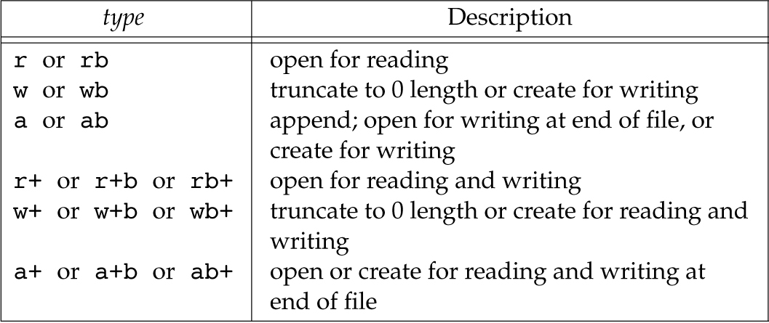
Stream Modes
UNIX does not treat binaries differently so in most cases using b does not affect the stream in any way, but it does increase code readability

Slide 5
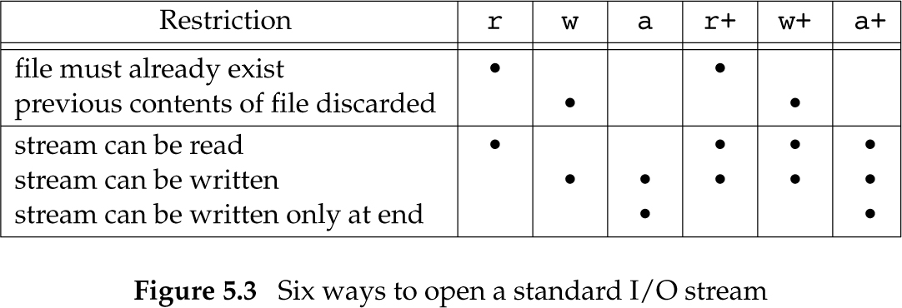
Mode Restrictions

Slide 6
Closing a Stream
int fclose(FILE *fp);
Flushes the stream pointed to by fp (writing any buffered output data using fflush(3)) and closes the underlying file descriptor
Warning: If you are writing or appending to a file remember to always close it or otherwise your changes may not be written to disk.
// openfile.c
#include <stdio.h>
int main(int argc, char **argv) {
FILE *fp;
fp = fopen("/path/to/your/file", "r");
fclose(fp); //close the opened stream
return 0;
}

Slide 7
Reopen a Stream
FILE *freopen(const char *path, const char *mode, FILE *stream);
Opens the file whose name is the string pointed to by path and associates the stream pointed to by stream with it.
The original stream (if it exists) is closed.
The primary use of the freopen() function is to change the file associated with a standard text stream(stderr, stdin, or stdout)
// freopen example: redirecting stdout
#include <stdio.h>
int main(int argc, char** argv) {
freopen("myfile.txt", "w", stdout);
// associate "standard output" to "myfile.txt"
printf("This sentence is redirected to a file.");
fclose(stdout);
return 0;
}

Slide 8
Read/Write with Streams
char *fgets(char *s, int size, FILE *stream);
Reads in at most one less than size characters from stream and stores them into the buffer pointed to by s.
Reading stops after an EOF or a newline (i.e., '\n'). If a newline is read, it is stored into the buffer.
A terminating null byte ('\0') is stored after the last character in the buffer.
int fputs(const char *s, FILE *stream);
Writes the string s to stream, without its terminating null byte ('\0').
#include <stdio.h>
int main(int argc, char **argv) {
char str[20];
FILE *fp = fopen("/path/to/your/file", "r");
fgets(str, 20, fp); // at most 19 bytes will be read and a null terminator will be appended thereafter.
fputs(str, stdout); // print what we just read to standard output
fclose(fp); // close the opened stream
return 1; }

Slide 9
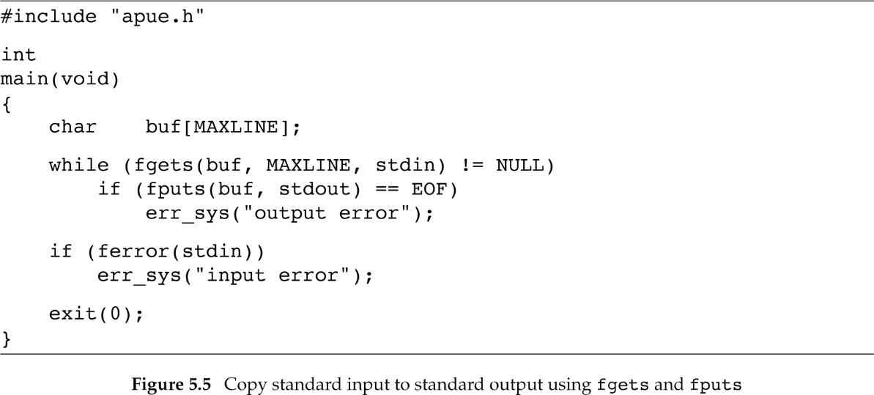
Improved echo

Slide 10
General IO read/write
size_t fread(void *ptr, size_t size, size_t nitems, FILE *stream);
Shall read into the array pointed to by ptr up to nitems elements whose size is specified by size in bytes
The file position indicator for the stream (if defined) shall be advanced by the number of bytes successfully read.
The return value indicates how many bytes are read
If an error occurs, the resulting value of the file position indicator for the stream is unspecified. If a partial element is read, its value is unspecified.
20 bytes
20 bytes
Stream position at beginning
Stream position after fread(str, 20, 1, fp)
#include <stdio.h>
int main(int argc, char **argv) { char str[20];
FILE *fp = fopen("/path/to/your/file", "r");
fread(str, 1, 20, fp); // read 20 * 1 bytes into str; if insufficient data, read as many bytes as the stream has
fputs(str, stdout); // print what we just read to standard output
fclose(fp); // close the opened stream
return 1; }

Slide 11
General IO read/write
size_t fwrite (const void *ptr, size_t size, size_t count, FILE *stream);
Writes an array of count elements, each one with a size of size bytes, from the block of memory pointed by ptr to the current position in the stream.
The position indicator of the stream is advanced by the total number of bytes written.
The number of bytes written is indicated by the return value.
20 bytes
Stream position at beginning
Stream position after fwrite(str, 20, 1, fp)
#include <stdio.h>
int main(int argc, char **argv) {
char str[] = "Hello World\n";
fwrite(str, 12, 1, stdout); // print "Hello World" to standard output;
return 0;
}

Slide 12
Not At the Beginning, Nor at the End
int fseek(FILE *stream, long offset, int whence);
Sets the file position indicator for the stream pointed to by stream.
The new position, measured in bytes, is obtained by adding offset bytes to the position specified by whence.
whence: SEEK_SET, SEEK_CUR, or SEEK_END
long ftell(FILE *stream);
Obtains the current value of the file position indicator for the stream pointed to by stream.
void rewind(FILE *stream);
Sets the file position indicator for the stream pointed to by stream to the beginning of the file.
It is equivalent to: (void) fseek(stream, 0L, SEEK_SET)
int fgetpos(FILE *stream, fpos_t *pos);
int fsetpos(FILE *stream, fpos_t *pos);

Slide 13
Formatted Stream I/O
int fscanf ( FILE * stream, const char * format, ... );
Read formatted data from stream
Reads data from the stream and stores them according to the parameter format into the locations pointed by the additional arguments.
scanf(const char* format, …) = fscanf(stdin, const char *format, …)
int fprintf ( FILE * stream, const char * format, ... );
Write formatted data to stream
Writes the C string pointed by format to the stream. If format includes format specifiers (subsequences beginning with %), the additional arguments following format are formatted and inserted in the resulting string replacing their respective specifiers.
printf(const* format,…) = fprintf(stdout, const* format, …)

Slide 14
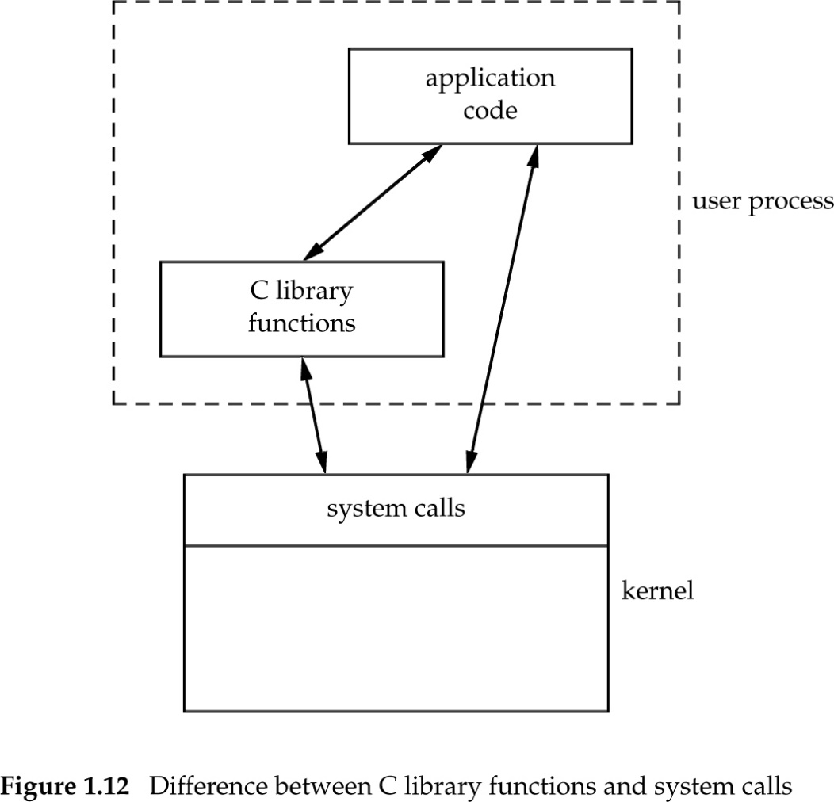
Buffering (1)
Buffer stream operations before sending them to the kernel
fgets(), fputs(), fgetc(), and friends
We do not want to make as many system calls as the calls to these functions

Slide 15
Buffering (2)
C library
Application
fgets(), fputs(), fgetc(), and friends
buffer
Block of bytes
1 or small number bytes
I/O system calls
Kernel

Slide 16
Buffering (3)
The standard I/O library uses buffering
Three types of buffering are provided
Fully buffered
Actual write takes place when the buffer is full and reads are buffered
Line buffered
Actual write takes place when a '\n ' is written or when the buffer is full and reads are buffered
Unbuffered
I/O takes place immediately

Slide 17
Buffering (4)
ISO C mandates that
stdin and stdout are fully buffered when referring to files
stdin and stdout are line buffered when they refer to an interactive device such as a terminal
The standard error stream is not fully buffered

Slide 18
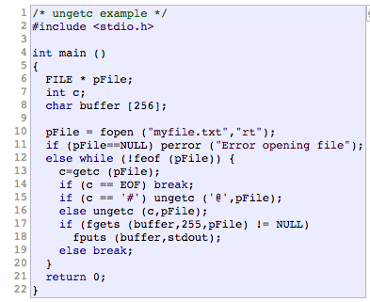
Fun Things with Buffered Streams
int ungetc(int c, FILE *stream);
Pushes c back to stream, cast to unsigned char, where it is available for subsequent read operations. Only one pushback is guaranteed!
This example opens an existing file called myfile.txt for reading and prints its lines, but first gets the first character of every line and puts it back into the stream replacing any starting # by an @.

Slide 19
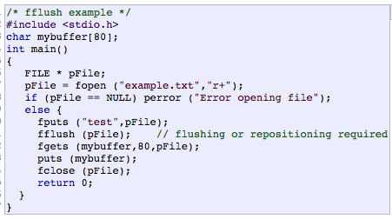
Fun Things with Buffered Streams
int fflush(FILE *stream);
For output streams, fflush() forces a write of all user-space buffered data for the given output or update stream via the stream's underlying write function. For input streams, fflush() discards any buffered data that has been fetched from the underlying file, but has not been consumed by the application. The open status of the stream is unaffected.

Slide 20
Error handling (1)
When fopen fails
fopen return NULL
errno keeps the error number
#include <stdio.h>
int main(int argc, char **argv) {
char str[20];
FILE *fp = fopen("/path/to/your/file", "r"); // how do we know if fopen fails?
if (fp == NULL) {
printf("Cannot open file due to error %d\n", errno);
// Who sets errno?
// what the meaning of errno?
exit(1);
}
return 0;
}

Slide 21
Error handling (2)
int feof(FILE *stream);
Return nonzero if EOF was encountered
#include <stdio.h>
int main(int argc, char **argv) {
char str[20];
FILE *fp = fopen("/path/to/your/file", "r");
while (true) { // this keeps the loop iterating
fread(str, 1, 20, fp); // how do we know if we have reached End of File (EoF)?
if ( feof(fp) ) { // when we reach the EoF, we break the loop
break;
}
}
fclose(fp);
return 1;
}

Slide 22
Error handling (3)
int ferror(FILE *stream);
Return nonzero if an error occurred in the stream
#include <stdio.h>
int main(int argc, char **argv){
char str[20];
FILE *fp = fopen("/path/to/your/file", "r");
while (true) { // this keeps the loop iterating
fread(str, 1, 20, fp); // how do we know if the read is unsuccessful?
if ( ferror(fp) ) { // when we hit an error, we break the loop
printf("Cannot read data due to error %d\n", errno);
break;
}
}
fclose(fp);
return 1;
}

Slide 23
Error handling (4)
void clearerr(FILE *stream);
It clears the end-of-file and error indicators for the stream pointed to by stream.
#include <stdio.h>
int main(int argc, char **argv) {
char str[20] = "Hello World";
FILE *fp = fopen("/path/to/your/file", "r");
fwrite(str, 1, 20, fp);
if (ferror(fp)) {
clearerr(fp); // clear the error and keep reading
}
fread(str, 1, 20, fp);
fclose(fp);
return 0;
}

Slide 24
Standard Error
In Unix-like operating systems, such as Linux, macOS X, and BSD, stderr is defined by the POSIX standard.
Its default file descriptor number is 2. In the terminal, standard error defaults to the user's screen.
stderr is a data stream defined in stdio.h for standard error
Libc: fprintf(stderr)
// error.c
#include <stdio.h>
int main(int argc, char **argv) {
fprintf(stderr, "Something Wrong\n");
return 1;
}
Syscall: write(fd = 2)
Kernel: write(fd = 2)
Something Wrong

Slide 25
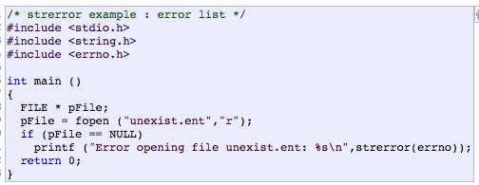
Errno (We have talked about it)
errno is a global integer variable set by libc functions
Whenever an error occurs it is set to a non-zero error number
It is never set to zero by libc, but you can modify it
Numbers are defined in errno.h
We can use errno -l to print the error message behind an error number
char *strerror(int errnum);
Return a pointer to a string describing the error behind errnum

Slide 26
perror()
void perror(const char *s);
Produces an error message including the string s, colon, and a description of the last error based on the error number stored in errno
perror(s) is equivalent to printf("%s: %s\n", s, strerror(errno));

Slide 27
Terminating a Process
void exit(int status);
In certain cases you may want to immediately terminate your process
For example, after a fatal error occurs
Process will exit with exit code status
All open streams will be flushed and closed
The C standard specifies two constants, EXIT_SUCCESS and EXIT_FAILURE, that may be passed to exit() to indicate successful or unsuccessful termination, respectively.

Slide 28
Dynamic Memory Allocation/Free
void *malloc(size_t size);
The malloc() function allocates size bytes and returns a pointer to the allocated memory. The memory is not initialized. If size is 0, then malloc() returns either NULL, or a unique pointer value that can later be successfully passed to deallocation
void free(void *ptr);
The free() function frees the memory space pointed to by ptr, which must have been returned by a previous call to malloc(), calloc() or realloc(). Otherwise, or if free(ptr) has already been called before, undefined behavior occurs. If ptr is NULL, no operation is performed.

Slide 29
Dynamic Memory Allocation/Free
#include <stdio.h>
int main(int argc, char **argv) {
char *ptr;
int sz;
FILE *fp = fopen("/path/to/your/file", "r"); // we do not know the size of this file
fseek(fp, 0L, SEEK_END);
sz = ftell(fp);
rewind(fp); // move the position indicator back the to file beginning
ptr = malloc(sz); // we dynamically allocate a block of memory with size of the file
fread(ptr, 1, sz, fp);
free(ptr); // free the memory we allocated
fclose(fp);
}

