Slide 1
Standard C libraries on Linux
Dr. B
CS 392: Systems Programming
Spring 2020

Slide 2
Standard C library
A library of standard functions that can be used by all C programs(and sometimes by programs in other languages).
By far the most widely used C library on Linux is the GNU C Library ⟨http://www.gnu.org/software/libc/⟩, often referred to as glibc.
#include <stdio.h>
int main(int argc, char **argv) {
printf("Hello World\n"); // Where is printf?
return 1;
}

Slide 3
Where is printf?
Source code defined in glibc(by default for Linux)
https://github.com/lattera/glibc/blob/master/stdio-common/printf.c
When we compile a program, glibc is dynamically linked(by default for Linux)
Try to run: $ ldd /path/to/your/program
When we run a program, glibc will be loaded to memory
The operating system will ensure that our program can find printf.

Slide 4
Commonly Used Library Functions
Standard IO and Stream IO operations
Prototypes: <stdio.h>
String operations
Prototypes: <string.h>
General functions
Prototypes: <stdlib.h>

Slide 5
Standard IO
int printf( const char *format, ... );
int putchar( int character );
int puts( const char *str );
int scanf( const char *format, ... );
int getchar( void );
char* gets( char *str );

Slide 6
Stream IO
FILE* fopen( const char *filename, const char *mode );
int fclose( FILE *stream );
int ferror( FILE *stream );
int feof( FILE *stream );
char* fgets( char *str, int num, FILE *stream );
int fgetc( FILE *stream );
int fscanf( FILE *stream, const char *format, ... );
size_t fread( void *ptr, size_t size, size_t count, FILE *stream );
int fputs( const char *str, FILE *stream );
int fputc( int character, FILE *stream );
size_t fwrite( const void *ptr, size_t size, size_t count, FILE *stream );
int fprintf( FILE *stream, const char *format, ... );

Slide 7
String Operations(1)
Copying:
void* memcpy(void *dest, void *src, size_t n);
copy n bytes of src into dest, return dest
char* strcpy(char *dest, char*src);
copy src string into dest, return dest(stop when encountering '\0')
Concatenation:
char* strcat(char *dest, char *src);
append copy of src to end of dest, return dest('\0' of dest is overwritten)
Comparison:
int strcmp(char *str1, char *str2);
compare str1, str2 by character (based on ASCII value of each character, then string length), return comparison result
str1 < str2: -1
str1 == str2: 0
str1 > str2: 1

Slide 8
String Operations(2)
Searching:
char* strstr(char *str1, char *str2);
return pointer to first occurrence of str2 in str1, else NULL
char* strtok(char *str, char *delimiters);
tokenize str according to delimiter characters provided in delimiters, return the next token per successive stroke call, using str = NULL
Other:
size_t strlen(const char *str);
returns length of the string(up to, but not including the '\0' character)
void* memset(void *ptr, int val, size_t n);
set first n bytes of memory block addressed by ptr to val

Slide 9
General Purpose Functions
Dynamic memory allocation:
malloc, calloc, free
String conversion:
int atoi(char *str);
parse string into integral value (return 0 if not parsed)
System Calls:
void exit(int status);
terminate calling process, return status to parent process
void abort();
aborts process abnormally

Slide 10
General Purpose Functions
Sorting:
void qsort(void* base, size_t num, size_t size, int(*compar)(const void*,const void*));
Sorts the array destructively
Function pointer: a pointer points to a function (pointer type must match the prototype)
Integer arithmetic:
int abs(int n);
returns absolute value of n

Slide 11
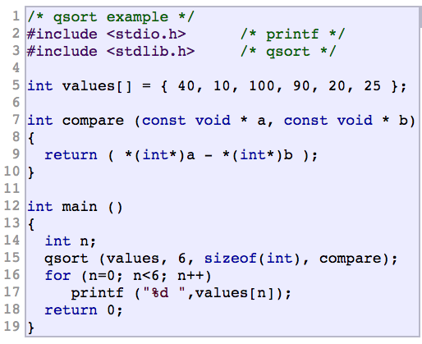
Example for qsort
Output: 10 20 25 40 90 100

