Slide 1
Compiling and Linking
Dr. B
CS 392: Systems Programming
Spring 2020

Slide 2
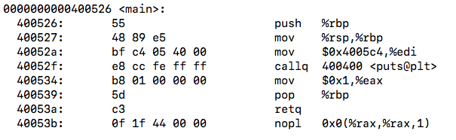
Compiling
Compiling is a process that transforms computer code written in one programming language (the source language) into another programming language (the target language).
For CS392, compiling is to transform Linux C code to binary code
#include <stdio.h>
int main(int argc, char **argv) {
printf("Hello World\n");
return 1;
}
Source Code
Binary Code

Slide 3
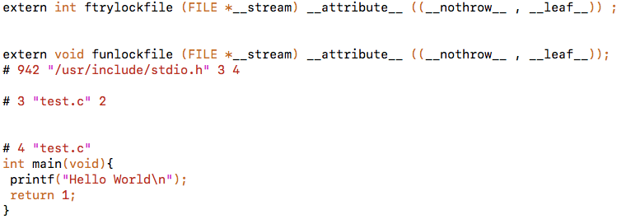
Compiling (1): Pre-processing
Pre-process the directives
Expand the #include and #define
Human readable source code
gcc –E main.c -o main.i or cpp main.c -o main.i
#include <stdio.h>
int main(int argc, char **argv) {
printf("Hello World\n");
return 1;
}
main.i
main.c

Slide 4
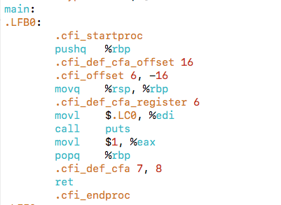
Compiling (2): Compilation
Translates the pre-processed source code into assembly code
Human readable machine code
gcc -S main.i -o main.s
main.i
main.s

Slide 5
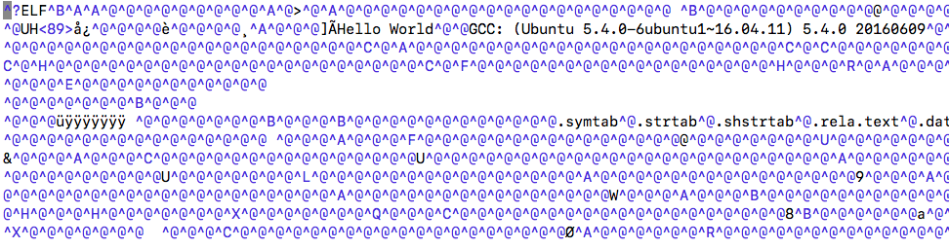
Compiling (3): Assemble
Translates the assembly code into machine code
Machine code
gcc -c main.s -o main.o or as main.s -o main.o
main.s
main.o

Slide 6
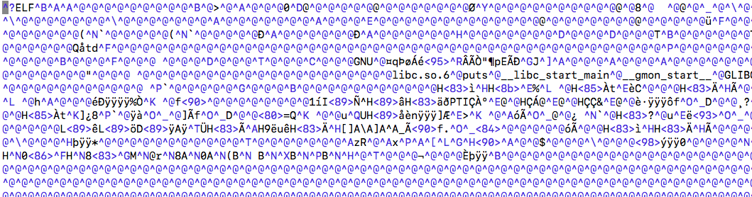
Compiling (4): Linking
Links object files to produce final executable file.
Executable machine code
gcc main.o -o main
main.o
main

Slide 7
Compiling A Program with Multiple Files
int sum(int *a, int n);
int array[2] = {1, 2};
int main() {
int val = sum(array, 2);
return val;
}
int sum(int *a, int n) {
int i, s = 0;
for (i = 0; i < n; i++) {
s += a[i];
}
return s;
}
main.c
sum.c

Slide 8
Linking
Programs are translated and linked using a compiler driver:
linux> gcc -Og -o prog main.c sum.c
linux> ./prog
main.c
sum.c
Source files
Translators
(cpp, cc1, as)
Translators
(cpp, cc1, as)
Separately compiled
relocatable object files
(gcc –c file.c –o file.o)
main.o
sum.o
Linker (ld)
Fully linked executable object file
(contains code and data for all functions
defined in main.c and sum.c)
prog

Slide 9
Why Linkers (1)
Reason 1: Modularity
Program can be written as a collection of smaller source files, rather than one monolithic mass
Can build libraries of common functions (more on this later)
e.g. Math library, standard C library

Slide 10
Why Linkers (2)
Reason 2: Efficiency
Time: Separate compilation
Change one source file, compile, and then relink
No need to recompile other source files
Space: Libraries
Common functions can be aggregated into a single file...
Yet executable files and running memory images contain only code for the functions they actually use

Slide 11
What Do Linkers Do?
Step 1: Symbol resolution
Programs define and reference symbols (global variables and functions):
void swap() {…} /* define symbol swap */
swap(); /* reference symbol swap */
int *xp = &x; /* define symbol xp, reference x */
Symbol definitions are stored in object file (by assembler) in symbol table.
Symbol table is an array of structs
Each entry includes name, size, and location of symbol.
During symbol resolution step, the linker associates each symbol reference with exactly one symbol definition.

Slide 12
Step 1: Symbol Resolution
Referencing
a global…
…that’s defined here
int sum(int *a, int n);
int array[2] = {1, 2};
int main()
{
int val = sum(array, 2);
return val;
}
int sum(int *a, int n)
{
int i, s = 0;
for (i = 0; i < n; i++) {
s += a[i];
}
return s;
}
main.c
sum.c
Defining
a global
Referencing
a global…
Linker knows
nothing of i or s
Linker knows
nothing of val
…that’s defined here

Slide 13
Local Symbols
Local non-static C variables vs. local static C variables
local non-static C variables: stored on the stack
local static C variables: stored in either .bss, or .data (in ELF)
int f()
{
static int x = 0;
return x;
}
int g()
{
static int x = 1;
return x;
}
Compiler allocates space in .data for each definition of x
Creates local symbols in the symbol table with unique names, e.g., x.1 and x.2.

Slide 14
How Linker Resolves Duplicate Symbol Definitions
Program symbols are either strong or weak
Strong: procedures and initialized globals
Weak: uninitialized globals
p1.c
p2.c
strong
int foo=5;
p1() {
}
int foo;
p2() {
}
weak
strong
strong

Slide 15
Linker Symbol Rules
Rule 1: Multiple strong symbols are not allowed
Each item can be defined only once
Otherwise: Linker error
Rule 2: Given a strong symbol and multiple weak symbols, choose the strong symbol
References to the weak symbol resolve to the strong symbol
Rule 3: If there are multiple weak symbols, pick an arbitrary one
Can override this with gcc –fno-common

Slide 16
Linker Puzzles
int x;
p1() {}
p1() {}
Link time error: two strong symbols (p1)
int x;
p1() {}
int x;
p2() {}
References to x will refer to the same
uninitialized int. Is this what you really want?
int x;
int y;
p1() {}
double x;
p2() {}
Writes to x in p2 might overwrite y!
Evil!
int x=7;
int y=5;
p1() {}
double x;
p2() {}
Writes to x in p2 will overwrite y!
Nasty!
int x=7;
p1() {}
int x;
p2() {}
References to x will refer to the same initialized
variable.

Slide 17
Global Variables
Avoid if you can
Otherwise
Use static if you can
Initialize if you define a global variable
Use extern if you reference an external global variable

Slide 18
Step 2: Relocation
Relocatable Object Files
Executable Object File
System code
.text
0
Headers
System data
.data
System code
main()
.text
main.o
swap()
main()
.text
.data
More system code
int array[2]={1,2}
System data
.data
sum.o
sum()
int array[2]={1,2}
.text
.symtab
.debug

Slide 19
Packaging Commonly Used Functions
How to package functions commonly used by programmers?
Math, I/O, memory management, string manipulation, etc.

Slide 20
Old Fashioned Solution: Static Libraries
Static libraries (.a archive files)
Concatenate related relocatable object files into a single file with an index (called an archive)
Enhance linker so that it tries to resolve unresolved external references by looking for the symbols in one or more archives
If an archive member file resolves reference, link it into the executable

Slide 21
Creating Static Libraries
atoi.c
printf.c
random.c
Translator
Translator
...
Translator
atoi.o
printf.o
random.o
Archiver (ar)
unix> ar rs libc.a \
atoi.o printf.o … random.o
libc.a
C standard library
Archiver allows incremental updates
Recompile function that changes and replace .o file in archive

Slide 22
Commonly Used Libraries
libc.a (the C standard library)
5.4 MB archive of 1737 object files in our lubuntu environment
I/O, memory allocation, signal handling, string handling, data and time, random numbers, integer math
libm.a (the C math library)
3.1 MB archive of 802 object files
floating point math (sin, cos, tan, log, exp, sqrt, …)
% ar –t libc.a | sort
…
fork.o
…
fprintf.o
fpu_control.o
fputc.o
freopen.o
fscanf.o
fseek.o
fstab.o
…
% ar –t libm-2.29.a | sort
…
e_acos.o
e_acosf.o
e_acosh.o
e_acoshf.o
e_acoshl.o
e_acosl.o
e_asin.o
e_asinf.o
e_asinl.o
…

Slide 23
Linking with Static Libraries
libvector.a
void addvec(int *x, int *y,
int *z, int n) {
int i;
for (i = 0; i < n; i++)
z[i] = x[i] + y[i];
}
#include <stdio.h>
#include "vector.h"
int x[2] = {1, 2};
int y[2] = {3, 4};
int z[2];
int main()
{
addvec(x, y, z, 2);
printf("z = [%d %d]\n”,
z[0], z[1]);
return 0;
}
addvec.c
void multvec(int *x, int *y,
int *z, int n)
{
int i;
for (i = 0; i < n; i++)
z[i] = x[i] * y[i];
}
main2.c
multvec.c

Slide 24
Linking with Static Libraries
linux> gcc -Og -o prog2c main2.o libvector.a
addvec.o
multvec.o
main2.c
vector.h
Archiver
(ar)
Translators
(cpp, cc1, as)
libvector.a
libc.a
Static libraries
Relocatable
object files
main2.o
addvec.o
printf.o and any other
modules called by printf.o
Linker (ld)
Fully linked
executable object file
prog2c
“c” for “compile-time”
Notes:
-Og enables optimizations that do not interfere with debugging

Slide 25
Using Static Libraries
Linker’s algorithm for resolving external references:
Scan .o files and .a files in the command line order.
During the scan, keep a list of the current unresolved references.
As each new .o or .a file, obj, is encountered, try to resolve each unresolved reference in the list against the symbols defined in obj.
If any entries in the unresolved list at end of scan, then error.
Problem:
Command line order matters!
Moral: put libraries at the end of the command line.

Slide 26
Using Static Libraries
Problem:
Command line order matters!
Moral: put libraries at the end of the command line.
unix> gcc -L. libtest.o -lmine
unix> gcc -L. -lmine libtest.o
libtest.o: In function `main':
libtest.o(.text+0x4): undefined reference to `libfun'

Slide 27
Modern Solution: Shared Libraries
Static libraries have the following disadvantages:
Duplication in the stored executables (every function needs libc)
Duplication in the running executables
Minor bug fixes of system libraries require each application to explicitly relink
Modern solution: Shared Libraries
Object files that contain code and data that are loaded and linked into an application dynamically, at either load-time or run-time
Also called: dynamic link libraries, DLLs, .so files

Slide 28
Shared Libraries
Dynamic linking can occur when executable is first loaded and run (load-time linking)
Common case for Linux, handled automatically by the dynamic linker (ld-linux.so)
Standard C library (libc.so) usually dynamically linked
Dynamic linking can also occur after program has begun (run-time linking)
In Linux, this is done by calls to the dlopen() interface
Distributing software
High-performance web servers
Runtime library interpositioning
Shared library routines can be shared by multiple processes.
More on this when we learn about virtual memory

Slide 29
Dynamic Linking at Load Time
main2.c
vector.h
unix> gcc -shared -o libvector.so \
addvec.c multvec.c
Translators
(cpp, cc1, as)
libc.so
libvector.so
Relocatable
object file
main2.o
Relocation and symbol table info
Linker (ld)
Partially linked
executable object file
prog2l
Loader (execve)
libc.so
libvector.so
Code and data
Fully linked
executable
in memory
Dynamic linker (ld-linux.so)

Slide 30
Dynamic Linking at Run Time
#include <stdio.h>
#include <stdlib.h>
#include <dlfcn.h>
int x[2] = {1, 2};
int y[2] = {3, 4};
int z[2];
int main()
{
void *handle;
void (*addvec)(int *, int *, int *, int);
char *error;
/* Dynamically load the shared library that contains addvec() */
handle = dlopen("./libvector.so", RTLD_LAZY);
if (!handle) {
fprintf(stderr, "%s\n", dlerror());
exit(1);
}
dll.c

Slide 31
Dynamic Linking at Run Time
...
/* Get a pointer to the addvec() function we just loaded */
addvec = dlsym(handle, "addvec");
if ((error = dlerror()) != NULL) {
fprintf(stderr, "%s\n", error);
exit(1);
}
/* Now we can call addvec() just like any other function */
addvec(x, y, z, 2);
printf("z = [%d %d]\n", z[0], z[1]);
/* Unload the shared library */
if (dlclose(handle) < 0) {
fprintf(stderr, "%s\n", dlerror());
exit(1);
}
return 0;
}
dll.c

Slide 32
Linking Summary
Linking is a technique that allows programs to be constructed from multiple object files
Linking can happen at different times in a program’s lifetime:
Compile time (when a program is compiled)
Load time (when a program is loaded into memory)
Run time (while a program is executing)
Understanding linking can help you avoid nasty errors and make you a better programmer

Slide 33
make

Slide 34
Automatic Rebuild
gmake or simply make automatically re-builds an executable after source files have changed
Specifically:
It compares last-write-time of target file (executable) versus that of dependencies (sources)
If any is newer (or if target doesn't exist) it executes commands associated with target

Slide 35
Makefiles
The “recipes” that make uses are stored in makefiles (e.g., “Makefile”)
# comment lines begin with #
# 'foo' is a target
# 'foo.c' is a dependency for foo
# 'gcc foo.cpp -o foo' is build command
# command begins with a tab!
# all three taken together form a ``rule'‘
#
foo : foo.c
gcc foo.c -o foo

Slide 36
Usefulness
Programmer need not remember (or figure out) which source files have changed since last compile
make compiles all those files that have changed
It compiles only those files that have changed
More useful as program size (number of files) rises
However…
The programmer still needs to declare dependencies correctly

Slide 37
Any File Can Be a Makefile
You can supply it in the command line: gmake -f file
By default it looks for standard files in the current directory, named:
Makefile (takes precedence over Makefile)
Makefile
Most common because, starting with a capital letter, it name stands out among names of other files (usually in lower case)

Slide 38
Rules
Necessary info expressed in a rule:
Each command line MUST begin with tab (an invisible character!)
If a makefile contains several targets the one listed first is used
…or you can explicitly build a target gmake -f makefile target
target : dependencies
<TAB> commands

Slide 39
Makefile Tutorial
// hellomake.c #include <hellomake.h>
int main() {
// call a function in another file
myPrintHelloMake();
return(0);
}
// hellofunc.c
#include <stdio.h>
#include <hellomake.h>
void myPrintHelloMake(void) {
printf("Hello makefiles!\n");
return;
}
// hellomake.h
void myPrintHelloMake(void);
Based on material posted by Bruce A. Maxwell (http://www.cs.colby.edu/maxwell/courses/tutorials/maketutor/)

Slide 40
Makefile Tutorial
Normally, compile using:
gcc -o hellomake hellomake.c hellofunc.c -I.
You must retype this line all the time
You must recompile all files even if they are not modified

Slide 41
Makefile Tutorial
Makefile 1
hellomake: hellomake.c hellofunc.c
gcc -o hellomake hellomake.c hellofunc.c -I.
Makefile 2
CC=gcc
CFLAGS=-I.
hellomake: hellomake.o hellofunc.o
$(CC) -o hellomake hellomake.o hellofunc.o $(CFLAGS)

Slide 42
Makefile Tutorial
Makefile 3
CC=gcc
CFLAGS=-I.
DEPS = hellomake.h
%.o: %.c $(DEPS)
$(CC) -c -o $@ $< $(CFLAGS)
hellomake: hellomake.o hellofunc.o
$(CC) -o hellomake hellomake.o hellofunc.o

Slide 43
Makefile Tutorial
Define macro DEPS, which is the set of .h files on which the .c files depend
Necessary for re-compiling if the .h file is modified
Define rule that applies to all files ending in .o saying that the .o file depends upon the .c version of the file and the .h files included in the DEPS macro
The rule says that to generate the .o file, make needs to compile the .c file using the compiler defined in the CC macro
The -c flag says to generate the object file, the -o $@ says to put the output of the compilation in the file named on the left side of the :, the $< is the first item in the dependencies list
CFLAGS is defined as above

