Slide 1
Processes
Dr. B
CS 392: Systems Programming
Spring 2020

Slide 2
Objectives
Processes (APUE Ch. 7)
Process Control (APUE Ch. 8)

Slide 3
The Process
A process is an instance of a running program
The life of a process begins when it is executed
Usually ends up calling its main() function
A process ends when its main function returns
Or when a function/system call that terminates it is made
Examples include exit(), _exit(), _Exit(), abort()
exit(0) and return 0 is the same
Notes:
_exit() and _Exit() are equivalent. #include <unistd.h> --- do not return
The abort() first unblocks the SIGABRT signal, and then raises that signal for the calling process. This results in the abnormal termination of the process unless the SIGABRTsignal is caught and the signal handler does not return

Slide 4
Exit Functions
return <nr> from main is equivalent to exit(nr)
exit(int) is a libc function
Calls all handlers installed with atexit() and on_exit()
Closes I/O streams
Calls _exit() or _Exit()
_exit(int) or _Exit(int) is a system call
Tells the kernel to immediately close all files and terminate the process

Slide 5
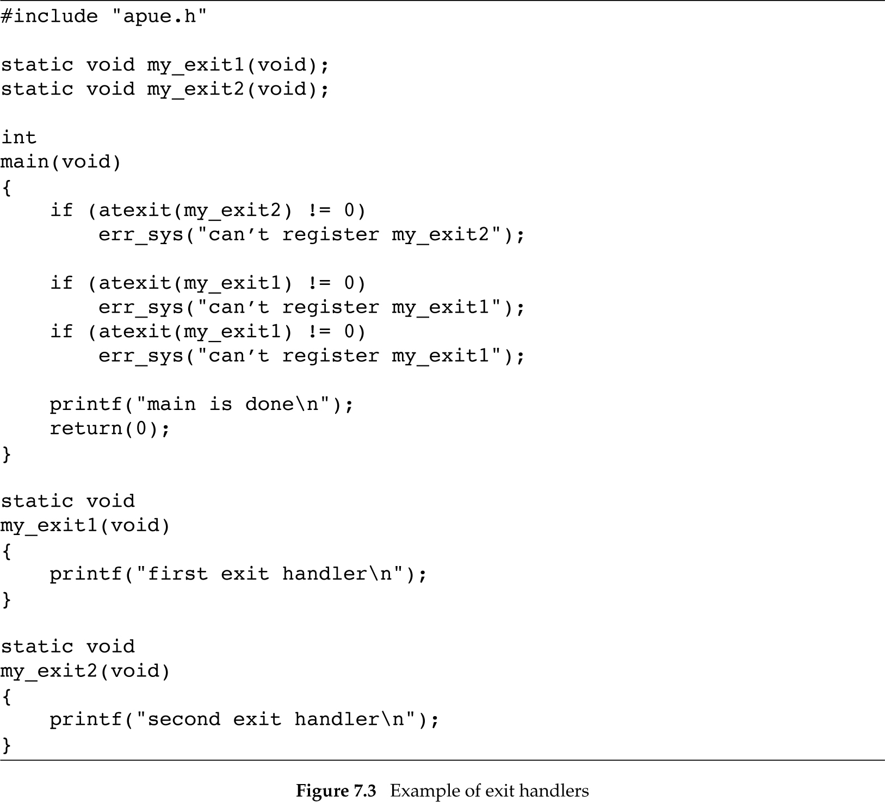
Functions are executed in reverse order from the order in which they are registered!
$ ./a.out
main is done
first exit handler
first exit handler
second exit handler

Slide 6
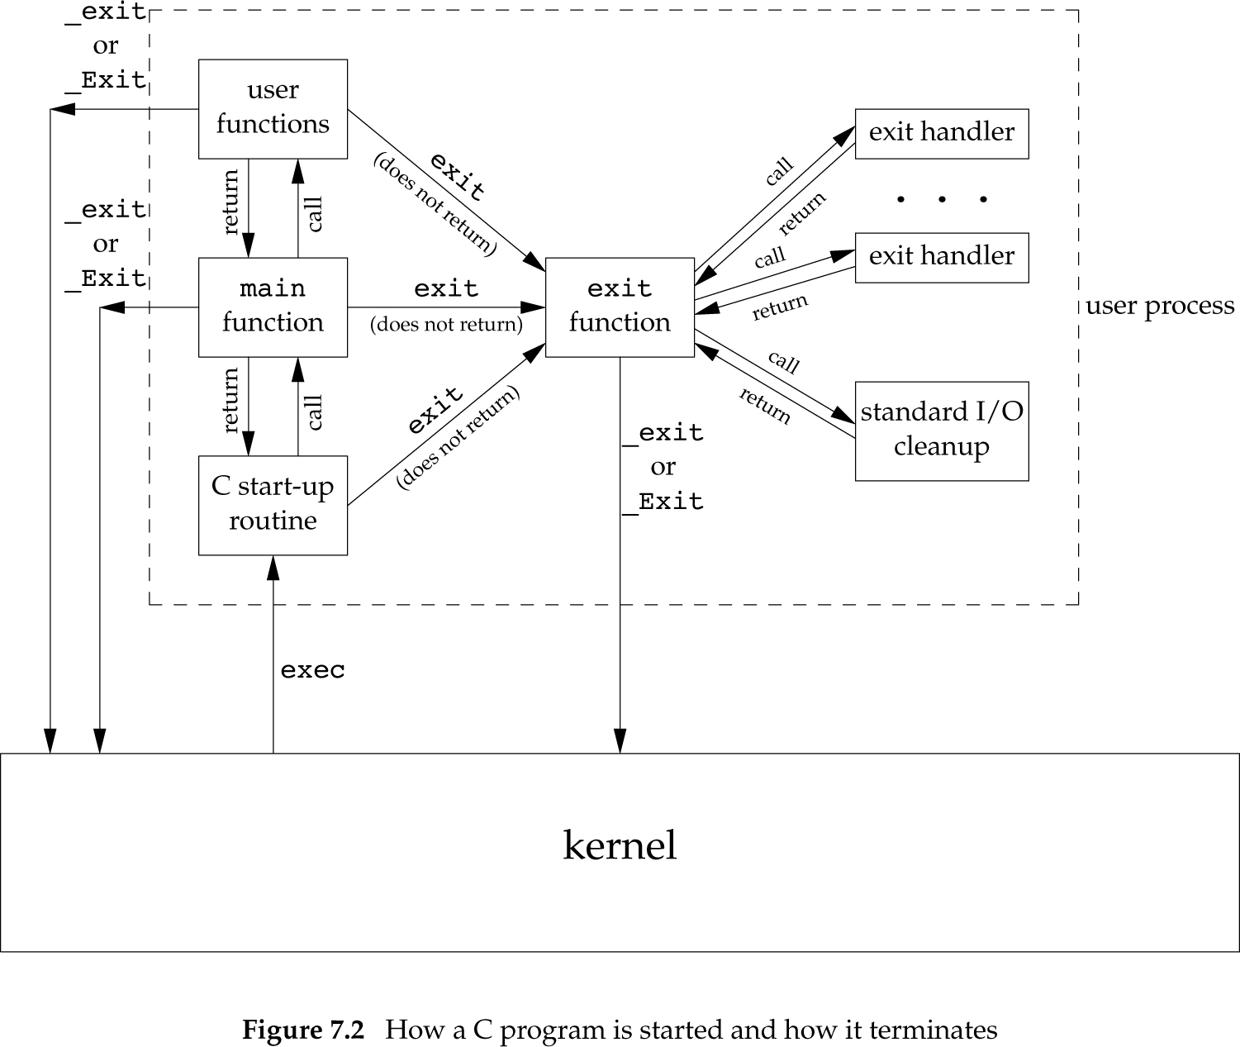

Slide 7
Command-line and More
argv
$ ./a.out arg1 arg2 3 4
NULL
arg1
arg2
3
4

Slide 8
Command-line and More
argv
$ ./a.out arg1 arg2 3 4
NULL
arg1
arg2
3
int main(int argc, char *argv[], char *envp[])
4
envp
NULL
HOME=/home/user
envp gives the program’s environment
it is the same as the value of environ
Try export in shell
PATH=/bin:/usr/bin
SHELL=/bin/nash
USER=user

Slide 9
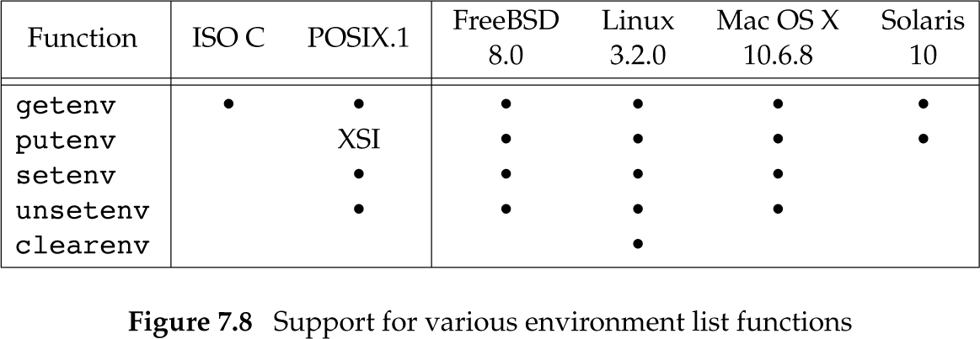
Environment Functions
Notes:
putenv function adds or removes definitions from the environment
setenv function can be used to add a new definition to the environment.

Slide 10
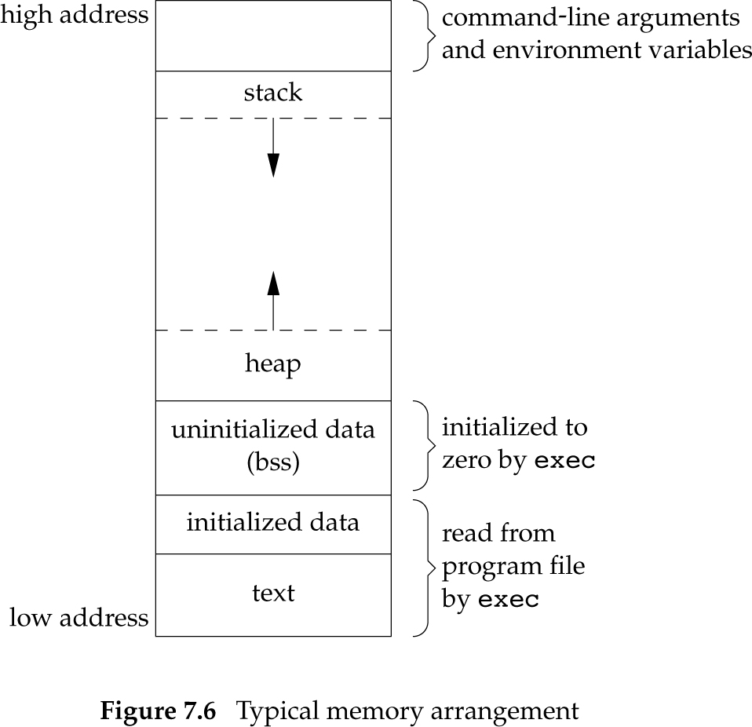
Memory Layout

Slide 11
Size
Lists the section sizes of object or archive files
text - Actual machine instructions that your CPU going to execute.
data - All initialized variables (declarations) declared in a program (e.g., float salary=123.45;)
bss - The BSS consists of uninitialized data such as arrays that you have not set any values to or null pointers
$ size /bin/bash
text data bss dec hex filename
989220 36968 25080 1051268 100a84 /bin/bash

Slide 12
Libraries
Libraries enable code-reuse
Static libraries are essentially new object files added to the program
Shared libraries are loaded and linked at runtime
Example: libc provides most of the functions we are using
ldd prints the dependencies of a program
$ldd /bin/bash
linux-vdso.so.1 (0x00007fffb4fe8000)
libdl.so.2 => /lib/x86_64-linux-gnu/libdl.so.2 (0x00007f2eb3224000)
libc.so.6 => /lib/x86_64-linux-gnu/libc.so.6 (0x00007f2eb2e79000)
/lib64/ld-linux-x86-64.so.2 (0x00007f2eb3877000)

Slide 13
Process Control

Slide 14
PIDs
Every process has a unique process ID (PID)
Non-negative integer
PID are assigned by the kernel
The ID of terminated process can be reused
The currently running processes can be listed using the ps command
$ ps
21271 pts/0 00:00:00 bash
21308 pts/0 00:00:00 ps

Slide 15
ps -aux
USER PID %CPU %MEM VSZ RSS TTY STAT START TIME COMMAND
root 1 0.0 0.0 176988 3264 ? Ss Feb26 0:03 /sbin/init
root 2 0.0 0.0 0 0 ? S Feb26 0:00 [kthreadd]
root 3 0.0 0.0 0 0 ? S Feb26 0:09 [ksoftirqd/0]
root 5 0.0 0.0 0 0 ? S< Feb26 0:00 [kworker/0:0H]
root 7 0.0 0.0 0 0 ? S Feb26 1:13 [rcu_sched]
root 8 0.0 0.0 0 0 ? S Feb26 0:00 [rcu_bh]
root 9 0.0 0.0 0 0 ? S Feb26 0:00 [migration/0]
user 14965 0.0 0.1 1039740 15852 ? Sl Feb29 0:05 texstudio --start-always
user 15626 0.0 0.0 128484 5144 ? S Feb29 0:00 orage
root 17886 0.0 0.0 86644 3728 ? Ss 07:35 0:00 /usr/sbin/cupsd -f
user 18016 4.1 7.8 1769348 639880 ? Sl 13:19 22:35 /usr/bin/iceweasel
user 18246 0.0 0.0 5964 396 ? S 13:23 0:00 cat
a = show processes for all users u = display the process's user/owner x = also show processes not attached to a terminal

Slide 16
What‘s my PID
pid_t getpid(void);
Return the process ID of the current process.

Slide 17
Creating more Processes
pid_t fork();
Create a child process
The child is copy of the parent (calling) process
Both the parent and child resume execution in the instruction following fork()
But a different value is returned in each case
0 -> to the child process
Child PID -> to the parent process
Parent has no other way of retrieving child PID

Slide 18
#include <stdio.h>
#include <sys/types.h>
#include <unistd.h>
int main()
{
pid_t pid;
if ((pid = fork()) < 0) {
perror("fork");
return -1;
} else if (pid == 0) {
/* child */
printf("I am the child\n");
return 0;
}
/* parent */
printf("I am the parent of %d\n", pid);
return 0;
}

Slide 19
#include <stdio.h>
#include <sys/types.h>
#include <unistd.h>
int main()
{
pid_t pid;
int w = 100;
if ((pid = fork()) < 0) {
perror("fork");
return -1;
} else if (pid == 0) {
/* child */
w = 200;
} else {
/* parent */
w = -100;
}
printf("I am %d, child of %d, w = %d\n", getpid(), getppid(), w);
return 0;
}

Slide 20
I am 22983, child of 22982, w = 200
I am 22982, child of 13673, w = -100

Slide 22
Output of Example 8.1
$ ./a.out
a write to stdout
before fork
pid = 430, glob = 7, var = 89 child’s variables were changed
pid = 429, glob = 6, var = 88 parent’s copy was not changed
$ ./a.out > temp.out
$ cat temp.out
a write to stdout
before fork
pid = 432, glob = 7, var = 89
before fork
pid = 431, glob = 6, var = 88
In this second case, the printf before the fork is called once, but the line remains in the buffer when fork is called. This buffer is then copied into the child when the parent’s data space is copied to the child. Both the parent and the child now have a standard I/O buffer with this line in it.

Slide 23
Properties Inherited by Child
Real user ID, real group ID, effective user ID, and effective group ID
Supplementary group IDs
Process group ID
Session ID
Controlling terminal
The set-user-ID and set-group-ID flags
Current working directory
Root directory
File mode creation mask
Signal mask and dispositions
The close-on-exec flag for any open file descriptors
Environment
Attached shared memory segments
Memory mappings
Resource limits

Slide 24
Differences between Parent and Child
The return values from fork are different.
The process IDs are different.
The two processes have different parent process IDs: the parent process ID of the child is the parent; the parent process ID of the parent doesn’t change.
The child’s tms_utime, tms_stime, tms_cutime, and tms_cstime values are set to 0
File locks set by the parent are not inherited by the child.
Pending alarms are cleared for the child.
The set of pending signals for the child is set to the empty set.

Slide 25
File Sharing
The child process inherits the all the file descriptors of its parent
It is like dup() is called for each fd
What happens to I/O streams?
Notes:
p. 232 of APUE

Slide 26
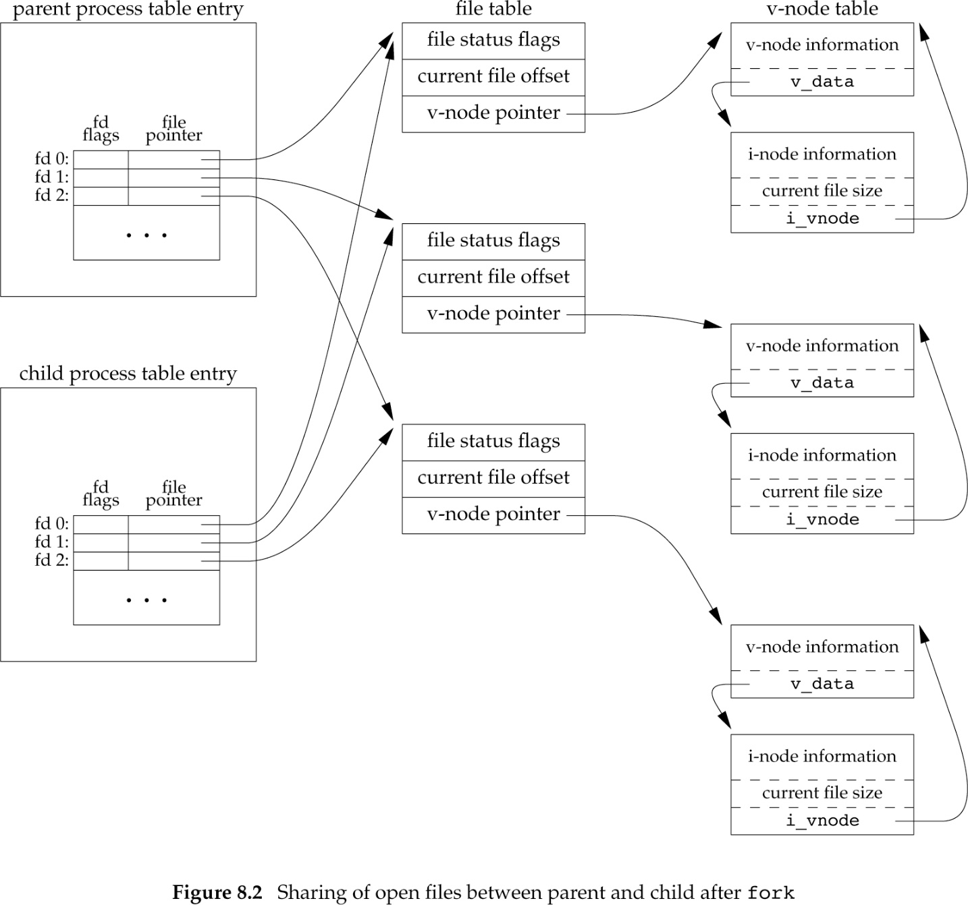

Slide 27
Waiting for Children
pid_t wait(int *status);
Wait for the status of a child process to change
For example, the child terminated, was stopped, etc.
Return the pid of the child
status contains information on the state change

Slide 28
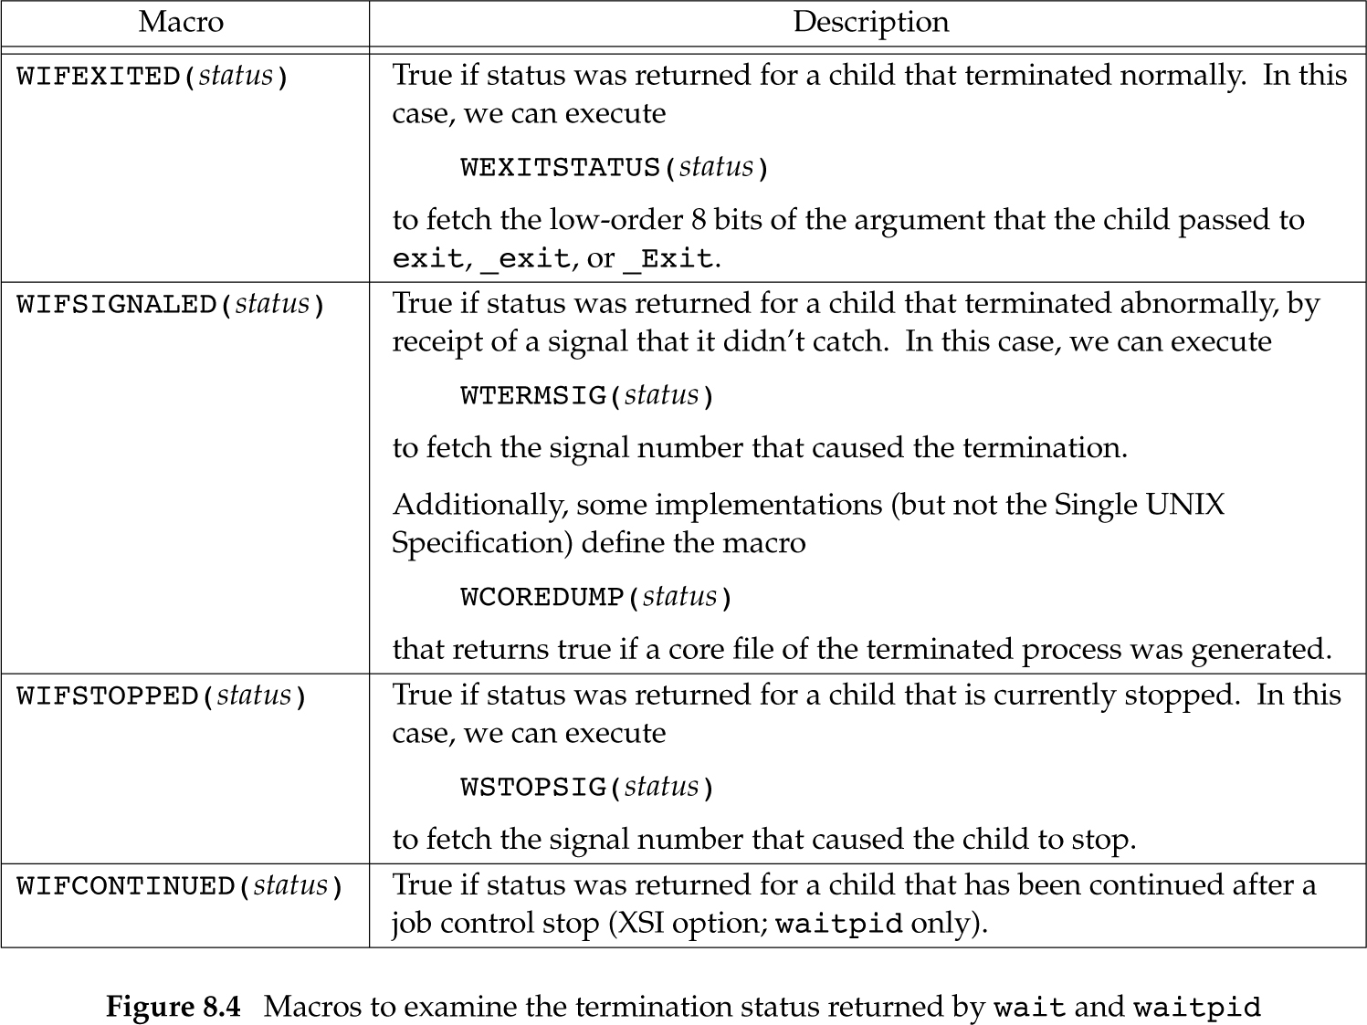

Slide 29
Waiting for PID
pid_t waitpid(pid_t pid, int *status, int options);
If pid
< -1 meaning wait for any child process whose process group ID is equal to the absolute value of pid
-1 meaning wait for any child process
0 meaning wait for any child process whose process group ID is equal to that of the calling process
> 0 meaning wait for the child whose process ID is equal to the value of pid
wait(&status) is equivalent to waitpid(-1, &status, 0)
waitpid only waits for terminated children, unless options is:
WNOHANG return immediately if no child has exited.
WUNTRACED also return if a child has stopped
WCONTINUED also return if a stopped child has been resumed by delivery of SIGCONT

Slide 30
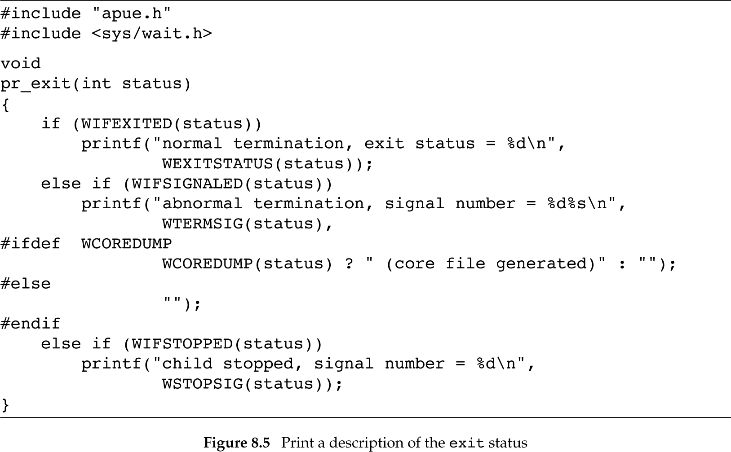

Slide 31
Zombies
Processes do not completely disappear until their parent waits for them
They become zombies until that happens
This ensures that their parent can retrieve their exit code, etc.
So always wait for your children!

Slide 32
exec()
int execl(const char *pathname, const char *arg0, ... /* (char *)0 */ );
int execv(const char *pathname, char *const argv []);
int execle(const char *pathname, const char *arg0, ... /* (char *)0, char *const envp[] */ );
int execve(const char *pathname, char *const argv[], char *const envp []);
int execlp(const char *filename, const char *arg0, ... /* (char *)0 */ );
int execvp(const char *filename, char *const argv []);
int fexecve(int fd, char *const argv[], char *const envp[]);

Slide 33
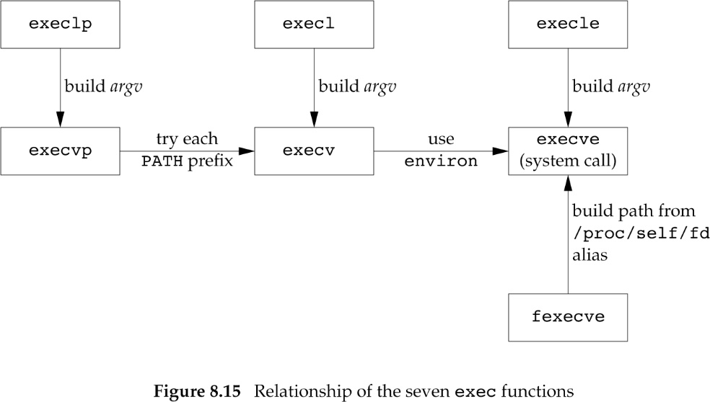

Slide 34
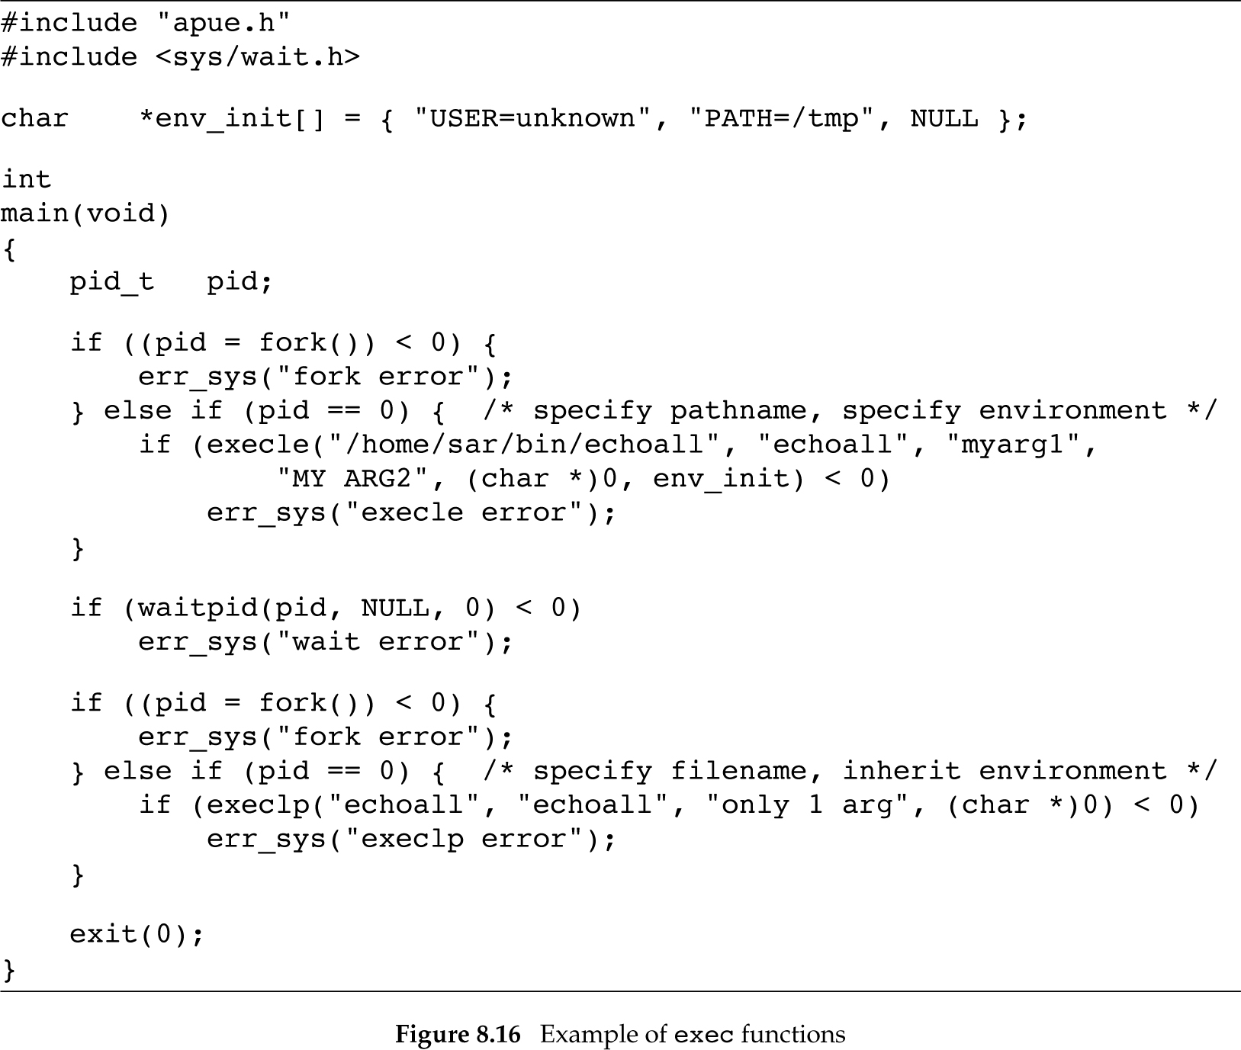

Slide 35
Least-privilege Model
Always use the least privileges needed for the job
So when things go wrong you mitigate the damage
setuid(uid_t) and seteuid(uid_t) can be used to change the UID or effective UID of the current process
Usually a process running as root drops its privileges
For example:
Open a file that is owned by a privileged user
Drop privileges
Perform main functionality with less privileges

Slide 36
Interpreter Files
Text files that begin with
#! pathname [ optional-argument ]
When exec() is called with such a file, the kernel invokes the interpreter

Slide 37
#include "apue.h"
#include <sys/wait.h>
int
main(void)
{
pid_t pid;
if ((pid = fork()) < 0) {
err_sys("fork error");
} else if (pid == 0) { /* child */
if (execl("/home/sar/bin/testinterp",
"testinterp", "myarg1", "MY ARG2", (char *)0) < 0)
err_sys("execl error");
}
if (waitpid(pid, NULL, 0) < 0) /* parent */
err_sys("waitpid error");
exit(0);
}

Slide 38
$ cat /home/sar/bin/testinterp
#!/home/sar/bin/echoarg foo
$ ./a.out
argv[0]: /home/sar/bin/echoarg
argv[1]: foo
argv[2]: /home/sar/bin/testinterp
argv[3]: myarg1
argv[4]: MY ARG2

Slide 39
system() Function
int system(const char *command);
Execute the shell command and return
Fork and invoke execl("/bin/sh", "sh", "-c", command, (char *) 0);
Don’t use in set-UID programs!

Slide 40
Process Accounting
int acct(const char *filename);
Enable process accounting to filename
Produces information about created and terminated processes
Children of current process
struct acct {
char ac_flag; /* Accounting flags */
u_int16_t ac_uid; /* Accounting user ID */
u_int16_t ac_gid; /* Accounting group ID */
u_int16_t ac_tty; /* Controlling terminal */
u_int32_t ac_btime; /* Process creation time
(seconds since the Epoch) */
comp_t ac_utime; /* User CPU time */
comp_t ac_stime; /* System CPU time */
comp_t ac_etime; /* Elapsed time */
comp_t ac_mem; /* Average memory usage (kB) */
comp_t ac_io; /* Characters transferred (unused) */
comp_t ac_rw; /* Blocks read or written (unused) */
comp_t ac_minflt; /* Minor page faults */
comp_t ac_majflt; /* Major page faults */
comp_t ac_swaps; /* Number of swaps (unused) */
u_int32_t ac_exitcode; /* Process termination status
(see wait(2)) */
char ac_comm[ACCT_COMM+1];
/* Command name (basename of last
executed command; null-terminated) */
char ac_pad[X]; /* padding bytes */
};
Notes:
The acct() system call enables or disables process accounting. If called with the name of an existing file as its argument, accounting is turned on, and records for each terminating process are appended to filename as it terminates. An argument of NULL causes accounting to be turned off.

Slide 41
Process Times
clock_t times(struct tms *buf);
Stores the times of the process in buf
struct tms {
clock_t tms_utime; /* user time */
clock_t tms_stime; /* system time */
clock_t tms_cutime; /* user time of children */
clock_t tms_cstime; /* system time of children */
};

