Slide 1
Basics of C
Dr. B
CS 392: Systems Programming
Spring 2020

Slide 2
Java vs C
Different philosophies!
Java – “Make it portable, provide a huge class library, and try to protect the programmer from doing stupid things.”
C -- “Make it efficient and simple, and let the programmer do whatever he wants”
C is preferred for systems programming, due to its better efficiency and low-level control.
Notes:
Why C language for system programming

Slide 3
Since You Already Know C++
The syntax of C is almost identical to that of C++; in fact, it is a subset.
C++ is incremented C.
Notable differences:
C is a procedural language
You build your algorithms and programs around procedures/functions and functionalities
Data are organized using structures instead of objects
Memory management is (even more) the job of the programmer
With great power comes great responsibility
No new or delete operators

Slide 4
Be Aware of Different Standards
ANSI C (ISO C)
Successive standards for the C programming language
C89, C90, C95, C99, C11, C18
POSIX --- Portable Operating System Interface
The application programming interface (API)
Standard C library
Single UNIX Specification
X/Open System Interfaces (XSI) enable additional interfaces in POSIX.1 systems
Notes:
published by the American National Standards Institute (ANSI) and the International Organization for Standardization (ISO).

Slide 5
First C Program
/* Every C program needs an entry point -- the main
function */
// function return type, name, arguments
int main(int argc, char **argv) {
return 0; // Every statement ends with ";"
}

Slide 6
Declare/Define Variables
int main(int argc, char **argv) {
char var0; // declare variable: type name (with letters, digits, "_")
int var_1; // first character should be alphabet or underscore
float Var_1; // variable names are case sensitive
var0 = '0';
return 0;
}

Slide 7
Primitive Types
int -- integer
char -- character - a single byte (it is actually a number)
short -- short integer
long -- long integer
Above types can also be unsigned.
float – floating point number
double -- double-precision floating point
No bool type in ANSI C!
But starting in C99, #include <stdbool.h>, and you have true and false.

Slide 8
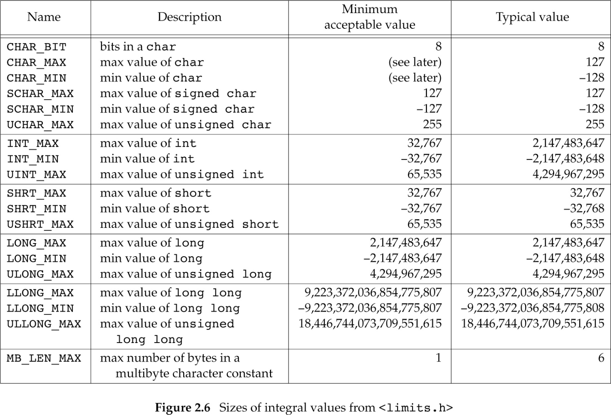
Typical Type Limits
Check on your own system here: /usr/include/limits.h

Slide 9
Literals
85 /* decimal */
0213 /* octal */
0x4b /* hexadecimal */
30 /* int */
30u /* unsigned int */
30l /* long */
30ul /* unsigned long */
3.14159 /* double*/
314159E-5L /* double */
210.5f /* float */
'c' /* char */
"abcd" /* string */
This is one case where C is case insensitive

Slide 10
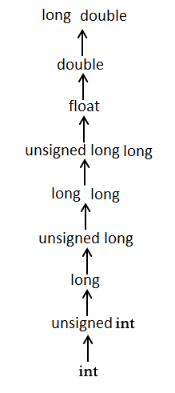
Implicit Type Casts

Slide 11
Implicit Type Casts
int main(int argc, char **argv) {
char var1 = 0x41; // type cast: 0x41 -> 'A'; integer->char
int var2 = 1.5; // type cast: 1.5 -> 1; float -> integer
// type cast: -1 -> 0xffffffff; unsigned ->signed
unsigned int var3 = -1;
}
char c = 0x41424344;
What is the value of c, assuming –Werror=overflow is not enabled?

Slide 12
Explicit Type Casts
int main(int argc, char **argv) {
float f;
int a = 20, b = 3;
f = a/b; // What is f?
f = (float)a/b; What is f now?
}

Slide 13
Constants by Macro
Define using #define <name> <replacement text>
Example: #define PI 3.14
The pre-processor will replace every instance of PI with 3.14 before passing your source code to the compiler
#define PI 3.14
int main(int argc, char **argv){
float pi = PI; // pi = 3.14
return 0;
}

Slide 14
Enumerations
Organize multiple constants together
The first member has value 0, the next 1, and so on unless explicitly specified
Examples:
enum boolean { NO, YES };
Defines NO as 0 and YES as 1
enum months { JAN = 1, FEB, MAR, … };
enum escapes { BELL = ‘\a’, BACKSPACE = ‘\b’, … };

Slide 15
Use of Enumeration
enum week { Sunday, Monday, Tuesday, Wednesday, Thursday, Friday, Saturday };
int main(int argc, char **argv){
enum week today;
today = Wednesday; // today = ?
return 0;
}

Slide 16
Unions
char
(1 byte)
Store different data types in the same
memory location
union my_union {
int i;
short s;
char c;
};
A union takes enough space to store the largest of its member
But only holds one piece of data: assignment to a member affects the other members
short
(2 bytes)
int
(4 bytes)

Slide 17
Use of Union
union my_union { int i; short s; char c; };
int main(int argc, char **argv) {
union my_union test;
int var0;
test.i = 0;
test.c = 'A';
test.s = 16383;
var0 = test.c;
}

Slide 18
Structures
Structure is a collection of variables (can be of different types) under a single type.
Similar to a class in C++/Java/Python
There are no classes in C.
struct my_struct {
int x;
int y;
int z;
};

Slide 19
Use of struct
struct Book {
int year;
int month;
int book_id;
}; // Do not forget about the ";" here
int main() {
struct Book book1; // declare book1 of type Books
book1.book_id = 100; //access members in struct
return 0;
}
How does a struct differ from a union?

Slide 20
Arrays
An array is a collection of data items, all of the same type, accessed using a common name.
Array can be multi-dimensional.
Examples of arrays allocated on the stack:
int a[10]; // type name[size1]
char b[10][100];
struct my_struct c[10][100][1000];

Slide 21
Use of Array
int main(int argc, char **argv) {
int array[10];
array[1] = 100;
array[2] = 200;
array[3] = array[1] + array[2];
array[0] = 1000; // Is this right?
array[10] = 1000; // Is this right?
}

Slide 22
Pointers
A pointer is a data object that stores the memory address of another data object located in computer memory.
int *intptr;
char *charptr;
struct my_struct *structptr;
int **intptrptr

Slide 23
Pointers
Pointer types store an address of memory
(Usually) an unsigned long integer
You can obtain a pointer to any variable using the & operator
Well, you can actually assign any integer to a pointer
int a, b, c, *p;
a = 1;
p = &a;
p = (int *)1000; // not a good idea
&a
1
p
a
b
c

Slide 24
Pointers
Pointer types store an address of memory
(Usually) an unsigned long integer
When dereferenced (operator *) they return the contents of what they point to according to the pointer type
For example, an integer pointer returns an int
int a, b, c, *p;
a = 1;
p = &a;
*p = 2;
&a
2
p
a
b
c

Slide 25
Pointer Arithmetic
You can add or subtract an integer from a pointer
You can also use the ++ -- operators
You can subtract two pointers
int a[10], *pa, b;
pa = a;
b = *(pa + 1);
int a[10], *pa, b;
pa = &a[0];
b = a[1];
These are functionally equivalent.

Slide 26
Defining Your Own Types
typedef <type> <new type name>;
typedef unsigned int uint_t;
typedef struct my_struct {
…
} my_struct_t;
typedef union {
int i;
char c;
double d;
char data[sizeof(double)];
} my_union_t;

Slide 27
Define Your Own Type
typedef struct Book {
int year;
int month;
int book_id;
} struct_Book; // Do not forget about the ";" here
int main( ) {
struct_Book book1; // struct Book Book1;
book1.book_id = 100;
return 0;
}

Slide 28
Variable Scope
Local – variables valid within functions
Defined within the function before use
Allocated in the program’s stack by the compiler
Prefer to define at the top of the function (required in ANSI C)
void func1() {
int i;
i = 1;
}
void func2() {
i = 1; // Wrong scope
}

Slide 29
Variable Scope
Global – variables accessible by the entire program
Defined outside functions
int g_debug_level;
void func1() {
g_debug_level = 1;
}
void func2(){
g_debug_level = 2;
}
void func3() {
g_debug_level = 3;
}

Slide 30
Variable Scope
Static – variables accessible only within the file they were defined in
Defined outside functions
They can actually be accessed by the whole program, if it can find them. It is only programmatically that they are inaccessible to other files.
Can only be initialized by constants literals
Initialized as 0 if not explicitly assigned
static int g_debug_level; // file1.c
void func1() { // file1.c
g_debug_level = 1; // OK
}
void func2() { // file2.c
g_debug_level = 2; // Not OK
}
You may also see this:
void func3() {
int var_1 = 0;
static int var_2 = 1;
}
How does var_1 differ from var_2?
// var_2 only is initialized once

Slide 31
Functions
Declaring functions is easy
Function visibility
Functions can be called from anywhere in the program
Unless the static keyword is used, which restricts visibility to the file defining them
int my_func(char arg1, int arg2, float arg3);
// return_type, function_name(arguments list)
static int my_func(char arg1, int arg2, float arg3)
…

Slide 32
Argument Passing (1)
C only does call by value
* Changes made by the child function will not affect the parent function
c is actually a local variable for callee() that gets a copy of i
void caller() {
int i;
i = 0;
callee(i); // i is not changed here
}
void callee(int c) {
c = 10;
}

Slide 33
Argument Passing (2)
You can update a value through a procedure’s return value
void caller() {
int i;
i = callee(i); // this makes i = 10
}
int callee(int c) {
c = 10;
return c;
}

Slide 34
Argument Passing (3)
A pointer is still passed by value, but you can update what it points to!
void caller() {
int i;
i = 0;
callee(&i); // this changes i to 10
}
void callee(int *c) {
*c = 10; // change by dereference
}

Slide 35
Coding Style
For systems programming, most people use the Linux kernel’s style
https://www.kernel.org/doc/Documentation/process/coding-style.rst
For C programming, look at 1TBS (1 True Brace Style, a minor variation of K&R): https://en.wikipedia.org/wiki/Indentation_style
Many other options available
May depend on preference, project you are contributing, the company you work at, etc.
Make sure that …
Your code is readable
You are consistent
Your code looks the same independently of the editor your are using

