Slide 1
Pipes
Dr. B
CS 392: Systems Programming
Spring 2020

Slide 2
Objectives
Interprocess Communication (IPC) (APUE Ch. 15)

Slide 3
IPC
A set of programming interfaces that allows coordinated activities between processes
Enables the exchange data between processes
Enables synchronization between processes
Includes a variety of APIs and mechanisms

Slide 4
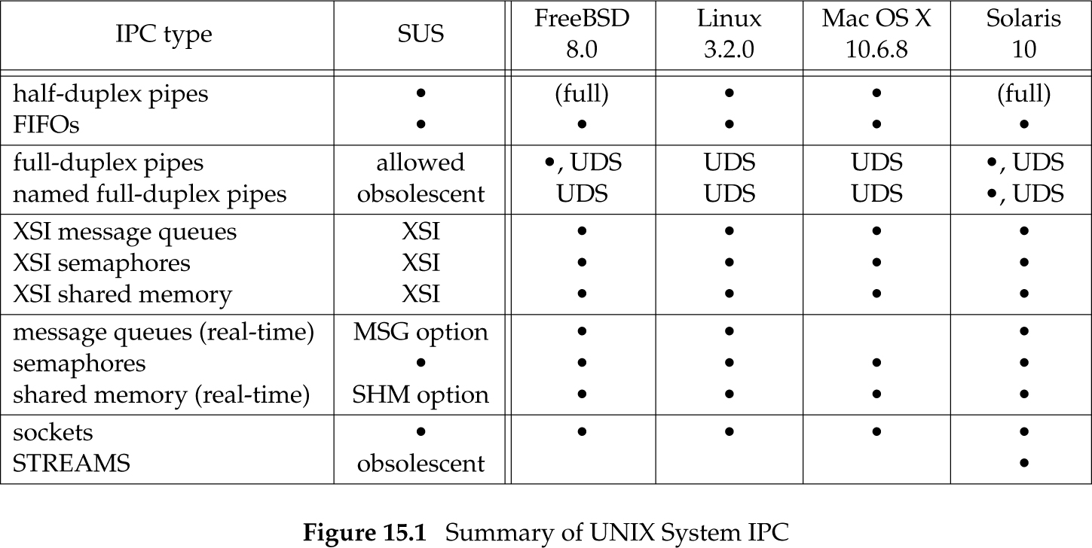
UNIX IPC
Notes:
Single UNIX Specification (the ‘‘SUS’’ column) allows an implementation to support full-duplex pipes, but requires only half-duplex pipes.
if the feature can be provided through UNIX domain sockets (Section 17.2), we show ‘‘UDS’’ in the column
Final two rows: IPC between processes on different hosts

Slide 5
UNIX Pipes
Pipes are the oldest form of UNIX System IPC and are provided by all UNIX systems
Pipes have two limitations:
  Historically, they have been half duplex (i.e., data flows in only one direction).
    Some systems now provide full-duplex pipes, but for maximum portability, we should never assume that this is the case.
  Pipes can be used only between processes that have a common ancestor.
    Normally, a pipe is created by a process, that process calls fork, and the pipe is used between the parent and the child

Slide 6
Pipelines in Shells
cat file.txt | sort | uniq > sorted_file.txt

Slide 7
Creating a Pipe
#include <unistd.h>
int pipe(int fd[2]);
Two file descriptors are returned through the fd argument:
  fd[0] is open for reading
  fd[1] is open for writing
The output of fd[1] is the input for fd[0]

Slide 8
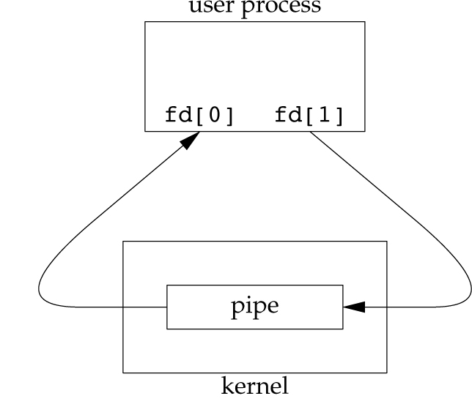
A Pipe is Provided by the OS
#include <unistd.h>
int pipe(int fd[2]);
Two file descriptors are returned through the fd argument:
  fd[0] is open for reading
  fd[1] is open for writing
The output of fd[1] is the input for fd[0]

Slide 9
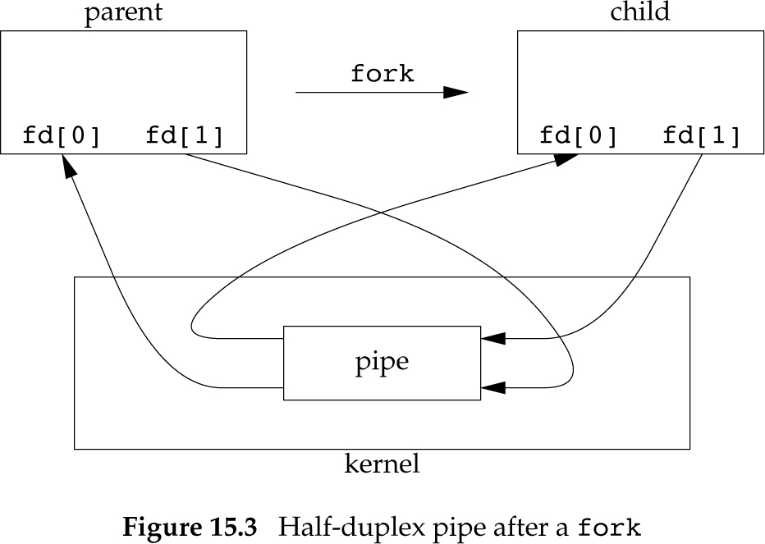
A Pipe after a Fork
A pipe in a single process is next to useless
Normally, the process that calls pipe then calls fork, creating an IPC channel from the parent to the child, or vice versa

Slide 10
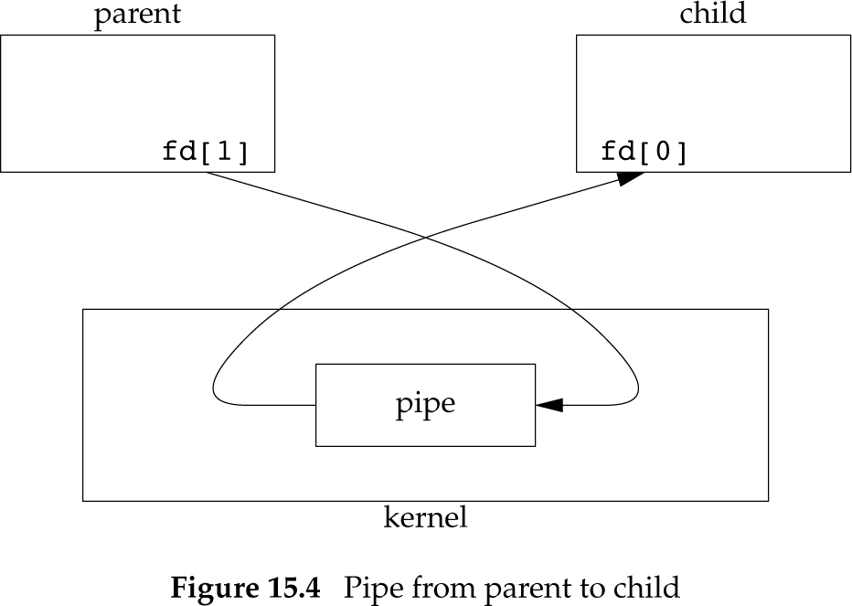
Half-duplex
Reading process should close fd[1] and use fd[0] for reading
Writing process should close fd[0] and use fd[1] for writing

Slide 11
Half-duplex
When one end of a pipe is closed, two rules apply.
1. If we read from a pipe whose write end has been closed, read returns 0 to indicate an end of file after all the data has been read.
  Technically, we should say that this end of file is not generated until there are no more writers for the pipe. It’s possible to duplicate a pipe descriptor so that multiple processes have the pipe open for writing. Normally, however, there is a single reader and a single writer for a pipe.

Slide 12
Half-duplex
2. If we write to a pipe whose read end has been closed, the signal SIGPIPE is generated. If we either ignore the signal or catch it and return from the signal handler, write returns -1 with errno set to EPIPE.

Slide 13
#include "apue.h"
int main(void)
{
int n;
int fd[2];
pid_t pid;
char line[MAXLINE];
if (pipe(fd) < 0)
err_sys("pipe error");
if ((pid = fork()) < 0) {
err_sys("fork error");
} else if (pid > 0) { /* parent */
close(fd[0]);
write(fd[1], "hello world\n", 12);
} else { /* child */
close(fd[1]);
n = read(fd[0], line, MAXLINE);
write(STDOUT_FILENO, line, n);
}
exit(0);
}

Slide 14
Example: Copy File to Pager Program
Consider a program that displays some output one page at a time.
Rather than reinvent the pagination done by several UNIX system utilities, we want to invoke the user’s favorite pager.
To avoid writing all the data to a temporary file and calling system to display that file, we want to pipe the output directly to the pager.
We create a pipe, fork a child process, set up the child’s standard input to be the read end of the pipe, and exec the user’s pager program.
  This example takes a command-line argument to specify the name of a file to display. Often, a program of this type would already have the data to display to the terminal in memory.

Slide 15
Redirecting stdin to a Pipe
#include <unistd.h>
int dup(int oldfd);
int dup2(int oldfd, int newfd);
The dup() system call creates a copy of a file descriptor.
  It uses the lowest-numbered unused descriptor for the new descriptor.
The dup2() system call is similar to dup() but the basic difference between them is that instead of using the lowest-numbered unused file descriptor, it uses the descriptor number specified by the user.

Slide 16
#include "apue.h"
#include <sys/wait.h>
#define DEF_PAGER "/bin/more" /* default pager program */
int main(int argc, char *argv[])
{
int n;
int fd[2];
pid_t pid;
char *pager, *argv0;
char line[MAXLINE];
FILE *fp;
if (argc != 2)
err_quit("usage: a.out <pathname>");
if ((fp = fopen(argv[1], "r")) == NULL)
err_sys("can't open %s", argv[1]);
if (pipe(fd) < 0)
err_sys("pipe error");

Slide 17
if ((pid = fork()) < 0) {
err_sys("fork error");
} else if (pid > 0) { /* parent */
close(fd[0]); /* close read end */
/* parent copies argv[1] to pipe */
while (fgets(line, MAXLINE, fp) != NULL) {
n = strlen(line);
if (write(fd[1], line, n) != n)
err_sys("write error to pipe");
}
if (ferror(fp))
err_sys("fgets error");
close(fd[1]); /* close write end of pipe for reader */
if (waitpid(pid, NULL, 0) < 0)
err_sys("waitpid error");

Slide 18
exit(0);
} else { /* child */
close(fd[1]); /* close write end */
if (fd[0] != STDIN_FILENO) {
if (dup2(fd[0], STDIN_FILENO) != STDIN_FILENO)
err_sys("dup2 error to stdin");
close(fd[0]); /* don’t need this after dup2 */
}
/* get arguments for execl() */
if ((pager = getenv("PAGER")) == NULL)
pager = DEF_PAGER;
if ((argv0 = strrchr(pager, '/')) != NULL)
argv0++; /* step past rightmost slash */
else
argv0 = pager; /* no slash in pager */
if (execl(pager, argv0, (char *)0) < 0)
err_sys("execl error for %s", pager);
}
exit(0);
}

Slide 19
Notes on Example
Before calling fork, we create a pipe.
After the fork, the parent closes its read end, and the child closes its write end.
The child then calls dup2 to have its standard input be the read end of the pipe.
When the pager program is executed, its standard input will be the read end of the pipe.
When we duplicate one descriptor onto another (fd[0] onto standard input in the child), we have to be careful that the descriptor doesn’t already have the desired value.
If the descriptor already had the desired value and we called dup2 and close, the single copy of the descriptor would be closed.

Slide 20
Parent – Child Synchronization
We create two pipes before the fork.
The parent writes the character ‘‘p’’ across the top pipe when TELL_CHILD is called, and the child writes the character ‘‘c’’ across the bottom pipe when TELL_PARENT is called.
The corresponding WAIT_xxx functions do a blocking read for the single character.

Slide 21
#include "apue.h"
static int pfd1[2], pfd2[2];
void TELL_WAIT(void)
{
if (pipe(pfd1) < 0 || pipe(pfd2) < 0)
err_sys("pipe error");
}
void TELL_PARENT(pid_t pid)
{
if (write(pfd2[1], "c", 1) != 1)
err_sys("write error");
}
void WAIT_PARENT(void)
{
char c;
if (read(pfd1[0], &c, 1) != 1)
err_sys("read error");
if (c != 'p')
err_quit("WAIT_PARENT: incorrect data");
}

Slide 22
void TELL_CHILD(pid_t pid)
{
if (write(pfd1[1], "p", 1) != 1)
err_sys("write error");
}
void WAIT_CHILD(void)
{
char c;
if (read(pfd2[0], &c, 1) != 1)
err_sys("read error");
if (c != 'c')
err_quit("WAIT_CHILD: incorrect data");
}

Slide 23
popen()
FILE *popen(const char *command, const char *type);
Creates a pipe, forks, closes unused ends of pipe and invokes the shell to execute command
The type corresponds to the type of the pipe
  Can be reading (“r”) or writing (“w”)
int pclose(FILE *stream);
Waits for the process to terminate and returns exit status

Slide 24
#include "apue.h"
#include <sys/wait.h>
#define PAGER "${PAGER:-more}" /* environment variable, or default */
int main(int argc, char *argv[])
{
char line[MAXLINE];
FILE *fpin, *fpout;
if (argc != 2)
err_quit("usage: a.out <pathname>");
if ((fpin = fopen(argv[1], "r")) == NULL)
err_sys("can't open %s", argv[1]);
if ((fpout = popen(PAGER, "w")) == NULL)
err_sys("popen error");
/* copy argv[1] to pager */

Slide 25
/* copy argv[1] to pager */
while (fgets(line, MAXLINE, fpin) != NULL) {
if (fputs(line, fpout) == EOF)
err_sys("fputs error to pipe");
}
if (ferror(fpin))
err_sys("fgets error");
if (pclose(fpout) == -1)
err_sys("pclose error");
exit(0);
}

Slide 26
Filter Example
Consider an application that writes a prompt to standard output and reads a line from standard input.
With popen(), we can interpose a program between the application and its input to transform the input.

Slide 27
myuclc
#include "apue.h"
#include <ctype.h>
int main(void)
{
int c;
while ((c = getchar()) != EOF) {
if (isupper(c))
c = tolower(c);
if (putchar(c) == EOF)
err_sys("output error");
if (c == '\n')
fflush(stdout);
}
exit(0);
}
Compile this to executable myuclc
myUpperCaseLowerCase

Slide 28
#include "apue.h"
#include <sys/wait.h>
int main(void)
{
char line[MAXLINE];
FILE *fpin;
if ((fpin = popen("myuclc", "r")) == NULL)
err_sys("popen error");
for ( ; ; ) {
fputs("prompt> ", stdout);
fflush(stdout);
if (fgets(line, MAXLINE, fpin) == NULL) /* read from pipe */
break;
if (fputs(line, stdout) == EOF)
err_sys("fputs error to pipe");
}
if (pclose(fpin) == -1)
err_sys("pclose error");
putchar('\n');
exit(0);
}
Call fflush() since standard output
is normally lined buffered

