Slide 1
Signals
Dr. B
CS 392: Systems Programming
Spring 2020

Slide 2
Questions
#include <stdio.h>
#include <unistd.h>
int main(int argc, char **argv) {
while (1) {
sleep(5);
printf("Hello\n");
}
return 0;
}
When you run the program above, what happens?
How can you get your terminal back?

Slide 3
Questions
#include <stdio.h>
#include <unistd.h>
int main(int argc, char **argv) {
while (1) {
sleep(5);
printf("Hello\n");
}
return 0;
}
When you run the program above, what happens?
-- It will run forever and keep printing ”Hello”
How can you get your terminal back?
-- CTRL + C
But what really happens?

Slide 4
What is a signal?
A notification of an event gains the attention of the OS
Hardware generated faults/exceptions
Operating system/software generated faults/exceptions
Explicitly by a requesting process to another
What happens then:
OS stops the application process immediately, sending it a signal
Signal handler executes to completion
Application process resumes where it left off

Slide 5
Examples
Hardware exceptions
Division by zero ← value / 0
Page (segmentation) faults ← dereferencing a pointer that points to non-existent or inaccessible memory
Software faults
A user-set timer expires
Explicit
A process sends a signal to another process
unsigned int alarm(unsigned int seconds);
int kill(pid_t pid, int sig);

Slide 6
Uses of Signals
Handle Hardware Errors
Handle Software Errors
SIGSEGV
Inter Process Communication

Slide 7
Signals and Default Actions

Slide 8
Handling Signals: The Old Way
typedef void (*sighandler_t)(int);
sighandler_t signal(int signum, sighandler_t handler);
Call handler when signal signum is delivered. The signal number is passed to the handler.
Return previous signal handler.

Slide 9
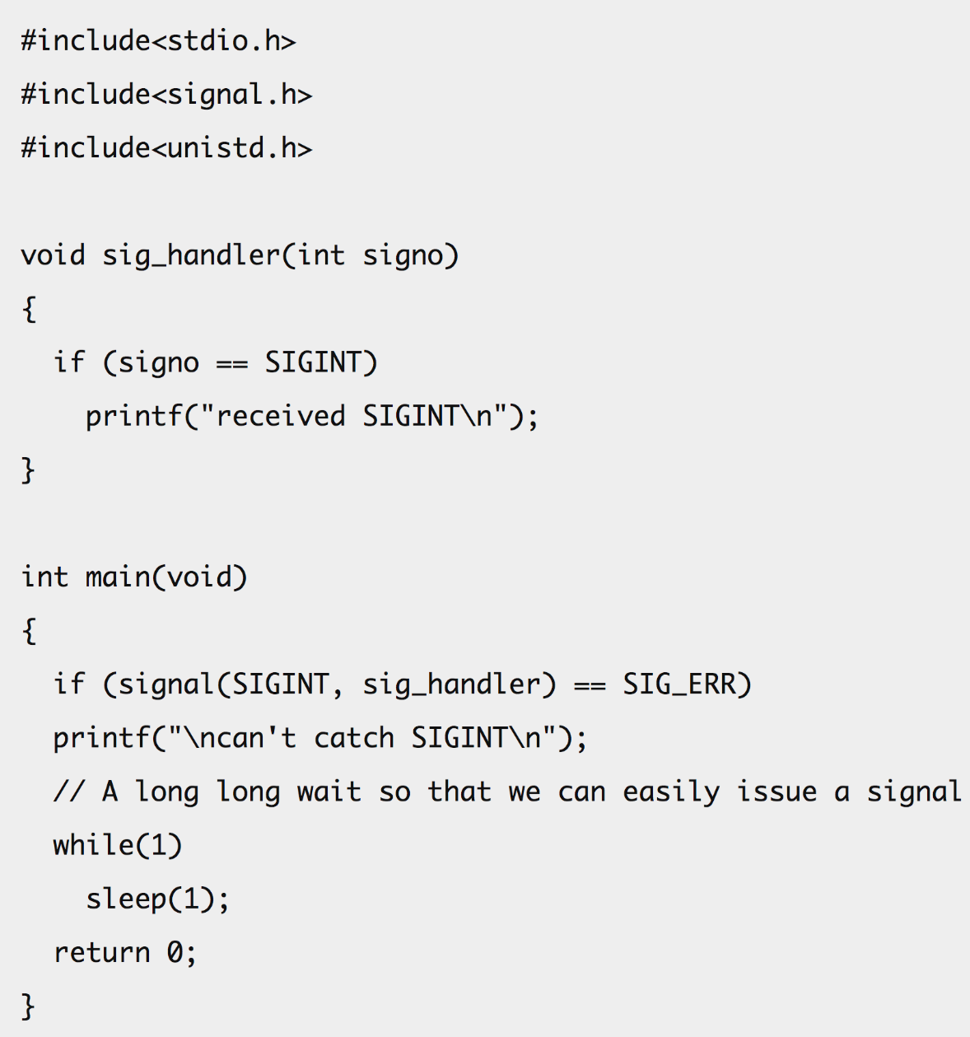
Example of Using signal()

Slide 10
The Modern Way
int sigaction(int signum, const struct sigaction *act, struct sigaction *oldact);
Examine and change the action to take on receipt of a signal signum
act → New action to take, if not null
oldact → Stores the previous action, if not null
struct sigaction {
void (*sa_handler)(int);
void (*sa_sigaction)(int, siginfo_t *, void *);
sigset_t sa_mask;
int sa_flags;
void (*sa_restorer)(void);
};

Slide 11
The Modern Way
int sigaction(int signum, const struct sigaction *act, struct sigaction *oldact);
Examine and change the action to take on receipt of a signal signum
act → New action to take, if not null
oldact → Stores the previous action, if not null
Function to be called when signal is received
struct sigaction {
void (*sa_handler)(int);
void (*sa_sigaction)(int, siginfo_t *, void *);
sigset_t sa_mask;
int sa_flags;
void (*sa_restorer)(void);
};

Slide 12
sa_sigaction
sa_flags is a set of bit flags
Setting SA_SIGINFO in sa_flags will cause the use of sa_sigaction instead of sa_handler.
Never set both sa_handler and sa_sigaction.
struct sigaction {
void (*sa_handler)(int);
void (*sa_sigaction)(int, siginfo_t *, void *);
sigset_t sa_mask;
int sa_flags;
void (*sa_restorer)(void);
};

Slide 13
sa_sigaction
The siginfo_t argument to a SA_SIGINFO handler…
When the SA_SIGINFO flag is specified in act.sa_flags, the signal handler address is passed via the act.sa_sigaction field. This handler takes three arguments, as follows:
void
handler(int sig, siginfo_t *info, void *ucontext)
{
...
}
These three arguments are as follows
sig The number of the signal that caused invocation of the handler.
info A pointer to a siginfo_t, which is a structure containing further
information about the signal, as described below.

Slide 14
sa_sigaction
ucontext
This is a pointer to a ucontext_t structure, cast to void *.
The structure pointed to by this field contains signal context
information that was saved on the user-space stack by the ker‐
nel; for details, see sigreturn(2). Further information about
the ucontext_t structure can be found in getcontext(3). Com‐
monly, the handler function doesn't make any use of the third
argument.

Slide 15
sa_sigaction
The siginfo_t data type is a structure with the following fields:
siginfo_t {
int si_signo; /* Signal number */
int si_errno; /* An errno value */
int si_code; /* Signal code */
int si_trapno; /* Trap number that caused
hardware-generated signal
(unused on most architectures) */
pid_t si_pid; /* Sending process ID */
uid_t si_uid; /* Real user ID of sending process */
int si_status; /* Exit value or signal */
clock_t si_utime; /* User time consumed */
clock_t si_stime; /* System time consumed */
sigval_t si_value; /* Signal value */
int si_int; /* POSIX.1b signal */
void *si_ptr; /* POSIX.1b signal */
int si_overrun; /* Timer overrun count;
POSIX.1b timers */
int si_timerid; /* Timer ID; POSIX.1b timers */
void *si_addr; /* Memory location which caused fault */
long si_band; /* Band event (was int in
glibc 2.3.2 and earlier) */
int si_fd; /* File descriptor */
short si_addr_lsb; /* Least significant bit of address
(since Linux 2.6.32) */
void *si_lower; /* Lower bound when address violation
occurred (since Linux 3.19) */
void *si_upper; /* Upper bound when address violation
occurred (since Linux 3.19) */
int si_pkey; /* Protection key on PTE that caused
fault (since Linux 4.6) */
void *si_call_addr; /* Address of system call instruction
(since Linux 3.5) */
int si_syscall; /* Number of attempted system call
(since Linux 3.5) */
unsigned int si_arch; /* Architecture of attempted system call
(since Linux 3.5) */
}

Slide 16
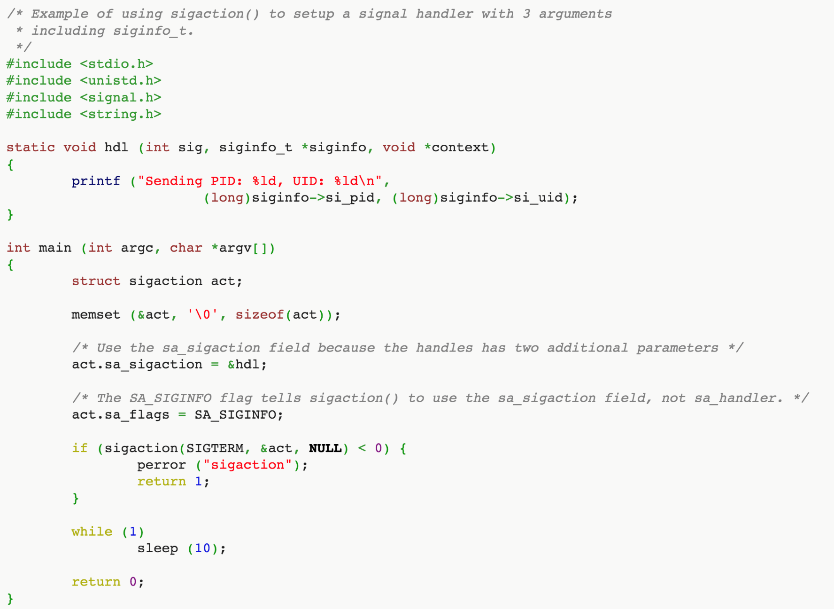
Example of Using sa_sigaction()

Slide 17
sa_mask
sa_mask specifies a set of signals which should be blocked while the signal handler is executing.
The signal that caused entering the handler is always blocked, unless the SA_NODEFER option is specified.
struct sigaction {
void (*sa_handler)(int);
void (*sa_sigaction)(int, siginfo_t *, void *);
sigset_t sa_mask;
int sa_flags;
void (*sa_restorer)(void);
};

Slide 18
Interrupted System Calls
Certain system calls are interrupted if a signal is delivered while executing them.
EINTR is returned as error, or errno is set to EINTR.
Some system calls can be automatically restarted (retried) after the signal handler finishes executing.
By setting SA_RESTART in sa_flags
signal() essentially uses that option by default

Slide 19
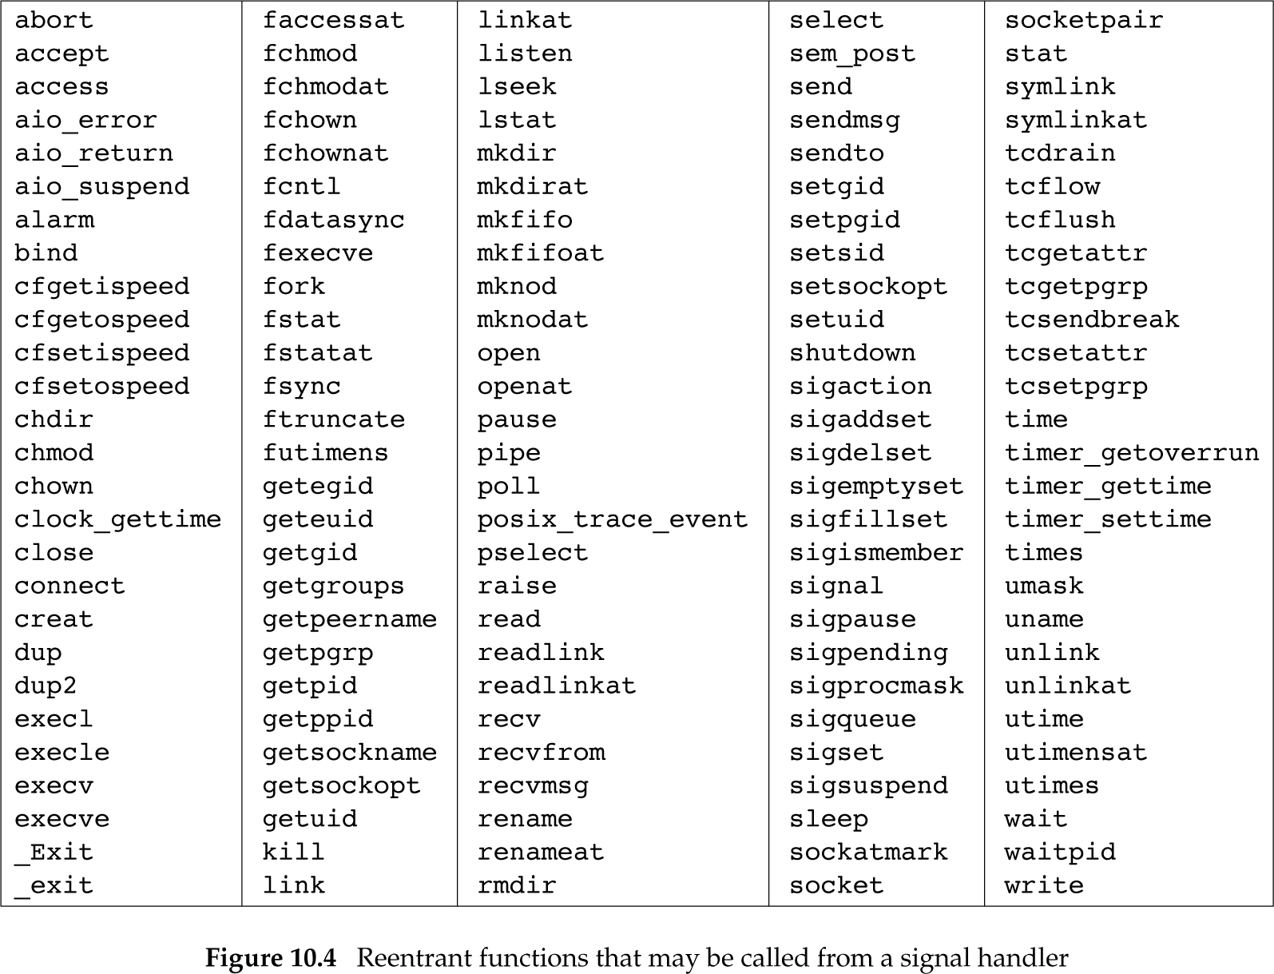
Reentrant Functions

Slide 20
Sending a Signal (1)
raise()
int raise(int iSig);
Commands OS to send a signal of type iSig to current process
Returns 0 to indicate success, non-0 to indicate failure
Example
int ret = raise(SIGINT); /* Process commits suicide. */
assert(ret != 0); /* Shouldn't get here. */
Note: C90 function

Slide 21
Sending a Signal (2)
kill()
int kill(pid_t iPid, int iSig);
Sends a iSig signal to the process whose id is iPid
Equivalent to raise(iSig) when iPid is the id of current process
Editorial comment: Better function name would be sendsig()
Example
pid_t iPid = getpid(); /* Process gets its id.*/
kill(iPid, SIGINT); /* Process sends itself a
SIGINT signal (commits
suicide?) */
Note: POSIX (not C90) function

