Slide 1
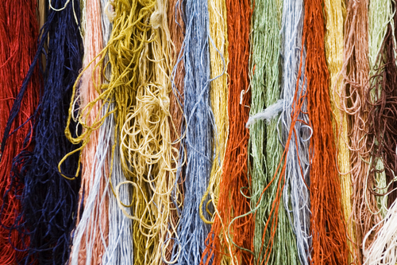
Linux Threads (pthreads)
Dr. B
CS 392: Systems Programming
Spring 2020

Slide 2
Thread
A thread
-- a fundamental unit of CPU utilization that forms the basis of multithreaded computer systems
OR
-- the smallest sequence of programmed instructions that can be managed independently

Slide 3
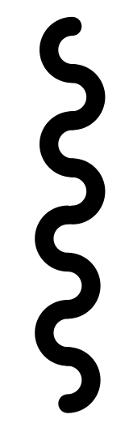
Single-threaded Processes
A process by default has a single thread of execution/control
A thread corresponds to an executing context or task
Threads have their own run-time context (e.g., program counter or instruction pointer)
Each thread has its own ID →thread ID (TID)
The kernel schedules tasks/threads for execution
Process
Thread

Slide 4
Multithreading
Process
A process can have multiple threads executing concurrently
They share the same address space and resources as the process
Can cause various concurrency issues when multiple threads read/write the same data concurrently
They are considered more lightweight than processes
Thread
Thread

Slide 5
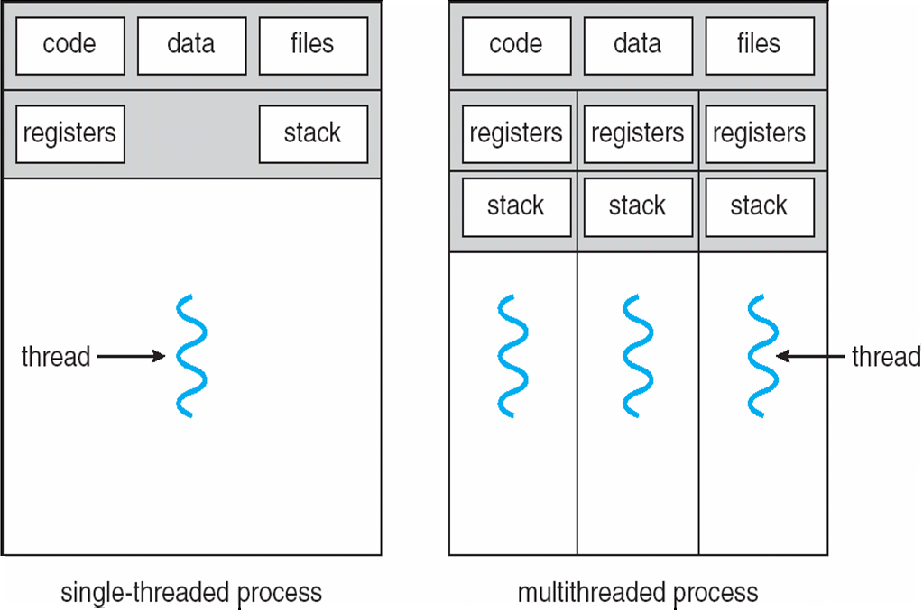
Process V.S. Thread

Slide 6
Using Threads to Parallelize Tasks
2
Consumer threads
3
1
Queue structure
Producer
thread
4

Slide 7
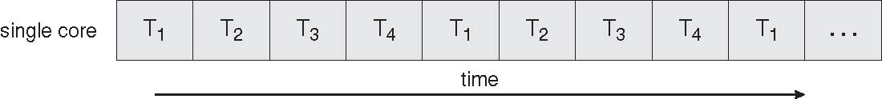
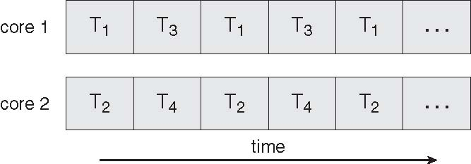
Concurrent Execution on a Single-core System
Parallel Execution on a Multicore System

Slide 8
More Benefits
Responsiveness
Allows a program continue running if part of it is blocked or its is performing a lengthy operation
Resource Sharing
Threads share the memory and the resources of the parent process
Economy
In Solaris, creating a process is 30 times slower than creating a thread, context switching is 5 times slower.
Scalability
Multithreading on a multi-CPU machine increase parallelism

Slide 9
#include <pthread.h>
#include <stdio.h>
#include <sys/types.h>
#include <unistd.h>
#include <sys/syscall.h>
#define gettid() syscall(SYS_gettid)
int main()
{
pthread_t tid;
pid_t pid, sys_tid;
pid = getpid();
tid = pthread_self();
sys_tid = gettid();
printf("pid=%u, tid=%lx, sys_tid=%u\n", pid, tid, sys_tid);
return 0;
}
Every thread has a unique Thread ID
All threads inside the same process share the same Process ID

Slide 10
#include <pthread.h>
#include <stdio.h>
#include <sys/types.h>
#include <unistd.h>
#include <sys/syscall.h>
#define gettid() syscall(SYS_gettid)
int main()
{
pthread_t tid;
pid_t pid, sys_tid;
pid = getpid();
tid = pthread_self();
sys_tid = gettid();
printf("pid=%u, tid=%lx, sys_tid=%u\n", pid, tid, sys_tid);
return 0;
}
pid=28001, tid=7f936016c700, sys_tid=28001

Slide 11
POSIX threads
Interfaces to manage threads in Linux
-- pthreads

Slide 12
Creating Threads
pthread_create
#include <pthread.h>
int pthread_create(pthread_t *thread, const pthread_attr_t *attr, void *(*start_routine) (void *), void *arg);
The pthread_create() function starts a new thread in the calling process. The new thread starts execution by invoking start_routine(); arg is passed as the sole argument of start_routine().
Compile and link with -pthread.

Slide 13
Creating Threads
int main(int argc, char **argv)
{
pthread_t tid;
int threads, e, i;
threads = atoi(argv[1]);
for (i = 0; i < threads; i++) {
e = pthread_create(&tid, NULL, run_thread, NULL);
if (e != 0) {
perror("pthread_create");
return -1;
}
}
sleep(2);
return 0;
}

Slide 14
Creating Threads
int main(int argc, char **argv)
{
pthread_t tid;
int threads, e, i;
threads = atoi(argv[1]);
for (i = 0; i < threads; i++) {
e = pthread_create(&tid, NULL, run_thread, NULL);
if (e != 0) {
perror("pthread_create");
return -1;
}
}
sleep(2);
return 0;
}
int pthread_create(pthread_t *thread, const pthread_attr_t *attr,
void *(*start_routine) (void *), void *arg);

Slide 15
Thread “main()”
static void printids()
{
pthread_t tid;
pid_t pid, sys_tid;
pid = getpid();
tid = pthread_self();
sys_tid = gettid();
printf("pid=%u, tid=%lx, sys_tid=%u\n", pid, tid, sys_tid);
}
static void *run_thread(void *arg)
{
printids();
return NULL;
}

Slide 16
Thread “main()”
static void printids()
{
pthread_t tid;
pid_t pid, sys_tid;
pid = getpid();
tid = pthread_self();
sys_tid = gettid();
printf("pid=%u, tid=%lx, sys_tid=%u\n", pid, tid, sys_tid);
}
static void *run_thread(void *arg)
{
printids();
return NULL;
}
pid=28119, tid=7f1bedfe8700, sys_tid=28121
pid=28119, tid=7f1bee7e9700, sys_tid=28120
pid=28119, tid=7f1bed7e7700, sys_tid=28122
pid=28119, tid=7f1becfe6700, sys_tid=28123
pid=28119, tid=7f1bec7e5700, sys_tid=28124
pid=28119, tid=7f1bebfe4700, sys_tid=28125
pid=28119, tid=7f1beb7e3700, sys_tid=28126
pid=28119, tid=7f1beafe2700, sys_tid=28127
pid=28119, tid=7f1bea7e1700, sys_tid=28128
pid=28119, tid=7f1be9fe0700, sys_tid=28129

Slide 17

Exiting a Thread
static void *run_thread(void *arg)
{
printids();
return NULL;
}

Slide 18
Exiting a Thread
static void *run_thread(void *arg)
{
printids();
return NULL;
}
static void *run_thread(void *arg)
{
printids();
void pthread_exit(NULL);
}
void pthread_exit(void *rval_ptr);
The pthread_exit() function terminates the calling thread and returns a value via retval that (if the thread is joinable) is available to another thread in the same process that calls pthread_join(3).

Slide 19
Exiting a Thread
static void *run_thread(void *arg)
{
printids();
return NULL;
}
static void *run_thread(void *arg)
{
printids();
void pthread_exit(NULL);
}
void pthread_exit(void *rval_ptr);
Calling exit(), _exit, or _Exit() will terminate the process and all of its threads!

Slide 20
Returning Data from Threads
static unsigned long printids()
{
pthread_t tid;
pid_t pid, sys_tid;
pid = getpid();
tid = pthread_self();
sys_tid = gettid();
printf("pid=%u, tid=%lx, sys_tid=%u\n", pid, tid, sys_tid);
return sys_tid;
}
static void *run_thread(void *arg)
{
return (void *)printids();
}

Slide 21
Joining with Terminated Threads
pthread_create
#include <pthread.h>
int pthread_join(pthread_t thread, void **retval);
The pthread_join() function waits for the thread specified by thread to terminate. If that thread has already terminated, then pthread_join() returns immediately. The thread specified by thread must be joinable.
Compile and link with -pthread.

Slide 22
Joining with Terminated Threads
pid_t tid;
pthread_t *tids = (pthread_t *)malloc(threads * sizeof(pthread_t));
if (!tids) {
perror("malloc");
return -1;
}
for (i = 0; i < threads; i++) {
e = pthread_create(tids + i, NULL, run_thread, NULL);
if (e != 0) {
perror("pthread_create");
return -1;
}
}
for (i = 0; i < threads; i++) {
pthread_join(tids[i], (void **)&tid);
printf("Thread %lx(%u) done!\n", tids[i], tid);
}

Slide 23
pid=28283, tid=7efe206fe700, sys_tid=28284
pid=28283, tid=7efe1def9700, sys_tid=28289
pid=28283, tid=7efe1f6fc700, sys_tid=28286
pid=28283, tid=7efe1cef7700, sys_tid=28291
pid=28283, tid=7efe1c6f6700, sys_tid=28292
pid=28283, tid=7efe1fefd700, sys_tid=28285
pid=28283, tid=7efe1d6f8700, sys_tid=28290
pid=28283, tid=7efe1eefb700, sys_tid=28287
pid=28283, tid=7efe1e6fa700, sys_tid=28288
Thread 7efe206fe700(28284) done!
Thread 7efe1fefd700(28285) done!
Thread 7efe1f6fc700(28286) done!
Thread 7efe1eefb700(28287) done!
pid=28283, tid=7efe1bef5700, sys_tid=28293
Thread 7efe1e6fa700(28288) done!
Thread 7efe1def9700(28289) done!
Thread 7efe1d6f8700(28290) done!
Thread 7efe1cef7700(28291) done!
Thread 7efe1c6f6700(28292) done!
Thread 7efe1bef5700(28293) done!

Slide 24

Canceling Threads
pthread_cancel
#include <pthread.h>
int pthread_cancel(pthread_t thread);
The pthread_cancel() function sends a cancellation request to the thread thread. Whether and when the target thread reacts to the cancellation request depends on two attributes that are under the control of that thread: its cancelability state and type.
Compile and link with -pthread.

Slide 25
Canceling Threads
pthread_t *tids = (pthread_t *)malloc(threads * sizeof(pthread_t));
if (!tids) {
perror("malloc");
return -1;
}
for (i = 0; i < threads; i++) {
e = pthread_create(tids + i, NULL, run_thread, NULL);
if (e != 0) {
perror("pthread_create");
return -1;
}
}
for (i = 0; i < threads; i++) {
pthread_cancel(tids[i]);
}
int pthread_cancel(pthread_t thread);

Slide 26
Cleanup Handlers
static unsigned long printids(char *s)
{
….
sprintf(s, "pid=%u, tid=%lx, sys_tid=%u", pid, tid, sys_tid);
return sys_tid;
}
static void *run_thread(void *arg)
{
void *ret;
char *s;
if ((s = malloc(STRSIZE)) == NULL)
return NULL;
ret = (void *)printids(s);
puts(s);
free(s)
return ret;
}

Slide 27
Cleanup Handlers
The pthread_cleanup_push() function pushes routine onto the top of the stack of clean-up handlers. When routine is later invoked, it will be given arg as its argument. The
pthread_cleanup_pop() function removes the routine at the top of the stack of clean-up handlers, and optionally executes it if execute is nonzero.
A cancellation clean-up handler is popped from the stack and executed:
When a thread is canceled, all of the stacked clean-up handlers are popped and executed in the reverse of the order in which they were pushed onto the stack.
When a thread terminates by calling pthread_exit(3), all clean-up handlers are executed as described in the preceding point. (Clean-up handlers are not called if the thread terminates by performing a return from the thread start function.)
When a thread calls pthread_cleanup_pop() with a nonzero execute argument, the top-most clean-up handler is popped and executed.
pthread_cleanup_push & pthread_cleanup_pop
#include <pthread.h>
void pthread_cleanup_push(void (*routine)(void *), void *arg);
void pthread_cleanup_pop(int execute);
Compile and link with -pthread.

Slide 28

Cleanup Handlers
static unsigned long printids(char *s)
{
….
sprintf(s, "pid=%u, tid=%lx, sys_tid=%u", pid, tid, sys_tid);
return sys_tid;
}
static void *run_thread(void *arg)
{
void *ret;
char *s = NULL;
pthread_cleanup_push(thread_cleanup, &s);
if ((s = malloc(STRSIZE)) == NULL)
return NULL;
ret = (void *)printids(s);
puts(s);
pthread_cleanup_pop(1);
return ret;
}
static void thread_cleanup(void *arg)
{
char *s = *(char **)arg;
if (s != NULL) {
free(s);
}
}

Slide 29
Detaching Threads
pthread_detach
#include <pthread.h>
int pthread_detach(pthread_t thread);
The pthread_detach() function marks the thread identified by thread as detached. When a detached thread terminates, its resources are automatically released back to the system without the need for another thread to join with the terminated thread.
Compile and link with -pthread.

Slide 30
Detaching Threads
pid_t tid;
for (i = 0; i < threads; i++) {
e = pthread_create(&tid, NULL, run_thread, NULL);
if (e != 0) {
perror("pthread_create");
return -1;
}
pthread_detach(&tid);
}
int pthread_detach(pthread_t tid)

